Slide 1
Faculty of Computer Science
National Research University Higher School of Economics

Slide 2
Faculty of Computer Science
Established in March 2014
3
Bachelor’s Programmes
12
Labs and Research Centres
6
257
Faculty Members
Master’s Programmes
1
Doctoral School
10
RSF Grants
1773
Students
1
Centre for Student Competitions
103
Foreign Students
1
Centre for Continuing Education

Slide 3
Bachelor’s Programmes
Applied Mathematics and Informatics
724
Students
4
Years
Ru/En
Language
Data Science and
Business Analytics
519
Students
4
Years
Ru/En
Language
Software
Engineering
Data Science and Business Analytics (since 2018)
72
Students
4
Years
En
Language

Slide 4
Master’s Programmes
Data Science and
Business Analytics
146
Students
2
Years
Ru/En
Language
Data Science
Statistical Learning
Theory
43
Students
2
Years
En
Language

Slide 5
Master’s Programmes
Data Science and
Business Analytics
54
Students
2
Years
Ru/En
Language
Financial Technologies and Data Analysis
Data Analysis in Biology and Medicine
32
Students
2
Years
Ru/En
Language

Slide 6
Master’s Programmes
Data Science and
Business Analytics
67
Students
2
Years
En
Language
System and Software Engineering
System
Programming
34
Students
2
Years
Ru/En
Language

Slide 7
Doctoral School
Data Science and
Business Analytics
51
Students
3-4
Years
Ru/En
Language
PhD in Computer Science
Recent graduates:
Yury Kashnitsky, “Methods Based on Closed Descriptions in Classification of Data with a Complex Structure”
Alexey Masyutin, “Interval Pattern Structures Randomized Algorithms for Classification and Regression Tasks in Credit Risk Management”
Anna Potapenko, “Semantic Vector Representations of Text with Probabilistic Topic Modeling”

Slide 8
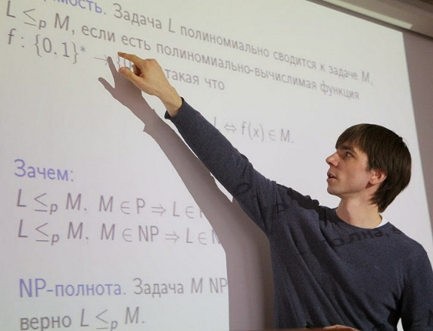
Research
Deep Learning and Bayesian Methods Centre
Samsung-HSE Lab
Sberbank-HSE Financial Data Analysis Lab
Process-Aware Information Systems Lab
Methods for Big Data Analysis Lab
Intelligent Systems and Structural Analysis Lab
Stochastic Algorithms and High-Dimensional Inference Lab
Theoretical Computer Science Lab
Bioinformatics Lab
Complex Systems Modeling and Control Lab
Models and Methods of Computational Pragmatics Lab
Applied Geometry and Topology Lab

Slide 9
Joint Departments
Joint Department with Yandex
Joint Department with SAS
Joint Department with the Federal Research Center of Computer Science and Control
Joint Department with the Institute for Information Transmission Problems
Joint Department with the Institute for System Programming SAS

Slide 10
Partners

Slide 11
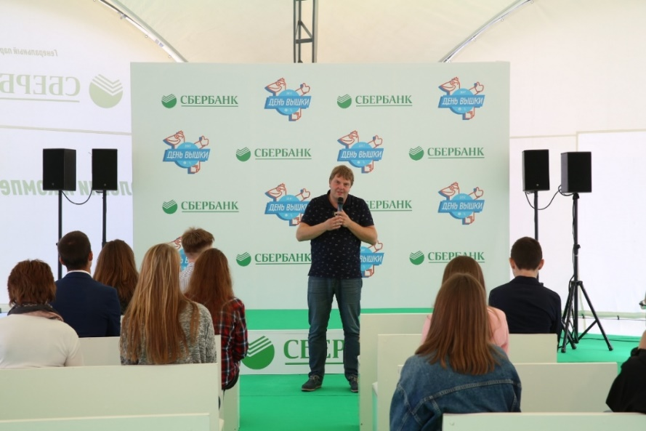
Joint Master’s Porgamme in Financial Technologies and Data Analysis
The Programme is offered in collaboration with Sberbank
Sberbank covers 100% of tuition fee for students
Practical classes with data science experts from Sberbank
Joint projects:
IDAO 2018 and 2019 - Sberbank was a partner of the Olympiad
Centre of Deep Learning and Bayesian Methods helped Sberbank to solve several data science tasks

Slide 12
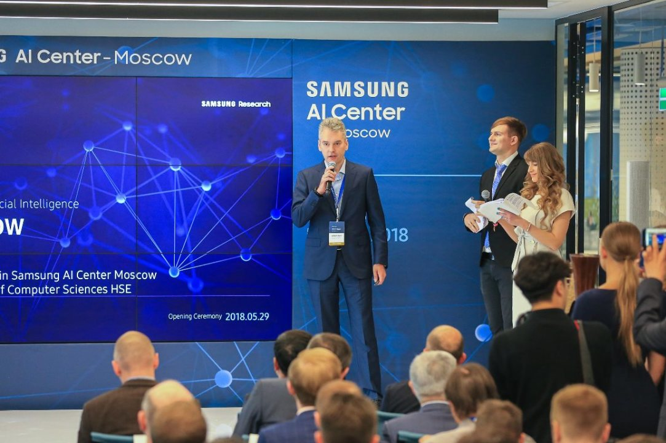
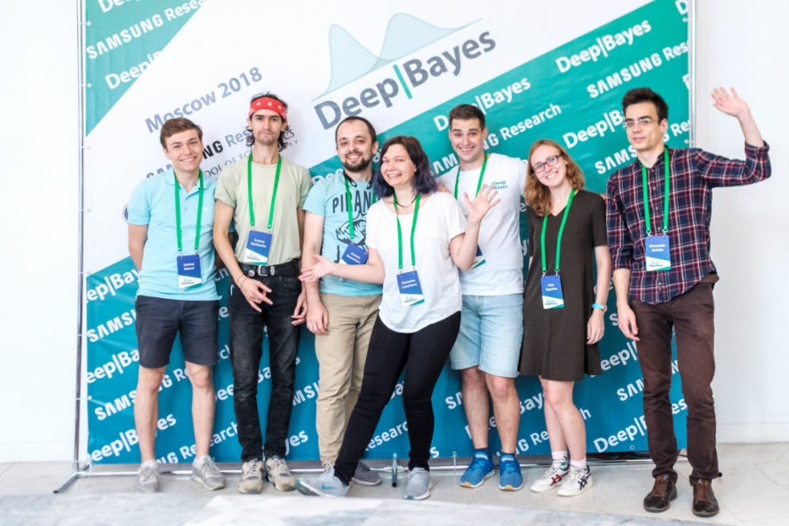
Samsung-HSE Laboratory
develops mechanisms of Bayesian inference in modern neural networks, which is to solve a number of problems in deep learning
Between HSE Centre of Deep Learning and Bayesian Methods and Samsung AI Center
Summer School on Deep Learning and Bayesian Methods
The major areas of research are:
Sparsification and acceleration of deep neural networks
Ensembles of ML algorithms
Uncertainty estimation and defenses against adversarial attacks
Loss-based learning for Deep Structured Prediction
Stochastic optimization methods
Learning and inference methods for probabilistic models using tensor decomposition

Slide 13
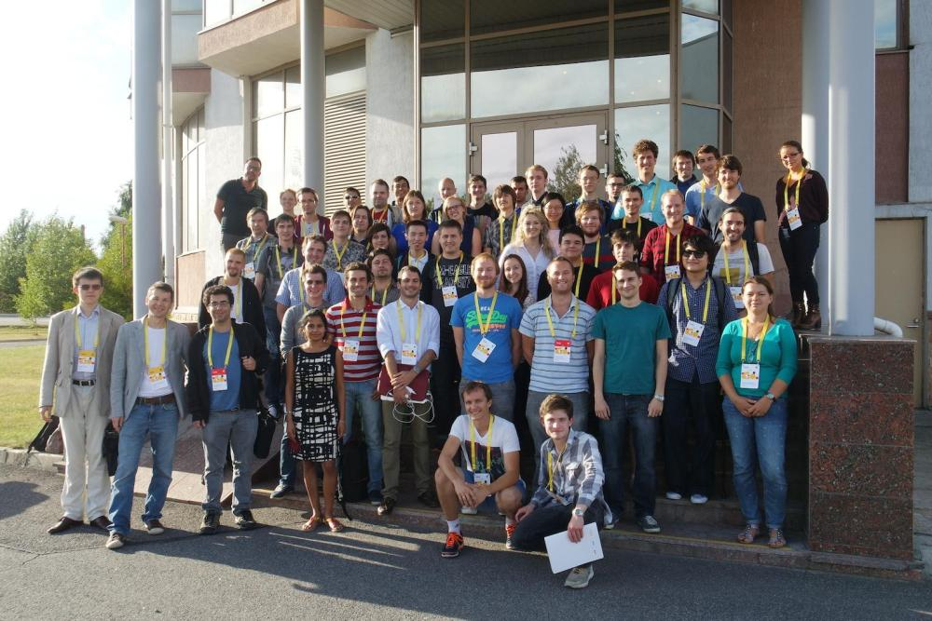
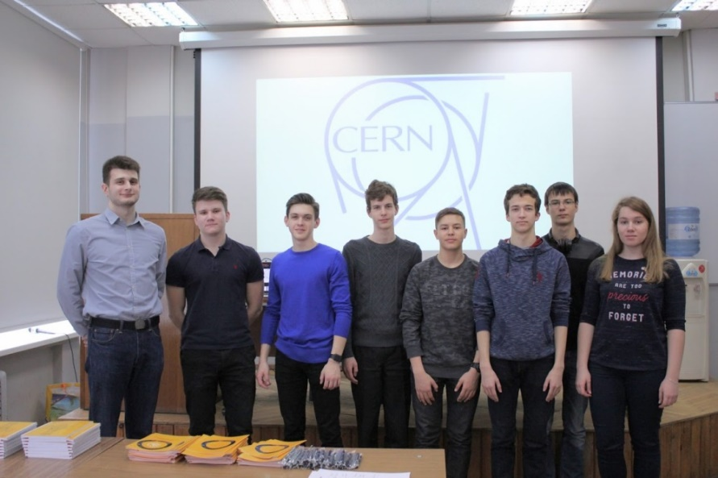
HSE is an LHCb Associate Member
at CERN
HSE researchers have full access to data from the collaboration and allow the university to participate in various projects
The group from HSE consists of researchers from the Laboratory of Methods for Big Data Analysis (LAMBDA)
Joint events with CERN
Annual CERN masterclass in particle physics: video conference between Moscow, Pisa, Paris, Cagliari, Rio de Janeiro.
Summer School on Machine Learning in High Energy Physics

Slide 14
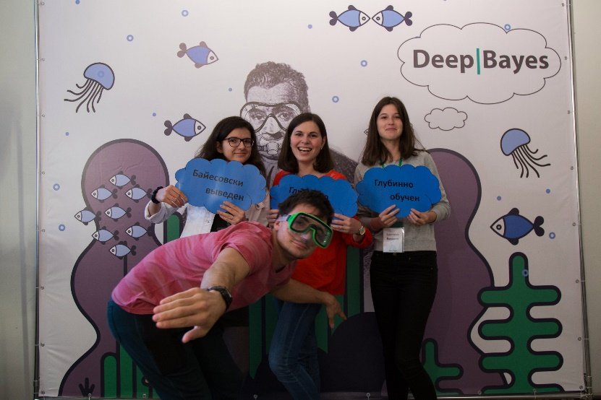
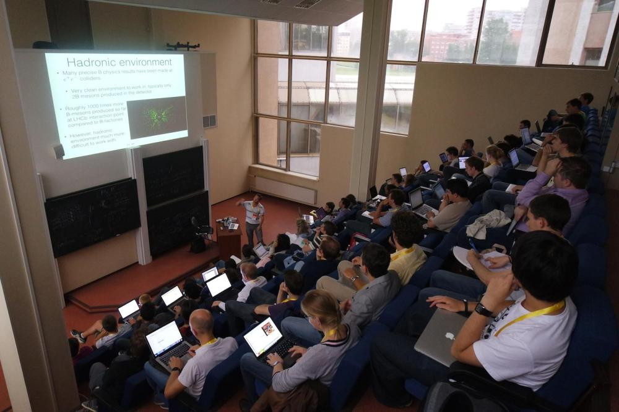
International Summer Schools
Summer School on Deep Learning
and Bayesian Methods, 20–25 August 2019
96 participants (students, graduate students and industry representatives)
7 countries (Great Britain, Spain, Netherlands, Belarus, USA, France, Switzerland)
In partnership with Samsung AI Center
5th Summer School on Machine Learning in High Energy Physics, 1 - 10 July 2019
The School will take place in Hamburg, Germany
In 2018 the Summer School was hosted in Oxford (UK) - 60 participants (students and faculty members) from 18 countries and 47 universities

Slide 15
Rankings
2017
2018
2019
QS Overall
411-420
382
343
48
QS Under 50
51-60
38
151-200
101-150
QS Mathematics
101-150
QS Computer
Science
351-400
251-300
201-250

Slide 16
Rankings
2017
2018
2019
ARWU Matematics
101-150
76-100
76-100
2017
2018
2019
THE Overall
401-500
351-400
301-350
96
84
60
THE Under 50

Slide 17
Foreign Partner Universities

Slide 18
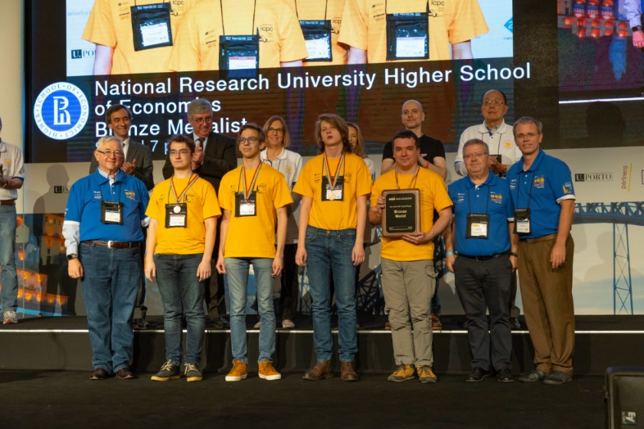
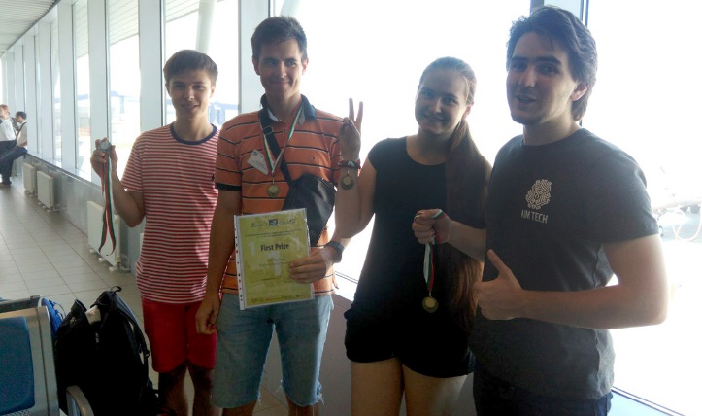
Competitions and Olympiads
Centre of Student Competitions of the Faculty of Computer Science helps students to prepare for various team and individual contests including ICPC, Yandex.Algorithm, Google Code Jam, Russian Code Cup and etc. HSE Faculty of Computer Science team won the bronze medal at ICPC World Finals 2019.
2015
2016
2017
2018
2019
ICPC Final Morocco
IMC
ICPC Final USA
IMC
ICPC Final China
ICPC Final Portugal
Bronze Medal
IMC
VJIMC
Czech Republic

Slide 19
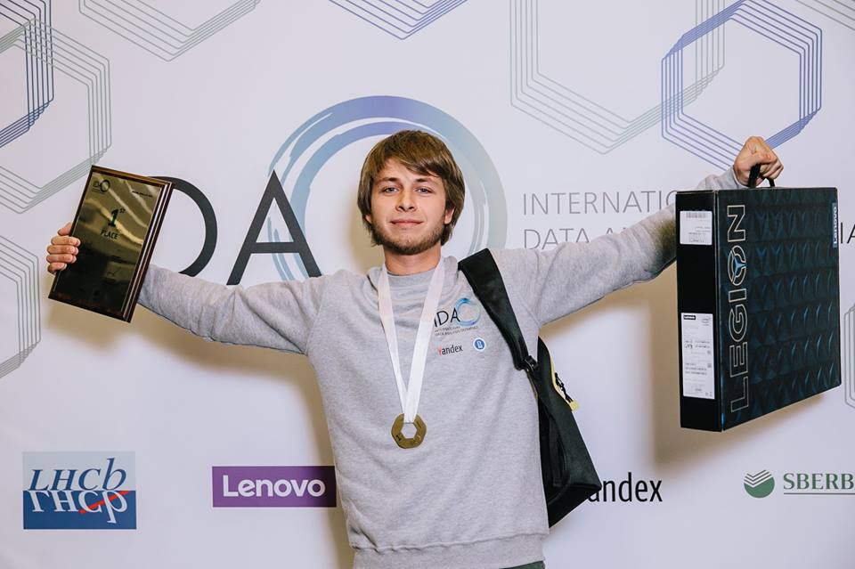
International Data Analysis Olympiad
Higher School of Economics and Yandex organized the contest for the second time.
Key numbers of IDAO 2019:
1287 teams registered for the Online Round
78 countries
31 teams in the Final Round
ORGANISERS
PARTNERS

Slide 20
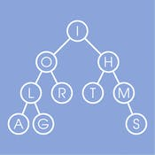
Coursera specializations
7
Advanced Machine Learning
courses
6
Data Structures and Algorithms
courses
5
Introduction to Discrete Mathematics for Computer Science
courses

Slide 21
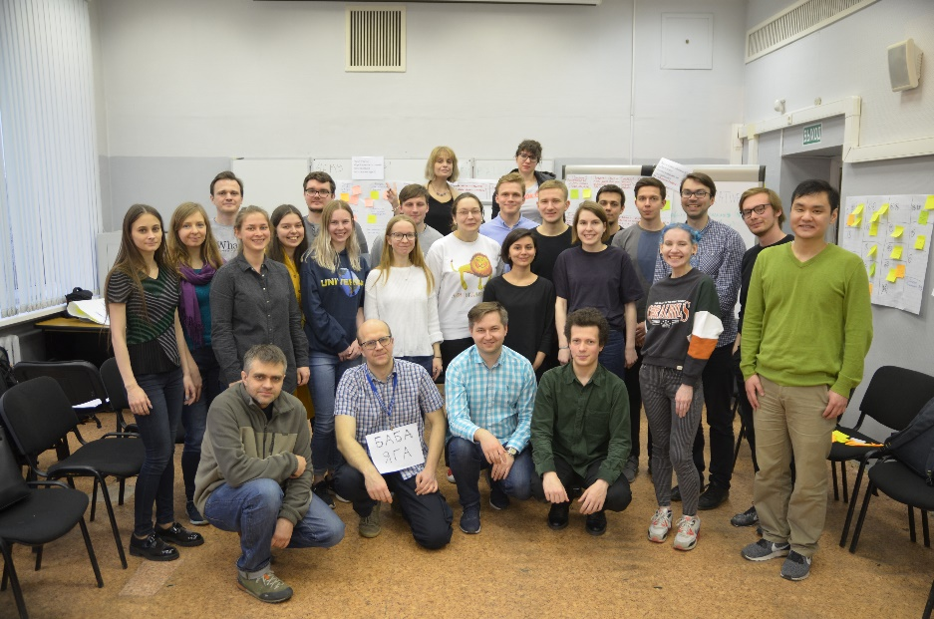
Data Culture
The key aim of HSE’s Data Culture project is to provide all undergrads insight into the latest technologies used in data analysis. This way, students in management will be able to set clear tasks for analysts, while analysts, in turn, will be fast and efficient in building their models, and applied specialists will rely on the most cutting-edge data tools.
Project Levels: Elementary, Basic, Advanced, Professional, Expert.

Slide 22
computerscience@hse.ru
https://cs.hse.ru/en/

