Slide 1
SRR
Compiler Lab
Oct 9, 2019
Notes:
Hello everybody!
I’m glad to be here, and I want thank the whole team for organizing this annual summer school.
I’m Kseniia, technology marketing specialist from Samsung Research Russia. Actually this is sponsorship talk and you may think that
I will try to promote our center. And you are right!☺

Slide 2
Russia
Samsung Electronics - 5,850 US patents
#2 in the world
Notes:
We have 14 R&D centers and 7 AI Centers worldwide with HQ in Korea. Here in Moscow we have two centers: Samsung Research Russia and Samsung AI Center.

Slide 3
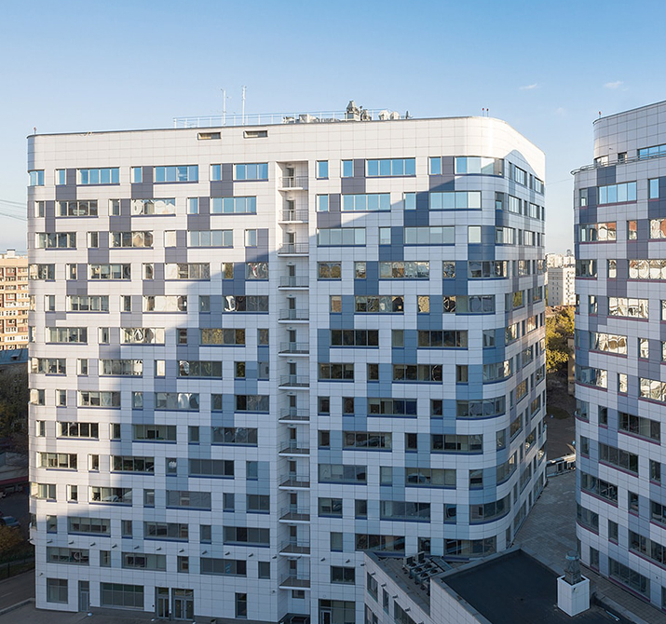
Samsung Research Russia
Established in 1993
Algorithm Research
Media Processing
Applied Intelligence
Deep System
Optics
Business Development
Notes:
Samsung Research Russia is one of the oldest centers worldwide with 300 employees. We have an expertise in 6 spheres. Algorithm Research with core biometric technologies, Media Processing (super slow-motion), Applied Intelligence, Deep System who are doing compilers, optics (or sensors) and business development team who are adapting out technologies to Samsung business.

Slide 4
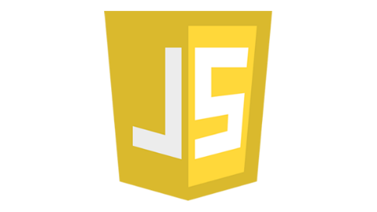
SRR Compiler Lab
Enabled C# for Tizen and developed Visual Studio Tools
Enabled C# for Tizen on ARM
Developed C# debugger and profiler
Developed Visual Studio tools
Optimized Android Runtime (ART)
App startup: ~30% faster than Google Android KitKat
Shipped with every Android phone from Samsung
Developed own lightweight JS engine (JerryScript)
Lowest memory consumption among competitors
Adopted by Pebble to watch face development
Optimized V8 JS engine
Optimization of V8 engine: 20% faster than V8
Implemented compilers for the ultimate Samsung chips like NPU and GPU
7+ years experience in LLVM and GCC internals

Slide 5
DSP Compiler Project
Samsung DSP processor is equipped with wide range of accessories for massive data parallel processing:
512 bits (64x8, 32x16, 16x32) vector data support,
4 ways WLIV,
2 simultaneous hardware threads,
2+ processing cores.
Project Summary
Development of LLVM-based C/C++ compiler for Samsung DSP IVP kernels
Support of Halide language for Samsung DSP platform
Implementation of Global Memory Allocator in the Graph Compiler
Specification High-Level Programming Language for Samsung DSP platform

Slide 6
Halide Back-end for DSP
“Halide is a programming language designed to make it easier to write high-performance image and array processing code on modern machines.” (https://halide-lang.org/)
Domain Specific Language embedded into C++.
CPU Architectures:
X86, ARM, MIPS, Hexagon, PowerPC
Operating systems:
Linux, Windows, macOS, Android, iOS, Qualcomm QuRT
GPU Compute APIs:
CUDA, OpenCL, OpenGL, OpenGL Compute Shaders, Apple Metal, Microsoft Direct X 12
The Goal of our project is to develop Halide back-end for Samsung DSP
Required: 1 person
Skills:
C/C++
Algorithms & Data structures
Compiler technologies

Slide 7
High-level Programming Language
Digital image processing is a graph of kernels applied to digital images.
Graph structure is fixed at design time.
Each kernel is a loop nest.
Input, output and intermediate data are mainly multidimensional arrays (tensors).
This also includes CNNs as a particular case.
OpenVX is a good example of exploitation of such model.
The Goal of our project is to design High-level programming language for CV and AI applications
Required: 1 person
Skills:
C/C++
Algorithms & Data structures
Formal languages

Slide 8
Android Runtime Stability and Optimization project
Samsung ships wide range of smartphone and tablet models based on Google Android (Galaxy S, Note, Galaxy A, Galaxy Tab, etc.)
Strong competition with other Android vendors (Asus, Huawei, LG, OnePlus, Oppo, Sony, Vivo, Xiaomi, etc.)
Android is a set of 1000+ modules, each requires expertize to deal with
ART (Android RunTime) is core module to run apps Java code
Project Summary
Research and develop ART-related optimizations to improve application start time, benchmarks score, UI smoothness (including optimizations based on AI)
Investigate and fix stability issues for upcoming Android release

Slide 9
RR tool to reproduce and debug crashes
“Mozilla/rr aspires to be your primary C/C++ debugging tool for Linux. You record a failure once, then debug the recording, deterministically, as many times as you want. The same execution is replayed every time.” (https://rr-project.org/)
Low overhead, works on user level, integration with gdb, multi-threaded code support
Can play the trace backward, greatly reduces the time to find root cause of a bug
Linux/x64 is supported
Arm64 is not supported so far
The goal of this activity: to research ARM capabilities needed for rr, and to prototype support of arm64 on Android (Linux)
Required: 1 participant
Skills: C/C++, Computer architecture, Linux

Slide 10
ARM64 libs optimizer based LLVM
Mobile applications’ native code is optimized assuming the generic CPU model typically
There might be a room for further optimizations when the app is installed on a particular H/W
Unfortunately, the well-reputed framework, LLVM, works on the level of the intermediate representation, not on the level of the native code
A number of open-source Arm64 to LLVM decompilers exist (https://github.com/trailofbits/mcsema/) but work only for Hello World
A working Arm64 to LLVM bitcode decompiler is needed
The goal of this activity:
Research existing open-source frameworks for ARM64 code decompilation to LLVM
Propose an approach to ARM64-to-LLVM code conversion preserving the semantics
Implement a prototype able to decompile Arm64 shared libraries (at least partly)
Apply a set of optimizations and compile code back to Arm64 preserving the original code semantics
Required: 1-2 participants
Skills: C/C++, Computer architecture, Linux

Slide 11
Thank You
Notes:
Hello everybody!
I’m glad to be here, and I want thank the whole team for organizing this annual summer school.
I’m Kseniia, technology marketing specialist from Samsung Research Russia. Actually this is sponsorship talk and you may think that
I will try to promote our center. And you are right!☺

