Slide 1
Метод наиболее подходящего обобщения нечеткого множества запроса в таксономии
^{Б.Г. Миркин, Д.С. Фролов}
¹⁾ МЛАВР НИУ ВШЭ, Москва
²⁾ Факультет компьютерных наук НИУ ВШЭ, Москва
(при участии Т. Феннер (СК), С. Насименто (Португалия), З. Таран (США))

Slide 2
Structure
Taxonomy as is and Taxonomy of Data Science
Generalization as a lifting problem
An algorithm for lifting a fuzzy leaf set over a rooted tree
Applying to the analysis of a collection of research papers
Applying to targeted advertising
Conclusion: what is done and what to do
Notes:
надо бы вдвое увеличить фонт

Slide 3
Структура
Таксономия вообще и таксономия Науки Данных
Обобщение как подъем множества листьев в таксономии
Алгоритм подъема нечеткого множества
Применение к анализу научных публикаций
Применение к таргетированию объявлений
Заключение: что есть и что надо
Notes:
надо бы вдвое увеличить фонт

Slide 4
Taxonomy

Slide 5
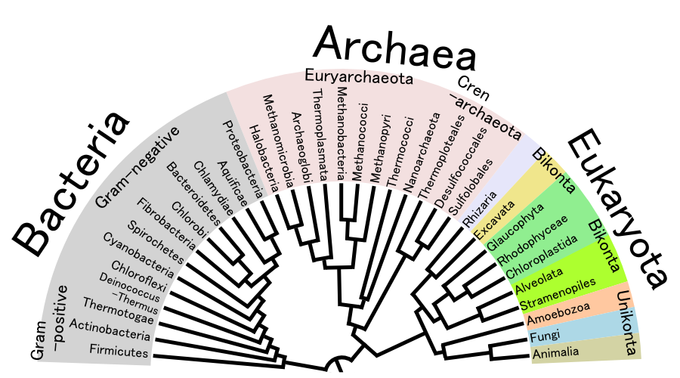
Taxonomy: A tree-like arrangement of objects over an extent of similarity. Example 1: Biology

Slide 6
Example 2: IAB (The Interactive Advertising Bureau) Content Taxonomy Fragment https://www.iab.com/
Style & Fashion
Men’s Personal Designer . . .
Fashion Care Clothing
Men’s Men’s Men's
Outerwear Watches Shoes

Slide 7
Example 3a: Data Science items in ACM CCS 2012

Slide 8
Example 3B : DS in ACM CCS 2012, Lower ranks

Slide 9
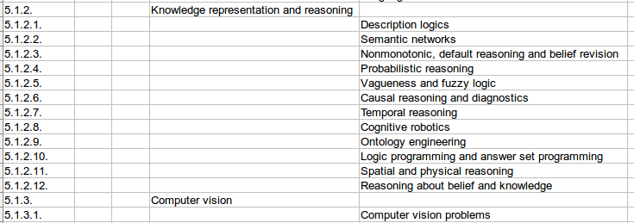
Data Science Taxonomy (Frolov et al. 2018)
Based on Classification of Computing Systems 2012 by ACM.
456 subjects, of which 317 are lowest layer subjects (leaves) ( https://www.hse.ru/mirror/pubs/share/213924179
Notes:
надо бы увеличить фонт в таблице

Slide 10
ОБОБЩЕНИЕ как подъем в таксономии
Толковый словарь Современного русского языка Ефремовой:
«Обобщать» - Объединять, соединять вместе.

Slide 11
“to Generalize” according to Merriam – webster (USA)
``to give a general form to''
``to derive or induce (a general conception or principle) from particulars''

Slide 12
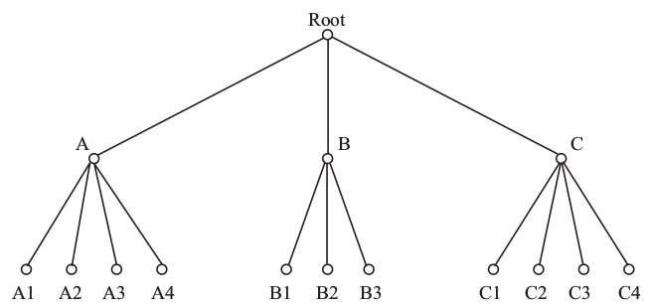
Generalization: appropriately Lifting clusters to common root concepts
Given a taxonomy and a leaf cluster, lift the leaves to a higher rank node: (A1, A2, A3, A4, B1) => (A), B1 disregarded as an offshoot.

Slide 13
Generalize: Given 5 leaves in a cluster, Where to lift that? Option А
Head subject (А)
Gap

Slide 14
Generalize: Given 5 leaves in a cluster, Where to lift that? Option B
Head subject (B)
Gap
Offshoot

Slide 15
Minimize the penalty!
Penalty:
#Head_Subject + λ#Gap + γ#Offshoot
Penalty at A: 1+4λ
Penalty at B: 1+ γ + λ

Slide 16
Algorithm ParGenFS:
Parsimonious generalization
Output: set of head subjects Н, minimizing
Penalties: λ – for a gap, γ for an offshoot, 1 for a head subject
I – leaf set of the taxonomy rooted tree,
u(h) – query fuzzy set membership function

Slide 17
Algorithm computes two sets at each node t :
H(t) – set of newly emerged subjects
L(t) – set of lost subjects
and penalty value p(t).
Starting from the leaves, algorithm recursively computes these till root is reached.
At each node t, two scenarios: (a) head subject emerges at t, or, (b) it does not.
Notes:
нельзя так мелко

Slide 18
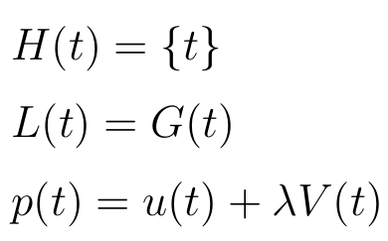
Scenario (a) – Head subject emerges at t. Then:
Notes:
к черту подробности

Slide 19
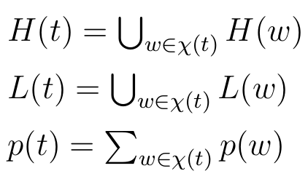
Scenario (b) – head subject does not emerge. Then sets H и L are derived as unions of the corresponding sets in all the children:
Scenario (a) or (b) is chosen depending on the value p(t) – the smaller wins.
Notes:
к черту подробности

Slide 20
Пример анализа научных публикаций
A collection from springeropen.com: 17685 items (abstracts), 17 journals in Data Science (1998-2017):
1. Pattern Analysis and Applications (Volume 1 /1998 - Volume 20 /2017)
2. World Wide Web (Volume 1 /1998 - Volume 20 /2017)
3. Annals of Mathematics &Artificial Intelligence (23/1998 - 80/2017)
. . .
17. Machine Learning (30/1998—106/2017)
Notes:
слишком мелко

Slide 21
Analyzing Springer research publications (in-house)
1. AST method (Mirkin, Chernyak, 2014) ⇒ matrix T = (Tij) 317х17685 of
Relevance index taxonomy_leaf_topic x paper.
2. Taxonomy leaf FADDIS clustering after Laplace transformation (Mirkin, Nascimento, 2012): 6 fuzzy clusters of leaf subjects of which 3 are interpretable.

Slide 22
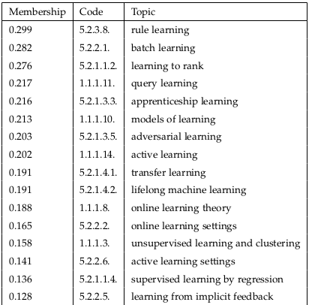
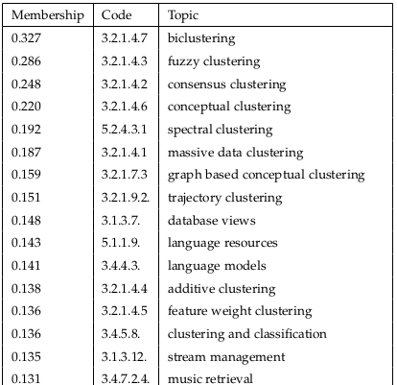
Cluster L: Learning Cluster C: Clustering
Notes:
слишком мелко

Slide 23
Lifting parameters (according to structure of DST)
gap penalty: λ=0.1,
offshoot penalty: γ=0.9
3 out of 6 clusters are interpretable (learning L, retrieval R, clustering C)
Each of L, R, and C clusters is lifted with ParGenFS

Slide 24
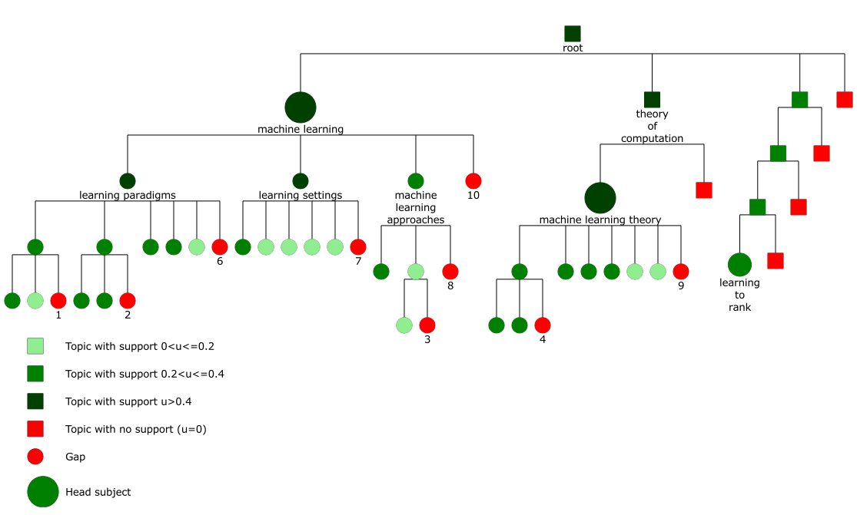
Cluster L lifting:
Head subjects: {Machine learning,
Machine learning theory, Learning to rank}
Notes:
сначала надо перечислить хотя бы 6 тем из кластера!

Slide 25
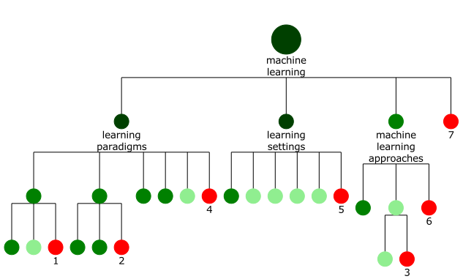
Cluster L lifting (fragment):

Slide 26
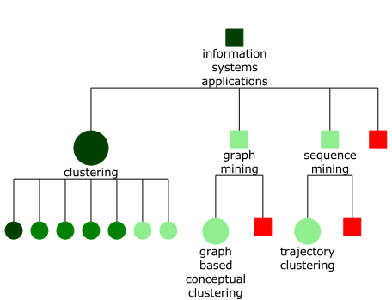
Cluster C lifting: a fragment

Slide 27
Cluster lifting results suggest, 1:
“Learning” lifted:
main work still on theory and method rather than applications.
Expanding from learning subsets and partitions towards learning of ranks and rankings.
Many subareas are not covered by publications.

Slide 28
Cluster lifting results suggest 2:
“Information retrieval” cluster R lifted:
Head subjects: (a) Information Systems, (b) Computer Vision
Text management
Moving from text to embrace images and video.
Ways for structuring visual information probably leading to a future "wordnet" for images

Slide 29
Cluster lifting results suggest 3:
“Clustering” cluster C lifted:
16 (!) head subjects, to be raised to higher ranks in Taxonomy of Data Science
Should be lifted from auxiliary roles to a main concept, and instrument, in knowledge engineering.

Slide 30
D. Frolov («Натиматика»): archive of ~ 20 mln visitors of popular sites, each tagged by labels from IAB Taxonomy according to their Internet behavior
Применение к таргетированному адвертайзингу

Slide 31
A user profile in IAB in Natimatica (green)
Computing Business
Computer Software and Applications Business
Account & Finance
0.35
3DGrap Video Graphics Operat (10 more categories)
Softw Softw Syst
0.68 0.57 0.57 0.31

Slide 32
Lifting user profile to a Head Subject
Computing Business
Computer Software and Applications Business
0.90 (Head subject) Account&Finance
0.35 (Offshoot)
3DGrap Video Graphics Operat (10 more categories)
Softw Softw Syst
0.68 0.57 0.57 0.31

Slide 33
Applying to (programmatic) Targeted adverts, 1: Example
USER’S TARGET for an advert on
*** AS: Antivirus Software ***
Solution: Show that to all users whose tag for AS is >0.3
Issue: Not too many visitors

Slide 34
Applying to Targeted adverts, 2: Example
USER’S TARGET for an advert on
***AS: Antivirus Software***
Solution 1: Show that to all users whose tag for AS is >0.3
Issue: Not too many visitors
Solution 2: Show that to all users whose tag for AS is >0.1
Issue: Falling efficiency (#Click/#User)

Slide 35
Applying to Targeted adverts, 3: Example
USER’S TARGET for an advert on
*** AS: Antivirus Software ***
Solution 1: Show that to all users whose tag for AS is >0.3
Issue: Not too many visitors
Solution 3: LIFT. Show that to all users whose lifted node contains AS
Feature: Surprising efficiency

Slide 36
Applying to Targeted adverts, 4: Example
USER’S TARGET: an advert on
Daycare and Pre-School; Internet Safety; Parenting Children Aged 4-11; Parenting Teens; Antivirus Software
Impressions | 378933 | 942104 | 1017598
Clicks | 1061 | 2544 | 1526
 | Standard | LIFT | Solution 2

Slide 37
Conclusion: done
A novel computational model for generalization, and an effective algorithm
Applied to the analysis of research publications leading to observations on tendencies of the research, which cannot be produced with a popular approach of the analysis of co-citation graphs

Slide 38
Conclusion: To do:
Deeper into generalization: inserting a node to reduce the penalty
Shifting to the criterion of maximum likelihood
More applications

Slide 39
Publication so far
D. Frolov, B. Mirkin, S. Nascimento, T. Fenner (2018) Finding an appropriate generalization for a fuzzy thematic set in taxonomy, preprint HSE, https://wp.hse.ru/data/2019/01/13/1146987922/WP7_2018_04_______.pdf

Slide 40
Related stuff

Slide 41
Some publications
Ekaterina Chernyak and Boris Mirkin (2014) An AST method for scoring string-to-text similiarity in semantic text analysis, In “Clusters, Orders, and Trees: Methods and Applications” pp 331-340 (Springer, SOIA, v. 92, 2014)
Mirkin, B., & Nascimento, S. (2012). Additive spectral method for fuzzy cluster analysis of similarity data including community structure and affinity matrices. Information Sciences, 183 (1), 16-34.
Mirkin, B. G., Nascimento, S., Fenner, T. I., & Pereira, L. M. (2010). Building Fuzzy Thematic Clusters and Mapping Them to Higher Ranks in a Taxonomy. Int. J. Software and Informatics, 4(3), 257-275.

Slide 42
Origin: ROUND 1 from EUGENE Koonin (NCBI NIH USA) Reconstruction of gene history

Slide 43
Evolutionary tree over 26 extant bacterial genomes: box (presence of R13 Gene). Question: At what place R13 emerged (was ganed)
y o z m k a p b l w d c r n s f g h e x j u t i q v
GENE R13 present

Slide 44
Evolutionary tree
Parsimoniously Reconstructing R13 history
GENE R13 present
y o z m k a p b l w d c r n s f g h e x j u t i q v

Slide 45
Evolutionary tree: more realistic case
GENE 0572 Uridine Kinase:
presence pattern
y o z m k a p b l w d c r n s f g h e x j u t i q v

Slide 46
GENE 0572 Uridine Kinase Evolutionary history Reconstruction at equal weights
Reconstructed history:
presence
4 losses
1 gain
inheritance / gain
loss
y o z m k a p b l w d c r n s f g h e x j u t i q v

Slide 47
Final results (Mirkin,…,Koonin, 2003): 20 reconstructions made over 3066 genes each from gain weight 10, loss weight 1 to Gain weight 1, Loss weight 10 LUCA contents differ each time; the best matching the theoretic Expectation (Model “Genome simple”) GW=LW=1 LUCA 567 genes

Slide 48
Origin: ROUND 2 from prof Luis Moniz Pereira (Universidade nova Lisboa Portugal) positioning of centria over the cs taxonomy

Slide 49
C. Computer Systems Organization D. Software and H. Information Systems F. Theory of Computation D. Software H. Information Systems I. Computing Methodologies
E1 E2 E£ E4 E5 G1 G2 G3 G4 K1 K2 K3 K4 K5 K6 K7 K8
A
E
B
G
J
K
Head subject
Subject’s offshoot
Gap
I
CS
I1 I2 I3 I4 I5 I6 I7
C
D
F
H

Slide 50
D. Frolov («Натиматика»): archive of ~ 5 mln visitors of popular sites, each tagged by labels from IAB Taxonomy according to their Internet behavior

Slide 51
A user profile in IAB in Natimatica (green)
Computing Business
Computer Software and Applications Business
Account & Finance
0.35
3DGrap Video Graphics Operat (10 more categories)
Softw Softw Syst
0.68 0.57 0.57 0.31

Slide 52
Lifting user profile to a Head Subject
Computing Business
Computer Software and Applications Business
0.90 (Head subject) Account&Finance
0.35 (Offshoot)
3DGrap Video Graphics Operat (10 more categories)
Softw Softw Syst
0.68 0.57 0.57 0.31

Slide 53
Applying to (programmatic) Targeted adverts, 1: Example
USER’S TARGET for an advert on
*** AS: Antivirus Software ***
Solution: Show that to all users whose tag for AS is >0.3
Issue: Not too many visitors

Slide 54
Applying to Targeted adverts, 2: Example
USER’S TARGET for an advert on
***AS: Antivirus Software***
Solution 1: Show that to all users whose tag for AS is >0.3
Issue: Not too many visitors
Solution 2: Show that to all users whose tag for AS is >0.1
Issue: Falling efficiency (#Click/#User)

Slide 55
Applying to Targeted adverts, 3: Example
USER’S TARGET for an advert on
*** AS: Antivirus Software ***
Solution 1: Show that to all users whose tag for AS is >0.3
Issue: Not too many visitors
Solution 3: LIFT. Show that to all users whose lifted node contains AS
Feature: Surprising efficiency

Slide 56
Applying to Targeted adverts, 4: Example
USER’S TARGET: an advert on
Daycare and Pre-School; Internet Safety; Parenting Children Aged 4-11; Parenting Teens; Antivirus Software
Impressions | 378933 | 942104 | 1017598
Clicks | 1061 | 2544 | 1526
 | Standard | LIFT | Solution 2

