Slide 1
Author: Popov Pavel Glebovich, group 234
Supervisor: Bashminova Daria Aleksandrovna
Development of a system for tracking personal data
Individual software project

Slide 2
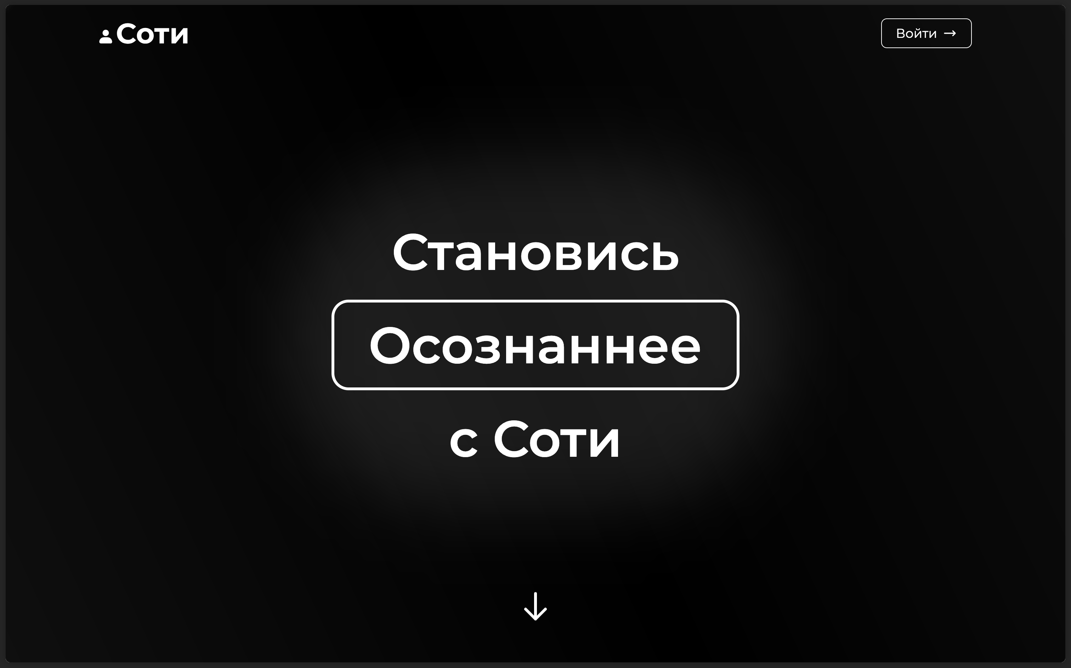
Subject Area Description
The personal data tracking system is a supportive tool for working on mental health, with which you can track what and why is happening in your life, and potentially achieve valuable insights which can directly influence your life decisions.
The system belongs to Mental Health Tech, a market that combines work on mental health and digital technologies.
2

Slide 3
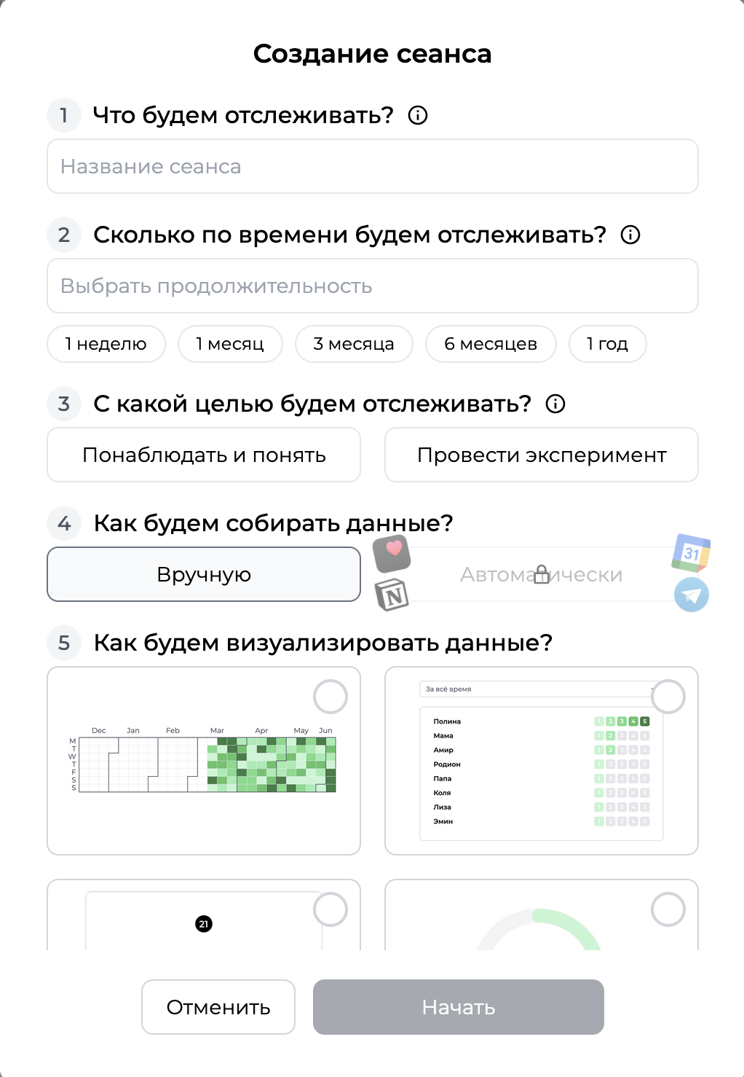
Relevance
We all know how recently the interest in working on mental health has been growing rapidly.
Various psychological practices are being used to improve mental health condition, and the demand for them is high.
The presented system is one of them, it implements a special practice developed by me personally - tracking life events in the concept of sessions, with a set goal, limited time, visualizations and analysis.
3

Slide 4
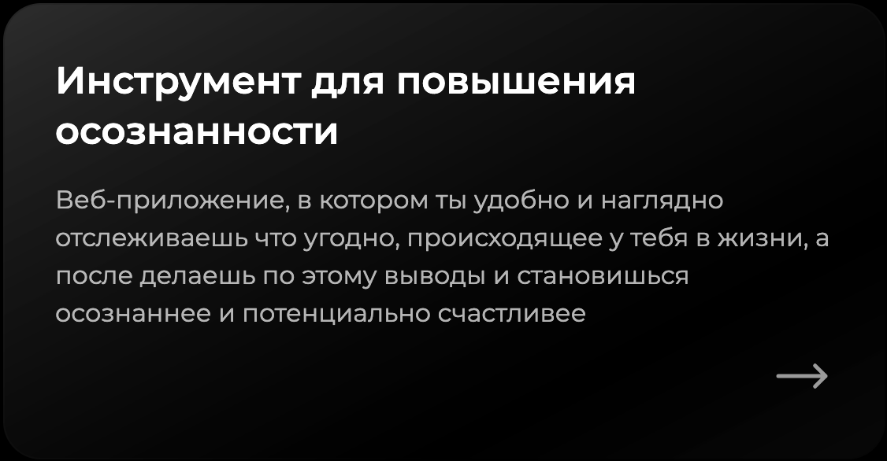
Goal and Objectives
Goal:
  To develop a lightweight web-application that allows users to manage data-tracking sessions
Objectives:
  Design a scalable client-server architecture
  Implement user authentication system
  Enable custom session creation and data entry
  Provide intuitive data visualizations
  Deploy and prepare for future scientific based features
4

Slide 5




Notion
Review of Existing Solutions
Existing solutions like Notion, Headspace, and Calm provide either general productivity tracking or guided meditation. However, they do not combine freeform data entry, flexible visualizations, and mindfulness goals in one system. This project fills that gap.
Headspace
Calm
5

Slide 6
Functional Requirements
User authentication system
Session management
Dynamic table management per session
Client-server connection via REST API
CRUD operations on user data
Data visualizations (heatmap, rating, calendar, etc.)
UI UX implementation and research
6

Slide 7

















Analysis of Existing Methods
Such technologies are usually used now for building web-apps:
For frontend –
For backend –
For database –
For caching –
For deployment –
For styling –
7

Slide 8
Selected Technologies and Methods
Backend:
FastAPI
Frontend:
Vue.js
Database:
PostgreSQL
Infrastructure:
Docker
Nginx
8

Slide 9
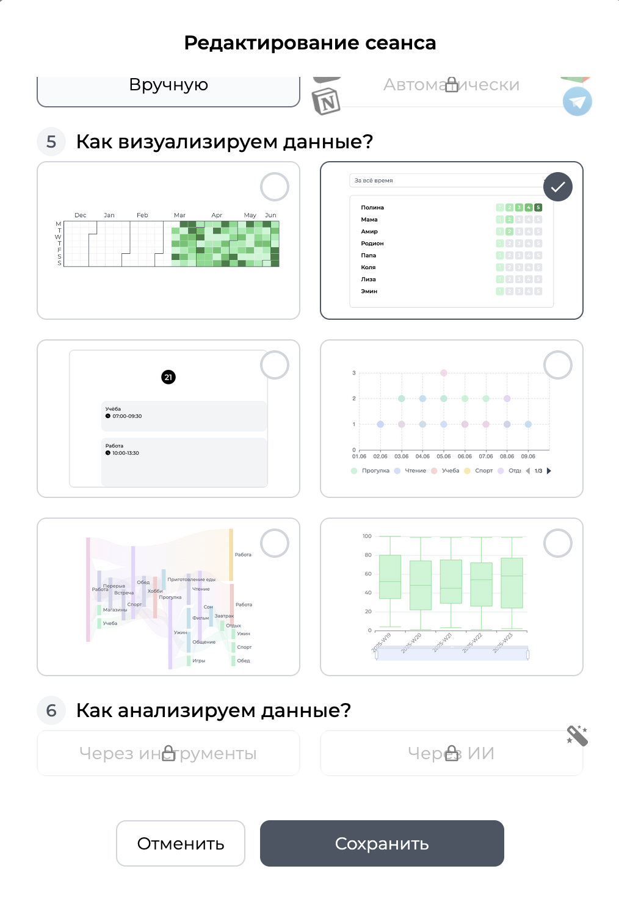
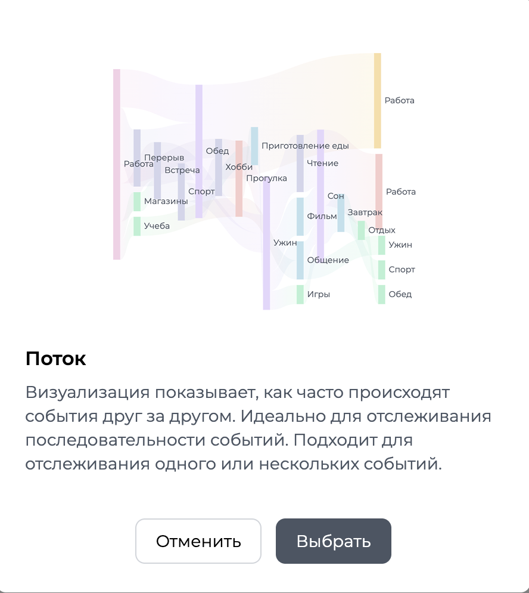
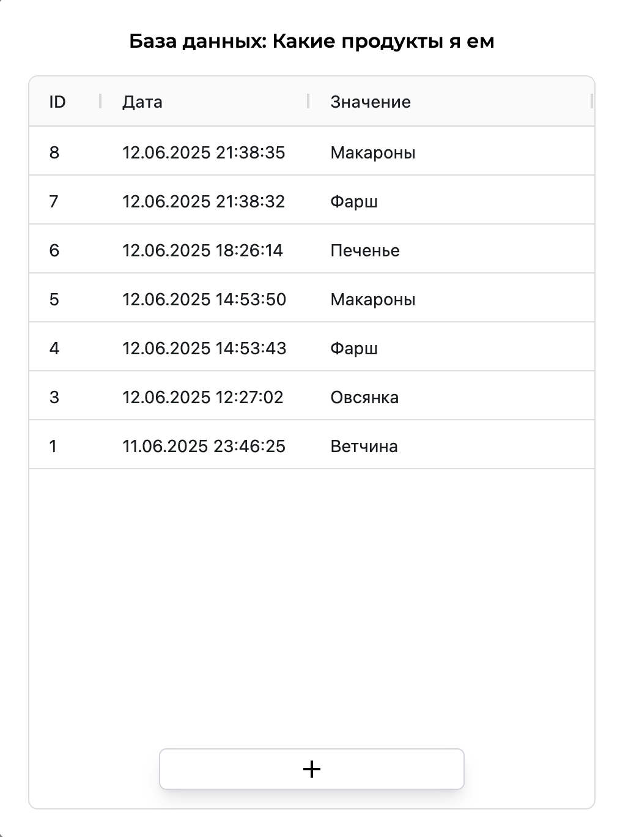
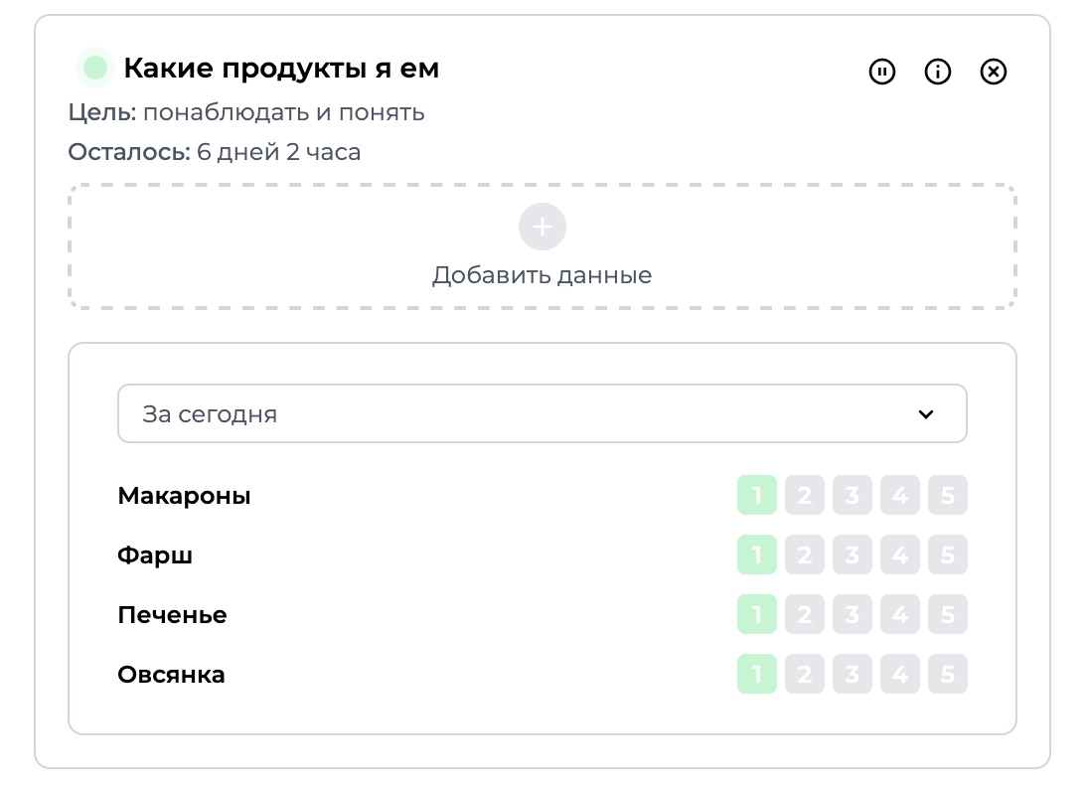
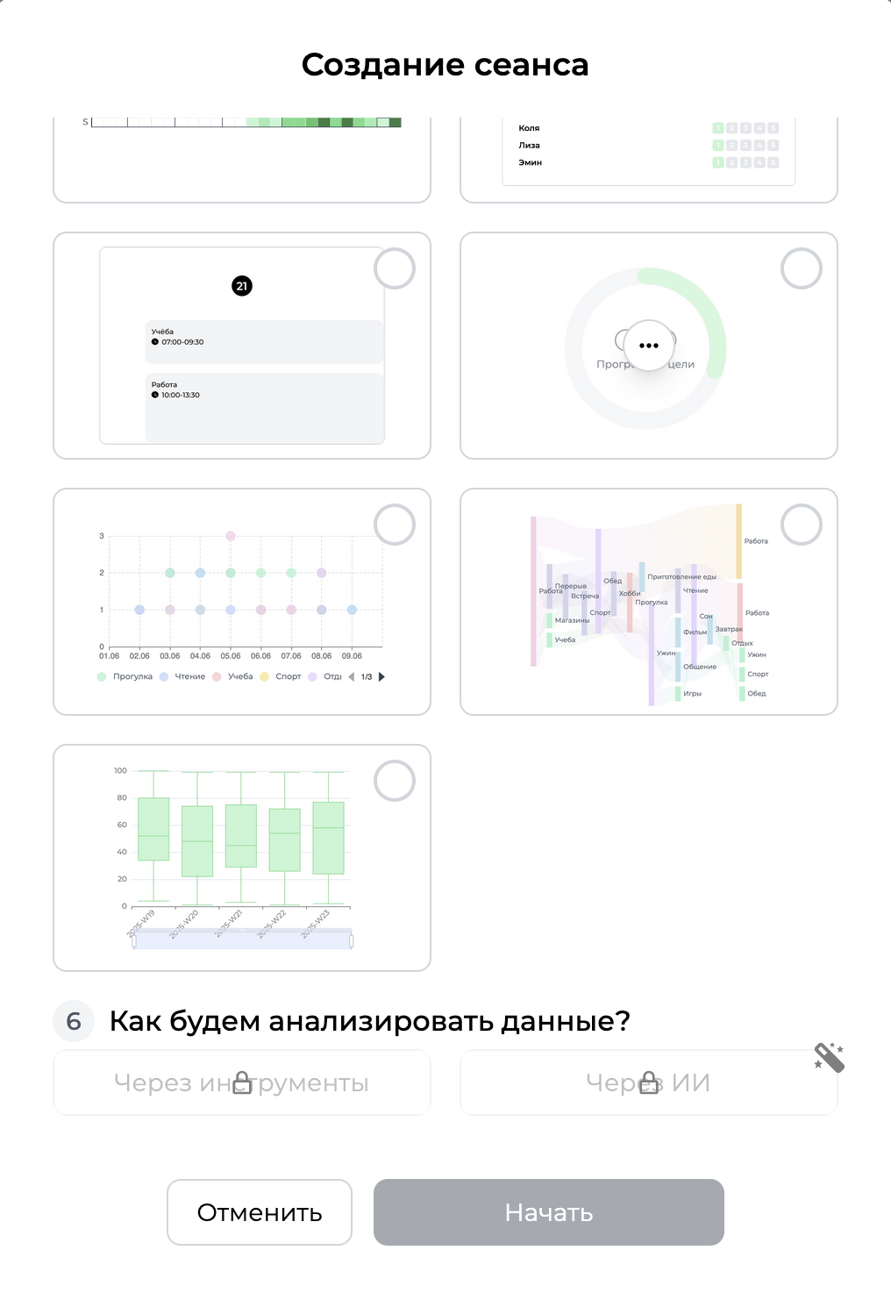
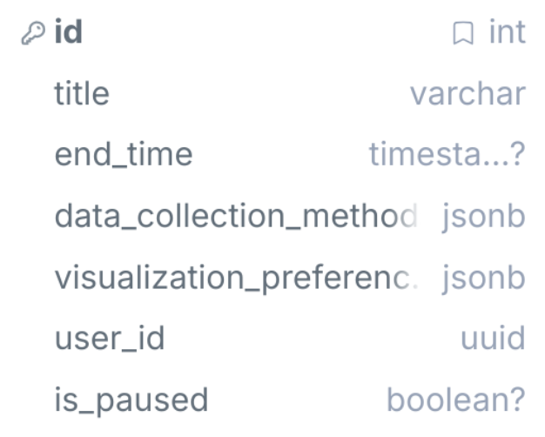
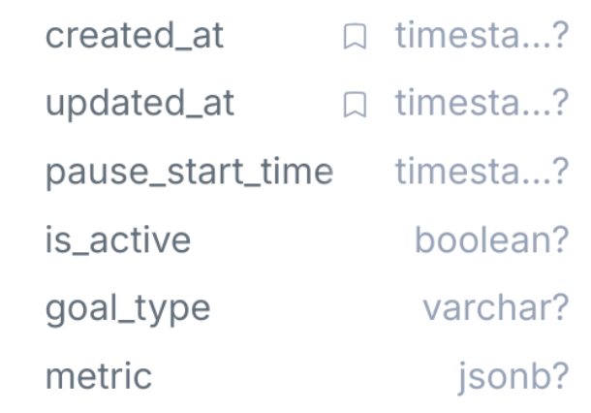
Developed Components and Algorithms
1
Session Сreation Component
Description:
Guided workflow for creating sessions
Frontend implementation:
Validated inputs with tooltip hints, presets
Vue’s reactive and computed properties to manage form state dynamically
Nested modals like SessionDurationPicker and SessionVisualizationPicker within Vue’s Teleport and Vue’s Transition
Vue’s event system within emits to send user interactions back to parent component
Backend implementation:
POST endpoint (/api/users/sessions/create)
Database implementation:
Schema of session:
9

Slide 10
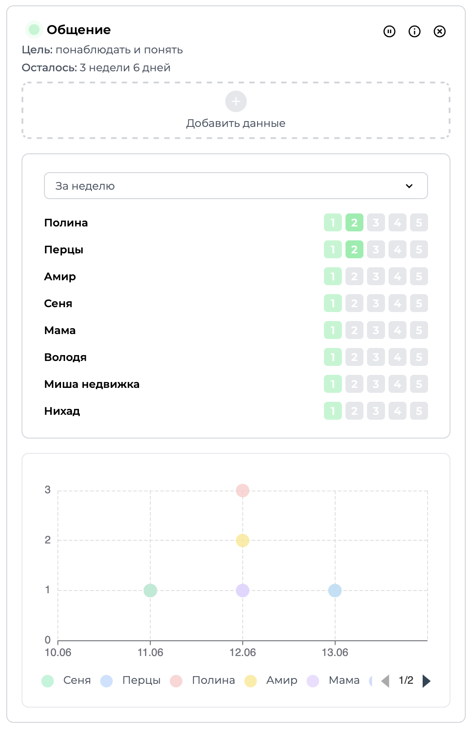
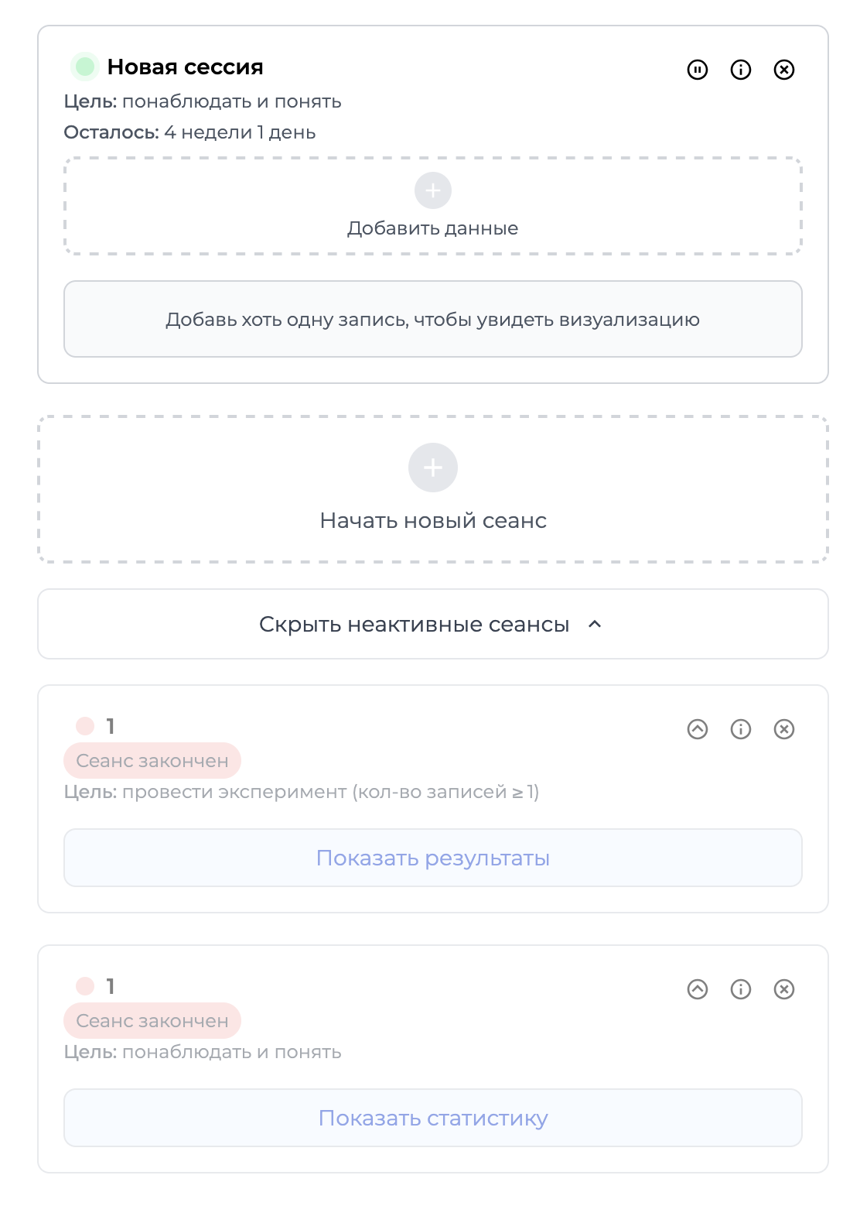
Developed Components and Algorithms
2
Session Card + List Components
Description:
Display of sessions, active and inactive, with options to manage each
Frontend implementation:
Vue’s properties, event system, teleport, transition, etc.
Components like SessionEditModal, SessionResultsModal and others
Backend implementation:
Endpoints to fetch, create, update, delete, and restore sessions
10

Slide 11
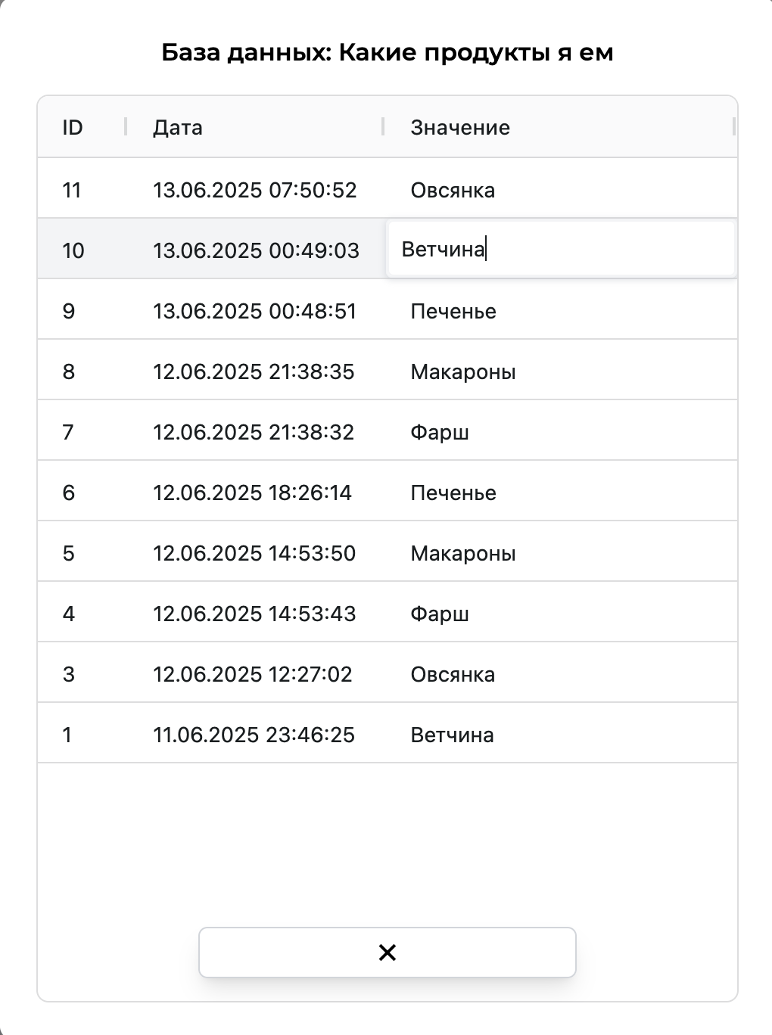
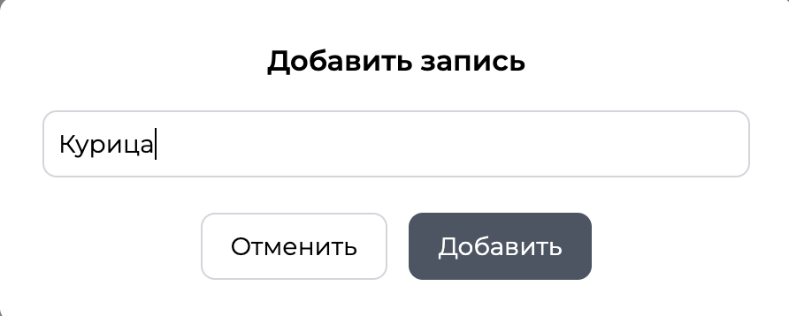
Developed Components and Algorithms
3
Database Component
Description:
Display and management of tables for specific sessions
Frontend implementation:
Data grid with creating, editing, deleting capabilities
Backend implementation:
Endpoints to fetch, create, update, delete, and restore sessions
Database implementation:
Universal schema that allows to create any possible type sessions:
  id: int
  datetime: datetime
  value: str
11

Slide 12
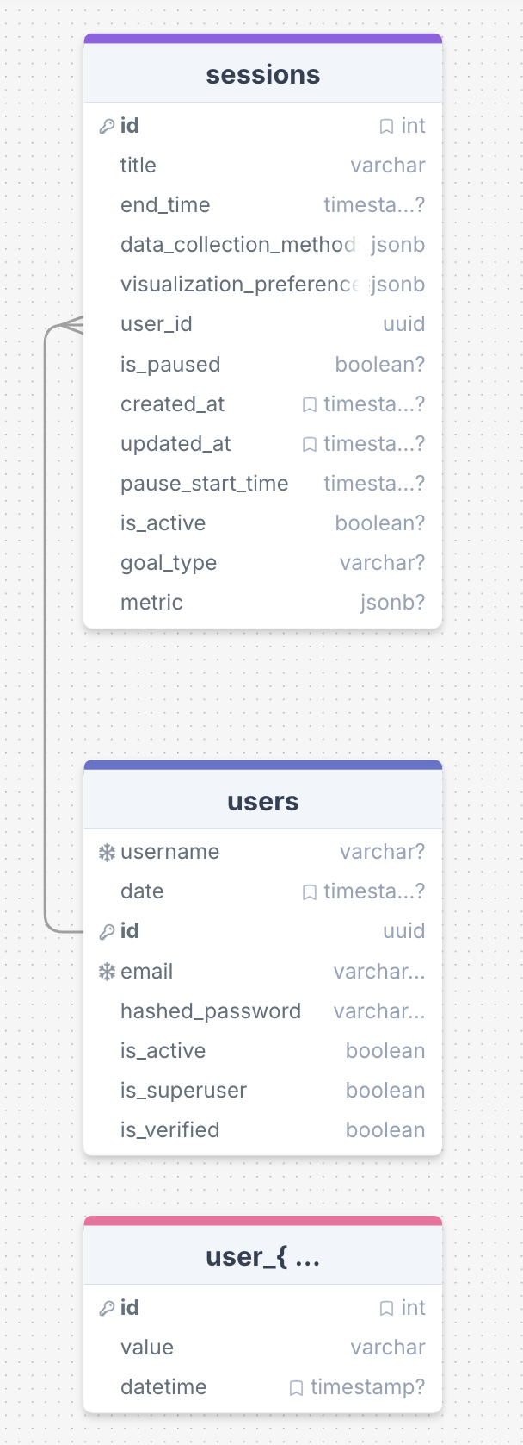
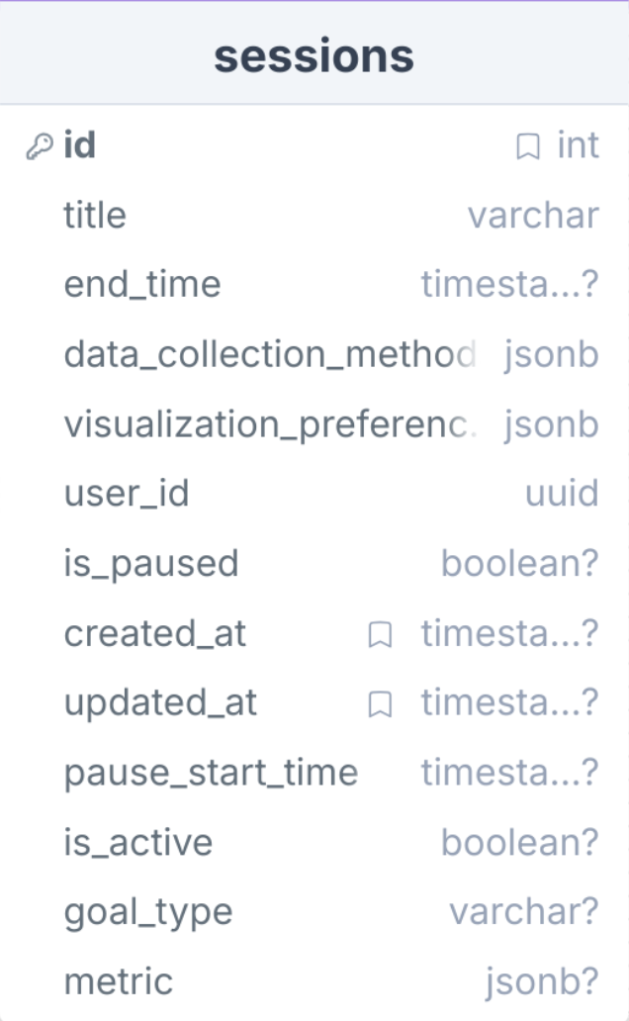
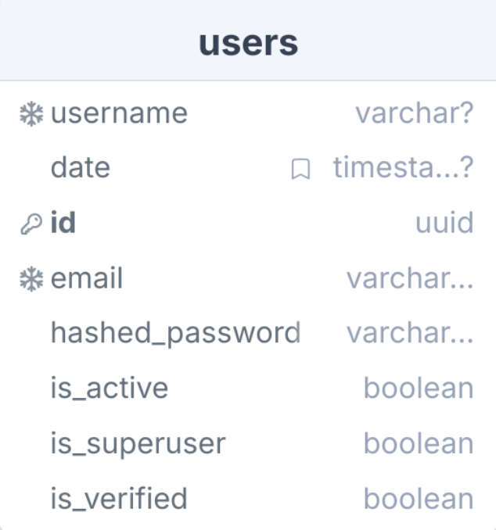
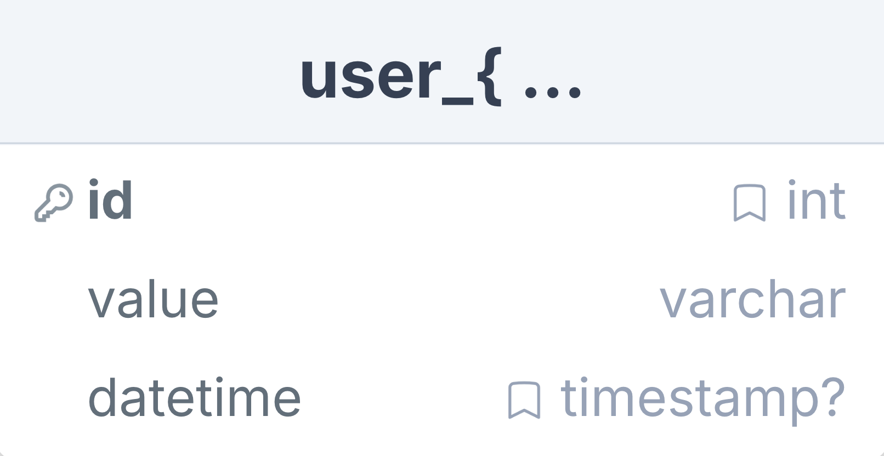
Application Architecture
Database Schemas
4

Slide 13
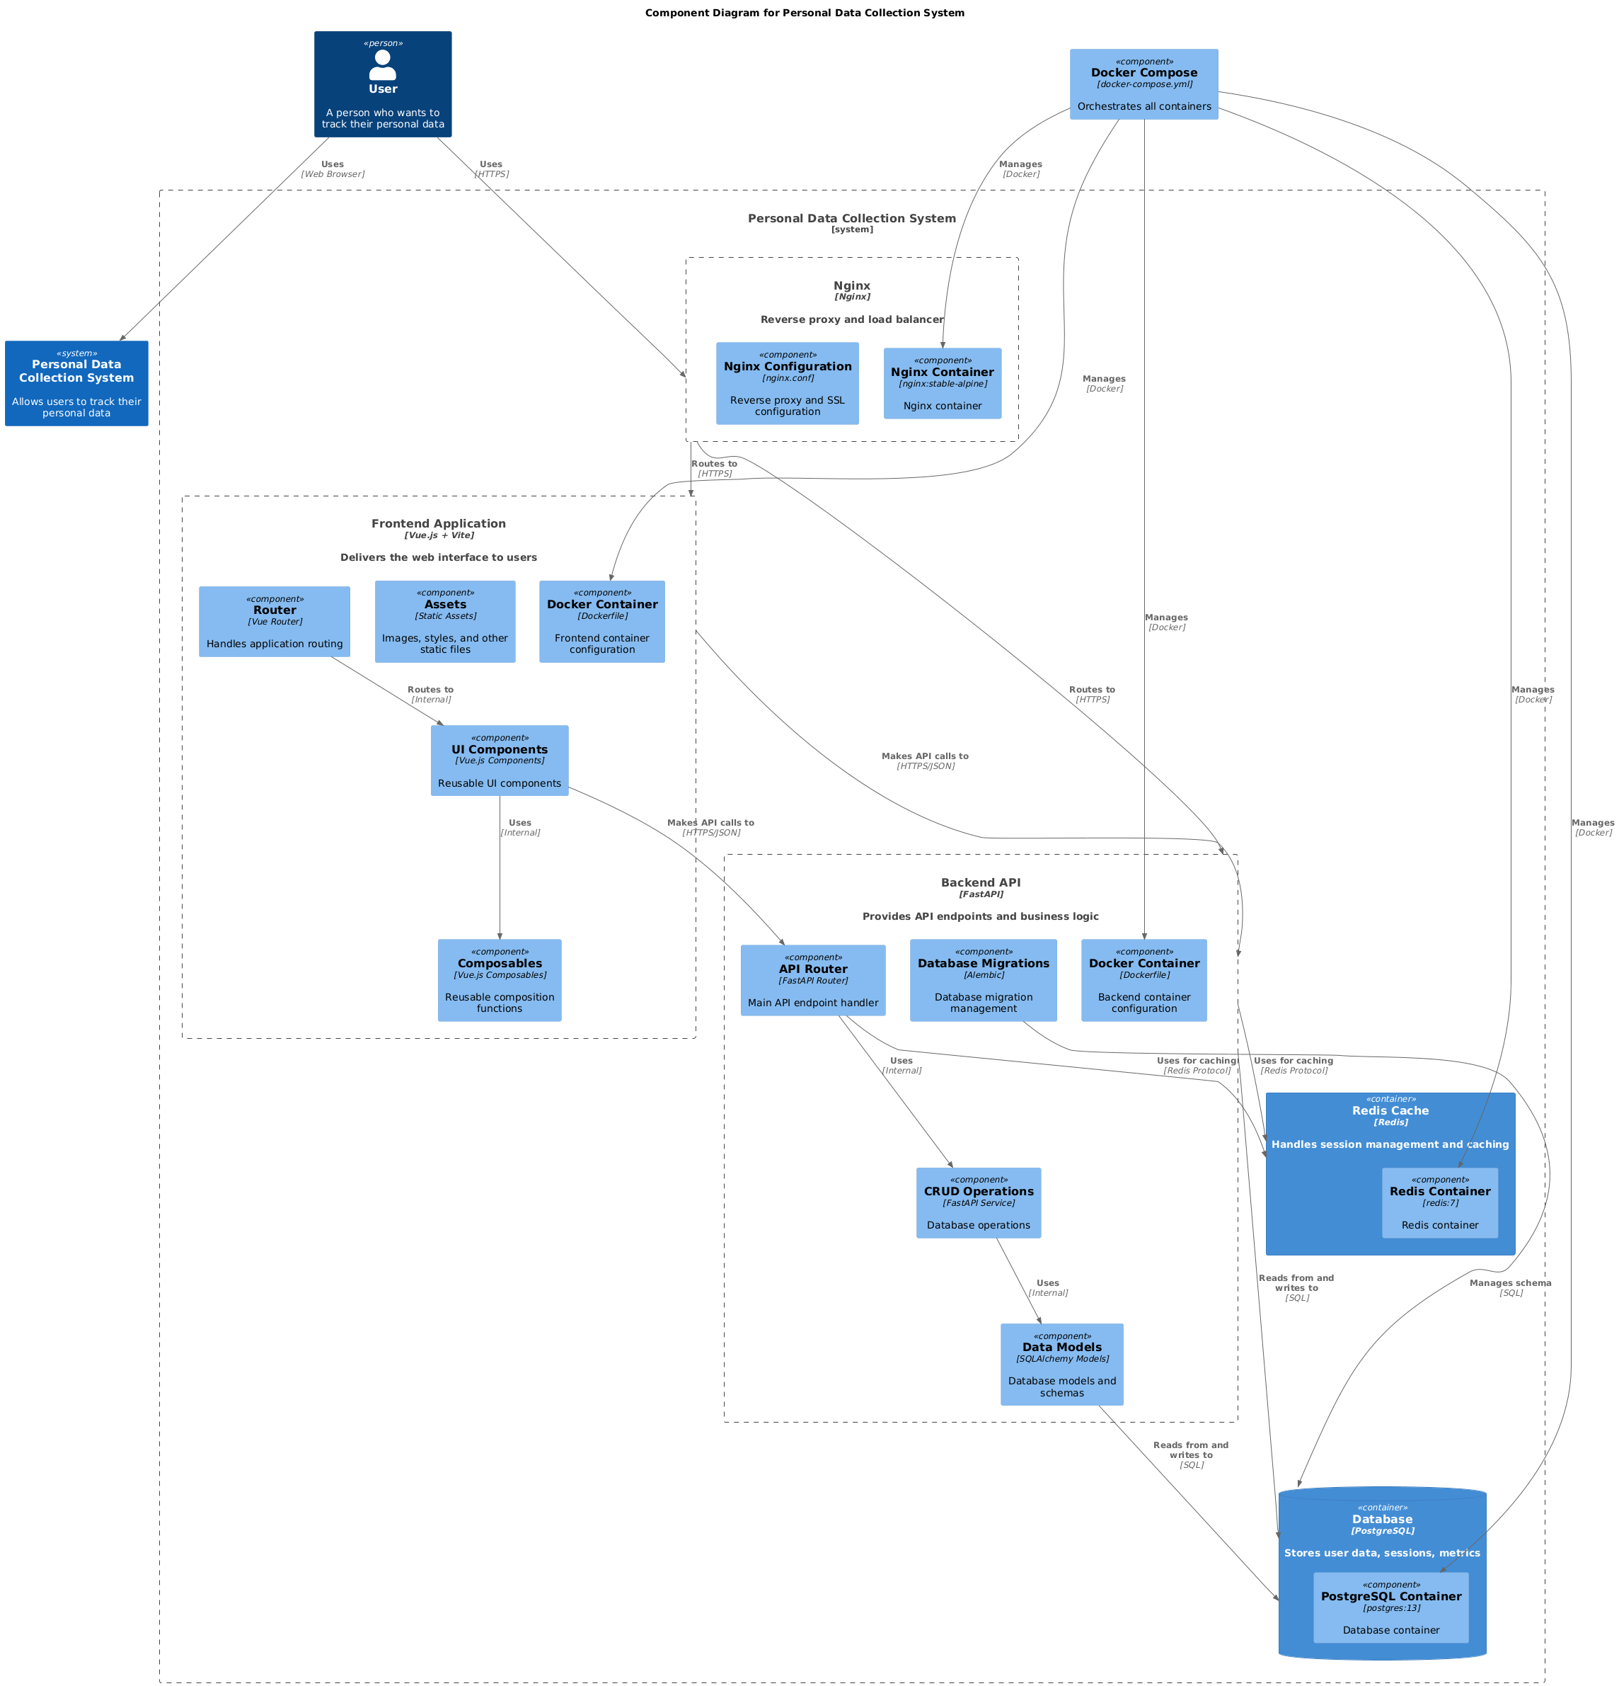
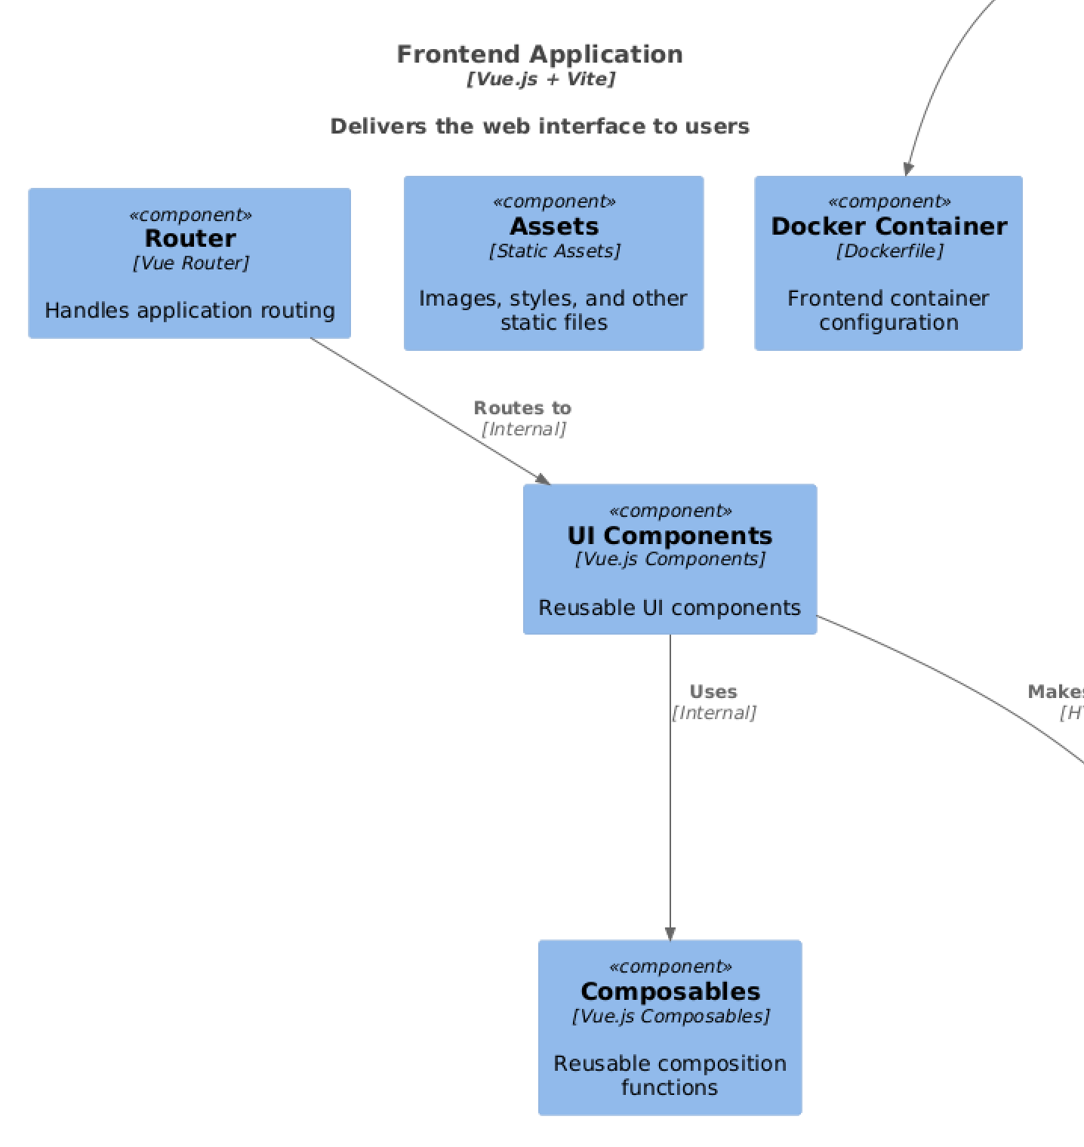
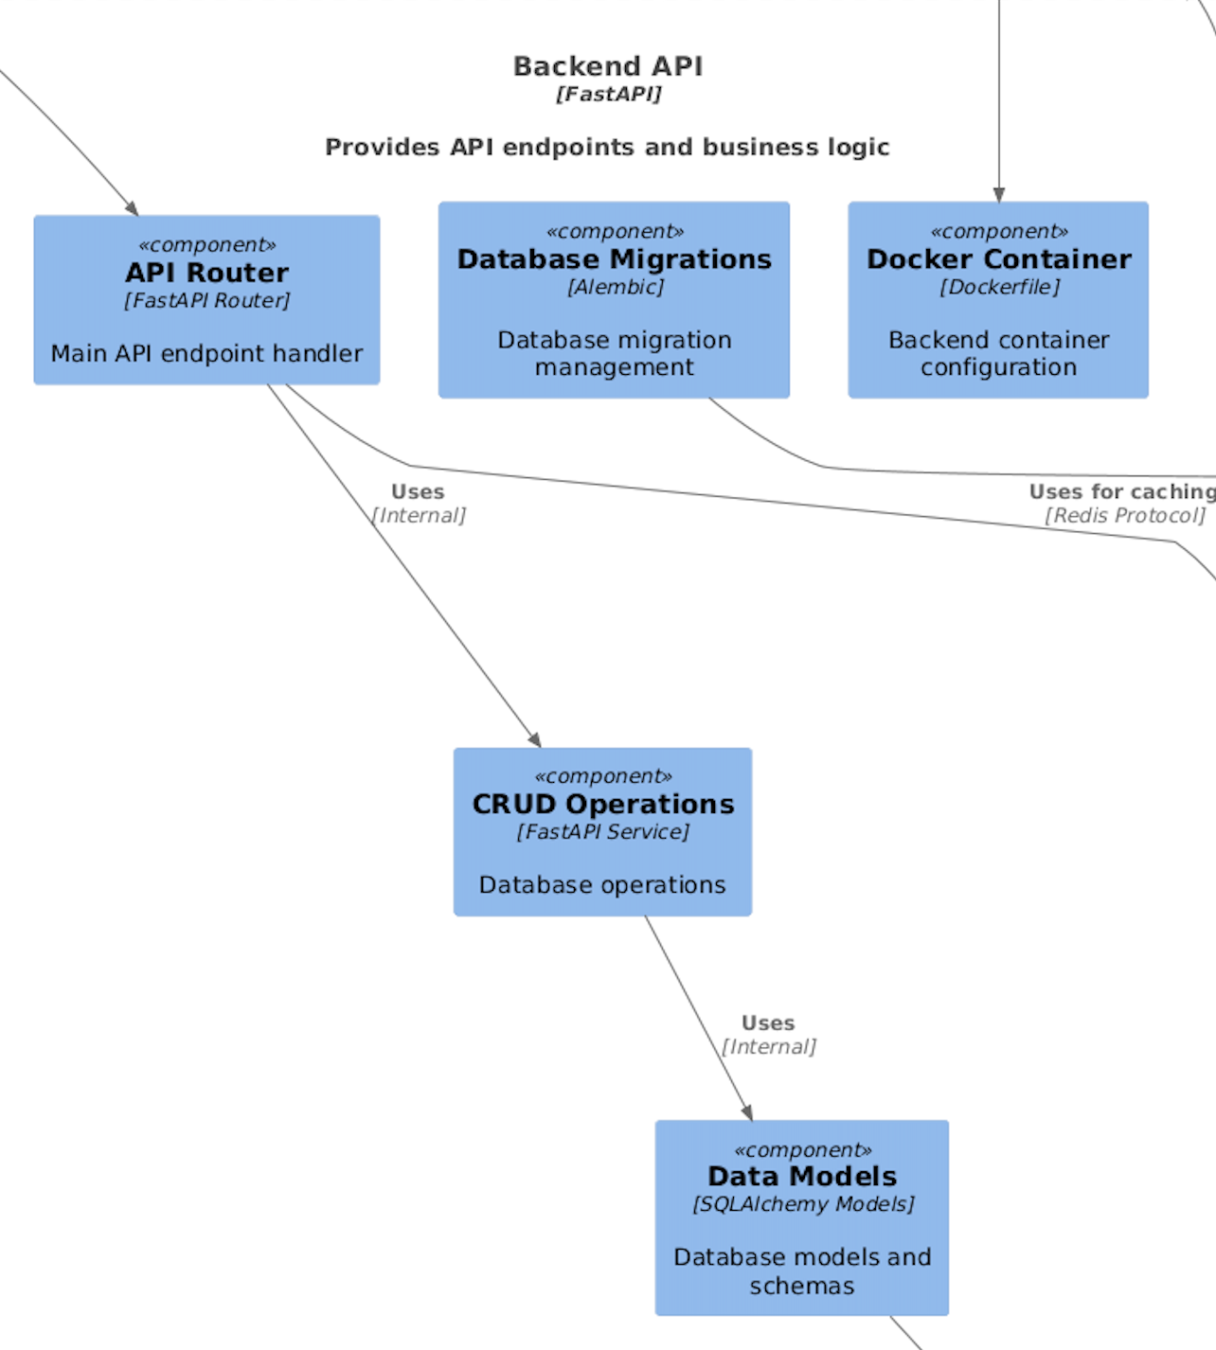
Application Architecture
UML Microservices Architecture
4

Slide 14
Key Results and Conclusions
A modern production-in web application, featuring a microservices architecture that enables seamless integration with external applications.
–
–
Prepared UX research and first beta-testers are already improving their mindfulness, their insights directly influence the development

Slide 15
DEMO
TIME

Slide 16
Future Work
–
LLM processing session tables and generating life insights and recommendations
–
Scientific methodology embedded throughout the application
–
Upgrading data collection methods, database management and visualizations rendering based on UX
–
Integrated external apps as new data collection methods
–
Analysis tools for session data

