Slide 1
Chaos in Music
Хаос в Музыке
Faculty of
Computer Science
Data Science and
Business Analytics
Moscow
2025
Prepared by Verzhbitskiy Makar Alekseevich
Supervisor Tomashchuk Korney Kirillovich

Slide 2

Introduction
Faculty of
Computer Science
Data Science and
Business Analytics
Chaos in Music
Traditional music analysis in recommendation systems and ML models often overlooks the chaotic nature of music, relying instead on familiar features like tempo, timbre, and key.
This creates a gap between perceived genre identity and the underlying nonlinear dynamics of sound, limiting understanding of musical similarity and structure.
This research introduces chaos-based metrics—permutation entropy, statistical complexity, and fractal dimension—to uncover hidden patterns across genres and enhance classification, recommendation, and generative tasks.

Slide 3

Relevance and Objectives
Faculty of
Computer Science
Data Science and
Business Analytics
Chaos in Music
Traditional music recommendation systems rely heavily on basic acoustic features, often overlooking the chaotic and nonlinear nature of musical signals.
Some listeners may be more drawn to the degree of structural unpredictability in music—such as entropy or complexity—rather than to conventional genre categories.
Classifying music based on chaos-related metrics enables a new dimension of analysis: distinguishing between more ordered and more chaotic tracks within or across genres.
This approach enhances genre modeling, refines user preference profiling, and supports the development of more personalized, dynamics-aware recommendation systems.

Slide 4

Novelty
Faculty of
Computer Science
Data Science and
Business Analytics
Chaos in Music
This research proposes a novel approach to music analysis by applying chaos theory metrics—permutation entropy, statistical complexity, and fractal dimension—on preprocessed audio signals, using windowed time-series representations and four tailored preprocessing methods designed to extract meaningful musical features from raw sound.

Slide 5

Roadmap =
Faculty of
Computer Science
Data Science and
Business Analytics
Chaos in Music
Data collection ,
Data processing ,
Audio preprocessing ,
Chaotic metrics estimation ,
Hypothesis Statement ,
Hypothesis Testing ,
Conclusion from the research

Slide 6

Data collection
Faculty of
Computer Science
Data Science and
Business Analytics
Chaos in Music
For this research, data was collected from the Kaggle - 🎹 Spotify Tracks Dataset, as Spotify's API does not provide direct access to genre information for individual tracks.
This dataset includes a wide range of track features, such as audio attributes (e.g., danceability, tempo, energy) and genre labels, all conveniently compiled into one resource.
This allows for efficient analysis and exploration of musical features alongside their genre classifications, providing a complete set of data for our chaos-based metrics analysis.

Slide 7
Data processing
Faculty of
Computer Science
Data Science and
Business Analytics
Chaos in Music
From the data set, a random sample of 100 tracks from each of the following genres was selected: acoustic, blues, classical, rock, metal, country, disco, hip-hop, jazz, pop, and reggae — totaling 1,100 tracks.
Each track was downloaded using a custom script involving yt-dlp, resulting in .wav audio files for all selections.
Specifically, four different types of entropy and two types of fractal dimensions were computed — all grounded in statistical entropy theory, box counting dimensions and Higuchi fractal dimension — but almost each based on a uniquely preprocessed version of the original signal.

Slide 8
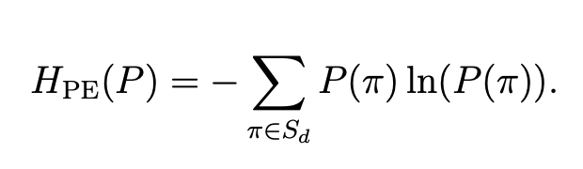
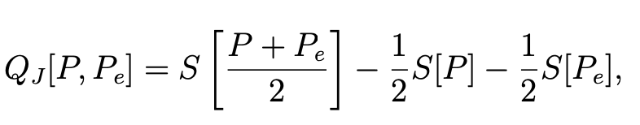
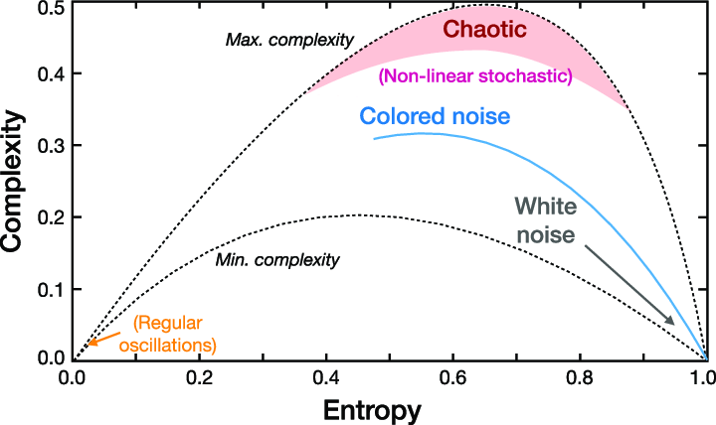
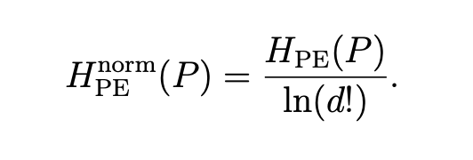
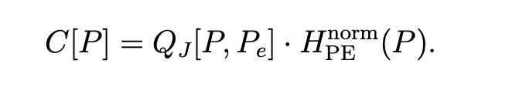
Main Metrics Part 1
Faculty of
Computer Science
Data Science and
Business Analytics
Chaos in Music
Permutational Entropy
Statistical Complexity

Slide 9
Main Metrics Part 1
Faculty of
Computer Science
Data Science and
Business Analytics
Chaos in Music

Slide 10

Entropy Measures
Faculty of
Computer Science
Data Science and
Business Analytics
Chaos in Music
To capture the chaotic characteristics of musical signals, four entropy-complexity analysis methods were applied developed by me.
Each method is based on statistical entropy and complexity but differs in the signal processing used before computation:
Amplitude Entropy
Flux Entropy
Harmony Entropy
Spectral Entropy

Slide 11
Attention
Faculty of
Computer Science
Data Science and
Business Analytics
Chaos in Music
The following slides illustrate how the audio signal is preprocessed in different ways before being analyzed using permutation entropy and statistical complexity framework.

Slide 12
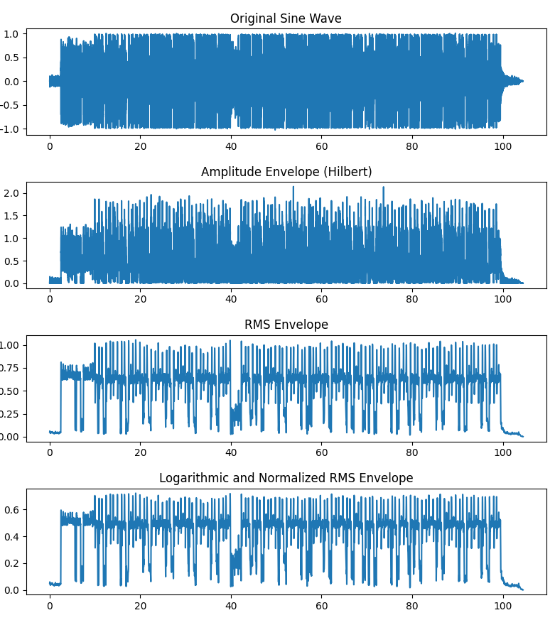
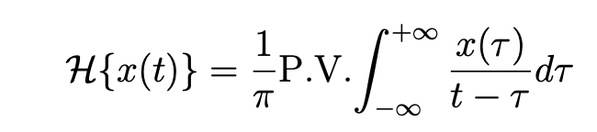
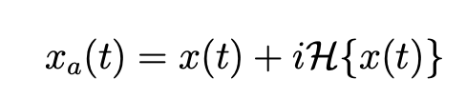
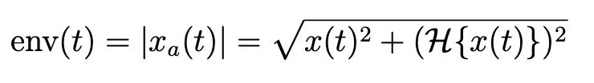
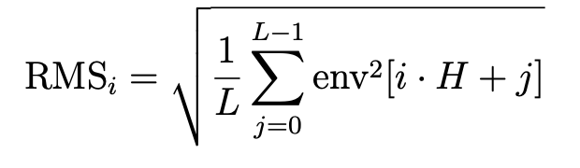
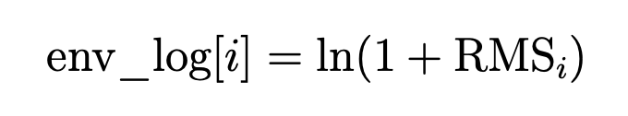
Amplitude Entropy
Faculty of
Computer Science
Data Science and
Business Analytics
Chaos in Music

Slide 13
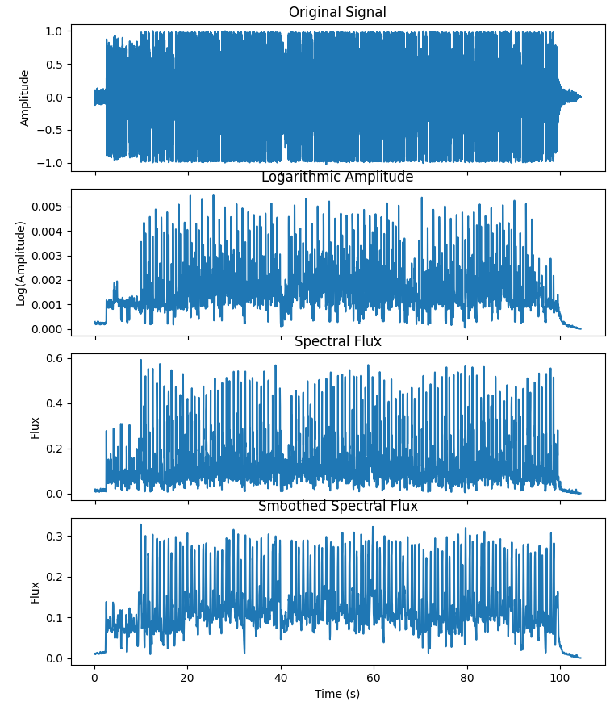
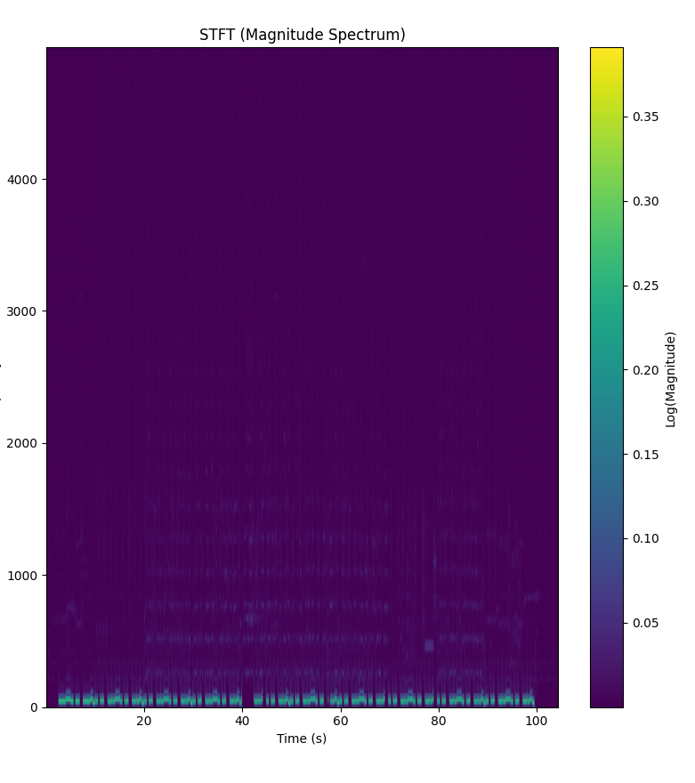
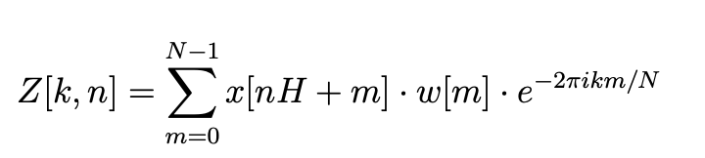

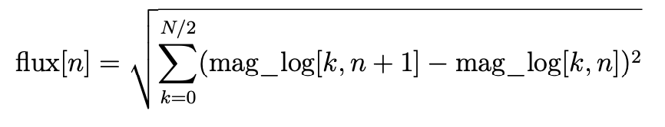
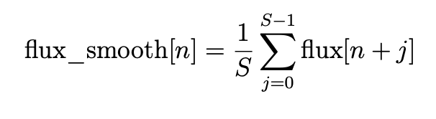
Flux Entropy
Faculty of
Computer Science
Data Science and
Business Analytics
Chaos in Music
Formulas for each step
STFT

Slide 14
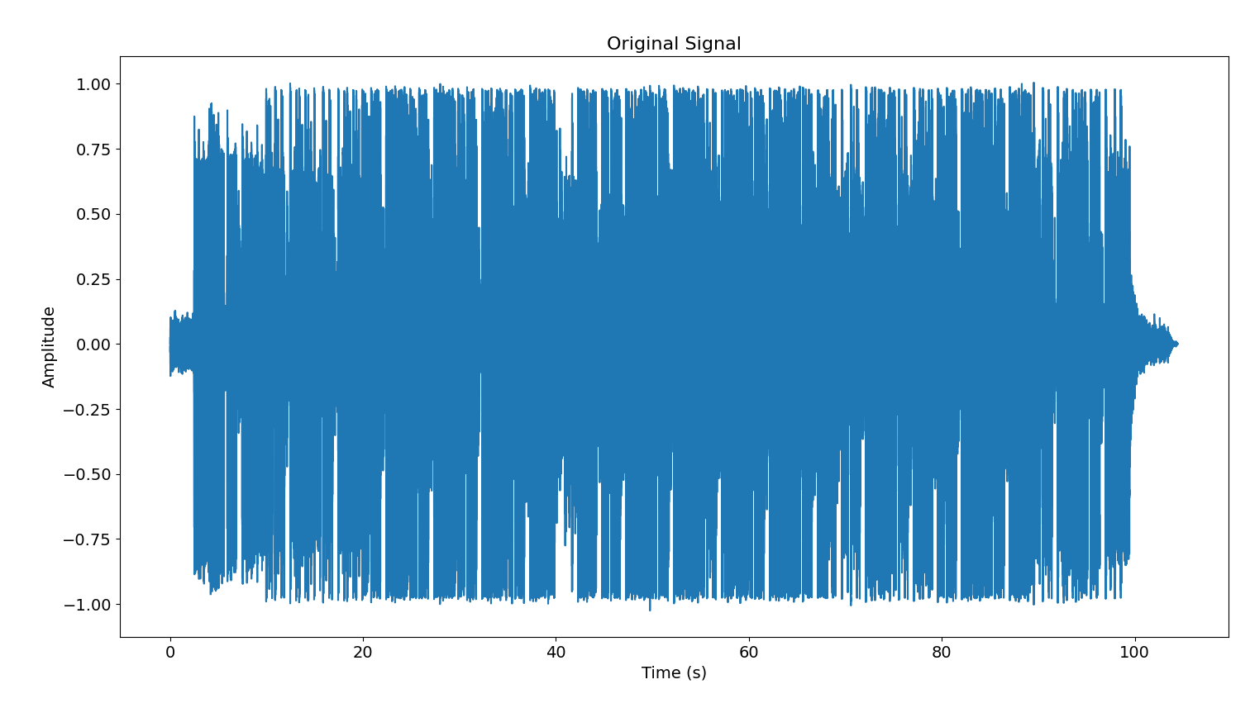
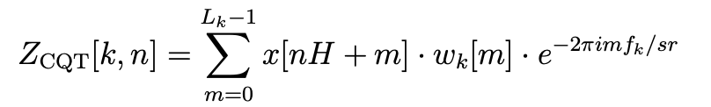
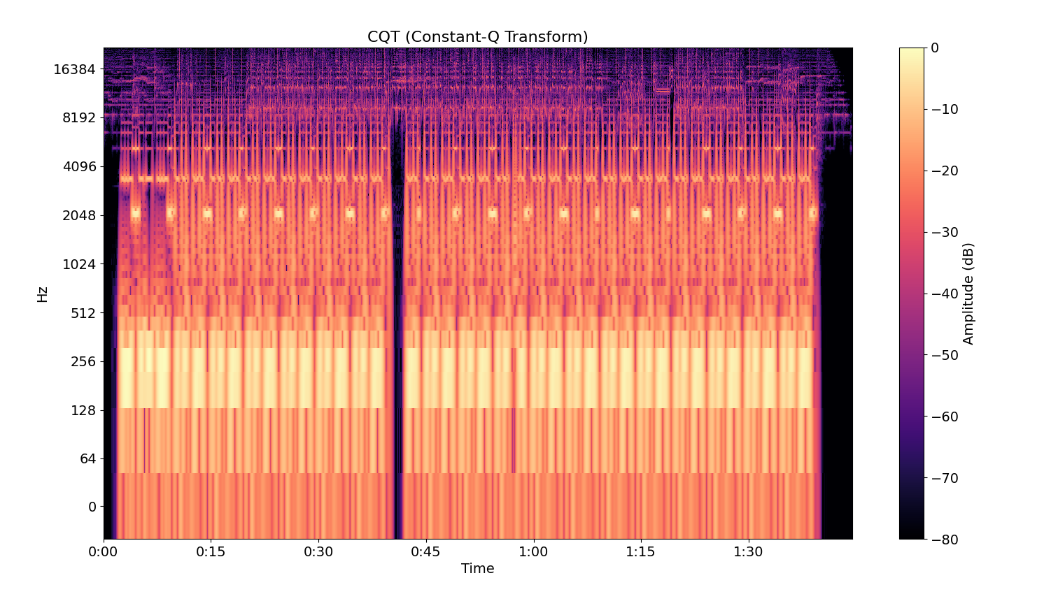
Harmony Entropy
Faculty of
Computer Science
Data Science and
Business Analytics
Chaos in Music
Formula for this step

Slide 15
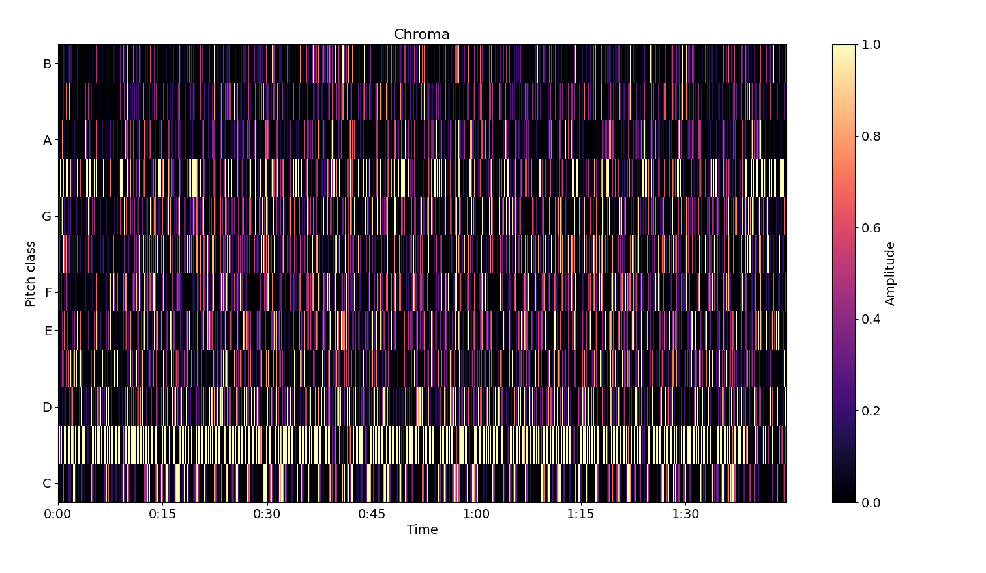
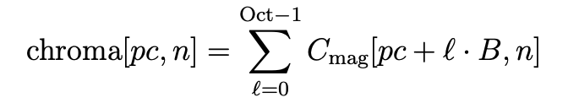

Harmony Entropy
Faculty of
Computer Science
Data Science and
Business Analytics
Chaos in Music
Formulas for this step

Slide 16
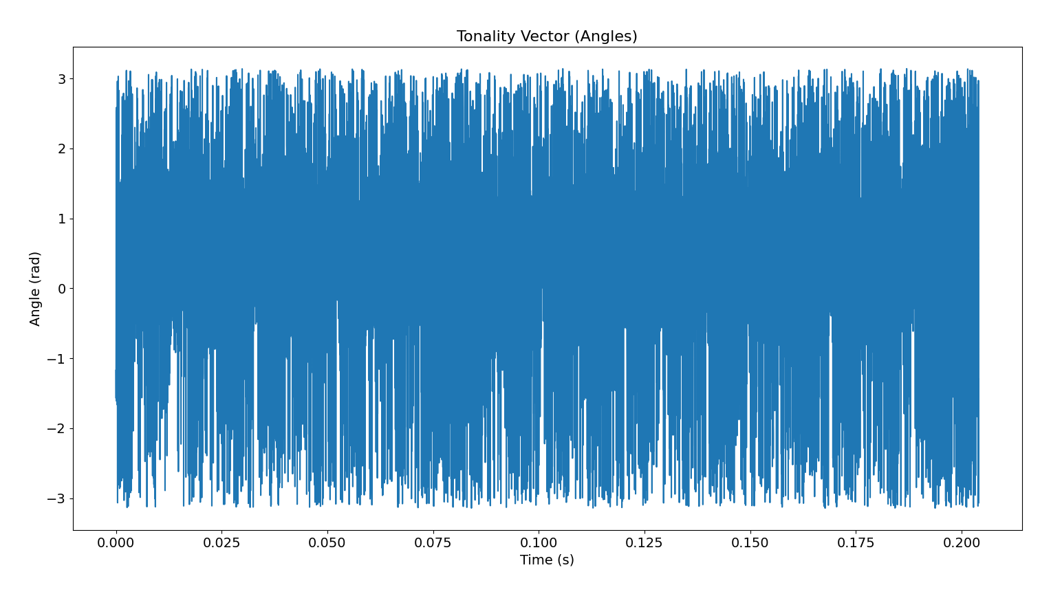
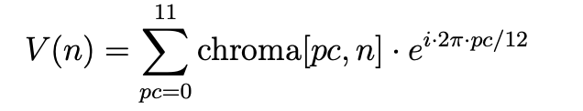
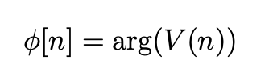
Harmony Entropy
Faculty of
Computer Science
Data Science and
Business Analytics
Chaos in Music
Formulas for this step

Slide 17
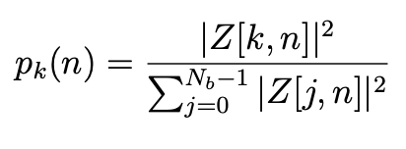
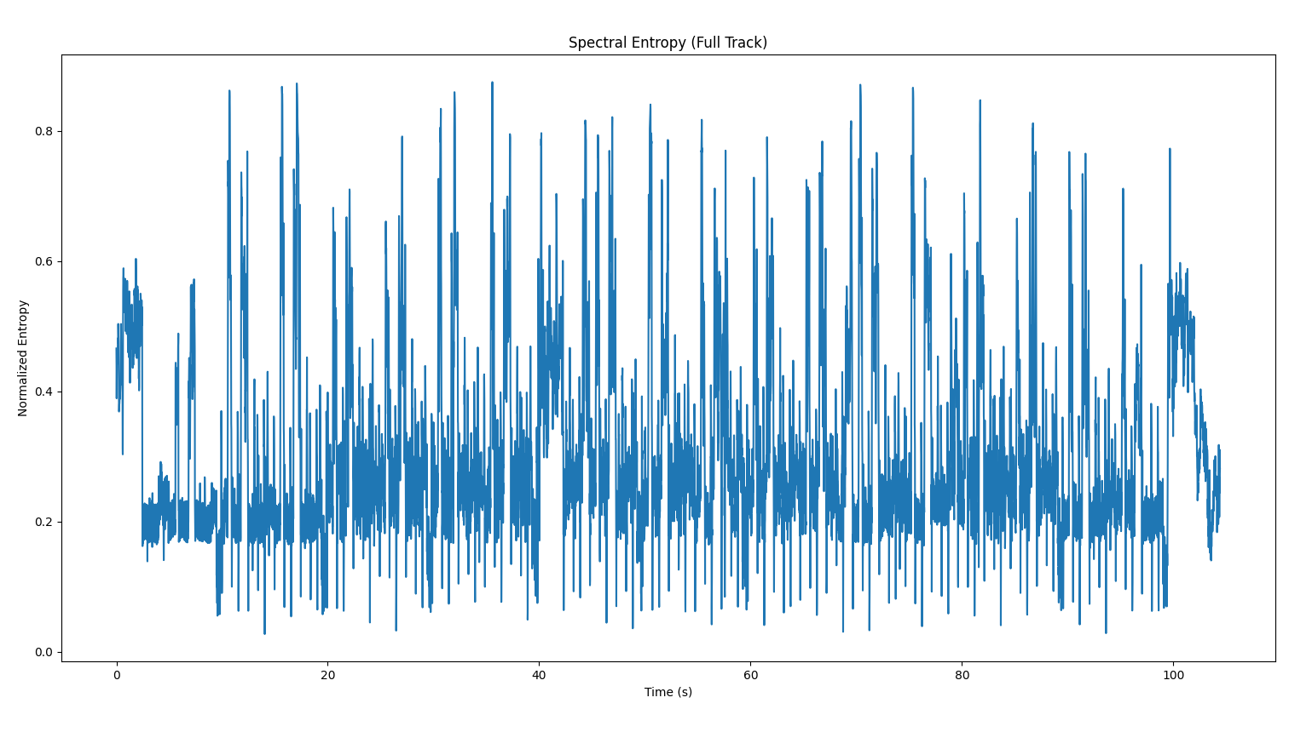
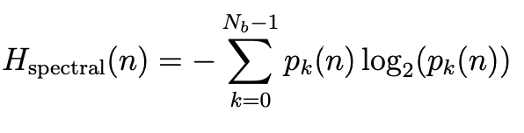
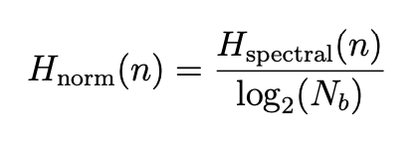
Spectral Entropy
Faculty of
Computer Science
Data Science and
Business Analytics
Chaos in Music
Formulas for each step
Nb is the number of frequency bins
Spectral Entropy

Slide 18
Main Metrics Part 2
Faculty of
Computer Science
Data Science and
Business Analytics
Chaos in Music
Why Higuchi fractal dimension
HFD is applied to analyze the fractal nature of music signals, revealing the degree of complexity and self-similarity within the temporal structure of music. It is particularly useful because it quantifies the roughness or irregularity of a time series, which in music reflects the underlying chaotic dynamics.
A higher HFD value indicates a more complex and irregular signal, while a lower value suggests more regularity.
In my music analysis, this method helps to capture subtle variations in sound that conventional methods may miss, offering deeper insights into the nonlinear dynamics of musical compositions and their relationship to genre-specific features.
Box counting fractal dimension
Treats the log-mel spectrogram as a 2-D image and counts how many “occupied” boxes are needed at successively finer scales.
Quantifies how densely musical energy fills time-frequency space:
high BCFD equals rich, texture-dense spectra
low BCFD sparse, tone-focused spectra.
Complements 1-D Higuchi analysis by capturing the spatial self-similarity of harmonic and timbral patterns, helping separate genres with thick spectral layers (e.g., metal) from those with leaner arrangements (e.g., classical).

Slide 19
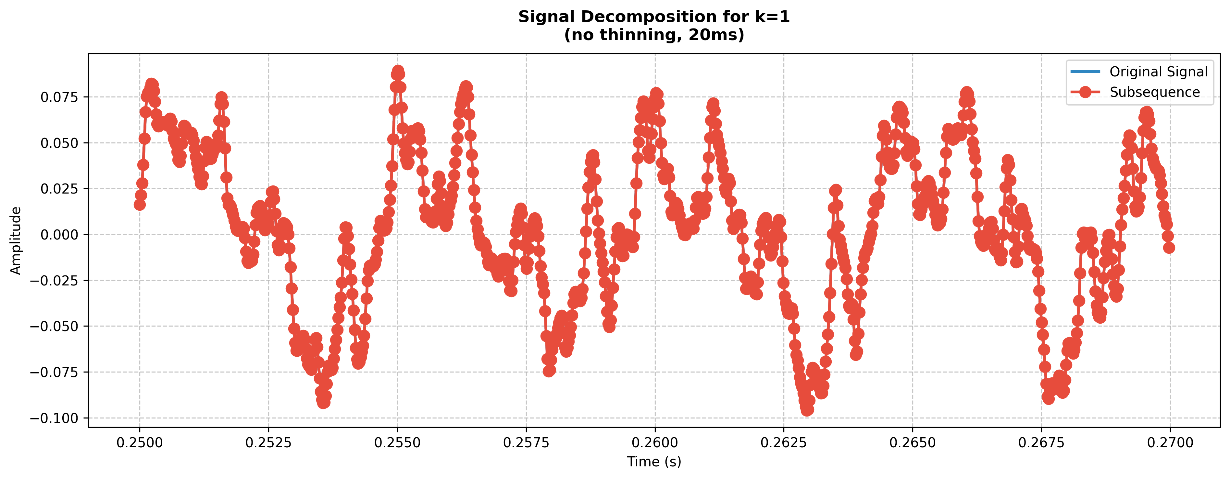
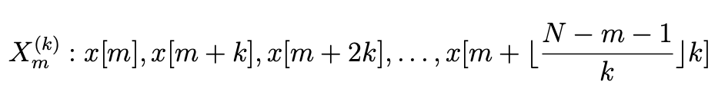
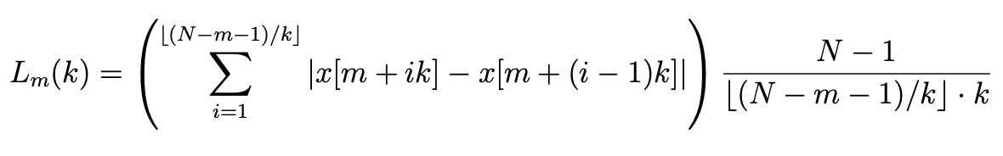
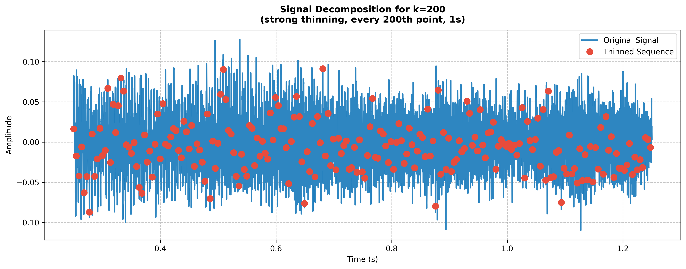
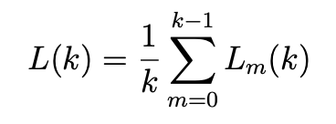

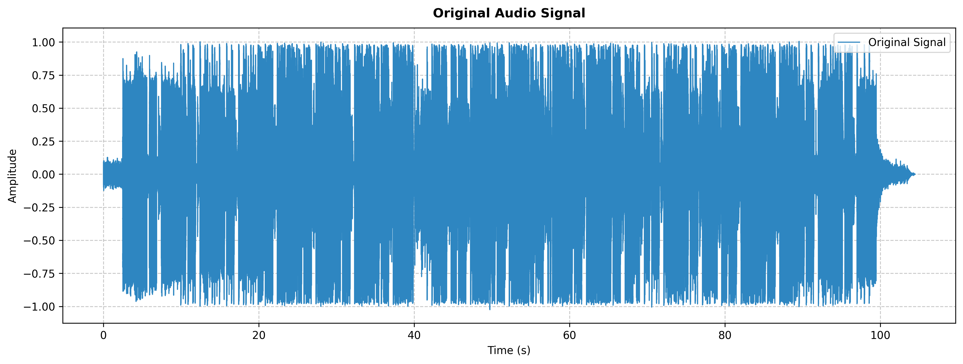
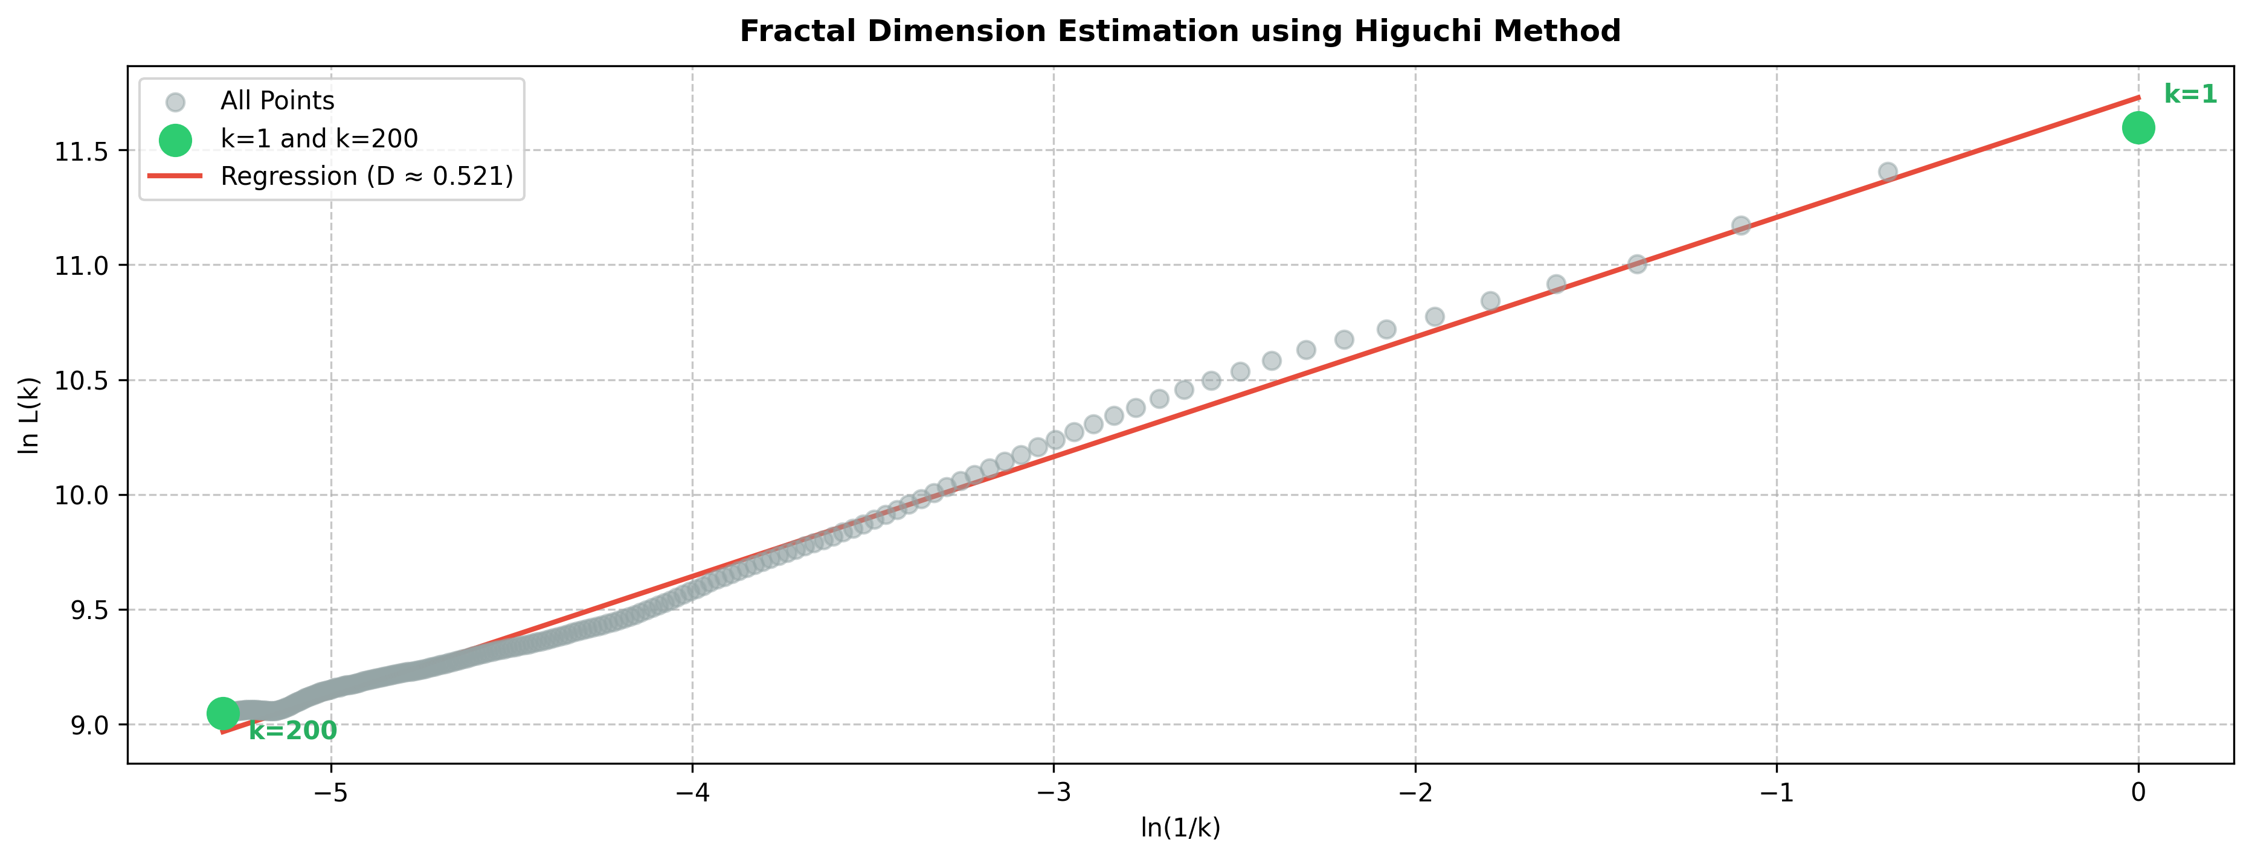
Higuchi fractal dimension
Faculty of
Computer Science
Data Science and
Business Analytics
Chaos in Music
Formulas for each step
20ms
1.2s
regression

Slide 20
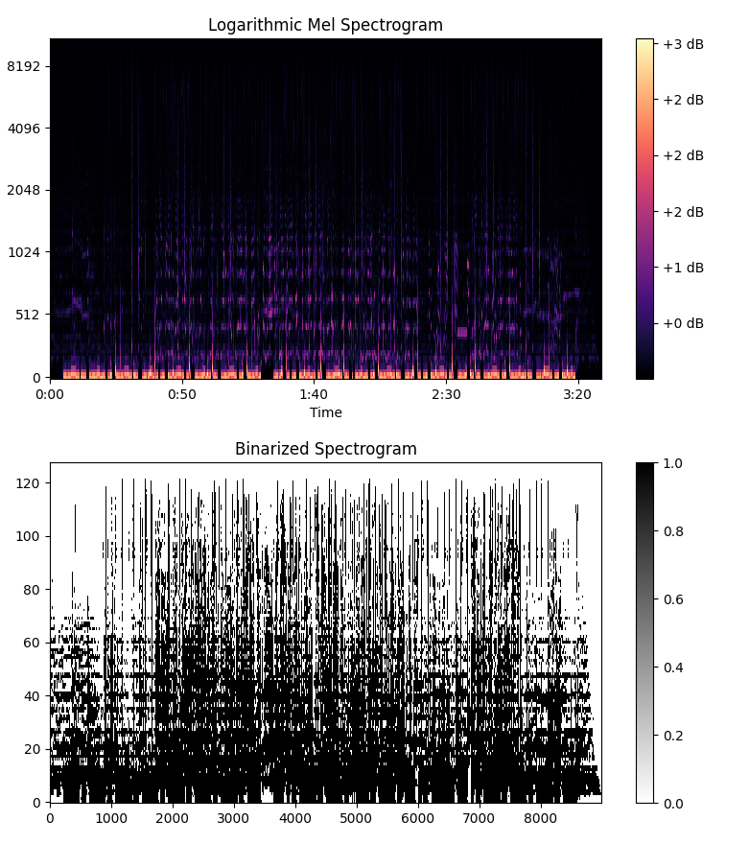
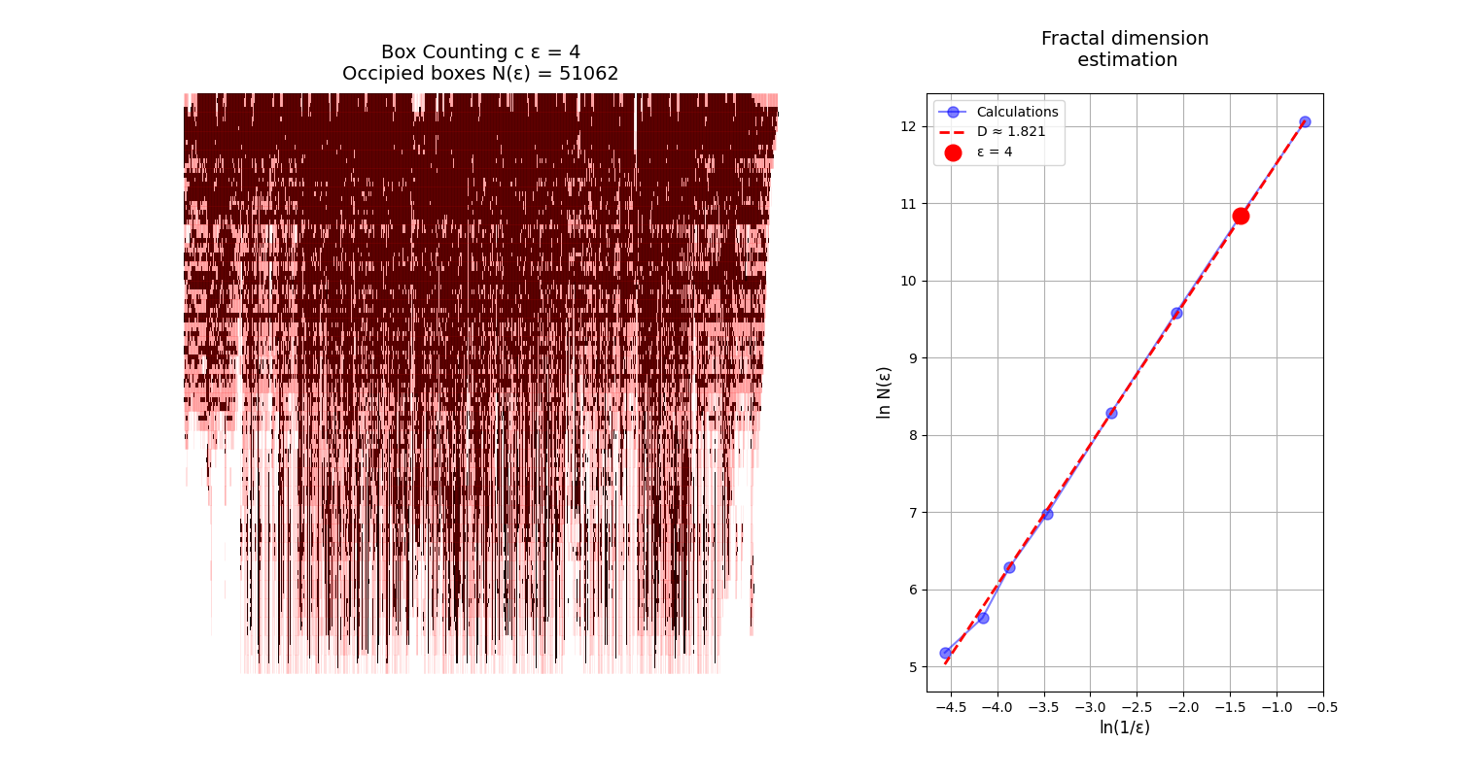
Box counting fractal dimension
Faculty of
Computer Science
Data Science and
Business Analytics
Chaos in Music

Slide 21
Hypothesis Statement
Faculty of
Computer Science
Data Science and
Business Analytics
Chaos in Music
Classical: On the spectral entropy-complexity plane, classical pieces cluster in the low-entropy / low-complexity corner (close to the “regular oscillations” region); in contrast, on the amplitude plane they drift toward moderate entropy with the highest complexity, mirroring their dynamic yet spectrally focused writing.
Metal: Metal tracks sit at the high-entropy / low-complexity tip of the amplitude plane—virtually on the “white-noise” boundary—while achieving maximum complexity at moderate entropy in the spectral plane, a signature of dense, distorted mixes that still contain hidden structure.
Disco & Reggae: Dance-centric genres occupy the chaotic belt of the flux plane: low flux entropy paired with high flux complexity, capturing their tightly organised yet vibrant rhythmic grooves.
Hip-hop: Hip-hop clusters on the left slope of the maximum-complexity dome in the harmony plane, combining low harmonic entropy with high harmonic complexity—consistent with rapidly evolving harmonic pockets over a stable tonal centre.
Pop, Rock, Blues, Country & Acoustic: These styles populate the central swathes of most entropy-complexity planes, avoiding both extreme randomness and rigid order, which explains their broadly balanced sound profiles.

Slide 22
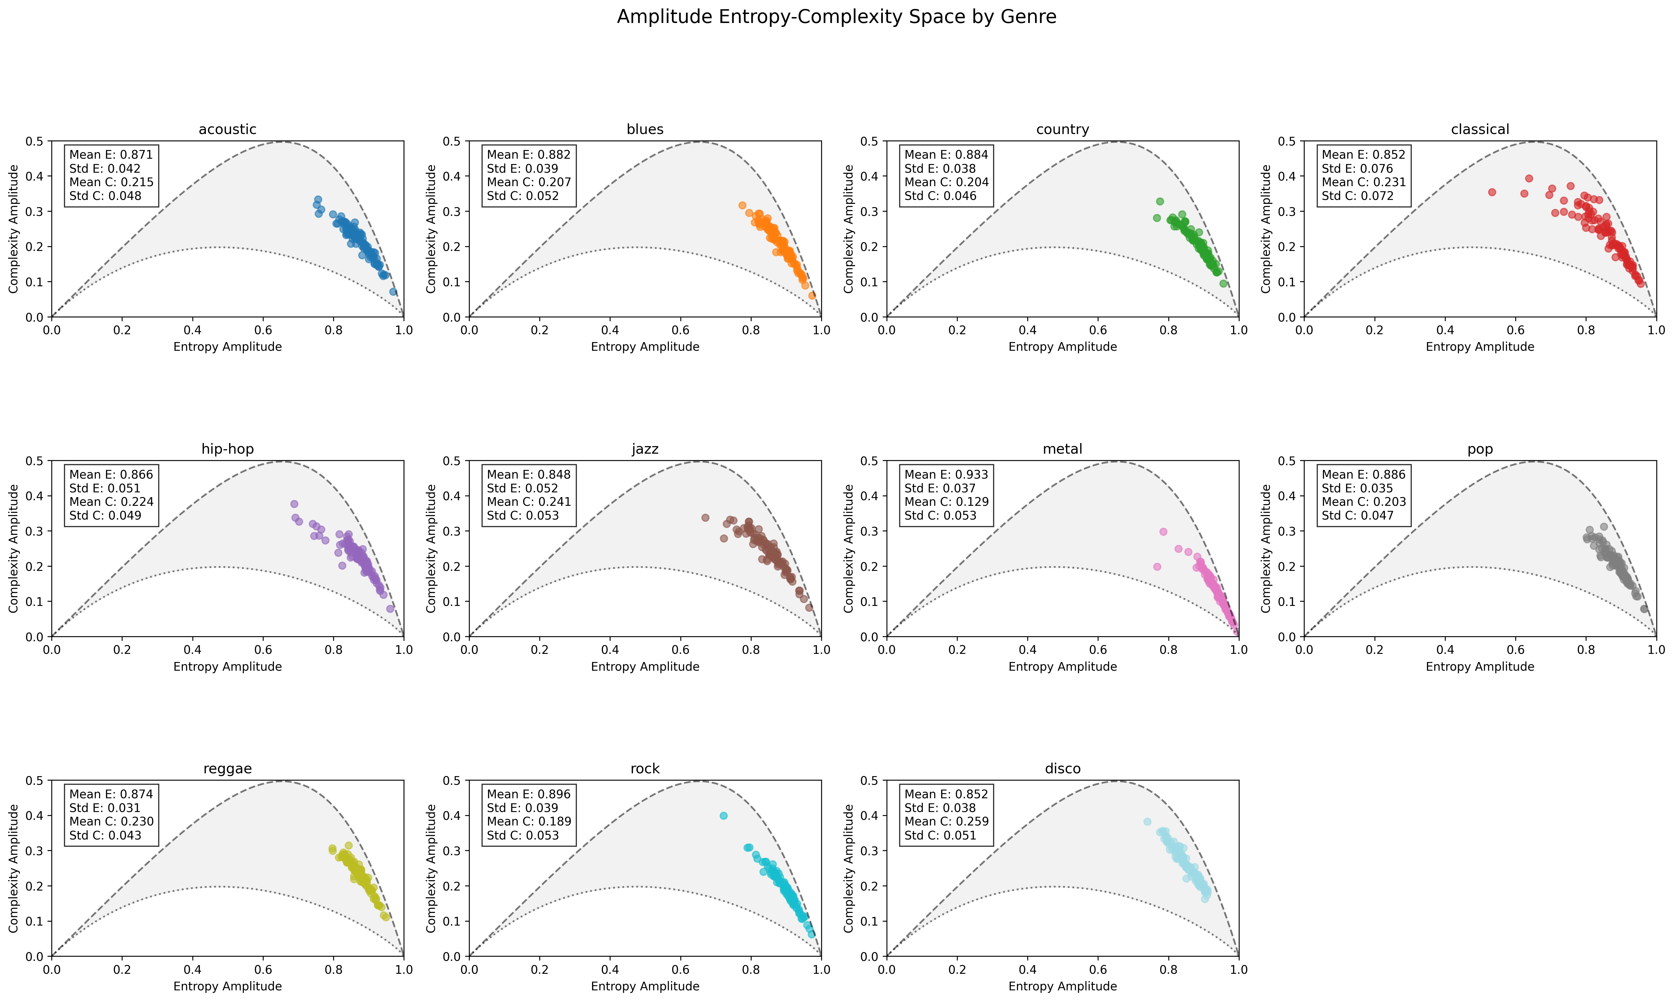
Observings Amplitude Entropy Complexity Space sapc
Faculty of
Computer Science
Data Science and
Business Analytics
Chaos in Music

Slide 23
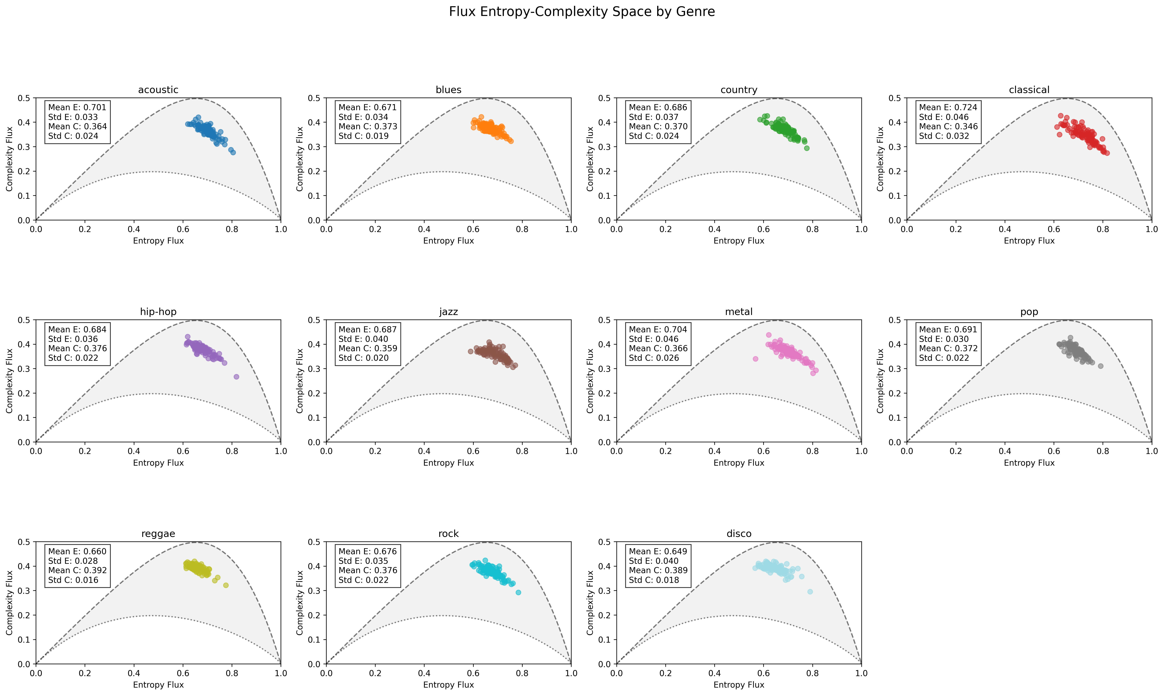
Observings Flux Entropy Complexity Space sapc
Faculty of
Computer Science
Data Science and
Business Analytics
Chaos in Music

Slide 24
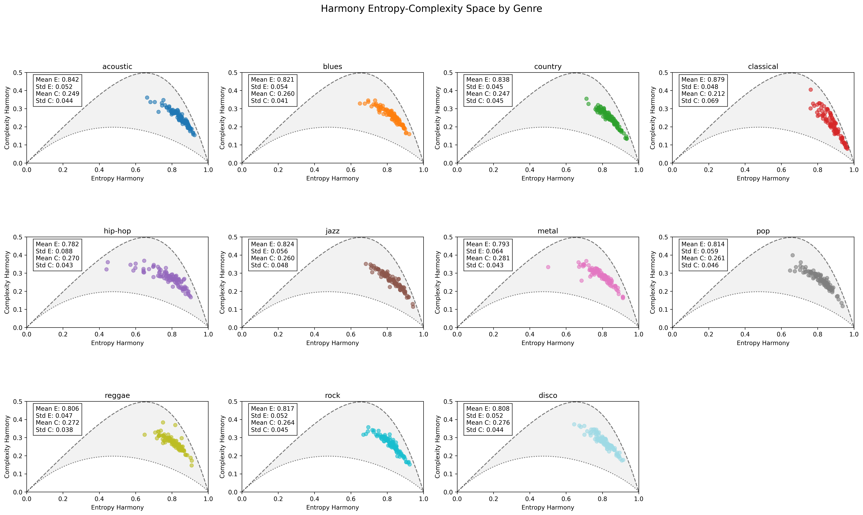
Observings Harmony Entropy Complexity Space sapc
Faculty of
Computer Science
Data Science and
Business Analytics
Chaos in Music

Slide 25
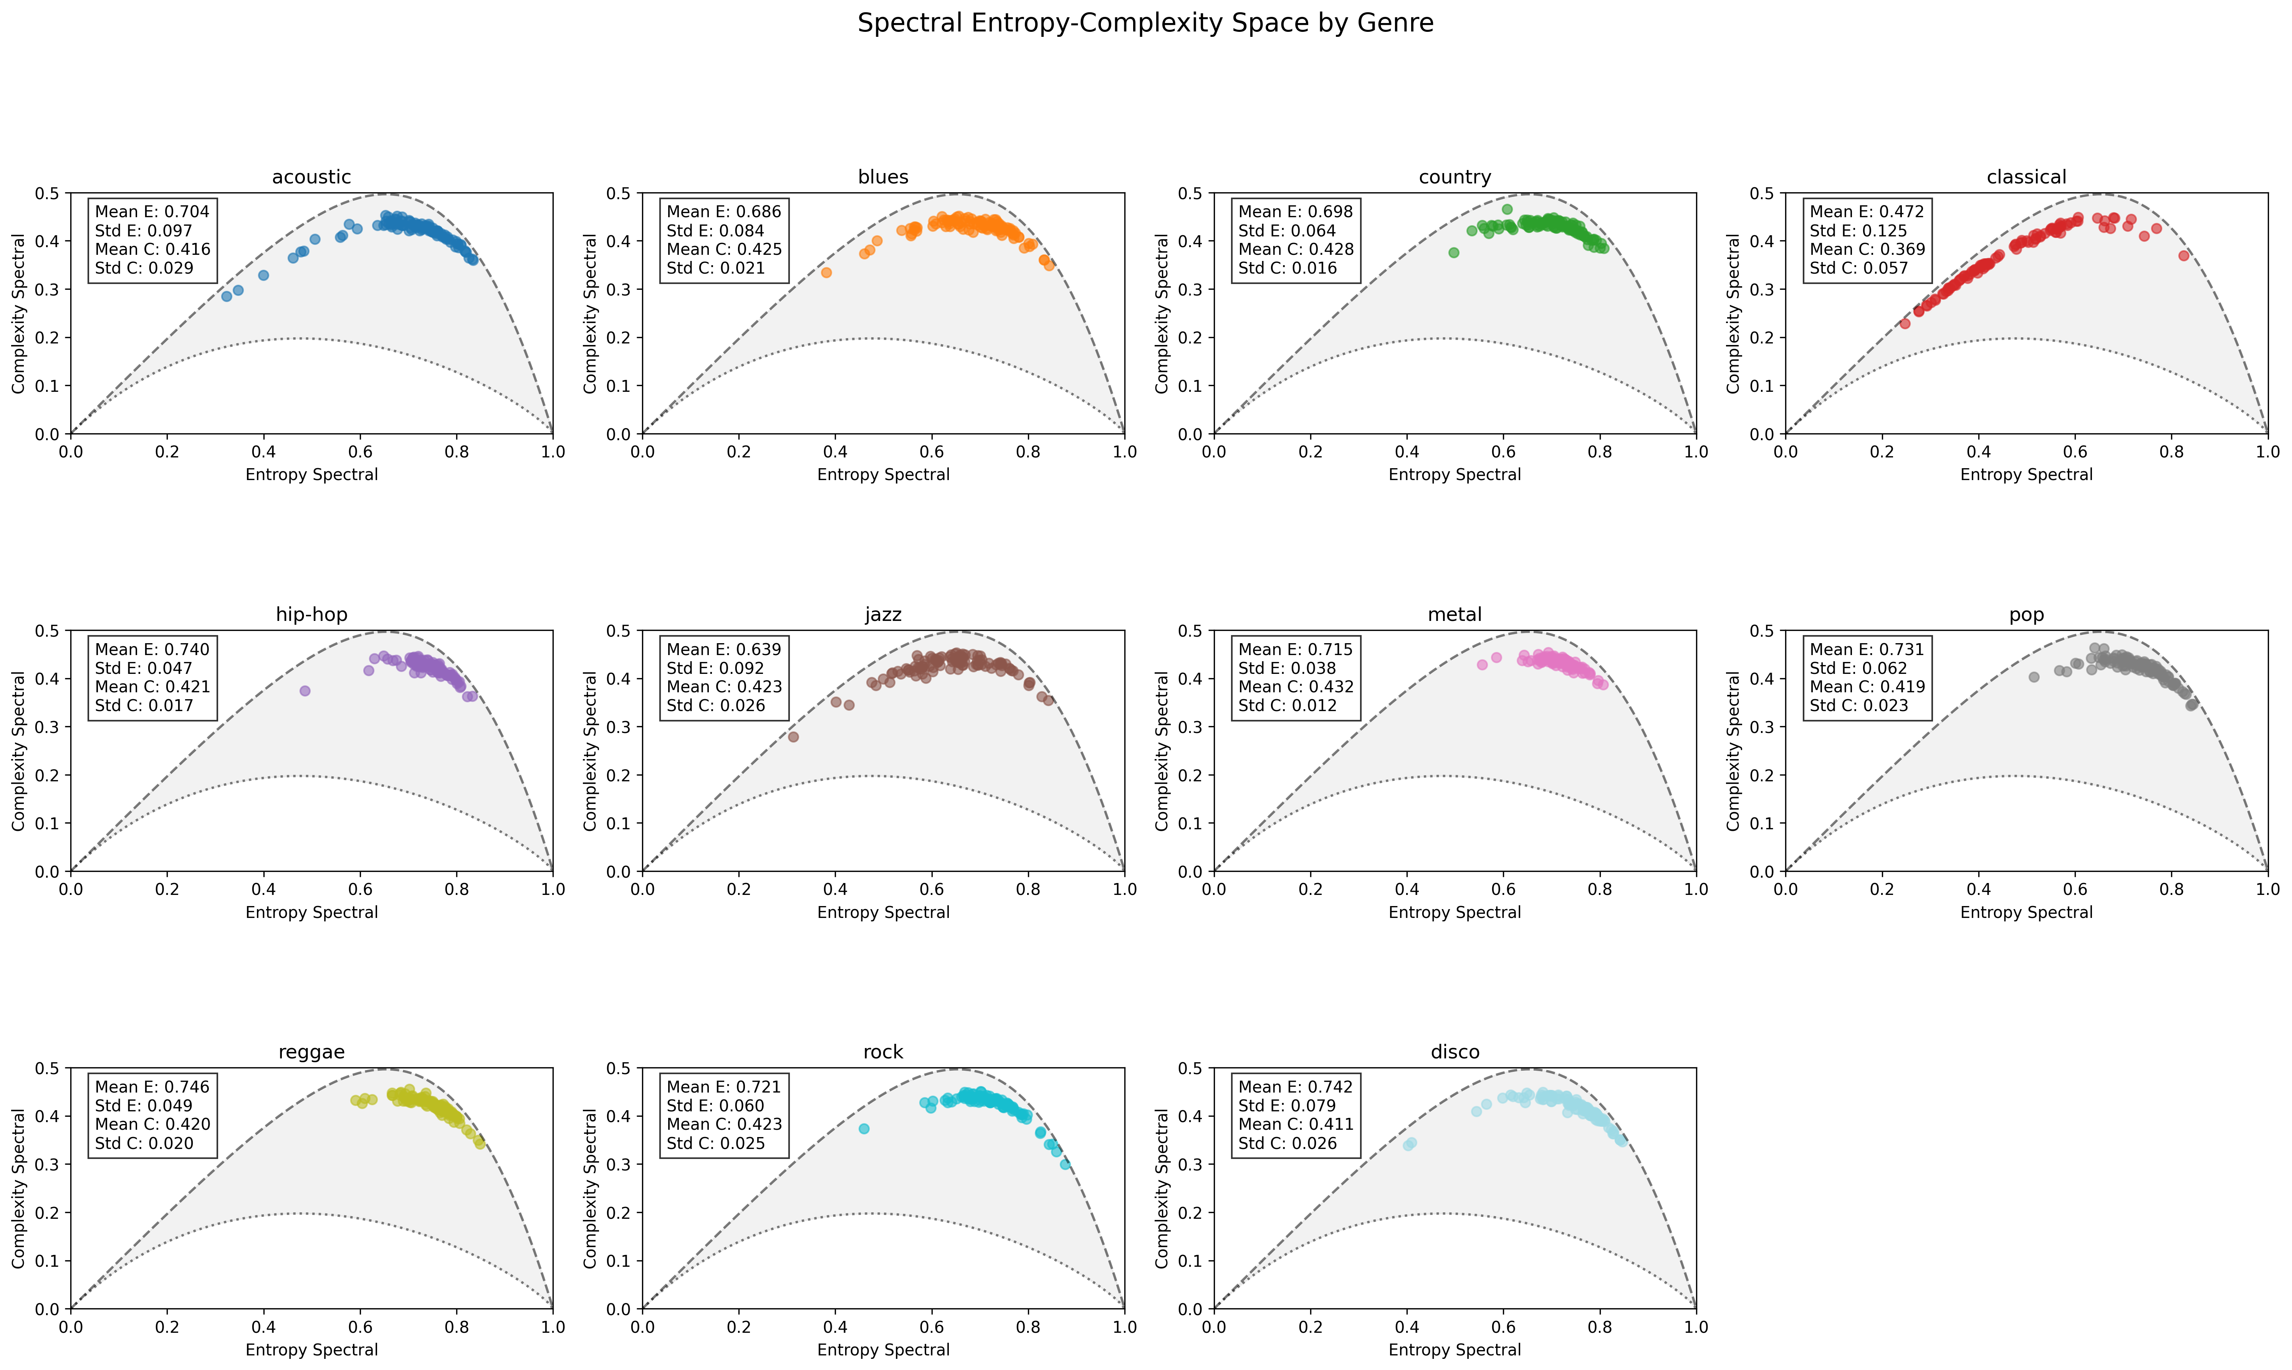
Observings Spectral Entropy Complexity Space sapc
Faculty of
Computer Science
Data Science and
Business Analytics
Chaos in Music

Slide 26
Thank you for your attention
Faculty of
Computer Science
Data Science and
Business Analytics
Chaos in Music

