Slide 1
Comparative Analysis of Process Mining and Object-Centric Process Mining Methods in the Exploration of SOA-Based Systems
Faculty of Computer Science
Data Science and Business Analytics
Moscow
Completed by:
Zhou Jinyu, group #БПАД221, 3rd year of study
DSBA, Faculty of Computer Science, HSE University
Approved by Supervisor:
Sergey A. Shershakov, Ph.D., Associate Professor Faculty of Computer Science, HSE University

Slide 2
Outline
Faculty of Computer Science
Data Science and Business Analytics
Comparative Analysis of Process Mining and Object-Centric Process Mining Methods in the Exploration of SOA-Based Systems
Introduction
Motivation and Goal
Systematic Literature Review
Methodology for transforming flat event logs to object-centric event logs
Visualization tool Overview
Comparison with Traditional Event Log Sequence Diagrams
Conclusion and Future works

Slide 3
Introduction
Faculty of Computer Science
Data Science and Business Analytics
Comparative Analysis of Process Mining and Object-Centric Process Mining Methods in the Exploration of SOA-Based Systems

Slide 4
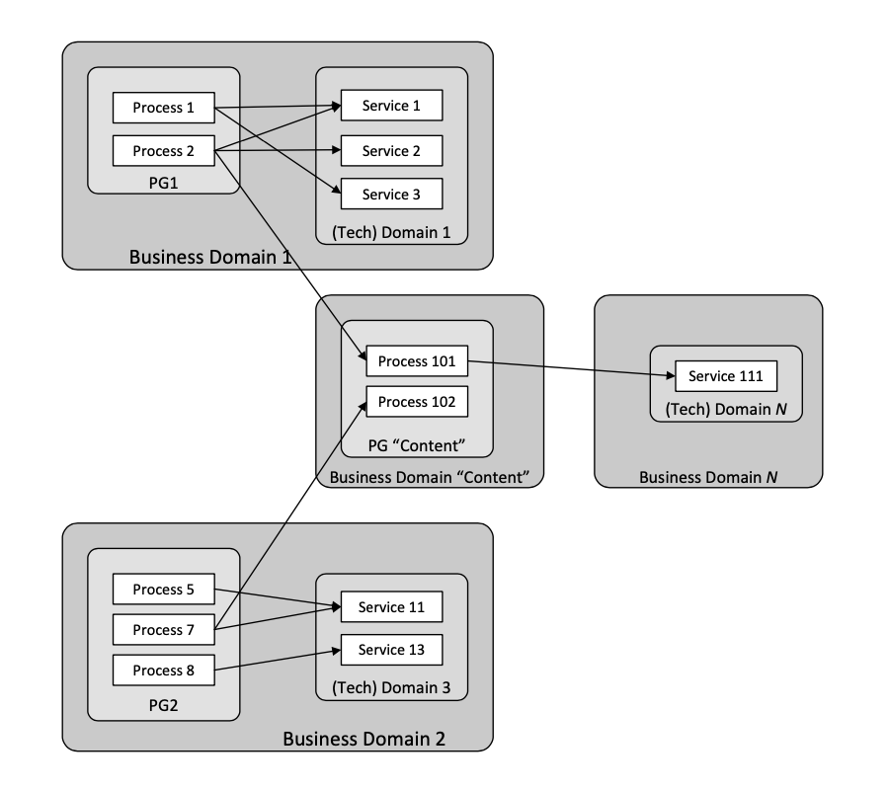
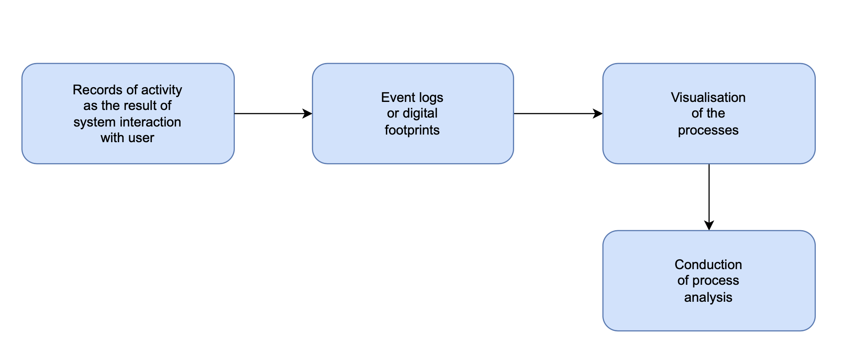
Subject Area
Faculty of Computer Science
Data Science and Business Analytics
Comparative Analysis of Process Mining and Object-Centric Process Mining Methods in the Exploration of SOA-Based Systems
Process Mining and Service-oriented architecture systems
Main Stages of Process Mining
“Domains-Processes-Services” architecture scheme.

Slide 5
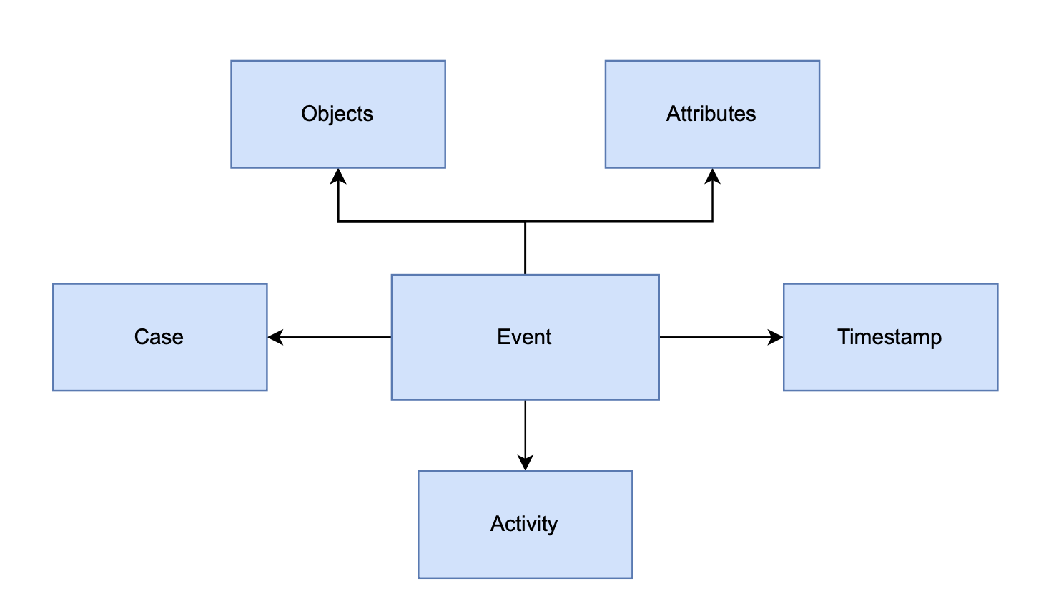
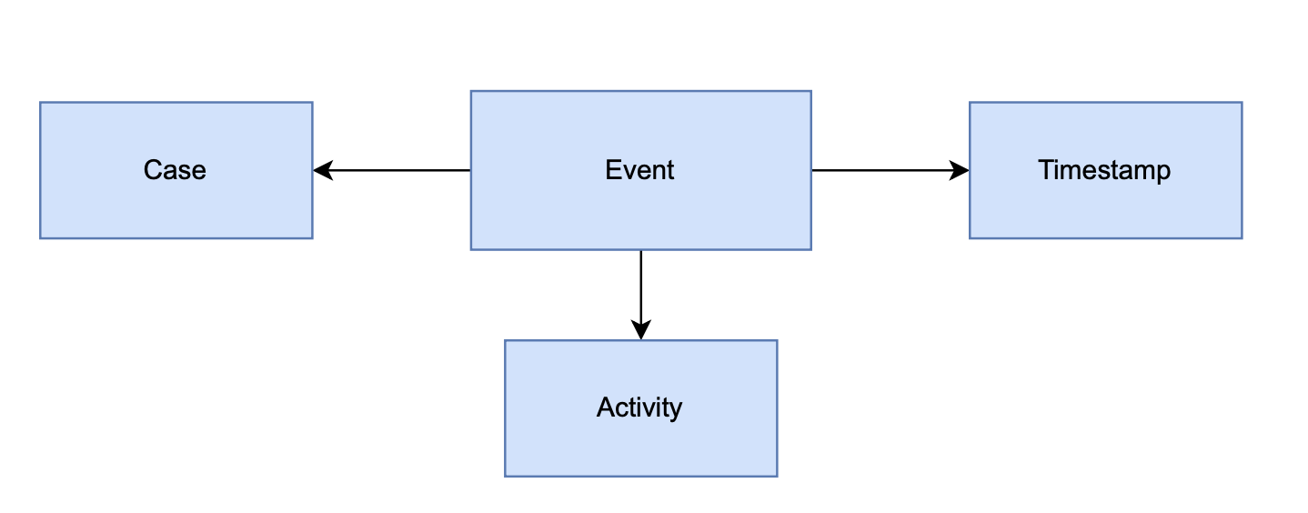
Object-centric process mining
Faculty of Computer Science
Data Science and Business Analytics
Comparative Analysis of Process Mining and Object-Centric Process Mining Methods in the Exploration of SOA-Based Systems
Object-centric event logs
VS
Traditional event logs

Slide 6
Object-centric process mining
Faculty of Computer Science
Data Science and Business Analytics
Comparative Analysis of Process Mining and Object-Centric Process Mining Methods in the Exploration of SOA-Based Systems
Object-centric event logs
VS
Traditional event logs
Object ID | Object Name/Type | Object Value
(3891, 7) | Traveller | NULL
(3891, 11) | ReservationID | NULL
(3891, 13) | Agent | NULL
… | … | …
EventID | InterfaceID | Activity | CaseID | Event Type | Timestamp | PayloadSize
3891 | 13 | getReservation | 8429104824 | RQ | 2012-02-11 11:09:03 | 512
3892 | 13 | getReservation | 8429104824 | RS | 2012-02-11 11:11:03 | 22
… | … | … | … | … | … | …

Slide 7
Motivation and Goal
Faculty of Computer Science
Data Science and Business Analytics
Comparative Analysis of Process Mining and Object-Centric Process Mining Methods in the Exploration of SOA-Based Systems

Slide 8
Motivation and Goal
Faculty of Computer Science
Data Science and Business Analytics
Comparative Analysis of Process Mining and Object-Centric Process Mining Methods in the Exploration of SOA-Based Systems
Motivation: Existing tools like BPMN and Petri Nets miss the dynamic flow and lifecycle of interacting objects, for either flat or object-centric event logs.
Goal:
Сompare the methodologies used in traditional Process Mining and multi-dimensional Object-Centric Process Mining
Novel tool for automatically generating sequence diagrams from object-centric event logs, derived from flat traditional logs.

Slide 9
Systematic Literature Review
Faculty of Computer Science
Data Science and Business Analytics
Comparative Analysis of Process Mining and Object-Centric Process Mining Methods in the Exploration of SOA-Based Systems

Slide 10
Systematic Literature Review
Faculty of Computer Science
Data Science and Business Analytics
Comparative Analysis of Process Mining and Object-Centric Process Mining Methods in the Exploration of SOA-Based Systems
Approach | Contribution | Limitation
OCPNs and OC-DFGs (van der Aalst, Berti) | Cross-object modeling, concurrency | Not intuitive for businesses
Object-centric behavioral constraint (OCBC) model (Li et al., Xiu et al.) | Interacting instances and complex data dependencies | No object lifecycle view and no tool support
Hybrid UML (Davydova, Shershakov) | Sequence diagrams from SOA event logs | Not object-centric supported
OCCGs (Park et al.) | Flexible modeling aligning to rela-world processes | Complex constraint management and poor scalability

Slide 11
Methodology for transforming flat event logs to object-centric event logs
Faculty of Computer Science
Data Science and Business Analytics
Comparative Analysis of Process Mining and Object-Centric Process Mining Methods in the Exploration of SOA-Based Systems

Slide 12
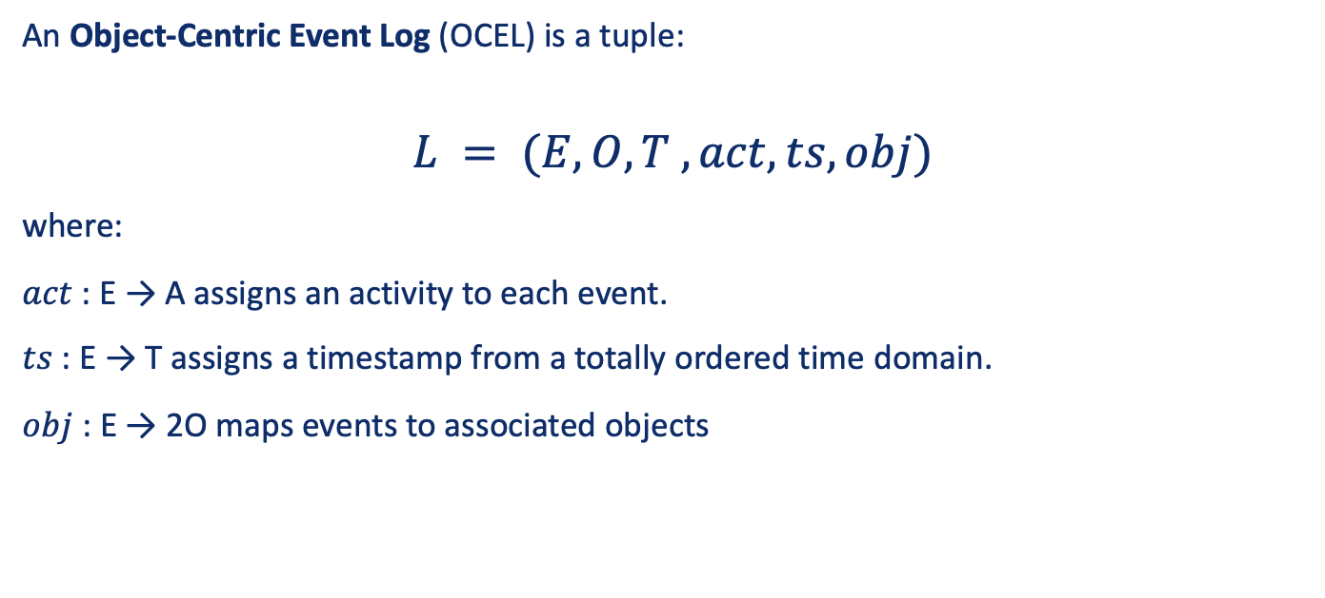
Methodology for transforming flat event logs to object-centric event logs
Faculty of Computer Science
Data Science and Business Analytics
Comparative Analysis of Process Mining and Object-Centric Process Mining Methods in the Exploration of SOA-Based Systems
An Object-Centric Event Log (OCEL) is a tuple:
$$L = (E, O, T , act, ts, obj)$$
where:
$act$ : E → A assigns an activity to each event.
$ts$ : E → T assigns a timestamp from a totally ordered time domain.
$obj$ : E → 2O maps events to associated objects
Transformation Process
Payload into attributes
Define Object Types
Identify Object Instance and lifecycles

Slide 13
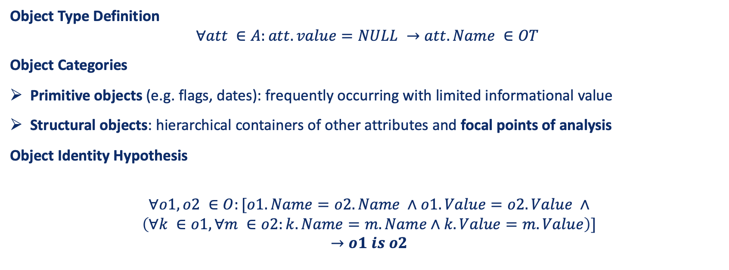
Methodology for transforming flat event logs to object-centric event logs
Faculty of Computer Science
Data Science and Business Analytics
Comparative Analysis of Process Mining and Object-Centric Process Mining Methods in the Exploration of SOA-Based Systems
Object Type Definition
$$∀att ∈A:att.value=NULL →att.Name ∈OT$$
Object Categories
Primitive objects (e.g. flags, dates): frequently occurring with limited informational value
Structural objects: hierarchical containers of other attributes and focal points of analysis
Object Identity Hypothesis
$$∀o1, o2 ∈O:[o1.Name=o2.Name ∧o1.Value=o2.Value ∧$$
$$\left(∀k ∈o1, ∀m ∈o2:k.Name=m.Name∧k.Value=m.Value\right)]$$
$$→o1 is o2$$

Slide 14
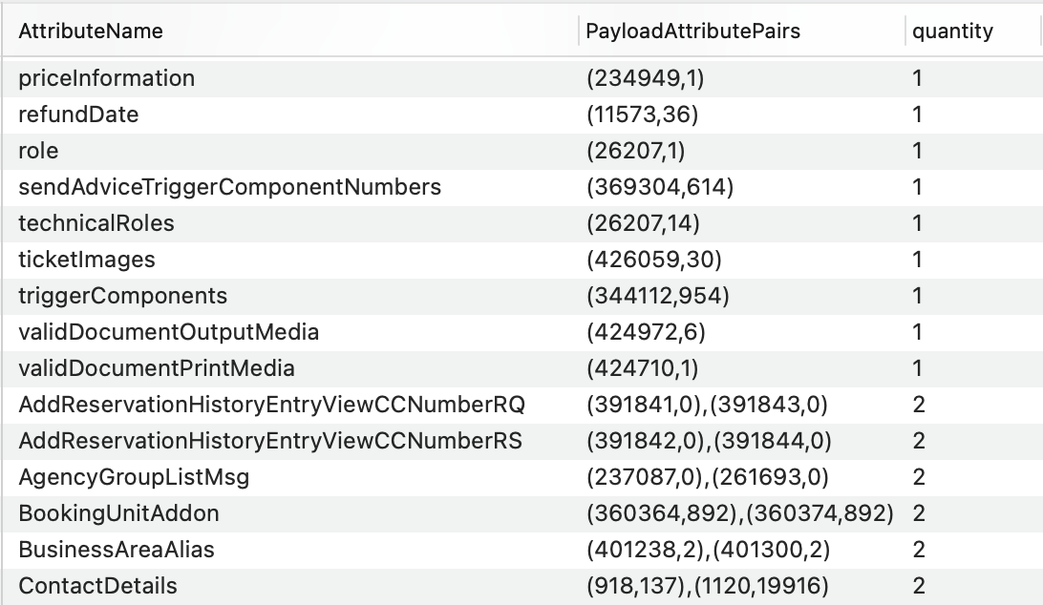
Methodology for transforming flat event logs to object-centric event logs
Faculty of Computer Science
Data Science and Business Analytics
Comparative Analysis of Process Mining and Object-Centric Process Mining Methods in the Exploration of SOA-Based Systems
Transformation Results:
1741 object types
35 870 931 object instances
462 258 events
18 392 cases
“ObjectList” Table fragment

Slide 15
Visualization Tool Overview
Faculty of Computer Science
Data Science and Business Analytics
Comparative Analysis of Process Mining and Object-Centric Process Mining Methods in the Exploration of SOA-Based Systems

Slide 16
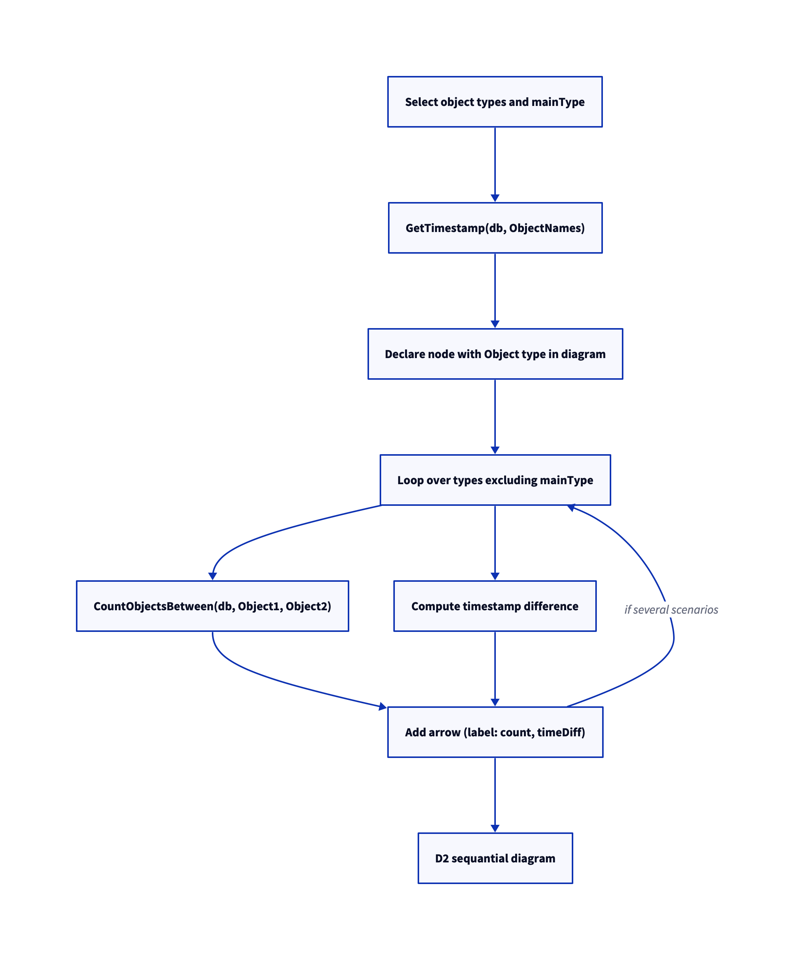
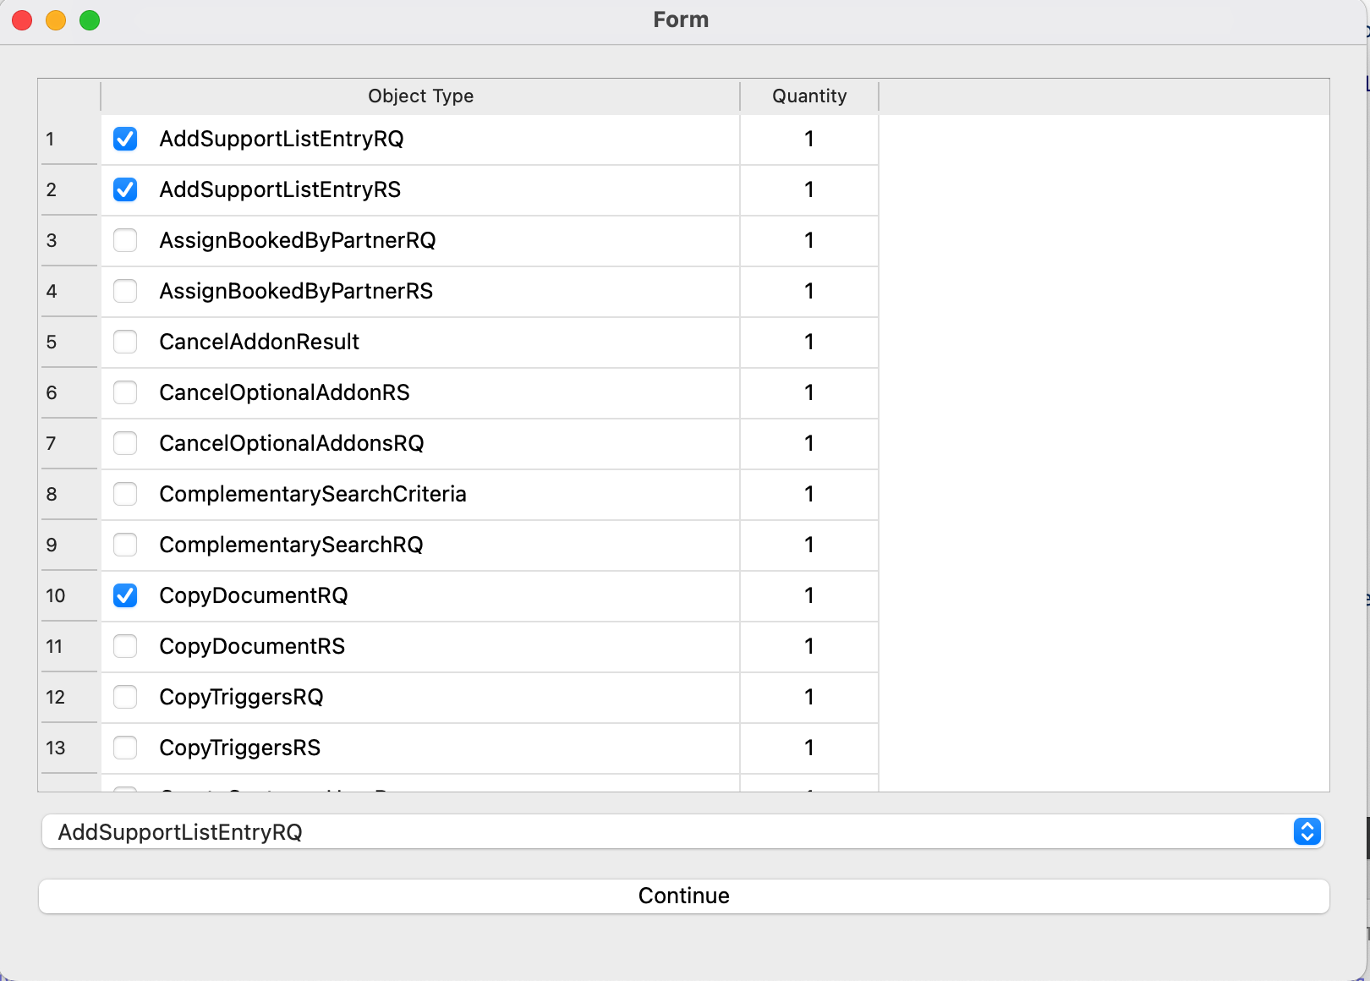
1. Type-based visualization approach
Faculty of Computer Science
Data Science and Business Analytics
Comparative Analysis of Process Mining and Object-Centric Process Mining Methods in the Exploration of SOA-Based Systems
Algorithm:
User Interface for Selecting Object Types

Slide 17
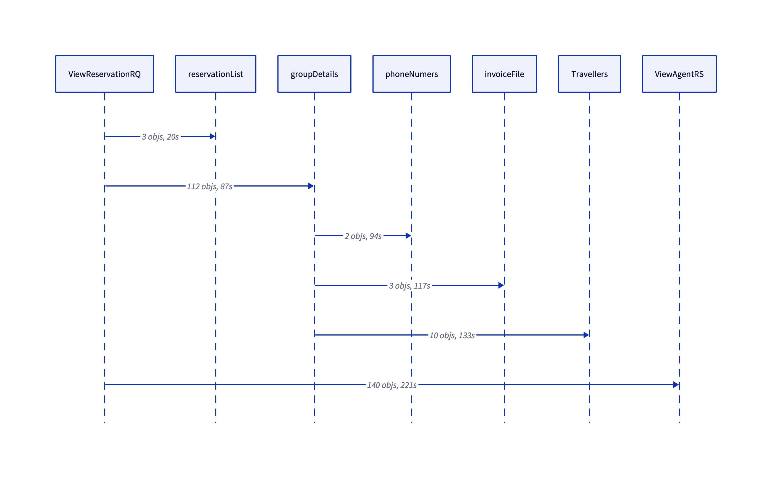

1. Type-based visualization approach
Faculty of Computer Science
Data Science and Business Analytics
Comparative Analysis of Process Mining and Object-Centric Process Mining Methods in the Exploration of SOA-Based Systems
Variant 1 for Object Types Interaction
Variant 2 for Object Types Interaction

Slide 18
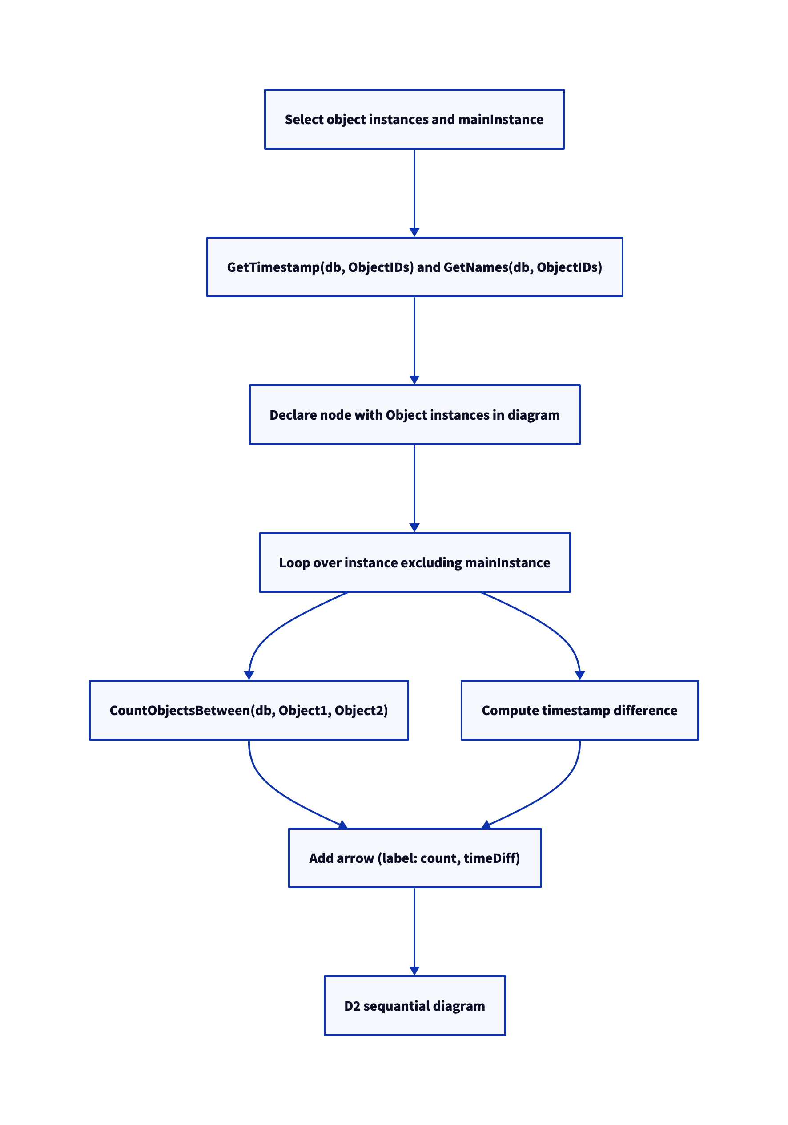
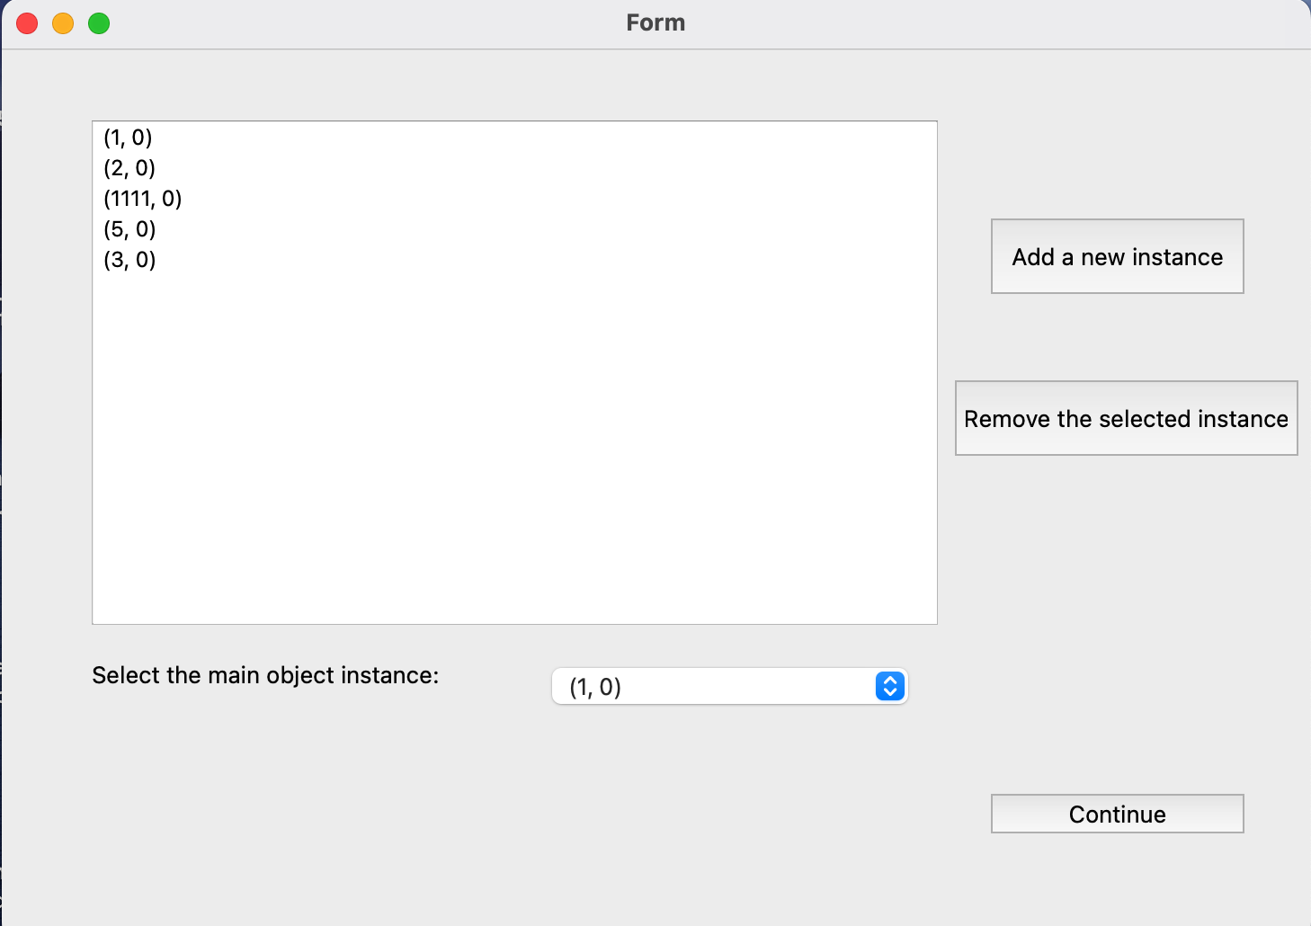
2. Instance-based visualization approach
Faculty of Computer Science
Data Science and Business Analytics
Comparative Analysis of Process Mining and Object-Centric Process Mining Methods in the Exploration of SOA-Based Systems
Algorithm:
User Interface for Selecting Object Instances

Slide 19
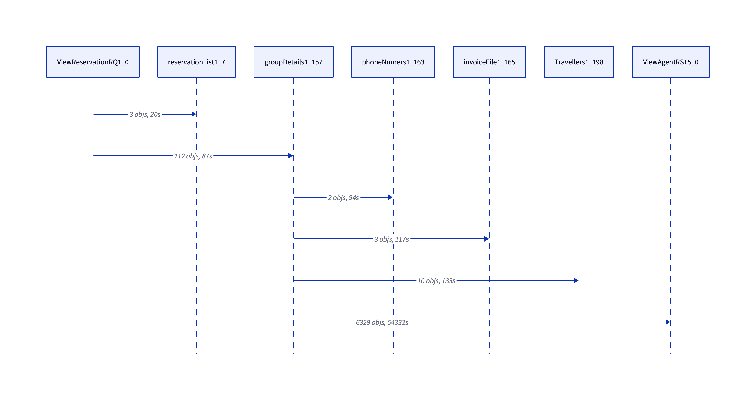
2. Instance-based visualization approach
Faculty of Computer Science
Data Science and Business Analytics
Comparative Analysis of Process Mining and Object-Centric Process Mining Methods in the Exploration of SOA-Based Systems
Sequence Diagram of Object Instance (1,0) interacting with other Object Instances

Slide 20
Comparison with Traditional Event Log Sequence Diagrams
Faculty of Computer Science
Data Science and Business Analytics
Comparative Analysis of Process Mining and Object-Centric Process Mining Methods in the Exploration of SOA-Based Systems

Slide 21
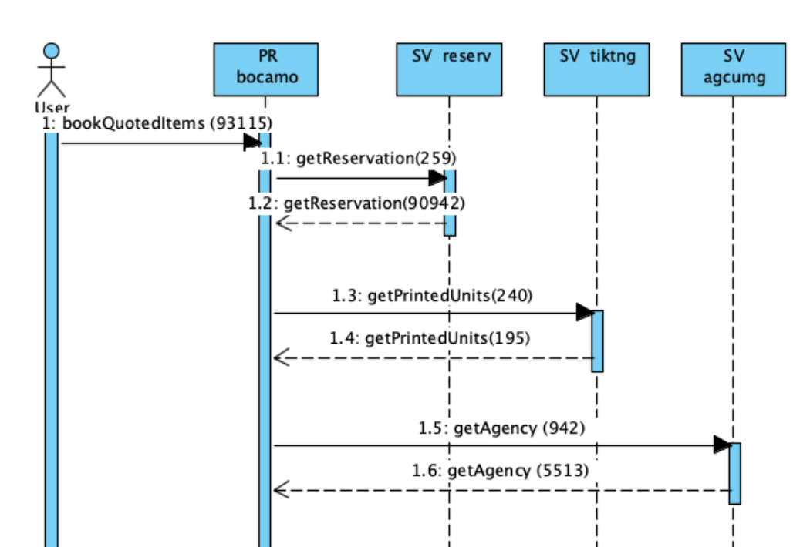
Faculty of Computer Science
Data Science and Business Analytics
Comparative Analysis of Process Mining and Object-Centric Process Mining Methods in the Exploration of SOA-Based Systems
Comparison with Traditional Event Log Sequence Diagrams
No more Single-case bounded
Obtained insights for systematic object interaction processes
Structural Interaction without duplicates
Understanding time consumption for each object reference
Partial Sequence Diagram in Traditional Approach (Event-Centric)

Slide 22
Conclusion and Future Works
Faculty of Computer Science
Data Science and Business Analytics
Comparative Analysis of Process Mining and Object-Centric Process Mining Methods in the Exploration of SOA-Based Systems

Slide 23
Results and Future
Faculty of Computer Science
Data Science and Business Analytics
Comparative Analysis of Process Mining and Object-Centric Process Mining Methods in the Exploration of SOA-Based Systems
Transformed flat event logs into object-centric event logs
Presented multi-object interaction through a visualization tool for generating sequence diagrams
Compared the traditional process mining modeling approach with object-centric one
Integrate expanded object interactions
Function of automatic detection of anomalies in inter-object connections

Slide 24
Thank You for Attention!
Faculty of Computer Science
Data Science and Business Analytics
Comparative Analysis of Process Mining and Object-Centric Process Mining Methods in the Exploration of SOA-Based Systems

