Slide 1
Chatbot for Assisting 9th-11th Grade Students in Choosing a University through Interaction with Current Students
Bachelor’s Programme “Data Science and Business Analytics”
Faculty of Computer Science
Moscow
2025
Ivanov Aleksey, Edalov Andrey, Vasiliev Egor, Pavlov Evgeny
Project Supervisor
Tarasov Oleg Vasilyevich CEO ООО "ЕГЭ Прорыв"

Slide 2
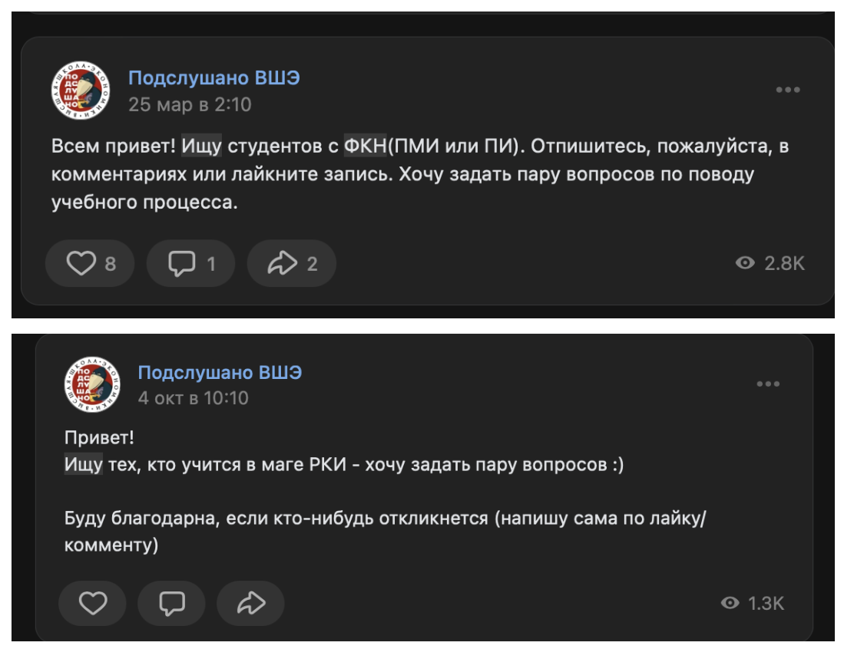
Introduction
Bachelor’s Programme “Data Science and Business Analytics”
Chatbot for Assisting 9th-11th Grade Students in Choosing a University through Interaction with Current Students
What problem does this project solve?
Applicants face difficulties when choosing a university and field.
Information on official websites is often:
Insufficient / outdated
Does not inspire confidence
Unofficial sources such as "Overheard" are popular, but they are fragmentary and subjective.
Examples of “Подслушано” community posts

Slide 3
Competitors & Concept
Bachelor’s Programme “Data Science and Business Analytics”
Chatbot for Assisting 9th-11th Grade Students in Choosing a University through Interaction with Current Students
The idea of the project is similar to the idea of another Random Coffee chatbot, which was a reference. But Random Coffee is absolutely different conceptually, since it is used among colleagues in huge companies for team building.
The goal of this project was to develop a chatbot for Telegram, with the help of which schoolchildren could find a student by the course or university they want to enroll in.

Slide 4
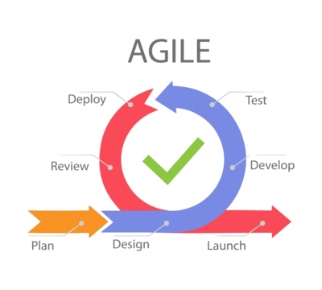
Distribution of tasks in the team
Bachelor’s Programme “Data Science and Business Analytics”
Chatbot for Assisting 9th-11th Grade Students in Choosing a University through Interaction with Current Students
We organized work in short sprints to deliver functional parts of the chatbot regularly.
Tasks were distributed dynamically based on progress and feedback.
After each sprint, we tested new features with users and made adjustments.
This approach allowed us to:
Quickly identify problems
Improve matching logic and notifications
Keep users engaged during development

Slide 5



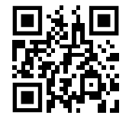






Stack & bot link
Bachelor’s Programme “Data Science and Business Analytics”
Chatbot for Assisting 9th-11th Grade Students in Choosing a University through Interaction with Current Students

Slide 6
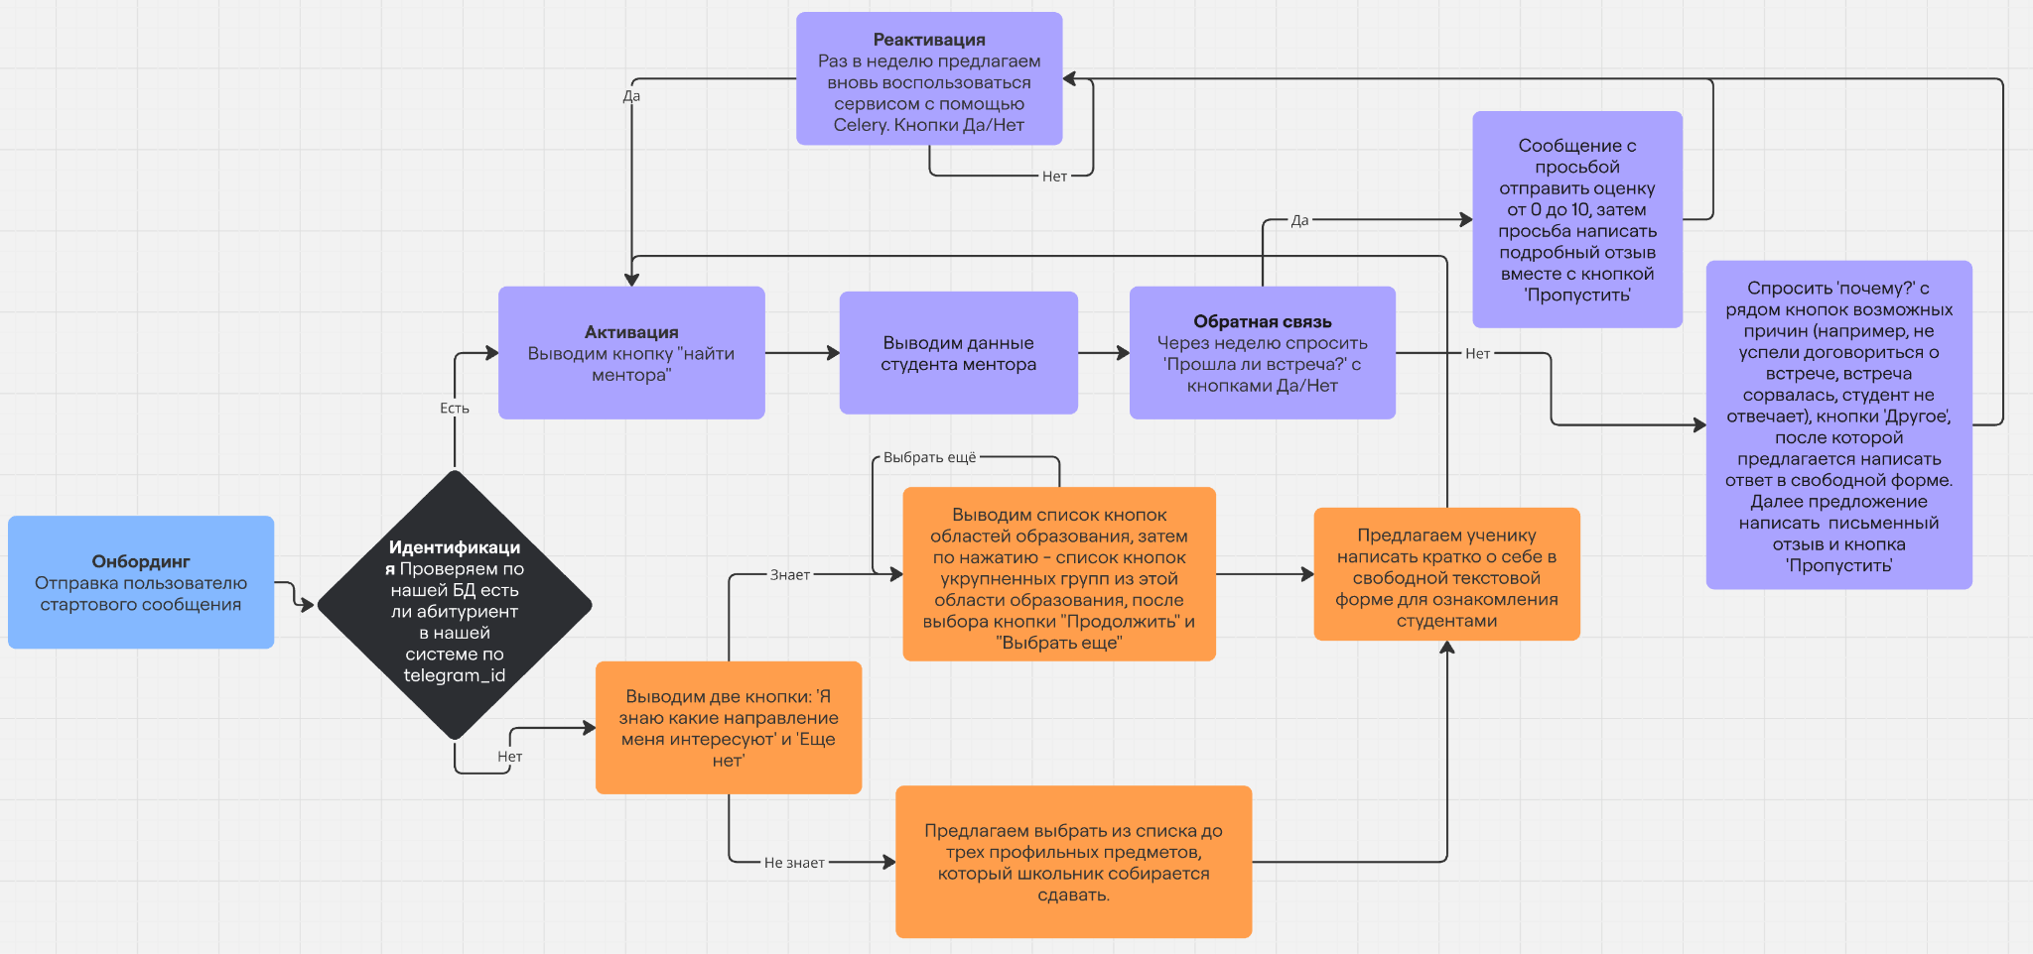
Chatbot interaction logic
Bachelor’s Programme “Data Science and Business Analytics”
Chatbot for Assisting 9th-11th Grade Students in Choosing a University through Interaction with Current Students
We focused on designing a step-by-step flow to ensure seamless and intuitive experience for all users.
Key features of our bot include:
Onboarding
Identification
Registration
Activation
Feedback
Reactivation
Registration branches into either a choice of preferred specializations or state exams.

Slide 7
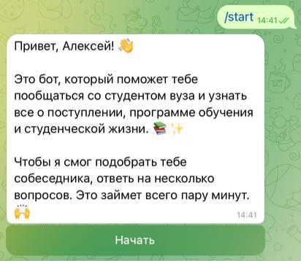
Base implementation
Bachelor’s Programme “Data Science and Business Analytics”
Chatbot for Assisting 9th-11th Grade Students in Choosing a University through Interaction with Current Students
The bot’s core functionality was built using the python-telegram-bot library for asynchronous Telegram API interactions and SQLAlchemy for storing and managing collected data. Key aspects include:
Conversational design guiding users step-by-step
Inline keyboards replacing manual input
Error handling to recover from invalid inputs
Commands to restart interaction or get help

Slide 8
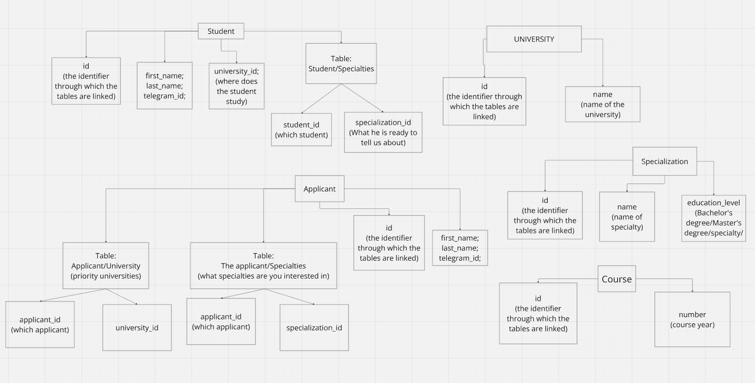
Beta Version
Database design
Bachelor’s Programme “Data Science and Business Analytics”
Chatbot for Assisting 9th-11th Grade Students in Choosing a University through Interaction with Current Students
At first, the database was designed to have 5 tables:
Applicant
Student
University
Specialization
Course
with some subtables for convenience:
In “Applicant” table:
Subtable “ApplicantUniversity” - to set a prioritized university(-ies) for the applicant
Subtable “ApplicantSpecialties” - to understand applicant's priority subjects for study
In “Student” table:
Subtable “StudentSpecialties” - to identify specialties that the student will be able to tell the applicant about
Initial database structure

Slide 9
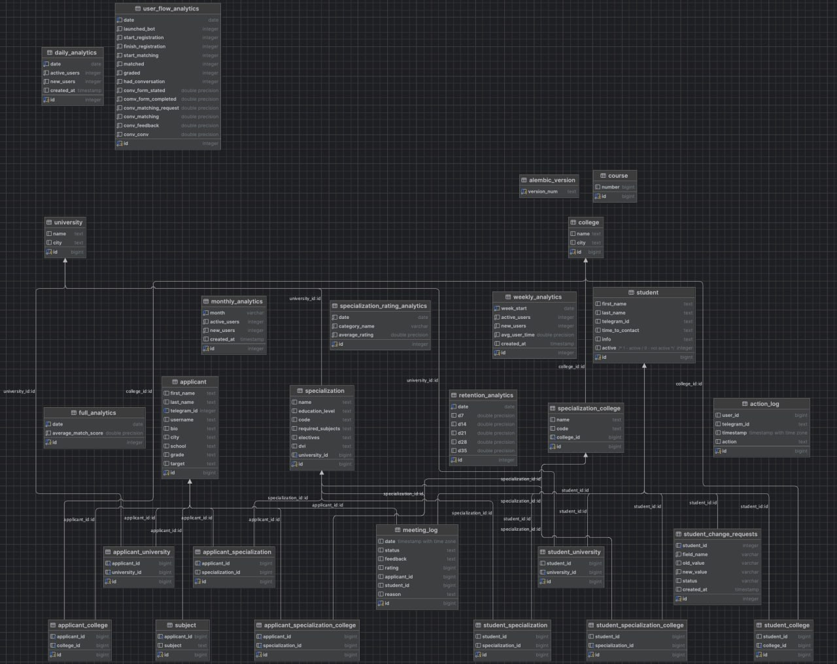
Database structure
Bachelor’s Programme “Data Science and Business Analytics”
Chatbot for Assisting 9th-11th Grade Students in Choosing a University through Interaction with Current Students

Slide 10
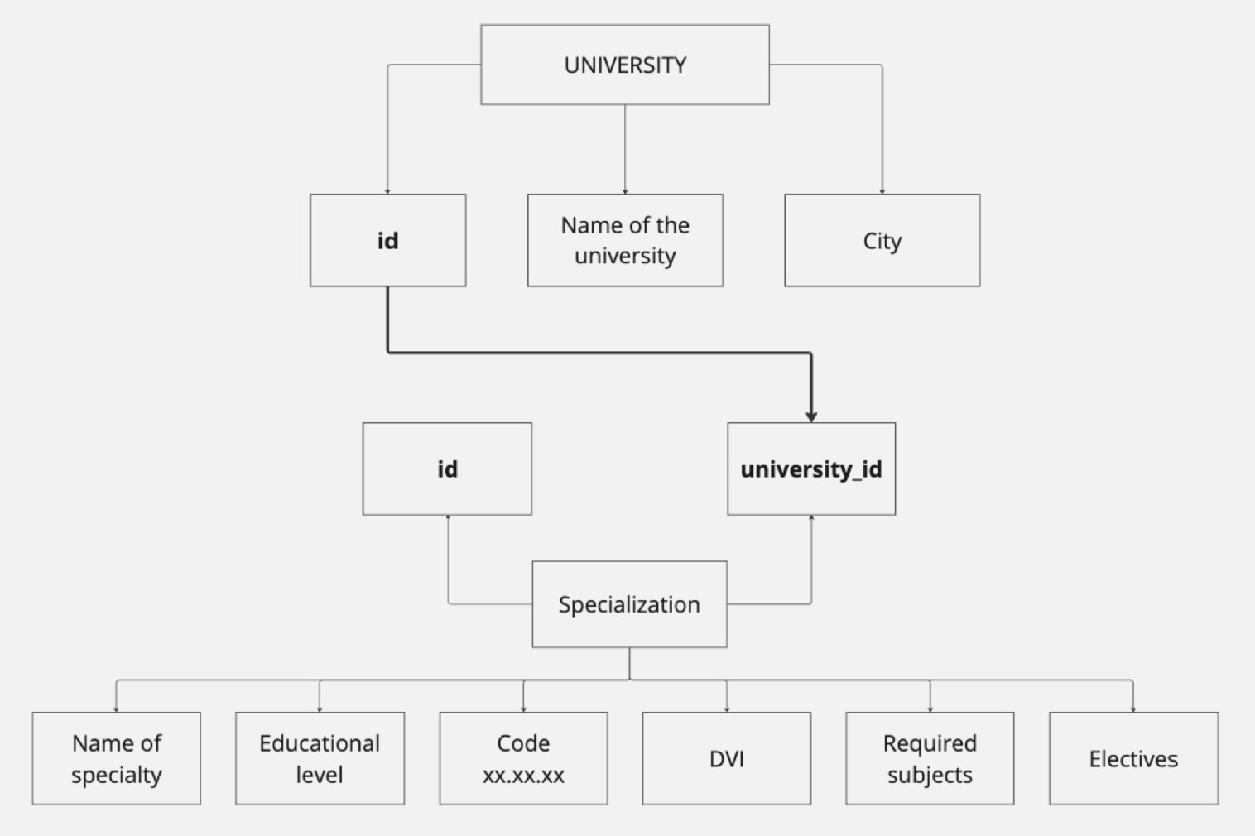
University Data Parsing & Database Integration
Bachelor’s Programme “Data Science and Business Analytics”
Chatbot for Assisting 9th-11th Grade Students in Choosing a University through Interaction with Current Students
Goal:
Extract and structure academic data (specializations, exams, faculties) from Vuzopedia for clustering and matching purposes.
Technologies:
Selenium for dynamic JavaScript content loading
Data saved in CSV: 14,000+ faculties, 11 key fields
Extracted Fields:
City, University, Specialisation, Faculty, Level of education Program ID, Program Link
Faculty code (XX.XX.XX)
Compulsory / Elective EGE subjects, Entrance exams
Database structure for storing data on universities

Slide 11
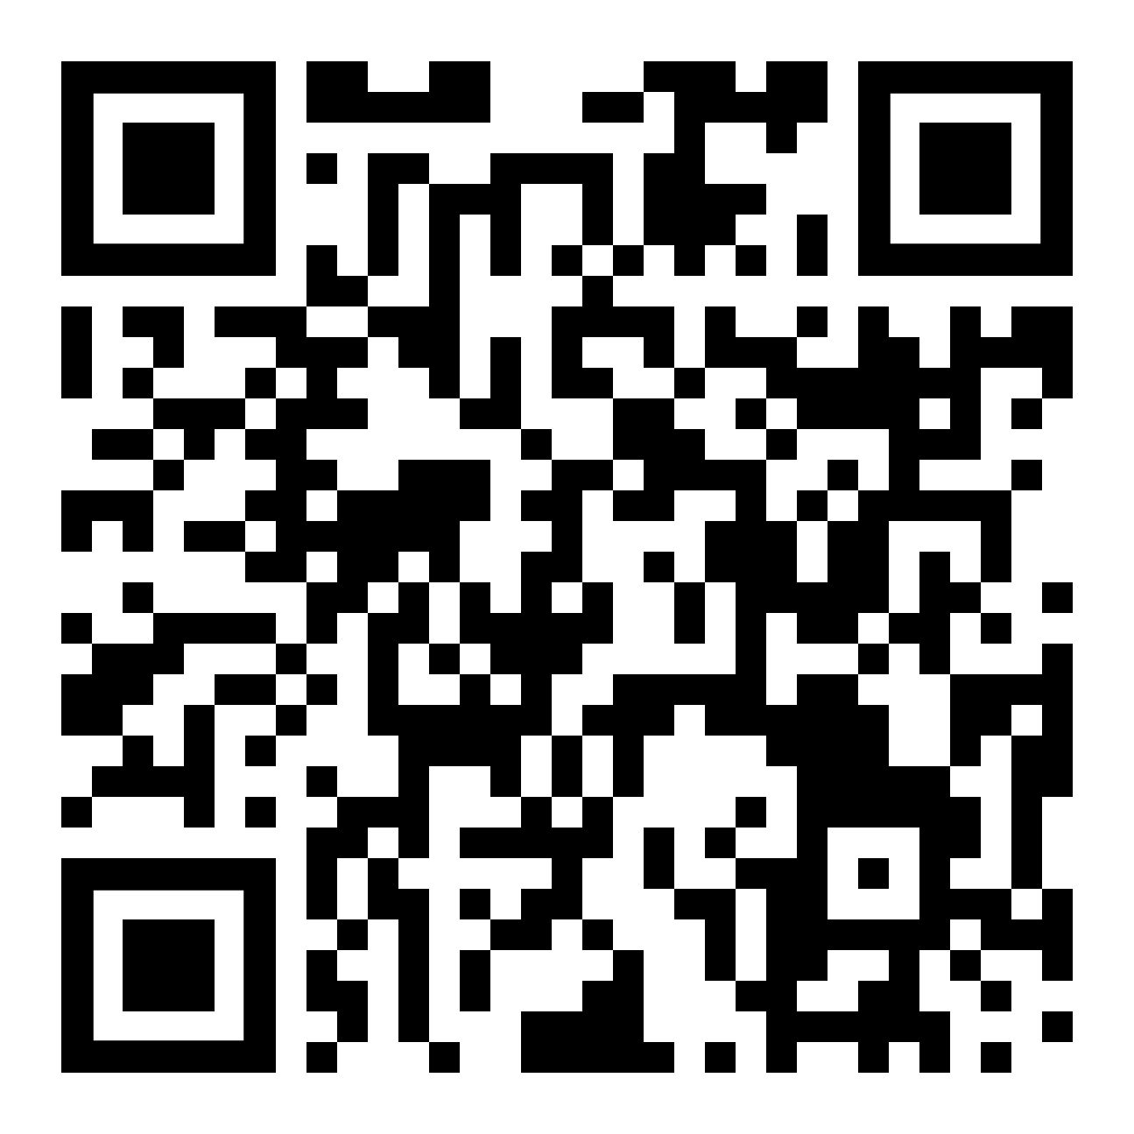
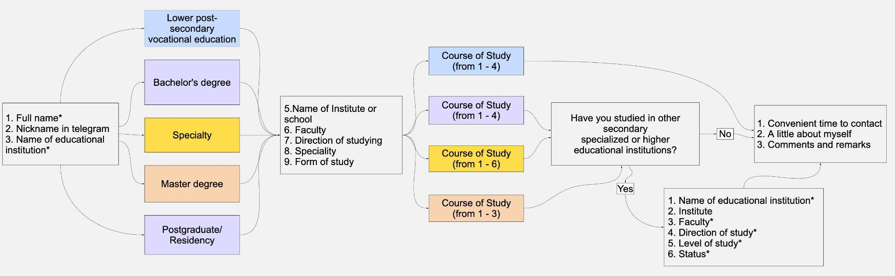
Student Registration Form & Data Model
Bachelor’s Programme “Data Science and Business Analytics”
Chatbot for Assisting 9th-11th Grade Students in Choosing a University through Interaction with Current Students
Goal:
Collect accurate, rich profiles of real students to support applicant interaction.
Form Contents
Full name, Telegram handle
University, Faculty, Program, Study level
Option to add two degrees for better matching
Database Design
Many-to-many tables for:
Students ↔ Universities
Students ↔ Specialisations
Student registration process block diagram

Slide 12

Student Matching Based on Specialization Groups
Bachelor’s Programme “Data Science and Business Analytics”
Chatbot for Assisting 9th-11th Grade Students in Choosing a University through Interaction with Current Students
Goal:
To connect each applicant with a suitable student mentor who studies in a related specialization within the same academic group.
How it works:
When an applicant selects their desired specialization group (e.g. Engineering, IT, Social Sciences), the algorithm searches for students whose university programs belong to the same group. Among the candidates, one suitable student is selected and assigned for further communication.

Slide 13
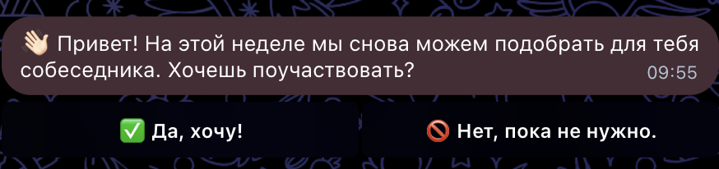
Weekly Notifications via Celery
Bachelor’s Programme “Data Science and Business Analytics”
Chatbot for Assisting 9th-11th Grade Students in Choosing a University through Interaction with Current Students
Goal:
To keep applicants engaged and informed by sending regular reminders about the possibility of receiving a new student match.
How it works:
Every week, all registered applicants receive a notification inviting them to search for a new potential student mentor.This helps the bot stay relevant, prevents users from forgetting about it, and enhances the overall user experience.
Technologies:
Celery
Redis
Example of weekly notification

Slide 14
Meeting Log System
Bachelor’s Programme “Data Science and Business Analytics”
Chatbot for Assisting 9th-11th Grade Students in Choosing a University through Interaction with Current Students
Goal:
Avoid repeating matches and record interaction history between applicants and students.
SQLAlchemy Model
id, date, status, feedback, reason, rating, telegram_id, applicant_id, student_id
Benefits:
Prevents duplicate matches
Tracks participation & engagement
Enables feedback-based improvement of the recommendation system

Slide 15
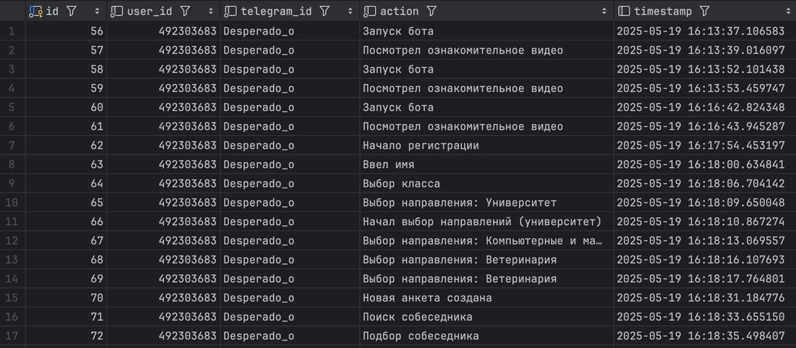
MVP 1
Logging of all other important actions
Bachelor’s Programme “Data Science and Business Analytics”
Chatbot for Assisting 9th-11th Grade Students in Choosing a University through Interaction with Current Students
Goal:
To track and log all key user actions in our chatbot for further usage (e.g. analytics).
SQLAlchemy Model:
id, user_id, telegram_id, action, timestamp
Logging functions:
log_action() - recording of “raw” events
log_user_action() - extended log with context (for example: log_user_action (telegram_id, username, "Новая анкета создана"))
Integration into logic:
Used in key methods:
Profile creation (creation/editing)
Matching attempts
and other actions.
Example of user’s actions in the table

Slide 16
Collecting feedback from users
Bachelor’s Programme “Data Science and Business Analytics”
Chatbot for Assisting 9th-11th Grade Students in Choosing a University through Interaction with Current Students
Goal:
Receive data on user experience after each meeting; Collect both structured (rating) and textual (comments) feedback
Process:
First, the user confirms whether the communication took place
Then either rates the student on a scale 0-10 or gives us a reason for cancelation
Further usage:
We can calculate average scores from multiple interactions to identify the best students
Analytics - Tracks success rates across specializations

Slide 17
Subject-Based Student Matching
Bachelor’s Programme “Data Science and Business Analytics”
Chatbot for Assisting 9th-11th Grade Students in Choosing a University through Interaction with Current Students
Goal:
To improve match precision and relevance by taking into account the applicant’s selected USE (Unified State Exam) subjects and filtering out inactive or already matched users.
How it works:
During registration, applicants indicate the USE subjects they plan to take. Based on this information, the system identifies suitable specializations and finds students who were admitted through similar subject combinations.
Filter by Meeting Log:
An additional filter was implemented based on the meeting log to prevent repeated matches.

Slide 18
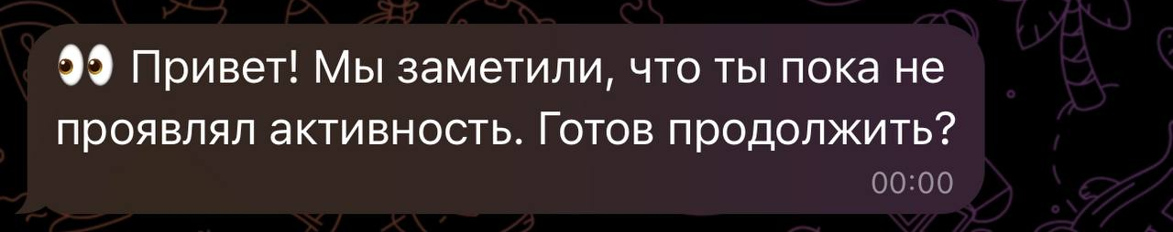
Re-Engaging Inactive Users & Collecting Feedback
Bachelor’s Programme “Data Science and Business Analytics”
Chatbot for Assisting 9th-11th Grade Students in Choosing a University through Interaction with Current Students
What’s New:
Notifications for inactive users:
Users who haven’t interacted with the bot for a while now receive personalized reminders encouraging them to come back and get matched again.
Weekly feedback requests:
Feedback collection has been moved to Celery and now runs automatically once a week. This allows us to gather regular insights without manual effort.
Example of a reminder sent to inactive user

Slide 19


Migration to PostgreSQL
Bachelor’s Programme “Data Science and Business Analytics”
Chatbot for Assisting 9th-11th Grade Students in Choosing a University through Interaction with Current Students
Why We Moved from SQLite
Limited parallelism → No concurrent write access
Poor scalability → Suitable only for 1–2 users
No server architecture → Can’t run as a standalone DB server
Weak access control → Anyone can access all tables
Why PostgreSQL
Used by Instagram, Reddit, Notion → Proven reliability
Full support for:
Concurrent access
Server deployment
Advanced permissions & indexing

Slide 20
Database Migrations with Alembic
Bachelor’s Programme “Data Science and Business Analytics”
Chatbot for Assisting 9th-11th Grade Students in Choosing a University through Interaction with Current Students
Purpose:
After migrating to PostgreSQL, we implemented Alembic to manage database structure changes safely and versioned.
Team Collaboration
Migration files are stored in Git
Guarantees consistent schema across developers
Prevents manual editing & merge conflicts
Alembic ensured stable evolution of our PostgreSQL schema throughout development.

Slide 21
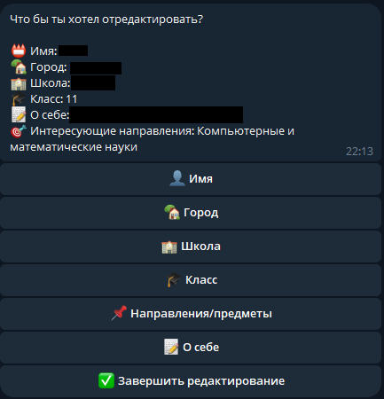
Applicant’s profile editing & deletion
Bachelor’s Programme “Data Science and Business Analytics”
Chatbot for Assisting 9th-11th Grade Students in Choosing a University through Interaction with Current Students
To improve flexibility of the platform, we implemented functionality for applicants to edit or fully delete their profiles. This helps users keep their data relevant or leave the platform if desired.
Editing enables applicants to update information due to reasons such as:
Correcting mistakes
Change of study direction
Outdated information
Rewriting “About me” section
Profile deletion can also be utilized to register from scratch.

Slide 22
Adding a University/College Choice for Schoolchildren
Bachelor’s Programme “Data Science and Business Analytics”
Chatbot for Assisting 9th-11th Grade Students in Choosing a University through Interaction with Current Students
Motivation
Real testing showed: 9th grade students need help deciding between college vs university
Goal: Expand bot’s flexibility and support multiple educational paths
Implementation Steps
Parsing College Data
Database Integration
Updated Bot Logic
Outcomes
More freedom and control for users
Broader audience: supports students after 9th grade
Easier future development for diverse educational paths

Slide 23
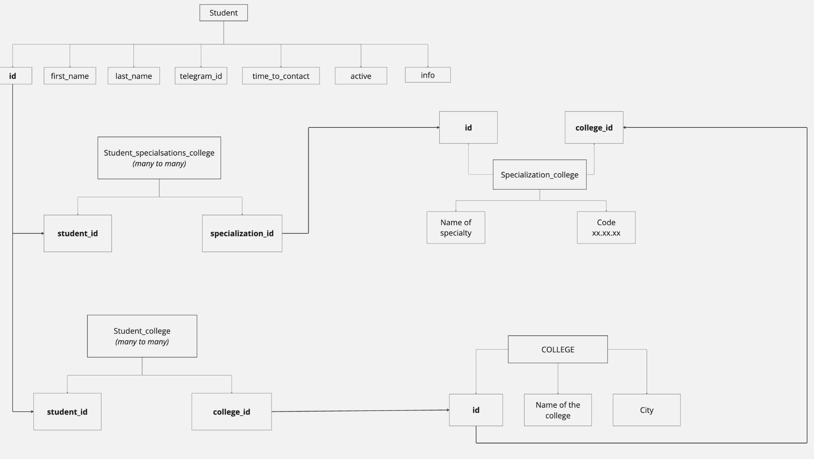
Bachelor’s Programme “Data Science and Business Analytics”
Chatbot for Assisting 9th-11th Grade Students in Choosing a University through Interaction with Current Students
Database structure for storing data on student college info

Slide 24
Matching for College Applicants
Bachelor’s Programme “Data Science and Business Analytics”
Chatbot for Assisting 9th-11th Grade Students in Choosing a University through Interaction with Current Students
Goal:
To expand the reach of the bot by enabling specialization-based matching for applicants interested in colleges, not just universities.
How it works:
The matching logic for colleges is identical to the one used for universities:
Each applicant selects a specialization group.
The algorithm finds a suitable student from that group
Matching is performed only within the same education level (college-to-college).

Slide 25
Product Analytics: Overview
Bachelor’s Programme “Data Science and Business Analytics”
Chatbot for Assisting 9th-11th Grade Students in Choosing a University through Interaction with Current Students
Goal:
Understand user behavior, identify weak points, and improve the bot based on real interaction data.
Key Components:
User Activity Metrics
User Funnel Analysis
Feedback & Matching Quality
Automated Analytics Collection
Data sources: ActionLog, MeetingLog tables

Slide 26
Dashboard for Product Analytics
Bachelor’s Programme “Data Science and Business Analytics”
Chatbot for Assisting 9th-11th Grade Students in Choosing a University through Interaction with Current Students
Goal:
To visually track key metrics and gain actionable insights into user behavior and matching quality.
Built With:
Streamlit – simple Python-based web framework for interactive dashboards
Structure of the Dashboard:
Key Metrics (KPI cards)
User Journey (Sankey Diagram)
Feedback & Matching Stats

Slide 27
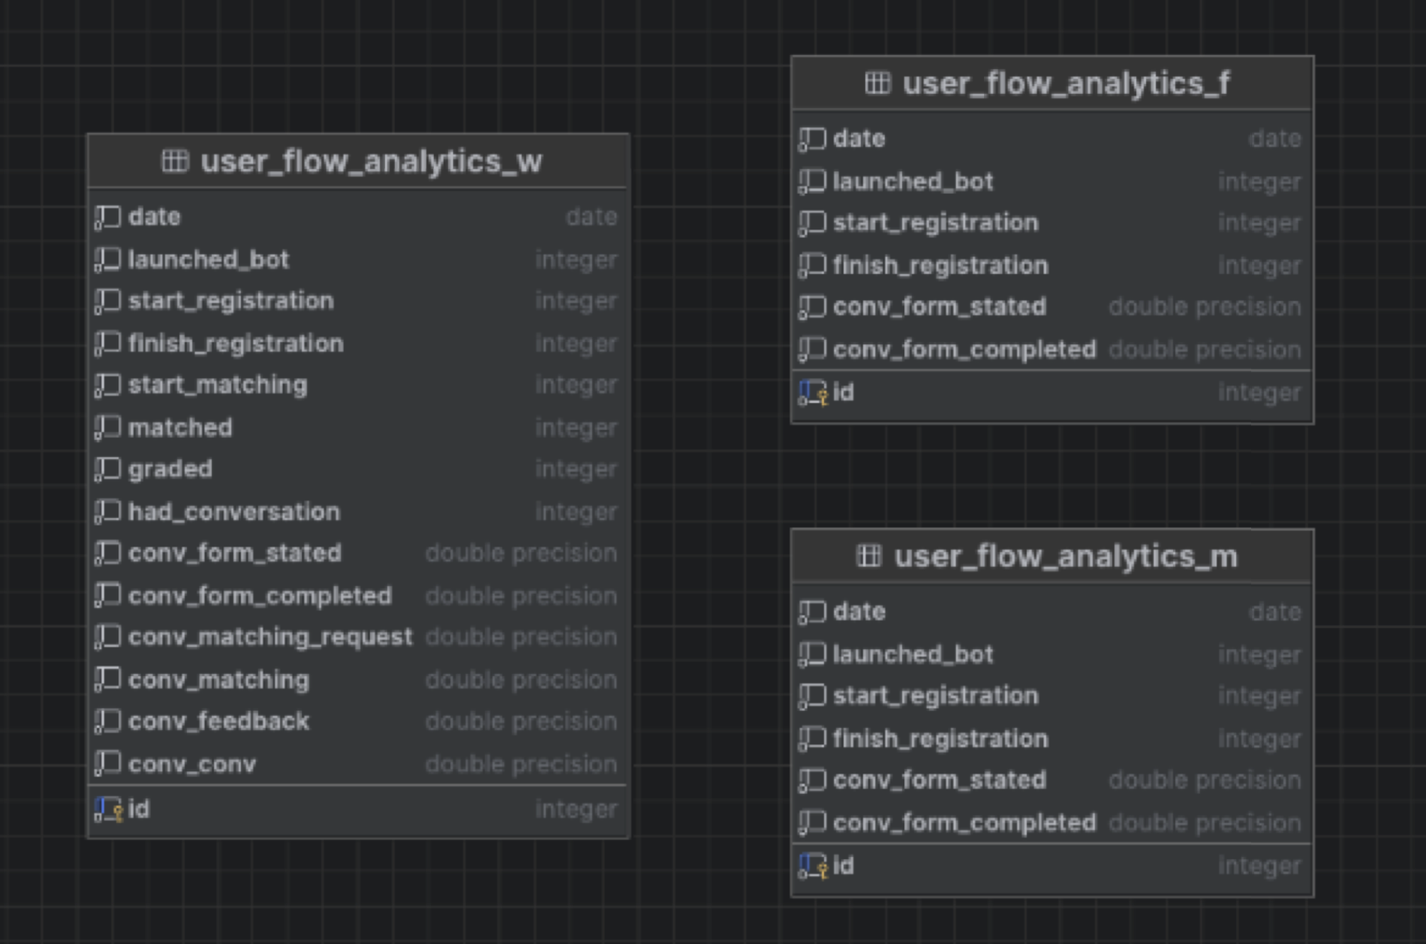
User Activity Metrics
Bachelor’s Programme “Data Science and Business Analytics”
Chatbot for Assisting 9th-11th Grade Students in Choosing a University through Interaction with Current Students
Key Indicators:
DAU, WAU, MAU — unique active users
New users per day/week/month
Retention — % of returning users
Avg. user lifetime (first to last action)
Avg. matches per user
Avg. delay between rejoining after refusal
Data stored in: DailyAnalytics, WeeklyAnalytics, MonthlyAnalytics
Structure of tables for user activity part of analytics

Slide 28
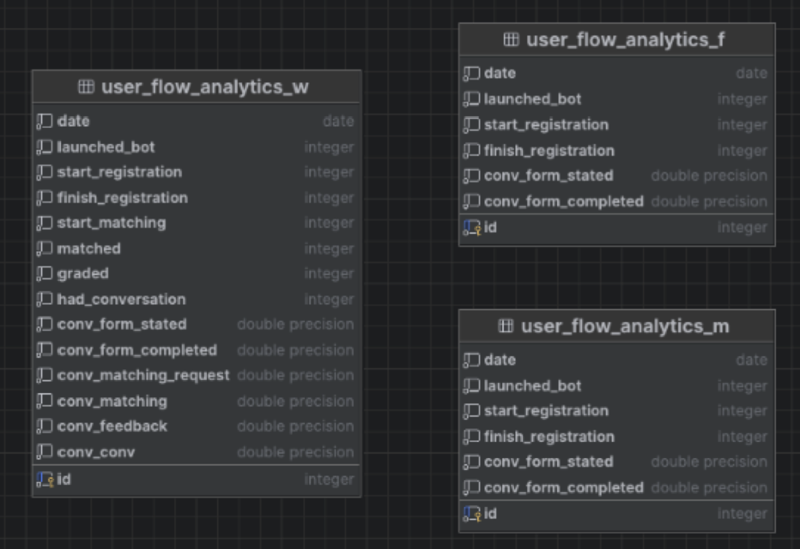
User Funnel Analysis
Bachelor’s Programme “Data Science and Business Analytics”
Chatbot for Assisting 9th-11th Grade Students in Choosing a University through Interaction with Current Students
Stages Tracked:
Bot launched
Registration started
Profile completed
Match requested
Match confirmed
Feedback left
Communication took place
Tracked as:
Absolute counts
Stage-to-stage conversion rates
Structure of tables for user flow analytics

Slide 29
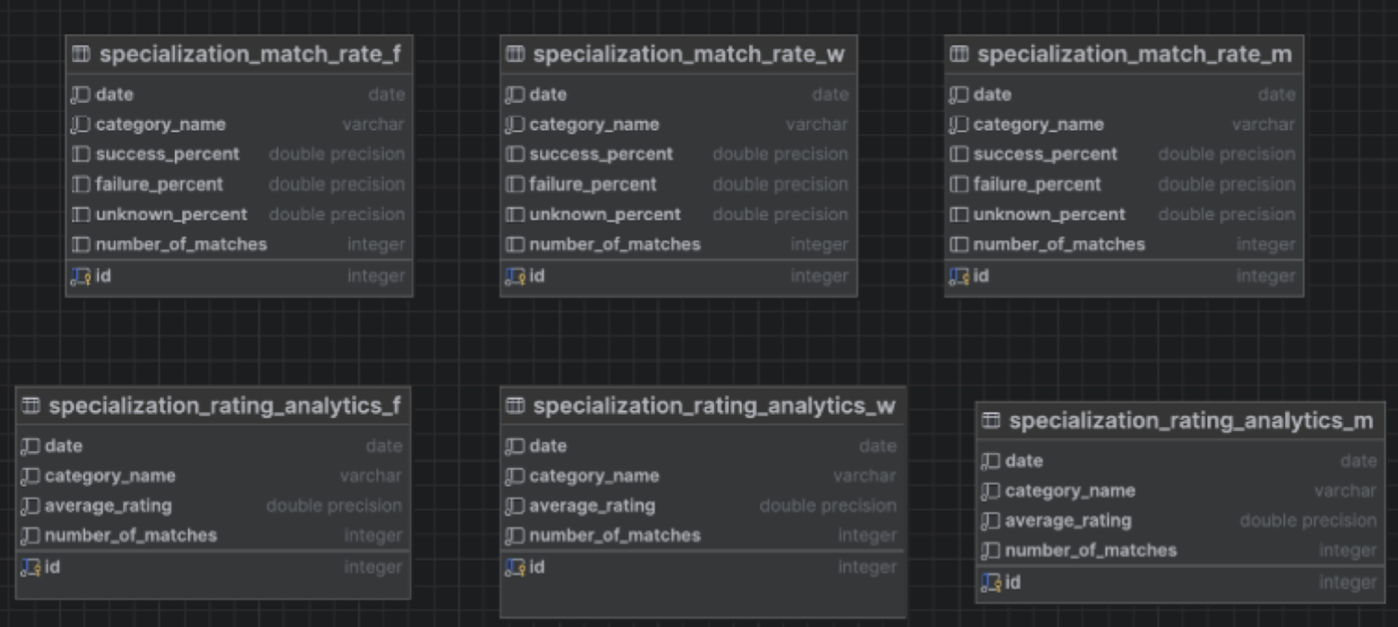
Feedback & Matching Quality
Bachelor’s Programme “Data Science and Business Analytics”
Chatbot for Assisting 9th-11th Grade Students in Choosing a University through Interaction with Current Students
Metrics:
Average match score (by specialization group)
Match status analysis:
Completed (with rating)
Failed (no rating)
No data
Stored in:
SpecializationRatingAnalytics_Week/Month/Full
SpecializationMatchRate_Week/Month/Full
Structure of tables for user Feedback analytics

Slide 30
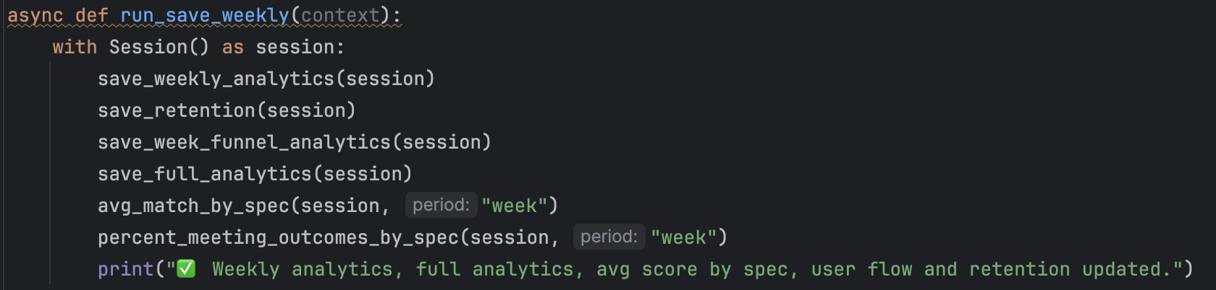
Automation with Job Scheduler
Bachelor’s Programme “Data Science and Business Analytics”
Chatbot for Assisting 9th-11th Grade Students in Choosing a University through Interaction with Current Students
Analytics Updated Automatically:
Daily @ 09:00:
save_daily_analytics()
Weekly (Mon @ 09:00):
Activity, retention, funnel, specialization ratings
Monthly (1st @ 09:00):
Long-term metrics, cumulative funnels
Tool: job_queue from Telegram API
Startup command: start_scheduler(application)
Example of function that collects weekly metrics

Slide 31
MVP 3
Deploying the Bot with Docker
Bachelor’s Programme “Data Science and Business Analytics”
Chatbot for Assisting 9th-11th Grade Students in Choosing a University through Interaction with Current Students
Goal:
To ensure the bot is reliably running 24/7 in a production environment and seamlessly connected to a PostgreSQL database.
How it works:
The bot is containerized using Docker, allowing it to run consistently across environments.
Configuration is handled via environment variables stored in a .env file and loaded using python-dotenv.
PostgreSQL is used as the primary database for scalable, persistent storage.
Redis is used as a message broker for Celery tasks.
Key Components:
Docker: Ensures the bot runs reliably and restarts automatically on failure
.env + Config class: Manages all environment-specific settings (tokens, DB credentials, etc.)
PostgreSQL: Replaces local SQLite to support concurrent user operations

Slide 32
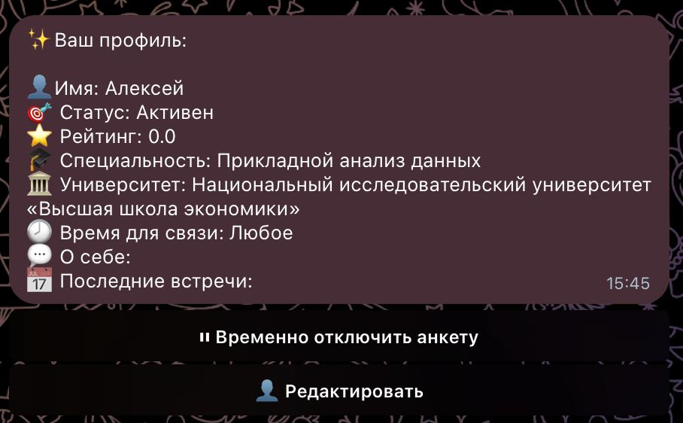
Student’s profile
Bachelor’s Programme “Data Science and Business Analytics”
Chatbot for Assisting 9th-11th Grade Students in Choosing a University through Interaction with Current Students
Goal:
Allow students to review their profile, control their availability to applicants and keep their information relevant.
Key features:
Current profile display including student’s rating
Modify profile details
Activity toggle

Slide 33
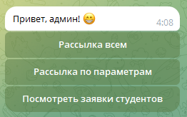
Administrator profile
Bachelor’s Programme “Data Science and Business Analytics”
Chatbot for Assisting 9th-11th Grade Students in Choosing a University through Interaction with Current Students
Goal:
Allow users with administrator access to communicate with chatbot users via broadcasting messages to all users or those chosen by parameters.
Key features:
Send message to all users
Select parameters of target users and send them a message
Moderation of changes submitted by students

Slide 34
Mass & Targeted Messaging System
Bachelor’s Programme “Data Science and Business Analytics”
Chatbot for Assisting 9th-11th Grade Students in Choosing a University through Interaction with Current Students
Goal:
To provide administrators with flexible tools for communicating with users — either all at once or in specific, filtered groups.
How it works:
Mass Messaging:
Admins can send a single message to all users (e.g. announcements, updates, reminders).
Targeted Messaging:
Admins can filter applicants by parameters such as:
Specialization group
Selected USE subjects
School grade
City
And send messages only to those matching the criteria.

Slide 35

Automatic user blocking system
Bachelor’s Programme “Data Science and Business Analytics”
Chatbot for Assisting 9th-11th Grade Students in Choosing a University through Interaction with Current Students
Penalty point system:
Awarding points for violations (0.5-1 point):
Skipping a meeting → 1 point
Giving low rating to your match → 0.5-1 point
Complaint → 1 point (if contains keywords)
Spam → 1 point
Suspicious links → 1 point
Blocking threshold: at ≥ 3 points - automatic ban for 7 days
Amnesty mechanism:
After 30 days with no new violations → -1 point
After 90 days without violations → reset the score counter to 0
To control users, we need a new UserBan table, which will:
Track and contain accumulated penalty points, date of last offense, telegram_id etc.
Allow us to automatically charge and assign points to a certain user based on their actions.

Slide 36
Testing
Bachelor’s Programme “Data Science and Business Analytics”
Chatbot for Assisting 9th-11th Grade Students in Choosing a University through Interaction with Current Students
To ensure reliability and correctness of the chatbot, we tested all major components during development and after each release.
Our key testing approaches involve:
Manual testing
Our development team simulated full user flows with various inputs to ensure everything was working
Edge case testing
We simulated cases with incorrect or missing inputs to ensure they were handled correctly
Real user testing
~100 applicants and ~80 students participated in our project, providing crucial data about bugs, logic inconsistency, UX/UI issues and requesting features

