Slide 1
High-precision Newton–Kantorovich method for nonlinear integral equations
Kirill Chertoganov, HSE University

Slide 2
Relevance
Nonlinear integral/integral-differential equations are the foundation of models in physics, biomechanics, and finance.
Numerical instability and loss of accuracy occur under strong nonlinearity.
Newton–Kantorovich (NK) method: locally quadratic convergence, but sensitive to rounding errors.
Goal: achieve high accuracy and stability of the NK method for Volterra equations.

Slide 3
Historical Context
Saleh & Amer (1990): NK method for singular integro-differential equations.
Alvarez & Tourin (1996): viscosity solutions for integro-differential equations.
Benth, Karlsen & Reikvam (2001): applications in optimization.
Chu (2007): matrix-based approach to Jacobians.
Boichuk & Chuiko (2013–2024): NK method for boundary-value and periodic problems; Penenko (2019), Usenov (2020).

Slide 4
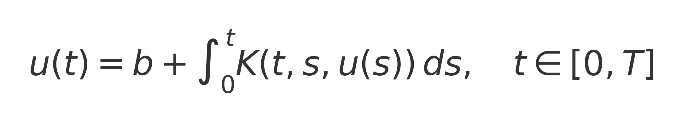
Problem Statement
A nonlinear Volterra equation on ([0, T]) with a kernel (K(t, s, u)) that is Lipschitz continuous in (u).
Objective: develop a reliable computational scheme for (u(t)) under strong nonlinearity.

Slide 5
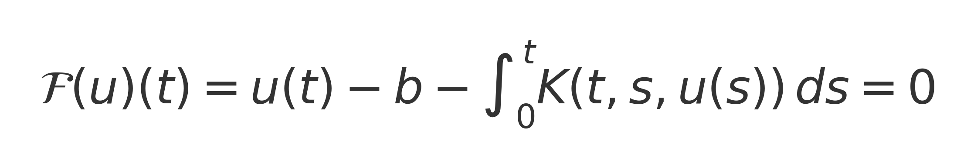
Operator form of the problem
Define the operator:
We solve the equation 𝓕(u) = 0 in the Banach space (X = C([0,T])).

Slide 6
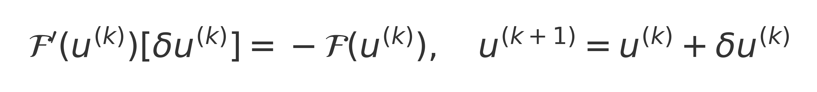
Newton–Kantorovich iteration
Solve the linear problem:
Update:
Key: stable construction and inversion of 𝓕′(u^{(k)}).

Slide 7
Problems of the classical implementation
Accumulation of rounding errors → loss of quadratic convergence.
Sensitivity to the grid and to the problem parameters.
Difficulty of inverting the integral operator 𝓕′(u).

Slide 8
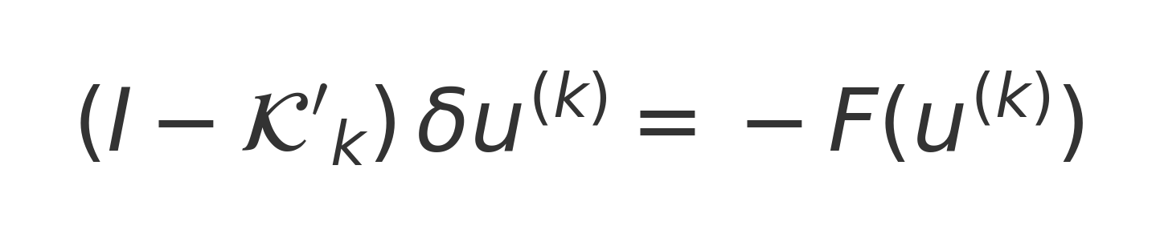
High-precision NK: idea and features
High-precision quadrature (mpmath, 50–200 digits).
Discretization of ∂₍u₎K and Jacobian assembly on the grid.
Solution: at each step.
Adaptive increase of precision when convergence slows.

Slide 9
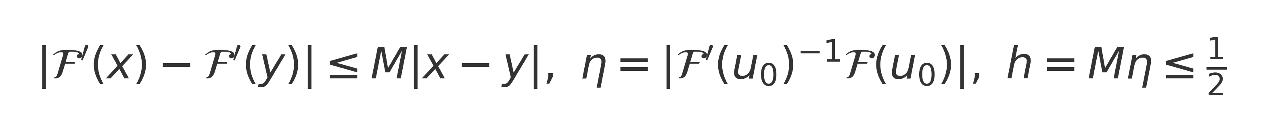
Theorem (Kantorovich for Volterra equations)
Conditions: invertibility of 𝓕′(u₀)⁻¹; Lipschitz continuity of 𝓕′ with constant M.
η = ⇒ local solvability.
Convergence: ‖u₍k+1₎ − u*‖ ≤ C ‖u₍k₎ − u*‖² (quadratic).

Slide 10
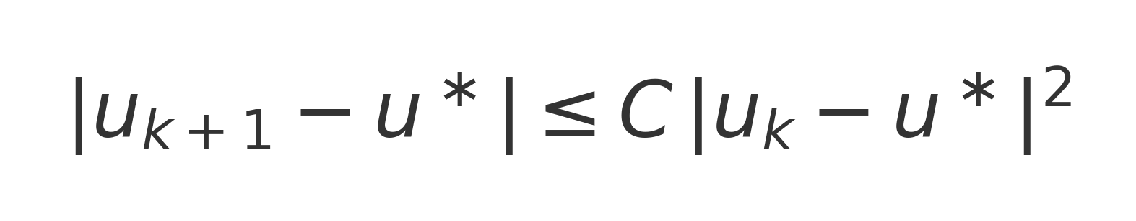
Convergence rate estimation
Quadratic convergence is achieved when the conditions of the theorem are satisfied.
High precision eliminates numerical dispersion and stabilizes the NK iteration step.

Slide 11
Pseudocode of the HP-NK method (short version)
Initialization: u ← u₀, precision ← 50 digits.
At each step: compute F(u), assemble J(u), solve J(u)·δu = −F(u).
Update u ← u + δu; increase precision if convergence slows; stop when ‖δu‖ < ε.

Slide 12
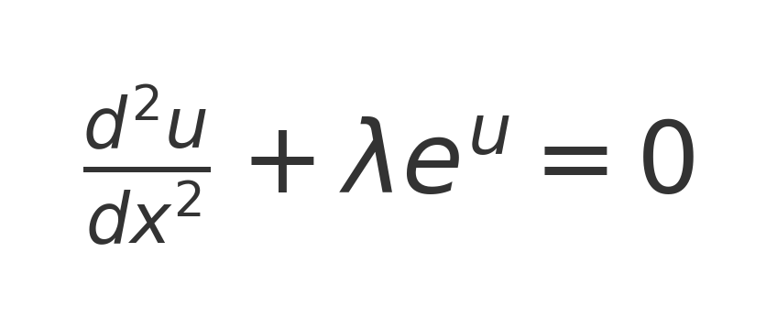
Test 1: Bratu equation
A classical model of combustion/reactive diffusion.
Used as a prototype for strong nonlinearity.

Slide 13
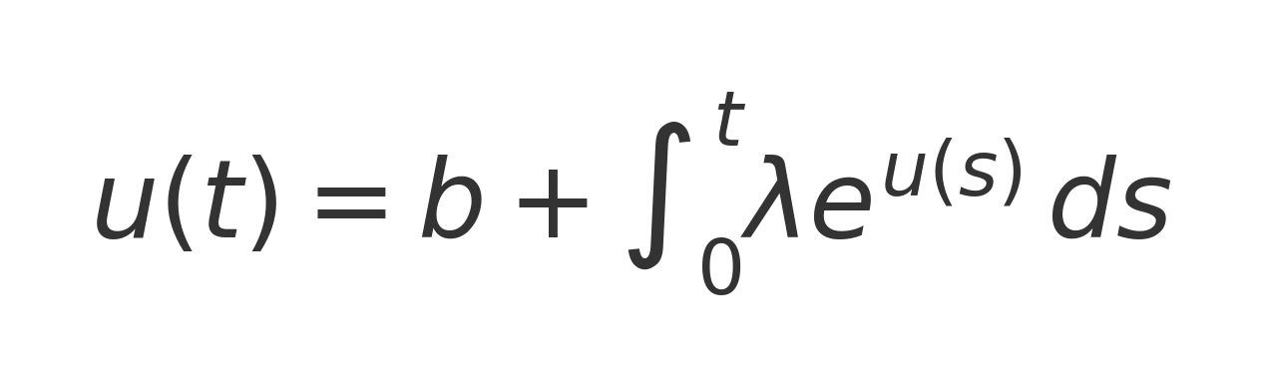
Bratu: integral form
An equivalent integral formulation for numerical analysis.
Demonstrates the effect of quadrature precision on convergence.

Slide 14
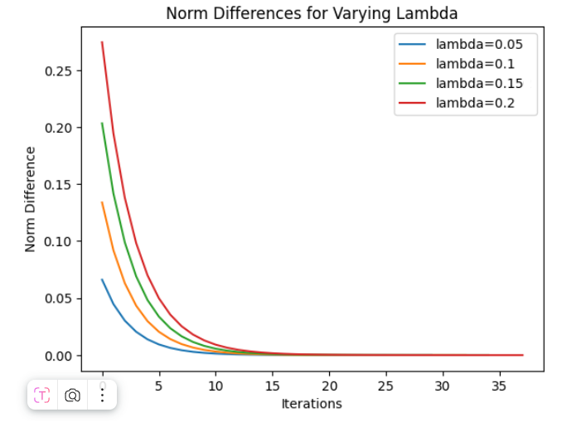
Convergence error plot

Slide 15
Comparison of methods
ыStandard NK: ~8 iterations, error ≈ 1e−8, precision 16 digits.
Modified NK: ~6 iterations, error ≈ 1e−12, precision 32 digits.
High-precision NK: ~5 iterations, error ≈ 1e−40, precision ~100 digits.

Slide 16
Implementation and verification
Python 3.12; libraries: mpmath, numpy, matplotlib.
Unit tests: interpolation, boundary conditions, positivity of the integral.
Reproducibility and control of random factors.

Slide 17
Analysis and advantages
Quadratic convergence confirmed experimentally.
High precision eliminates spurious dispersion.
Flexible and compatible with various types of integral operators.

Slide 18
Conclusions and prospects
The high-precision Newton–Kantorovich (HP-NK) method is stable and accurate for nonlinear integral problems.
Theoretical guarantees: Kantorovich conditions.
Next steps: systems of equations, stochastic/fractional kernels, GPU implementation.

Slide 19
Acknowledgments and questions
I thank my academic advisor and my colleagues at the lab.
Questions?
Contact: kirillchertoganov@gmail.com

