Slide 1
Spot the bot
Faculty of Computer Science
Laboratory for Semantic Analysis
Moscow,
2025
Vasilii A. Gromov,
Professor, Doctor of Sciences,
Deputy Head, Professor School of Data Analysis and Artificial Intelligence,
+79036865072, stroller@rambler.ru

Slide 2



Bots
Laboratory for Semantic Analysis
Bots
Spot the bot
Programs that generate texts like real ones.
They generate texts on any topic very quickly and in large quantities.
There are a lot of models/versions of bots.
Threats:
Disinformation (fake news, papers, social media posts)
Distortion of language personality development

Slide 3


Existing methods
Laboratory for Semantic Analysis
Existing methods
Spot the bot
Feature-based methods
Use metadata that may be not available
Text-based methods
Detect one particular bot

Slide 4
Our approach – various methods
Laboratory for Semantic Analysis
Our approach
Spot the bot
Method | Idea
Clustering | Bots generate probable phrases from dense regions of semantic space
Topological Data Analysis | People may write an unexpected phrase near a "hole" in language.
Entropy-Complexity | Texts written by humans will be more chaotic, complex
Intrinsic Dimensions | Language used by humans is more complex, it requires more dimensions to describe

Slide 5
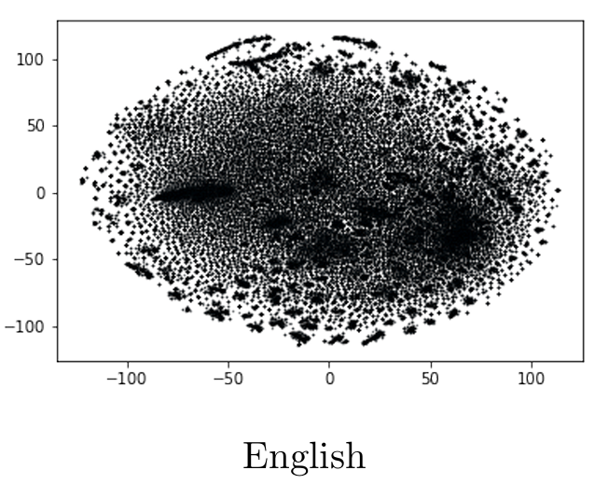
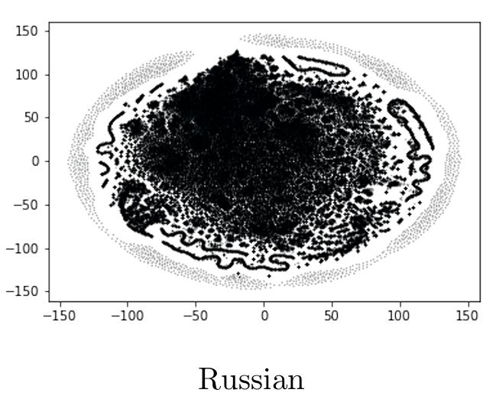
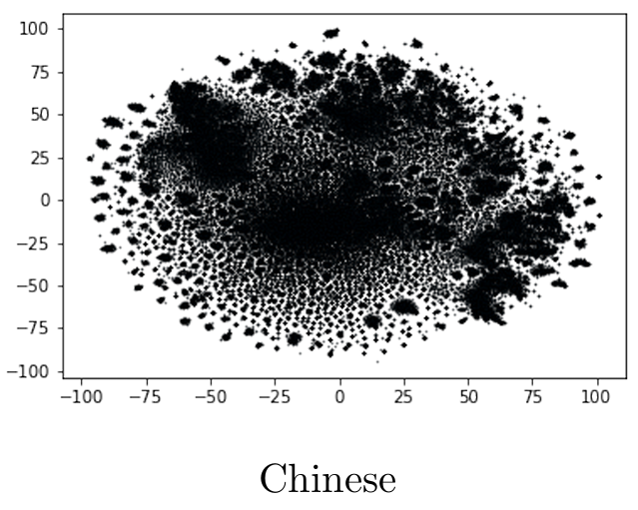
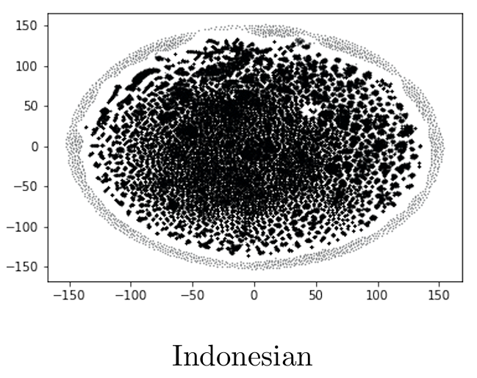
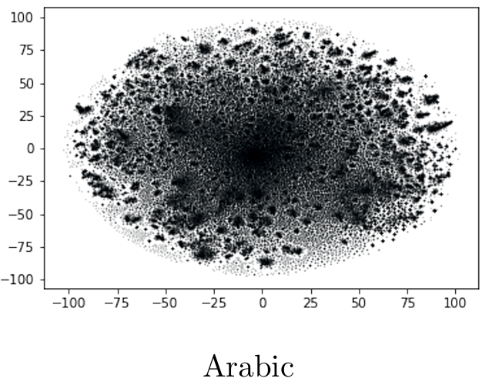
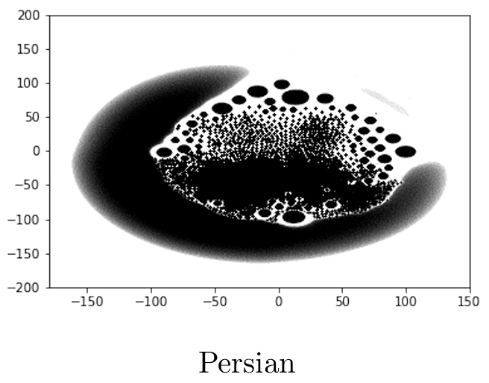
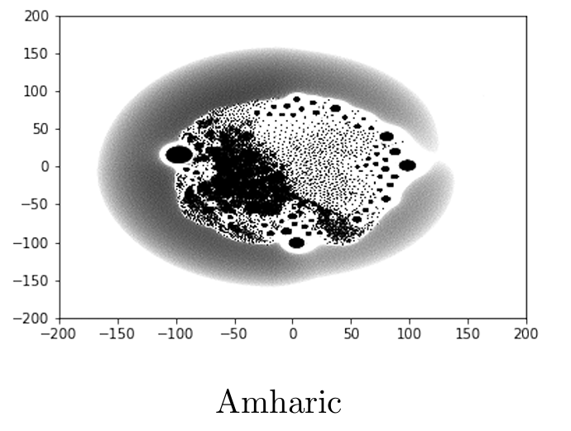
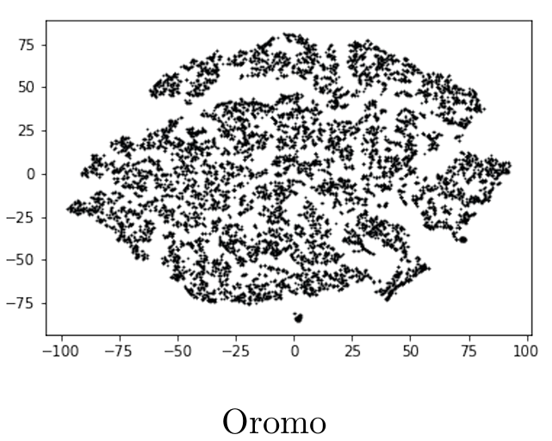
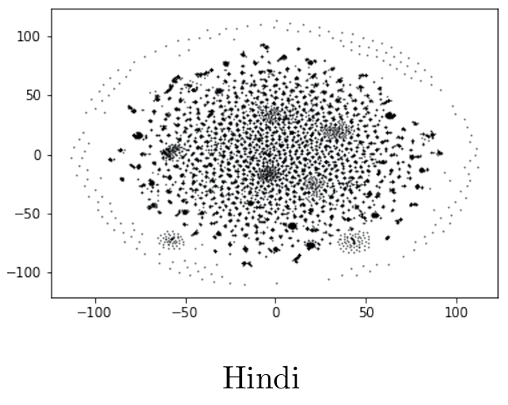
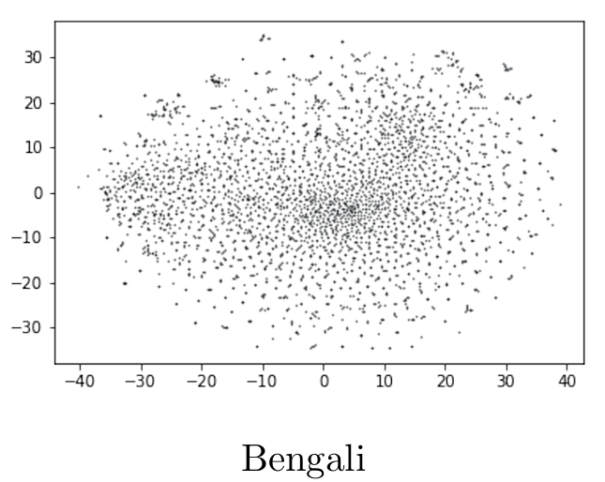
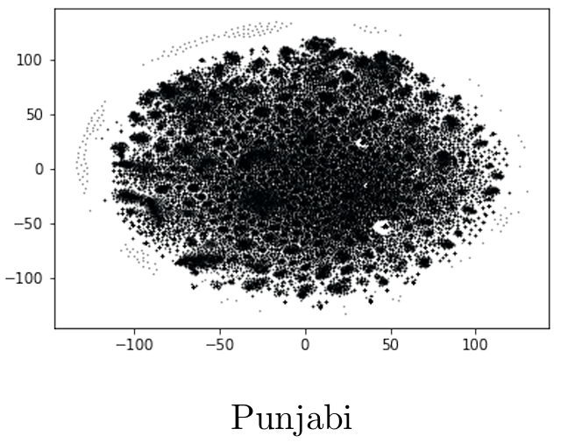
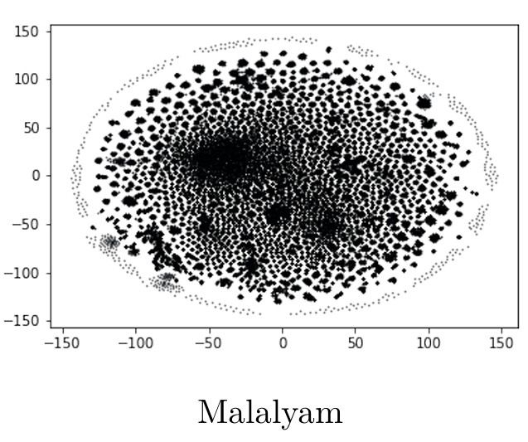
Laboratory for Semantic Analysis

Slide 6

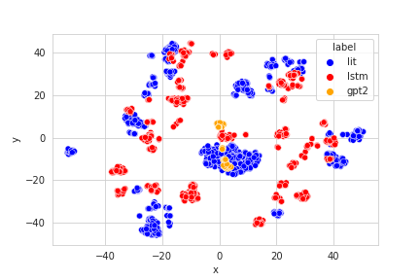
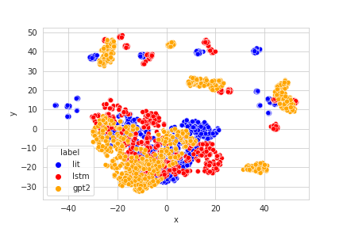

Semantic spaces of bots and humans
Laboratory for Semantic Analysis
Semantic spaces
Spot the bot
Language: Russian
Embedding: CBOW
Language: Russian
Embedding: SVD

Slide 7
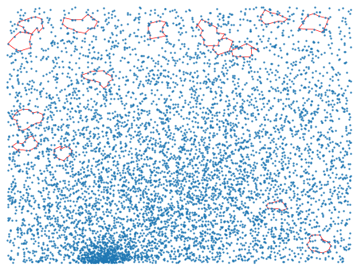
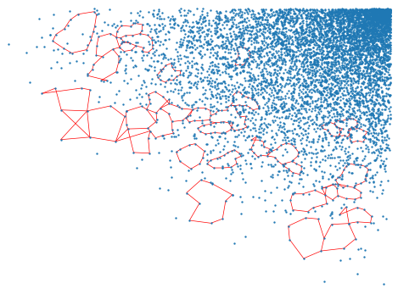
“holes” of the semantic space
Laboratory for Semantic Analysis
Topological Data Analysis
Spot the bot
Russian language

Slide 8
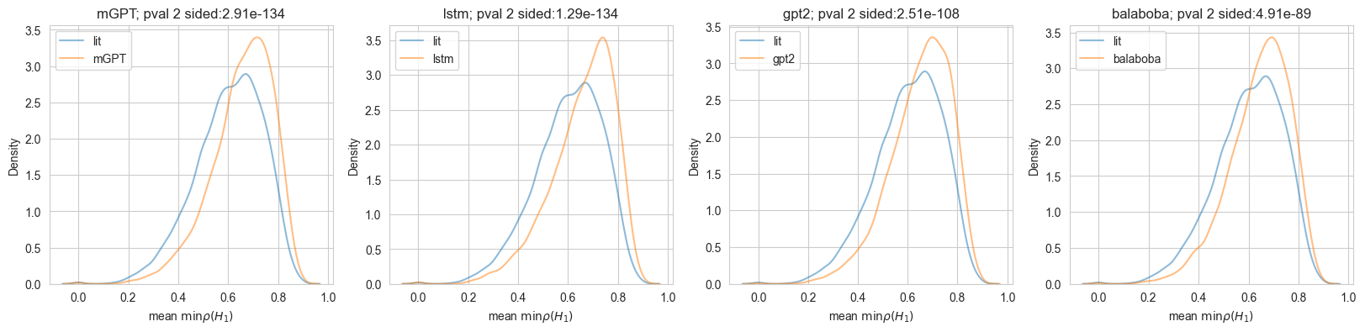
Distances to “holes”
Laboratory for Semantic Analysis
Topological Data Analysis
Spot the bot
Literature vs mGPT
Literature vs LSTM
Literature vs GPT-2
Literature vs YaLM
Russian language

Slide 9
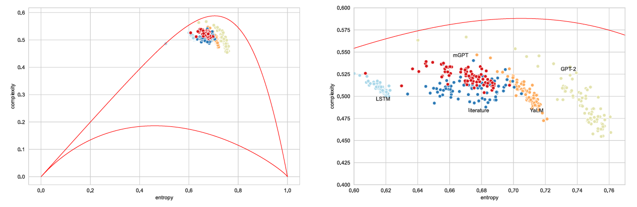
Entropy-complexity plane
Laboratory for Semantic Analysis
Entropy-complexity
Spot the bot

Slide 10

Classification
Laboratory for Semantic Analysis
Classification
Spot the bot
Classification task:
Train model using one set of bots
Test using another
Possible to reach F1-score $≥0.95$ for different languages
…
…

Slide 11
Conclusion
Laboratory for Semantic Analysis
Conclusion
Spot the bot
Bots can quickly generate a huge number of misleading texts.
They are a threat to society (spread disinformation, harm language personality)
Existing methods cannot detect various bots
We employ various methods (clustering, topological data analysis, etc.) to identify characteristics bots cannot imitate
It is possible to classify text (human/bot) with good quality (F1-score ≥𝟎.𝟗𝟓)

