Slide 1
The Applicability of Large Language Models for Best Execution Decision-making
Faculty of Computer Science
Research Project
Moscow
2026
Student: Paramonova Anna Dmitrievna,
BAMI234
Project Supervisor: Lukianchenko Petr Pavlovich,
Senior Lecturer

Slide 2
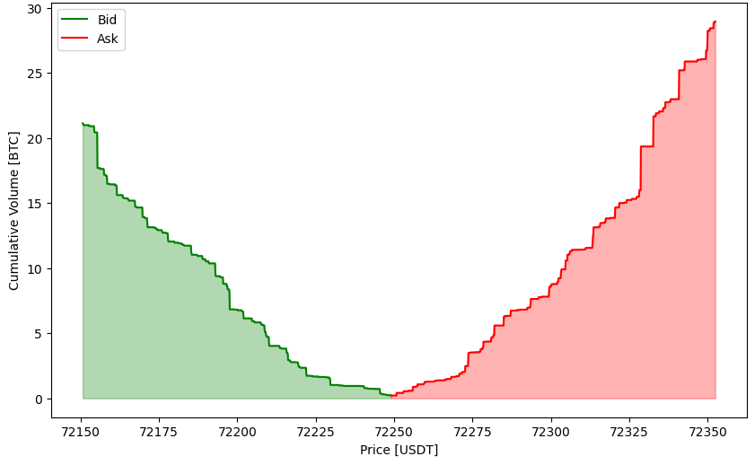
Best (Optimal) Execution
Faculty of Computer Science
The Applicability of Large Language Models for Best Execution Decision-making
Best Execution Decision-Making
Aims to minimize transaction costs by reducing the market impact of each individual trade
News flow shapes investor sentiment, directly affecting order book liquidity
LLMs enable real-time news analysis
Order book example for BTC-USDT
Purpose: Create an optimal execution strategy leveraging LLMs for news analysis and assess the applicability of such a approach to optimal execution

Slide 3
Related works and purpose of the research
Faculty of Computer Science
The Applicability of Large Language Models for Best Execution Decision-making
Related works and purpose of the research
Price impact models: instantaneous, transient, and permanent
Almgren-Chriss (1999): instantaneous + permanent impact; Obizhaeva-Wang (2013): transient
News affect liquidity, therefore affect speed of price recovery
LLM-based news analysis increasingly used for stock price prediction
FinMem (2025) extract relevancy, recency, sentiment; TradingGroup (2025) filters based on influence score and extracts sentiment
ATLAS (2025) analyzes confidence and source
Purpose: The objective of the research is to construct an LLM-based news metric to identify the current liquidity regime, create a transient impact model with a regime-dependent price recovery parameter and analyze the effectiveness of the proposed approach.

Slide 4
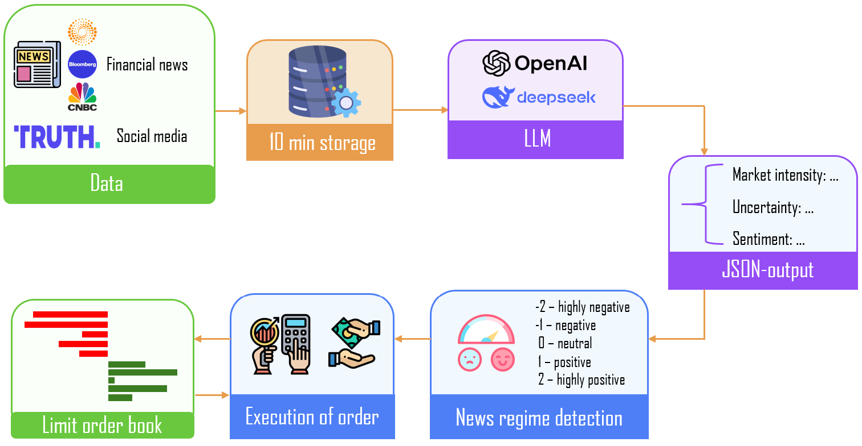
Proposed approach
Faculty of Computer Science
The Applicability of Large Language Models for Best Execution Decision-making
Proposed Approach
Every 10 minutes, an LLM extracts features from the latest news flow
Features are aggregated into news metric, mapped to one of 5 future regimes: highly negative → highly positive
Order volume for the next 10-minute window is derived from the current regime
Execution price is received and the cycle repeats
Proposed pipeline of optimal execution

Slide 5
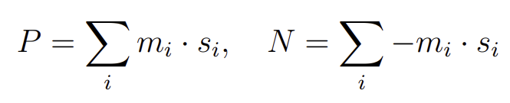
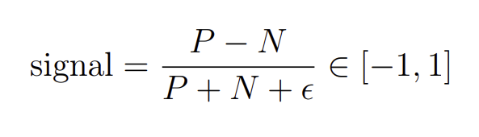

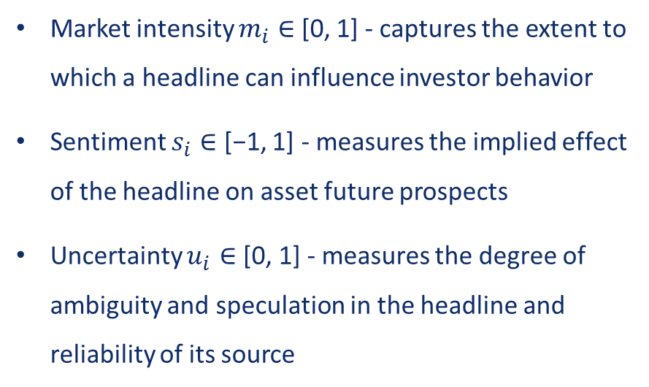
News metric construction
Faculty of Computer Science
The Applicability of Large Language Models for Best Execution Decision-making
News metric construction
Market intensity $m_{i}∈$ [0, 1] - captures the extent to which a headline can influence investor behavior
Sentiment $s_{i}∈$ [−1, 1] - measures the implied effect of the headline on asset future prospects
Uncertainty $u_{i}∈$ [0, 1] - measures the degree of ambiguity and speculation in the headline and reliability of its source
News metric construction

Slide 6
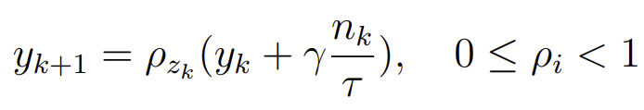
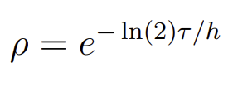
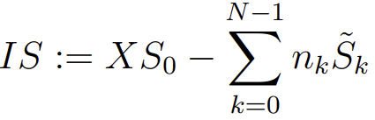
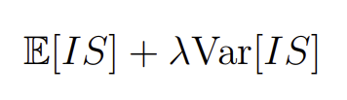
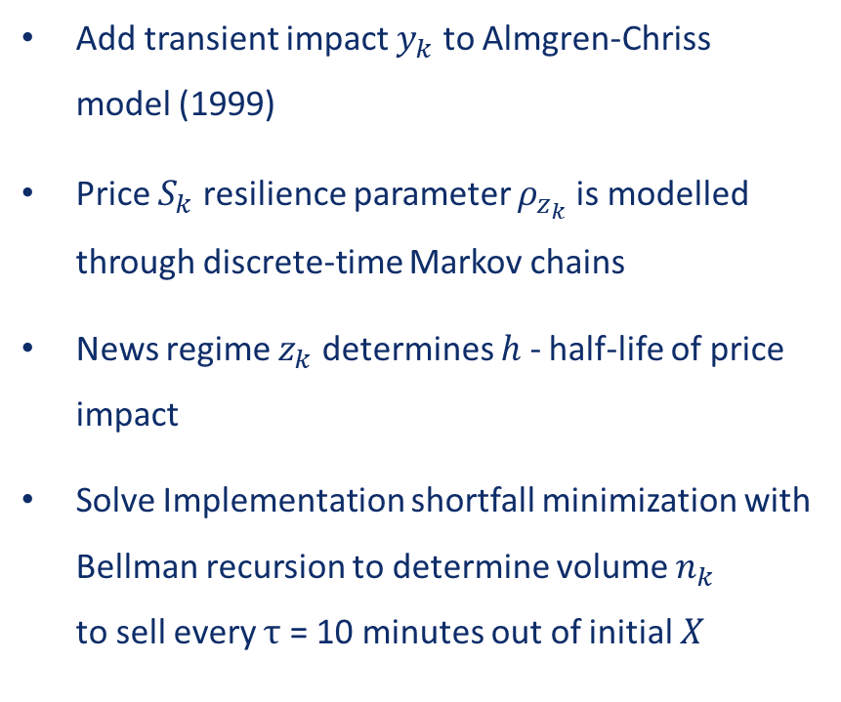
Optimal execution strategy
Faculty of Computer Science
The Applicability of Large Language Models for Best Execution Decision-making
Optimal execution strategy
Add transient impact $y_{k}$ to Almgren-Chriss
model (1999)
Price $S_{k}$resilience parameter $ρ_{z_{k}}$ is modelled through discrete-time Markov chains
News regime $z_{k}$determines $h$ - half-life of price impact
Solve Implementation shortfall minimization with Bellman recursion to determine volume $n_{k}$
to sell every $τ$ = 10 minutes out of initial $X$
Transient price impact
Price impact resilience
Implementation shortfall
Function to minimize

Slide 7
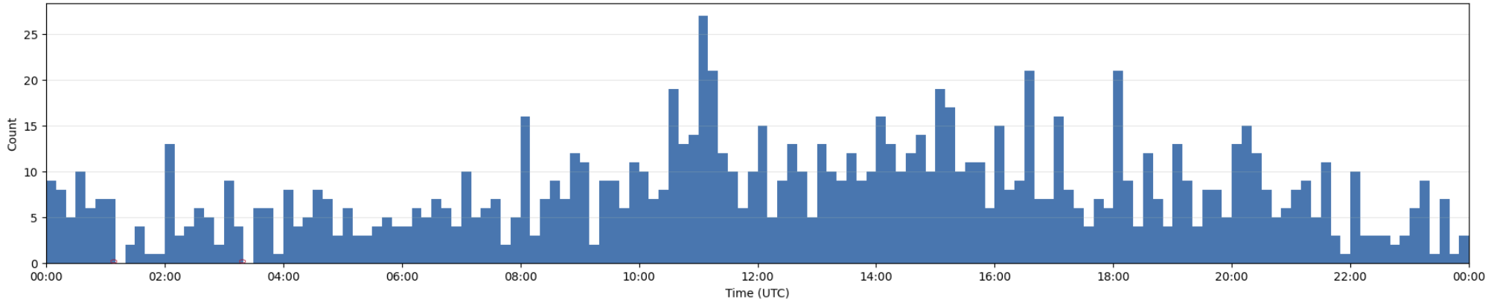
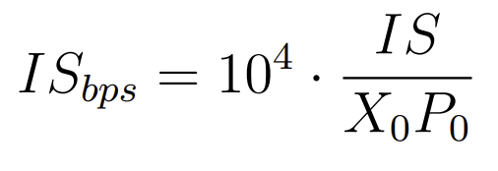
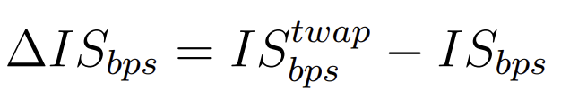
Experimental Setup
Faculty of Computer Science
The Applicability of Large Language Models for Best Execution Decision-making
Experimental Setup
Limit order book: L-2 data,
1 snapshot per 200 ms
News dataset: CryptoPanic, Reuters,
Bloomberg, CNBC, TRUTH Social
LLM models: ChatGPT-4o, DeepSeek-V3
Baseline: TWAP
Evaluation metrics: mean ± std and median of the Implementation Shortfall difference between TWAP and the proposed method (bps)
Example: News frequency during 1 day
Metric formula

Slide 8
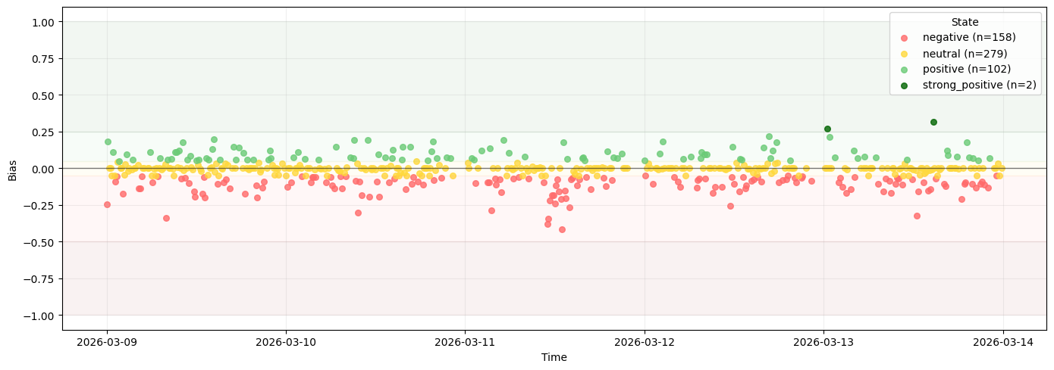
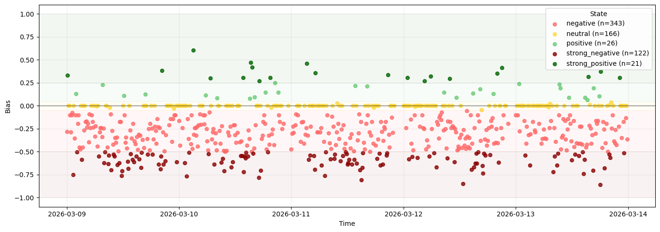
LLM scoring comparison
Faculty of Computer Science
The Applicability of Large Language Models for Best Execution Decision-making
LLM scoring comparison
ChatGPT: more moderate market intensity estimates, balanced sentiment distribution
DeepSeek: overestimated market intensity, negative sentiment bias
Result: DeepSeek is more prone to sudden and extreme shift in news regimes, than ChatGPT
News regimes across 5 days: a) ChatGPT-4o, b) DeepSeek-V3

Slide 9
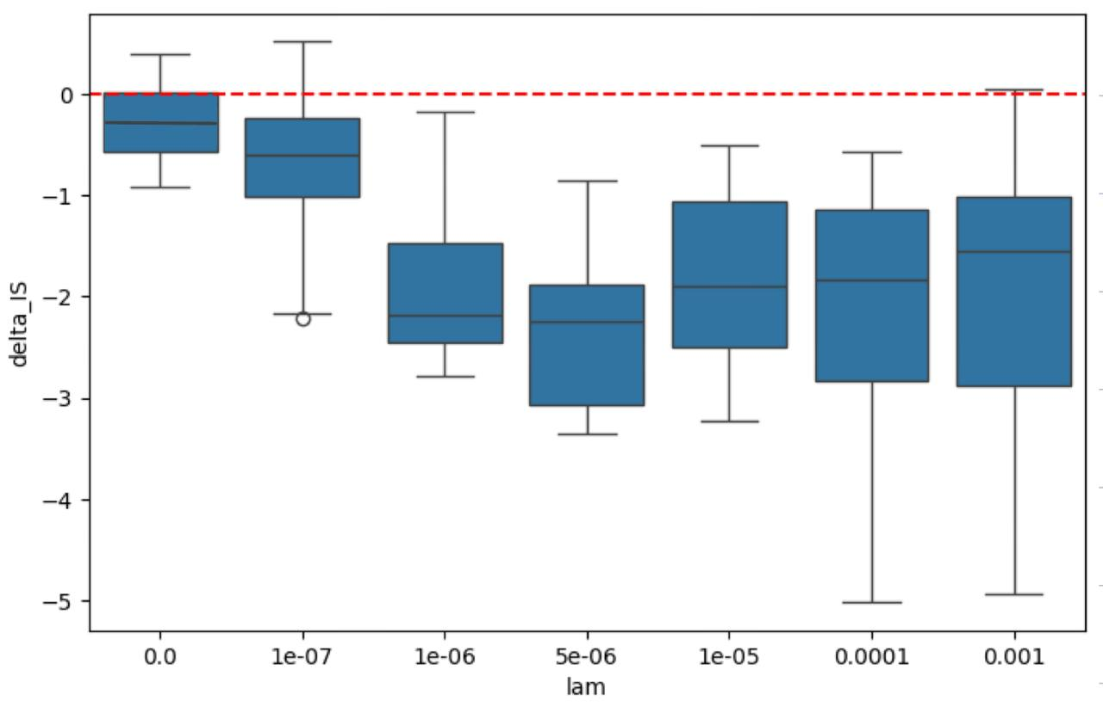
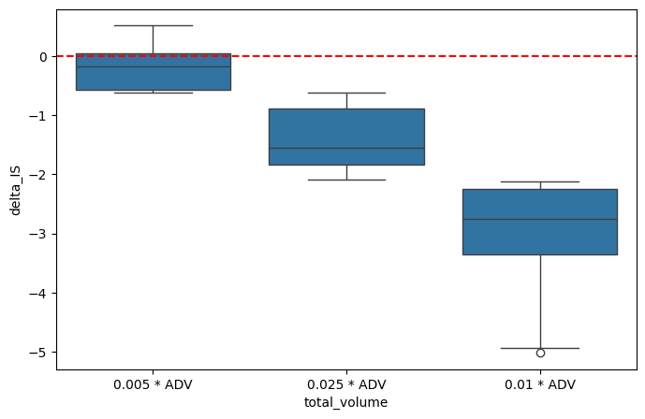
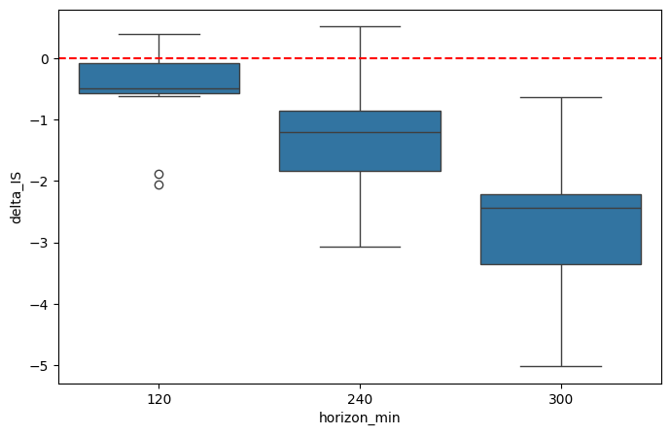
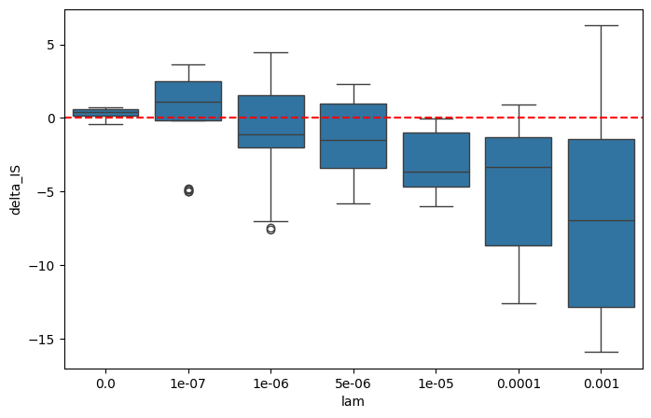
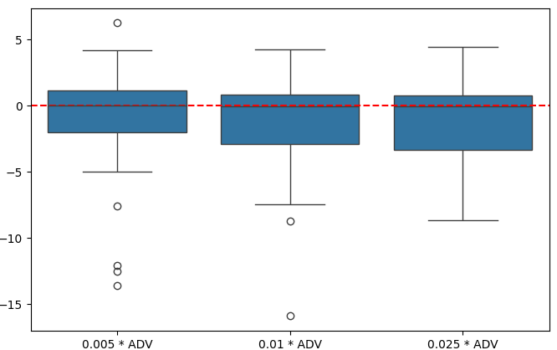
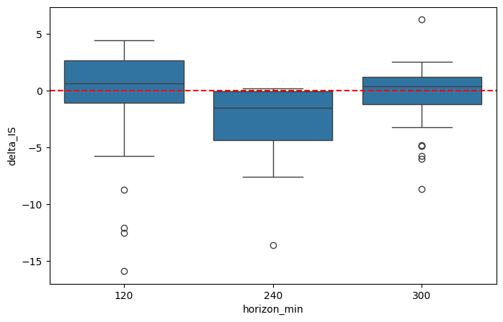



Results: Sensitivity analysis
Faculty of Computer Science
The Applicability of Large Language Models for Best Execution Decision-making
Results: Sensitivity Analysis
1
Risk-aversion $λ$
2
% of Average Daily Volume (ADV)
3
Execution Horizon, min
$Δ IS (stable regime)$ ↓
$Δ IS (volatile regime)$ ↓

Slide 10
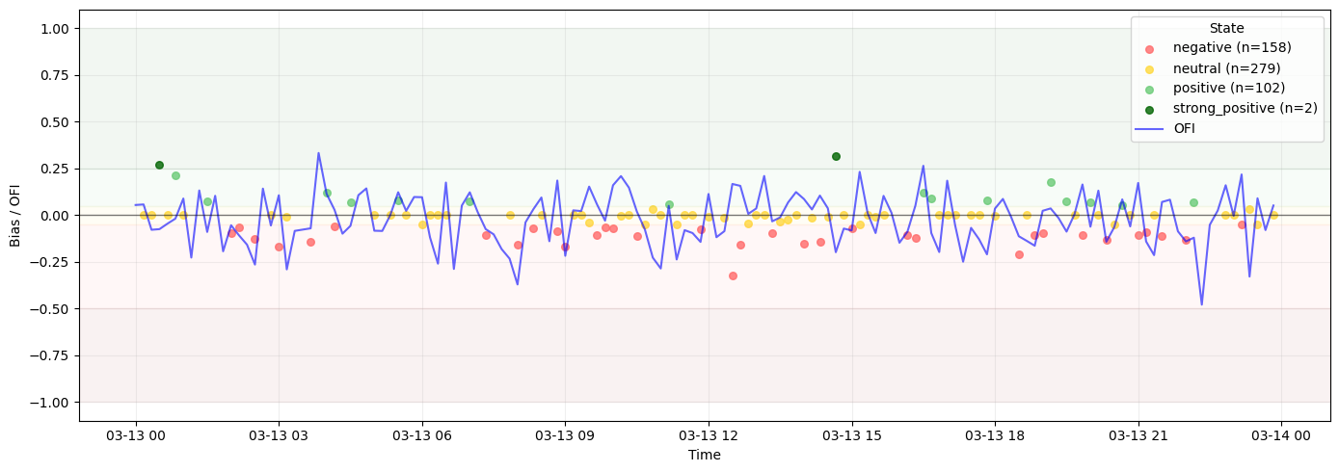
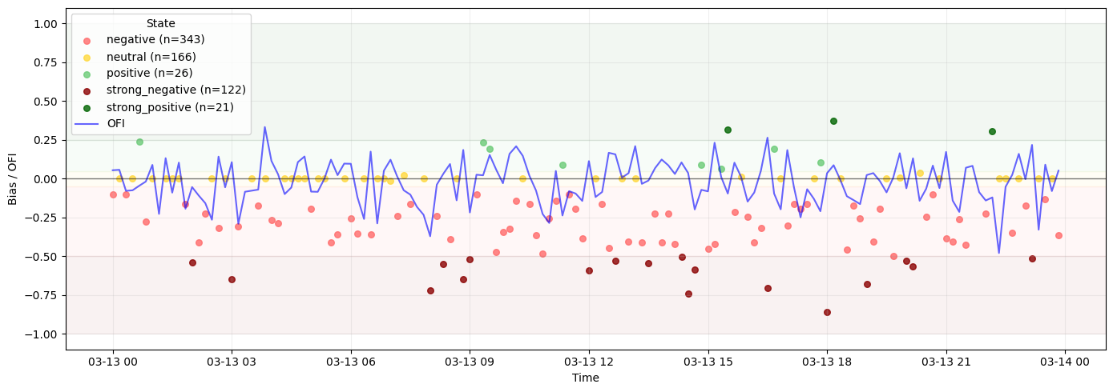
Strategy results
Faculty of Computer Science
The Applicability of Large Language Models for Best Execution Decision-making
Strategy results
Volume | GPT-Strategy |  | DeepSeek-Strategy
 | Mean ± Std (bps) ↓ | Median ↓ | Mean ± Std (bps) ↓ | Median ↓
0.5% ADV | -1.2 ± 0.90 | -0.8 | -0.5 ± 1.80 | -0.30
1% ADV | -2.10 ± 1.03 | -1.8 | -1.7 ± 5.10 | -0.63
2.5% ADV | -2.45 ± 1.15 | -2.1 | -1.40 ± 5.40 | -0.10
News regimes + OFI across 5 days: ChatGPT-4o
Results: Volume sensitivity
Horizon | GPT-Strategy |  | DeepSeek-Strategy
 | Mean ± Std (bps) ↓ | Median ↓ | Mean ± Std (bps) ↓ | Median ↓
120 min | -1.50 ± 0.53 | -1.10 | -1.10 ± 1.9 | -0.20
240 min | -1.69 ± 0.7 | -1.52 | -1.20 ± 4.60 | -0.80
300 min | -2.3 ± 1.2 | -1.89 | -0.95 ± 3.80 | 0.10
News regimes + OFI across 5 days: DeepSeek-V3.2
Results: Horizon sensitivity

Slide 11
Conclusions and Future work
Faculty of Computer Science
The Applicability of Large Language Models for Best Execution Decision-making
Conclusions and Future work
As part of this study, an optimal execution strategy was developed and tested, demonstrating that incorporating
a news signal can improve execution performance compared to the TWAP
Developed strategy with ChatGPT-4o consistently outperforms TWAP by 1–2 basis points
Strategy overly sensitive to frequent regime changes
ChatGPT-4o outperforms DeepSeek-V3.2 in financial context interpretation, captures macro-sentiment dynamics for Bitcoin closer to the chosen proxy
DeepSeek-V3 overestimates market intensity, exhibits excessive regime switching
Future work: long-term news component to smooth short-term shocks; further parameter calibration pending more data

Slide 12
References
Faculty of Computer Science
The Applicability of Large Language Models for Best Execution Decision-making
References
[1] Julia Ackermann, Thomas Kruse, and Mikhail Urusov. “Optimal Trade Execution in an Order Book Model with Stochastic Liquidity Parameters”. In: SIAM Journal on Financial Mathematics 12.2 (2021), pp. 788–822.
[2] Robert Almgren. “Optimal trading with stochastic liquidity and volatility”. In: SIAM Journal on Financial Mathematics 3.1 (2012), pp. 163–181.
[3] Robert Almgren and Neil Chriss. “Optimal execution of portfolio transactions”. In: Journal of Risk 3.2 (2000), pp. 5–39.
[4] Dogu Araci. FinBERT: Financial Sentiment Analysis with Pre-trained Language Models. 2019.
[5] Mostapha Benhenda. FinRL-DeepSeek: LLM-Infused Risk-Sensitive Reinforcement Learning for Trading Agents. Tech. rep. hal-04934770. HAL, 2025.
[6] Kane A. Bodie Z. and Marcus A. Investments. Global Edition. McGraw Hill Higher Education, New York., 2014.
[7] Jean-Philippe Bouchaud and Capital Management. “Price Impact”. In: arXiv.org, Quantitative Finance Papers (Mar. 2009).
[8] Johannes Braun, Jochen Hausler, and Wolfgang Schäfers. “Artificial intelligence, news sentiment, and property market liquidity”. In: Journal of Property Investment and Finance ahead-of-print (2019). [9] Patrick Cheridito and Tardu Sepin. “Optimal Trade Execution Under Stochastic Volatility and Liquidity”. In: Applied Mathematical Finance 21.4 (2014), pp. 342–362.
[10] Patrick Cheridito and Tardu Sepin. “Optimal trade execution under stochastic volatility and liquidity”. In: Applied Mathematical Finance 21.4 (2014), pp. 342–362.
[11] Jacob Devlin, Ming-Wei Chang, Kenton Lee, and Kristina Toutanova. BERT: Pre-training of Deep Bidirectional Transformers for Language Understanding. 2018.
[12] Ryan Donnelly. “Optimal Execution: A Review”. In: Applied Mathematical Finance 29.3 (2022), pp. 181–212.
[13] Lee M. Dunham and John Garcia. “Measuring the effect of investor sentiment on liquidity”. In: Managerial Finance 47.1 (2020), pp. 59–85.
[14] Murad Farzulla. The Extremity Premium: Sentiment Regimes and Adverse Selection in Cryptocurrency Markets. Feb. 2026.
[15] George Fatouros, Kostas Metaxas, John Soldatos, and Manos Karathanassis. MarketSenseAI2.0: Enhancing Stock Analysis through LLM Agents. 2025.
[16] Axel Groß-Klußmann and Nikolaus Hautsch. “When machines read the news: Using automated text analytics to quantify high frequency news-implied market reactions”. In: Journal of Empirical Finance 18.2 (2011), pp. 321–340.
[17] Steven Heston and Nitish Sinha. “News versus Sentiment: Predicting Stock Returns from News Stories”. In: Finance and Economics Discussion Series 2016 (2016), pp. 1–35.
[18] Nhan Huynh, Lurion De Mello, and Kai Li. “Evolution of investor sentiment: A systematic literature review and bibliometric analysis”. In: International Review of Economics and Finance 100 (2025), pp. 104–115.
[19] Alexander Kempf, Daniel Mayston, Monika Gehde-Trapp, and Pradeep K. Yadav. Resiliency: A dynamic view of liquidity. CFR Working Papers 15-04. University of Cologne, Centre for Financial Research (CFR), 2015.
[20] Kemal Kirtac and Guido Germano. Large language models in finance : what is financial sentiment? 2025.

Slide 13
References
Faculty of Computer Science
The Applicability of Large Language Models for Best Execution Decision-making
References
[21] Kemal Kirtac and Guido Germano. “Sentiment trading with large language models”. In: Finance Research Letters 62 (2024), pp. 105–227.
[22] Qing-Yu Lan, Zhan-He Wang, Jun-Qian Jiang, Yu-Tong Wang, and Yun-Song Piao. NewsAware Direct Reinforcement Trading for Financial Markets. Oct. 2025.
[23] Xiao Lin and Peter A Beling. “Deep reinforcement learning for optimum order execution: Mitigating risk and maximizing returns”. In: arXiv preprint arXiv:1904.05823 (2019).
[24] Jun Liu, Kai Wu, and Ming Zhou. “News tone, investor sentiment, and liquidity premium”. In: International Review of Economics and Finance 84 (2023), pp. 167–181.
[25] Shuming Liu. “Investor sentiment and stock market liquidity”. In: Journal of Behavioral Finance 16 (2015), pp. 51–67.
[26] Chen-Che Lu, Yun-Cheng Chou, and Teng-Ruei Chen. P1GPT: a multi-agent LLM workflow module for multi-modal financial information analysis. 2025.
[27] Anna Obizhaeva and Jiang Wang. “Optimal trading strategy and supply/demand dynamics”. In: Journal of Financial Markets 16.1 (2013), pp. 1–32.
[28] Yuhei Ono, Norio Hibiki, and Yoshiki Sakurai. “Dynamic optimal execution models with
transient market impact and downside risk”. In: Journal of Japan Industrial Management Association. 2019.
[29] Charidimos Papadakis, Angeliki Dimitriou, Giorgos Filandrianos, Maria Lymperaiou, Konstantinos Thomas, and Giorgos Stamou. ATLAS: Adaptive Trading with LLM AgentS Through Dynamic Prompt Optimization and Multi-Agent Coordination. 2025.
[30] Charidimos Papadakis, Angeliki Dimitriou, Giorgos Filandrianos, Maria Lymperaiou, Konstantinos Thomas, and Giorgos Stamou. ATLAS: Adaptive Trading with LLM AgentS Through Dynamic Prompt Optimization and Multi-Agent Coordination. 2025.
[31] A. Papanicolaou, H. Fu, P. Krishnamurthy, B. Healy, and F. Khorrami. An Optimal Control Strategy for Execution of Large Stock Orders Using LSTMs. Papers. arXiv.org, Jan. 2023.
[32] Zhilong Qin, Tao Liu, Xingjin Yu, and Lin Yang. “Will the negative psychological perceptions of investors reduce platform liquidity? Evidence from China’s online loans”. In: PLOS ONE 18.10 (Oct. 2023), pp. 1–18. doi: 10.1371/journal.pone.0292158.
[33] Paul Tetlock. “Giving Content to Investor Sentiment: The Role of Media in the Stock Market”. In: Journal of Finance 62 (2007), pp. 1139–1168.
[34] Feng Tian, Flora Salim, and Hao Xue. TradingGroup: A Multi-Agent Trading System with Self-Reflection and Data-Synthesis. 2025.
[35] Yangyang Yu, Haohang Li, Zhi Chen, Yuechen Jiang, Yang Li, Jordan Suchow, Denghui Zhang, and Khaldoun Khashanah. “FinMem: A Performance-Enhanced LLM Trading Agent With Layered Memory and Character Design”. In: IEEE Transactions on Big Data PP (2025), pp. 1–18.
[36] Susan Zhang, Stephen Roller, Naman Goyal, Mikel Artetxe, Moya Chen, Shuohui Chen, Christopher Dewan, Mona Diab, Xian Li, Victoria Lin, Todor Mihaylov, Myle Ott, Sam Shleifer, Kurt Shuster, Daniel Simig, Punit Koura, Anjali Sridhar, Tianlu Wang, and Luke Zettlemoyer. OPT: Open Pre-trained Transformer Language Models. 2022.
[37] Yuntao Zhang, Zheng Dong, and Wenrui Xu. “Integrative stock price trend prediction via hierarchical LLM text processing and patch-based transformer with co-attention”. In: Expert Systems with Applications 302 (2026), p. 130441.

Slide 15
Faculty of Computer Science
The Applicability of Large Language Models for Best Execution Decision-making
Additional information

Slide 16
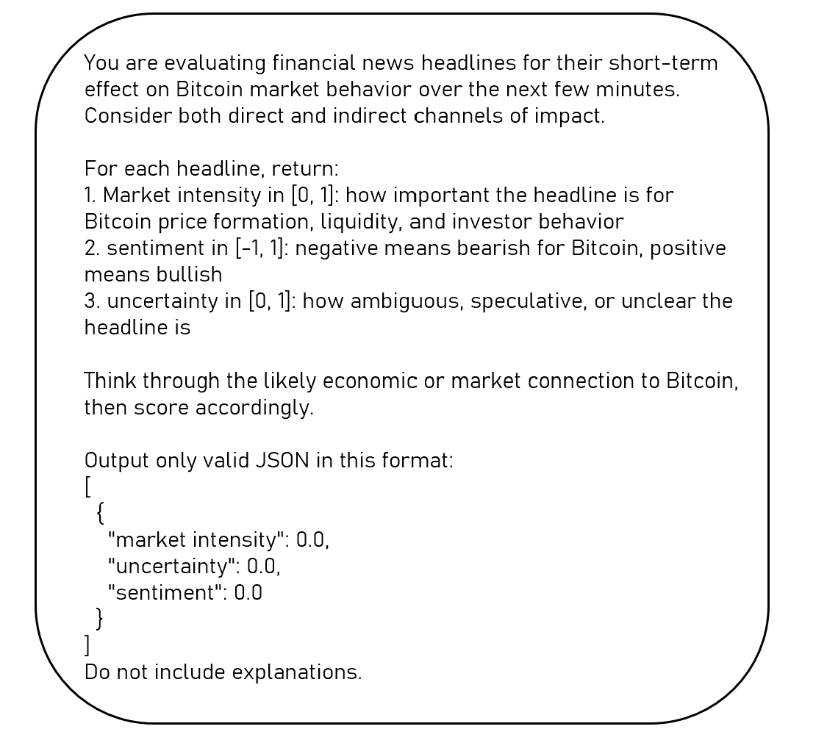
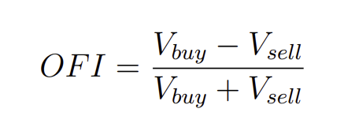
Prompt
Faculty of Computer Science
The Applicability of Large Language Models for Best Execution Decision-making
Additional information
Order-flow imbalance

Slide 17
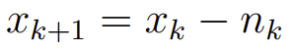
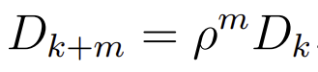
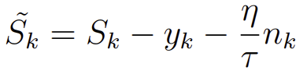
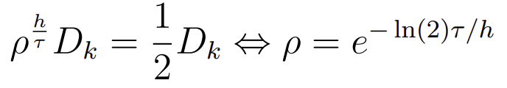
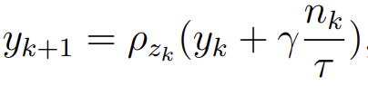
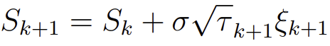
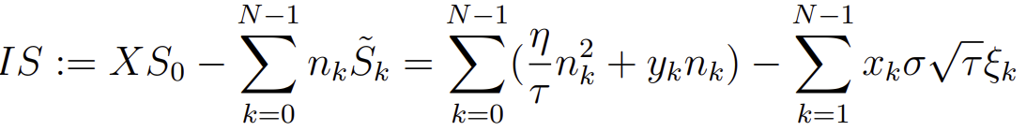

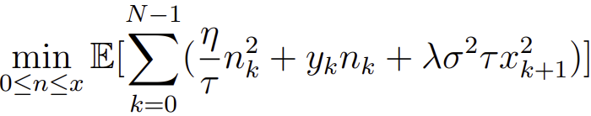
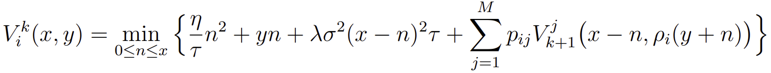
Faculty of Computer Science
The Applicability of Large Language Models for Best Execution Decision-making
Additional information

Slide 18
Faculty of Computer Science
The Applicability of Large Language Models for Best Execution Decision-making
Additional information
Калибровка параметров:
Параметр мгновенного восстановления = bid-ask spread / best bid quantity – стоимость пересечения спреда на единицу доступной ликвидности
Волатильность = средняя реализованная волатильность за 10 минут
Параметр half-life: брались крупные сделки, оценивалось время возвращения цены к прежнему состоянию. Полученный результат совпадал с выводами “Resiliency: A dynamic view of liquidity” (2015)

