Slide 1
Automated Data Analytics LLM Agent for Streamlining Business Operations
Автоматизированный агент аналитики данных для оптимизации бизнес-операций на основе больших языковых моделей
Faculty of Computer Science
Data Science and Business Analytics
Moscow 2026
Prepared by Podoliakina Anastasia and Milova Irina
Supervisor: Savchenko Andrey Vladimirovich
Leading Research Fellow

Slide 2
Why This Problem Matters
Faculty of Computer Science
Data Science and Business Analytics
Automated Data Analytics LLM Agent for Streamlining Business Operations
Data ≠ Decisions
Static Dashboards Fail
Companies collect more structured data than ever - yet most teams cannot extract insights without specialized analytical tooling.
Pre-built dashboards answer last quarter’s questions, not today’s. Business logic evolves faster than dashboard refresh cycles.
Analyst Bottleneck
No Accessible Bridge
Routine analytical questions still require manual multi-step workflows across SQL, spreadsheets, and BI tools.
A practical gap exists between natural-language business questions and computed, validated evidence over tabular data.

Slide 3
Key Terms and Definitions
Faculty of Computer Science
Data Science and Business Analytics
Automated Data Analytics LLM Agent for Streamlining Business Operations
Analytical Concepts
System & Infrastructure Terms
1
LLM (Large Language Model)
Neural language model trained to perform natural language understanding and generation tasks.
1
Grounding Critic
Validation component used to verify consistency between analytical outputs and computed evidence.
2
Deterministic Execution
Computational process in which analytical outputs are produced directly from structured data through predefined operations.
2
Validation Layer
System layer responsible for execution verification and aggregation consistency checks.
3
KPI (Key Performance Indicator)
Quantitative metric used to evaluate operational or business performance.
3
Multi-Dataset Workflow
Analytical process involving isolated reasoning across multiple datasets.
4
Semantic Routing
Process of selecting an analytical execution path based on inferred user intent.
4
Artifact
Persisted analytical output generated during system execution.
5
Evidence-Based Analytics
Analytical approach where conclusions are supported by computed and validated evidence.
5
SQLite Runtime Tables
Temporary relational tables used during deterministic analytical execution.

Slide 4
Why Existing Data Agents Fail
Faculty of Computer Science
Data Science and Business Analytics
Automated Data Analytics LLM Agent for Streamlining Business Operations
Code-Generation Agents (NVIDIA)
Notebook BI Platforms (DataLab)
No formal validation - LLM generates analytical code; correctness depends entirely on model behaviour.
High platform complexity. Tightly coupled to notebook UX - difficult to embed as a modular component.
SQL Function-Calling Agents
General LLM Agent Frameworks
LLM SQL can be syntactically valid but semantically wrong. No metric-level business constraints.
Flexibility alone does not guarantee correctness. Lack execution validation, grounded evidence tracking, and KPI logic.
The System’s Answer: Separate NL interpretation from deterministic computation, validate everything, track evidence.
Core principle: LLMs plan and explain - deterministic modules compute and validate. Result: 84.2% correctness over 19 benchmark cases.

Slide 5
Why Deterministic Execution Matters
Faculty of Computer Science
Data Science and Business Analytics
Automated Data Analytics LLM Agent for Streamlining Business Operations
Standard LLM Pipeline
Deterministic Analytical Pipeline
Prompt → LLM → Answer
Question → Semantic Plan
Probabilistic reasoning
Deterministic computation
Hallucinations possible
Validation + grounding critic
Weak validation
Evidence-backed outputs
Limited traceability
Traceable execution
Fluent, but not necessarily correct
Computed, checked, and grounded

Slide 6
Goal and Engineering Tasks
Faculty of Computer Science
Data Science and Business Analytics
Automated Data Analytics LLM Agent for Streamlining Business Operations
Goal: Develop a deterministic analytical agent platform for validated business analytics over structured tabular data.
1
Deterministic Analytical Execution
2
Validation Layer
3
Business-Semantic KPI Reasoning
Implement deterministic analytical execution over CSV datasets.
Implement grounding and validation mechanisms for analytical outputs.
Develop schema-driven KPI reasoning workflows.
4
Multi-Dataset Orchestration
5
Analytical Artifact Generation
6
Rigorous Evaluation
Implement isolated multi-dataset analytical orchestration.
Generate structured analytical artifacts and reports.
Evaluate analytical correctness using a deterministic benchmark.

Slide 7
Analytical Intelligence - Core Capabilities
Faculty of Computer Science
Data Science and Business Analytics
Automated Data Analytics LLM Agent for Streamlining Business Operations
Core Analytical Reasoning
Reliability & Evidence
Semantic Routing
Validation Layer
Intent classification and analytical path selection
Grounding critic and execution verification
Deterministic Execution
Multi-Dataset Branching
Restricted computation over real tabular data
Isolated evidence generation across datasets
KPI Reasoning
Evidence Output
Schema-driven KPI registry with business constraints
Validated charts, KPI tables, and analytical findings

Slide 8
End-to-End Example: Deterministic KPI Analysis
Faculty of Computer Science
Data Science and Business Analytics
Automated Data Analytics LLM Agent for Streamlining Business Operations
“Which regions have the highest total sales and profit?”
USER QUERY
ROUTE
Business aggregation analysis
Regional KPI aggregation detected
PLAN
Regional sales and profit ranking
Group by Region · Sum Sales · Sum Profit · Rank descending
EXECUTE
Deterministic Computation
Deterministic pandas aggregation over runtime tables
VALIDATE
Execution verification
Columns verified · aggregation checked · ranking validated
RESULT
Validated regional summary
EMEA: highest total sales ($13.6K) and strongest profit ($1.2K)
RESPONSE
Grounded analytical synthesis
APAC follows with total sales ($7.3K) and profit ($0.84K) across fewer transactions

Slide 9
Analytical Reasoning
Automated Data Analytics LLM Agent for Streamlining Business Operations

Slide 10
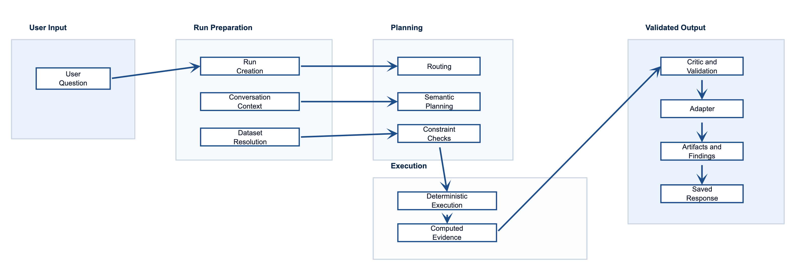
Faculty of Computer Science
Data Science and Business Analytics
Automated Data Analytics LLM Agent for Streamlining Business Operations
Agent Lifecycle: Request → Validated Response

Slide 11
Faculty of Computer Science
Data Science and Business Analytics
Automated Data Analytics LLM Agent for Streamlining Business Operations
KPI Planning Workflow: Business-Semantic Reasoning
Profit Margin
1
Intent Detection
Total Profit / Total Revenue × 100
Routing layer maps question to business KPI path
Loss Rate
Share of records with negative profit
2
Constraint Locking
Explicit metric / aggregation / grouping locked before LLM interpretation
Shipping Cost Burden
Total Shipping Cost / Total Revenue
3
Schema-Driven Registry
Discount Sensitivity
Column-name markers detect revenue, profit, discount, shipping fields
Discount vs Profit/Margin correlation
4
Formula Execution
Operational Inefficiency
KPI formulas executed deterministically via pandas over SQLite
Heuristic: weak margin + losses + discount + shipping
5
Grounded Synthesis
High-Sales-Low-Profit
LLM explanation receives only computed KPI rows - no raw dataframes
Heuristic: high revenue, weak profit/margin
100% KPI Correctness across all 7 KPI benchmark cases

Slide 12
Faculty of Computer Science
Data Science and Business Analytics
Automated Data Analytics LLM Agent for Streamlining Business Operations
Validation Workflow: Correctness Before Delivery
Plan Validation
Execution Gating
Grounding Critic
Artifact Metadata
Column existence check
Schema / dtype inspection blocked
Unknown field detection
Dataset ID + branch lineage
Metric type compatibility
Correct dataset scope selected
Domain leakage (health↔retail)
Metric / dimension logged
Forbidden aggregation guard
Runtime table available
Stale context prevention
Aggregation type recorded
Constraint lock enforcement
Aggregation matches intent
Unsupported claim blocking
Chart type confirmed
Identifier-column rejection
KPI formula inputs present
Hallucination marker check
Run ID linked to finding
100% groundedness within evaluated benchmark cases · 100% Metric Selection · 100% Aggregation Accuracy across all 19 benchmark cases

Slide 13
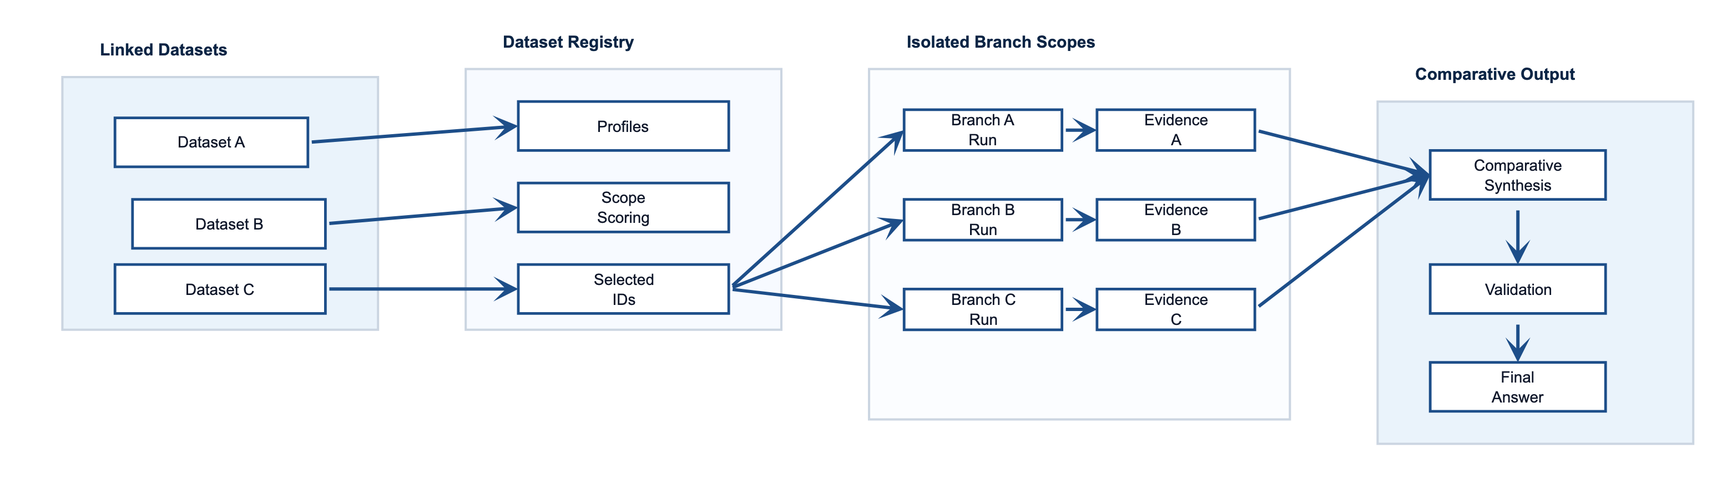
Faculty of Computer Science
Data Science and Business Analytics
Automated Data Analytics LLM Agent for Streamlining Business Operations
Multi-Dataset Branch Orchestration

Slide 14
Evaluation
Automated Data Analytics LLM Agent for Streamlining Business Operations

Slide 15
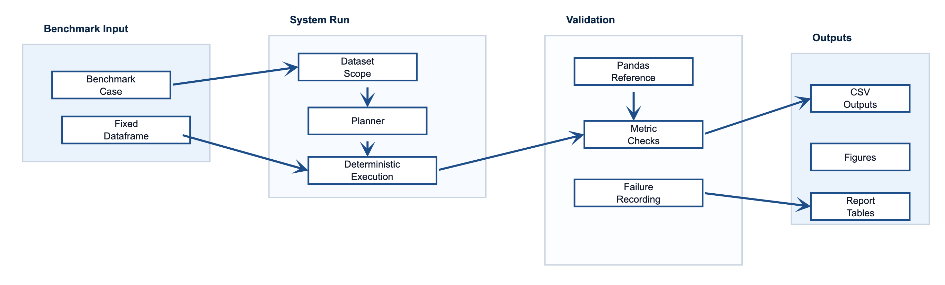
Faculty of Computer Science
Data Science and Business Analytics
Automated Data Analytics LLM Agent for Streamlining Business Operations
Evaluation Framework: Deterministic Benchmark

Slide 16
Results & Limitations
Automated Data Analytics LLM Agent for Streamlining Business Operations

Slide 17
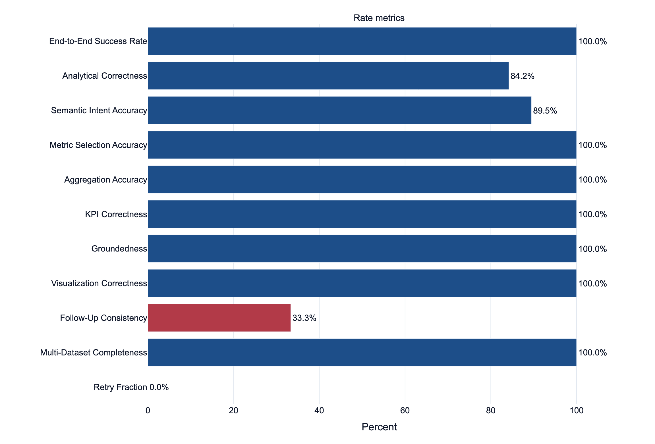
Faculty of Computer Science
Data Science and Business Analytics
Automated Data Analytics LLM Agent for Streamlining Business Operations
Benchmark Performance by Evaluation Metric
19
Benchmark Cases
16
Cases Passed
3
Failures
43ms
Mean Deterministic Execution Latency

Slide 18
Faculty of Computer Science
Data Science and Business Analytics
Automated Data Analytics LLM Agent for Streamlining Business Operations
Failure Analysis: 3 Real Failures from the Benchmark
All 3 failures produced an answer - without deterministic validation they would appear as successes.
F1 health_smoker_prevalence
F2 followup_avg_to_total_sales
F3 followup_filter_above_5000
Root Cause
Healthcare semantic mismatch. Extra gender grouping added despite smoker-only intent.
Impact
Output compared smoker×gender combinations instead of smoker-only groups.
Fix
Stronger domain-specific grouping constraints + dedicated prevalence planner for healthcare.
Root Cause
Aggregation patch failure. System kept mean aggregation despite explicit “use total sales” instruction.
Impact
Follow-up correction ignored. Ranking remained mean-based.
Fix
Explicit aggregation-override detection in follow-up patching logic.
Root Cause
Threshold filter was not applied after aggregation.
Impact
Result included a city below the total sales > 5000 threshold.
Fix
Post-execution filter validation for ranked and filtered outputs.
Healthcare Semantic Grouping
Follow-Up Aggregation Patching
Follow-Up Threshold Filtering

Slide 19

Faculty of Computer Science
Data Science and Business Analytics
Automated Data Analytics LLM Agent for Streamlining Business Operations
Strengths vs. Weaknesses
Strengths
Weaknesses
● Computed numbers in deterministic benchmark path
● 100% KPI correctness across benchmark cases
● No observed domain leakage in benchmark
● 100% visualization correctness
● Clear artifact and report workflow
● Multi-dataset evidence packages
● Honest benchmark - failures stay in denominator
● Follow-up consistency is weak (33.3%)
● Healthcare / categorical-heavy semantics need improvement
● Benchmark is focused, not exhaustive (19 cases)
● Live LLM benchmark not included
● Evaluation limited to CSV-based workflows
● No operating-system-level sandboxing

Slide 20
Faculty of Computer Science
Data Science and Business Analytics
Automated Data Analytics LLM Agent for Streamlining Business Operations
Limitations and Current Boundaries
A. Dataset Type Sensitivity
B. Follow-Up Reasoning
C. Benchmark Scope
Numeric and mixed business datasets perform reliably. Categorical-heavy datasets require stronger domain reasoning - key factor in healthcare-related errors.
Follow-up corrections are the weakest benchmark dimension (33.3%). Aggregation overrides and threshold filters need stronger constraint tracking.
19 deterministic cases - focused validation, not full certification. Live LLM provider variability was not evaluated in the final benchmark.
D. Data Source Scope
E. Execution Safety
F. Deployment Scope
G. Dataset Resolver
CSV-based analytical workflow. Database connectors and enterprise ingestion are future work.
Application-level: AST checks, restricted built-ins, read-only SQL. Not an OS-level sandbox.
SQLite/local prototype validated for coursework. Multi-tenant production deployment requires additional engineering.
Benchmark pre-selects IDs. Open-ended resolver accuracy is untested.
These limitations define the current scope of the system and future engineering priorities.

Slide 21
Faculty of Computer Science
Data Science and Business Analytics
Automated Data Analytics LLM Agent for Streamlining Business Operations
Product Walkthrough: End-to-End Investigation
1
Upload CSV
2
Ask a Question
3
Route & Plan
Upload CSV files
Schema profiling + SQLite runtime tables
Ask analytical question
Request enters investigation workspace
Semantic intent routing
Deterministic / KPI / Multi-DS path
4
Execute
5
Critic Validates
6
Deliver Artifacts
Deterministic execution
Computed over real data, not LLM inference
Validation + grounding critic
Checks metrics, constraints, and domain leakage
Deliver validated artifacts
Charts, tables, reports + metadata
deterministic benchmark & integration validation
19 benchmark cases
100% completion
84.2% analytical correctness

Slide 22
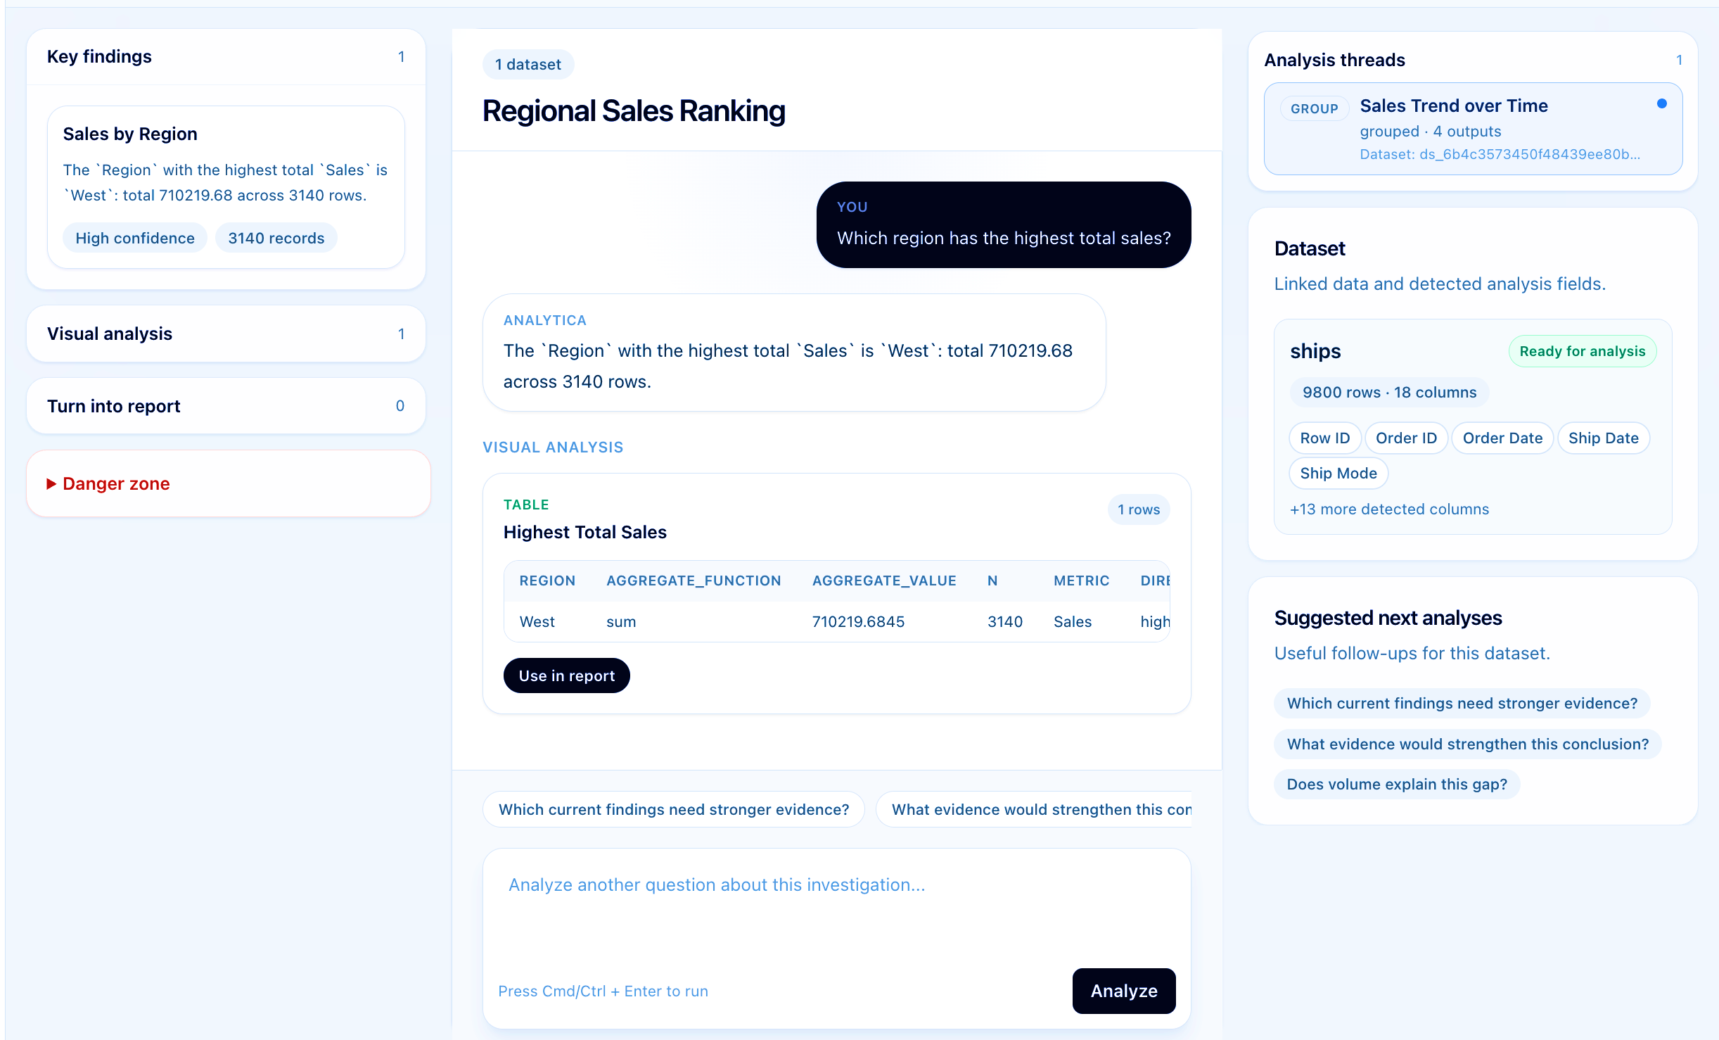
Faculty of Computer Science
Data Science and Business Analytics
Automated Data Analytics LLM Agent for Streamlining Business Operations
Interactive Investigation Workspace
Track analytical sessions and findings
Investigation Management
Validated KPI tables and grounded outputs
Evidence-Based Analytics
Isolated reasoning across datasets
Multi-Dataset Workflows
Turn investigations into editable reports
Human-in-the-Loop Reporting

Slide 23
System Architecture
Automated Data Analytics LLM Agent for Streamlining Business Operations

Slide 24
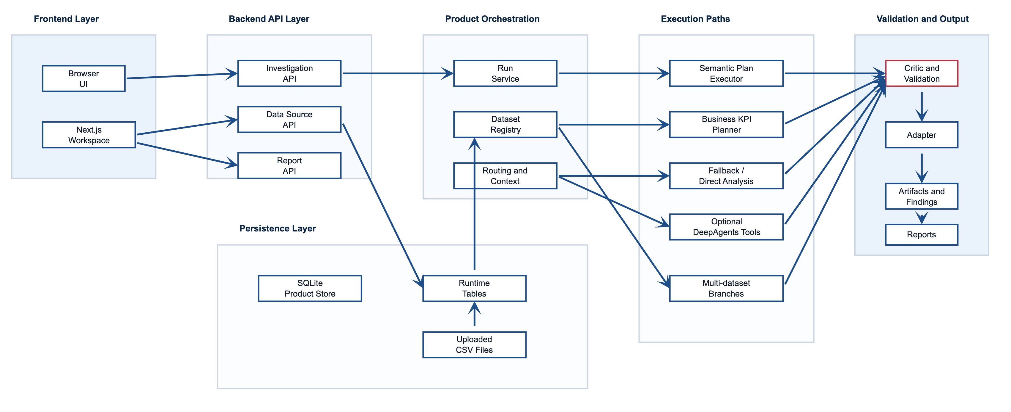
Faculty of Computer Science
Data Science and Business Analytics
Automated Data Analytics LLM Agent for Streamlining Business Operations
Full System Architecture

Slide 25
Faculty of Computer Science
Data Science and Business Analytics
Automated Data Analytics LLM Agent for Streamlining Business Operations
Technology Stack
Frontend
Backend
Persistence
Next.js 14 · React / TypeScript · Tailwind CSS · Typed API Client
FastAPI · Pydantic · LangChain · AST-restricted execution
SQLite (Product Store) · CSV Runtime Tables · Agent Checkpointing
AI / Planning
Evaluation
Testing
Provider-configurable LLM layer · Semantic Plan Validator · KPI Registry · Grounding Critic
Deterministic benchmark · Pandas reference validation · Failure analysis CSV
Backend regression validation · Frontend integration tests
Prototype deployment: FastAPI + Next.js · SQLite persistence · configurable LLM provider

Slide 26
Faculty of Computer Science
Data Science and Business Analytics
Automated Data Analytics LLM Agent for Streamlining Business Operations
Team Contribution
Irina Milova
Analytical Intelligence
Anastasia Podoliakina
Product Platform
• Analytical execution architecture
• Semantic routing
• Deterministic execution layer
• KPI planning and business-semantic reasoning
• Critic and validation logic
• Benchmark design and evaluation framework
• Multi-dataset reasoning workflows
• FastAPI service integration and orchestration
• Persistence layer (SQLite, runtime tables)
• Artifact and report infrastructure
• Frontend workspace UI (Next.js / React)
• Visualization infrastructure and deployment
• Integration testing and documentation
• Investigation workspace session model

Slide 27
Faculty of Computer Science
Data Science and Business Analytics
Automated Data Analytics LLM Agent for Streamlining Business Operations
Conclusion & Future Work
100%
Completion
84.2%
Analytical Correctness
100%
KPI Correctness
100%
Benchmark Groundness
The benchmark results suggest that separating semantic reasoning from deterministic computation improves analytical reliability.
Future Work
→ Improve follow-up consistency
→ Strengthen healthcare / categorical-heavy semantics
→ Add live LLM benchmarking with provider variability
→ Extend data ingestion beyond CSV

Slide 28

Faculty of Computer Science
Data Science and Business Analytics
Automated Data Analytics LLM Agent for Streamlining Business Operations
References
References
[1] crazycloud. Data Analysis LLM Agent. GitHub Repository, 2023.
[2] Egg et al. DABstep: Data Agent Benchmark for Multi-step Reasoning. arXiv, 2025.
[3] Ferrag et al. From LLM Reasoning to Autonomous AI Agents: A Comprehensive Review. arXiv, 2025.
[4] Lei et al. DAComp: Benchmarking Data Agents Across the Full Data Intelligence Lifecycle. ICLR, 2026.
[5] Liang and Tong. LLM-Powered AI Agent Systems and Their Applications in Industry. arXiv, 2025.
[6] NVIDIA. GenerativeAIExamples: Data Analysis Agent. GitHub Repository, 2025.
[7] Pantiukhin et al. A Hierarchical Multi-Agent System for Autonomous Discovery in Geoscientific Data Archives. arXiv, 2026.
[8] Rahman et al. LLM-Based Data Science Agents: Capabilities, Challenges, and Future Directions. arXiv, 2025.
[9] Tang et al. LLM/Agent-as-Data-Analyst: A Survey. arXiv, 2025.
[10] Wang et al. LLM and Agent-Driven Data Analysis for Enterprise Applications. arXiv, 2025.
[11] Weng et al. DataLab: A Unified Platform for LLM-Powered Business Intelligence. arXiv, 2024.

