Slide 1
Reinforcement Learning-Guided Beam-Search
Decoding for CTC-Based ASR Models
Diagnosis: the bottleneck in near-converged CTC decoding is linguistic, not acoustic.
Individual Research Project
Ivan Novosad
BSc Data Science & Business Analytics, HSE University
Supervisor: Peter Lukianchenko, Cand. of Sciences, Senior Lecturer
Notes:
Good afternoon. My project is on reinforcement-learning-guided beam-search decoding for CTC speech-recognition models. I'm Ivan Novosad, from Data Science and Business Analytics. I'll spend most of these ten minutes on the result and what it tells us.

Slide 2
The opportunity: a frozen model already knows better
CTC + greedy decoding is fast, but greedy does not pick the model’s most probable transcript.
Better candidates already sit in the N-best list — free accuracy the model supports but greedy throws away.
Two levers to claim the gap:
Change the model — training
Change the selection — decoding
Greedy
6.02%
Oracle
3.53%
2.49 pp
oracle gap on dev-other at G=128
Formal problem
oracle gap = WER(greedy) − minᵢ WER(yᵢ)
Notes:
CTC models recognise speech fast because they decode every frame in parallel. The standard choice, greedy decoding, is quick but it doesn't pick the most probable transcript the model can actually produce. If you generate a list of candidates and take the best one in each list, the oracle, the error rate drops from six percent to three and a half. That two-and-a-half-point gap is real, free accuracy the model already supports but greedy throws away. There are exactly two levers: change the model with training, or keep the model fixed and choose a better candidate at decode time. I test both.

Slide 3
One diagnostic question — two probes
Research question
Where does the missing information live — inside the acoustic model, or at the acoustic↔linguistic boundary?
Probe A — Training (RL)
Modify the model with a sequence-level objective
Probe B — Decoding
Keep the model frozen; reselect from the beam-search N-best
Both probes run on one frozen model — the 22M-parameter CR-CTC checkpoint (consistency-regularized CTC).
Notes:
Underneath both levers is one diagnostic question: where does the information needed to close the gap actually live, inside the acoustic model, or at the boundary between acoustics and language? I treat the two levers as two probes of that question, both run on one frozen model. The RL-style training probe and the beam-search decoding probe are both named in the title; as you'll see, it's the contrast between them, one fails and one works, that localizes the bottleneck.

Slide 4
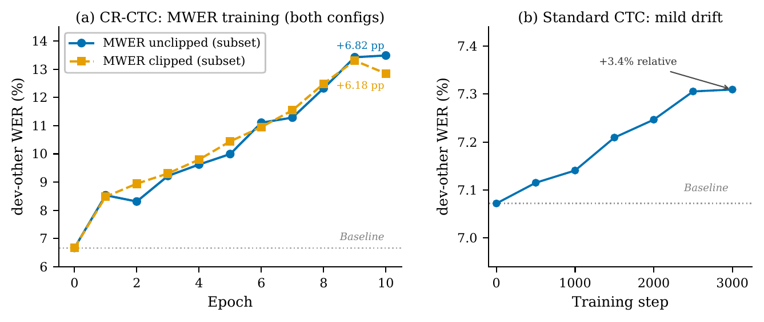
Probe A — training cannot close the gap (and that is the finding)
 | MWER (REINFORCE) | RAFT (distillation)
CR-CTC | Collapse +6.2 to +8.9 pp | Not run — gap ≈ 0
Standard CTC | Mild drift +3.4% / 3k | Collapse / frozen (basin)
RAFT = best-candidate supervised distillation (a cleaner, lower-variance gradient than MWER).
All four MWER/RAFT cells degrade WER.
Two separable causes: no reward signal (training gap 0.007 pp) · behavior consistent with a sharp loss basin.
Not a gradient-quality problem: CTC backward is already a Rao-Blackwellized REINFORCE estimator (~3× lower variance). Verified in the report.
Notes:
First probe: can training push the model to close the gap? I ran a two-by-two, two model types crossed with two training objectives. Every cell degrades accuracy. But the way they fail is the finding. On the consistency-regularised model there's essentially no reward to learn from: on training data the oracle gap is seven thousandths of a point, so the gradient just tracks noise. On the standard model there is signal, but the checkpoint sits in such a sharp loss basin that any step large enough to matter overshoots it. I also proved that the CTC backward pass is already a Rao-Blackwellised REINFORCE estimator, about three times lower variance than the alternatives, so this is not a gradient-quality problem. The takeaway: more training does not close the gap at a converged checkpoint. Q&A: the standard-CTC checkpoint is AED-shaped, trained with 90 percent attention-decoder loss, so the two-by-two separates CR-CTC versus AED-shaped CTC, not versus pure CTC; volunteer that if pressed. And the sharp-basin reading can't be fully separated from distribution-mismatch forgetting, both predict collapse at 1e-6 and frozen at 1e-7.

Slide 5
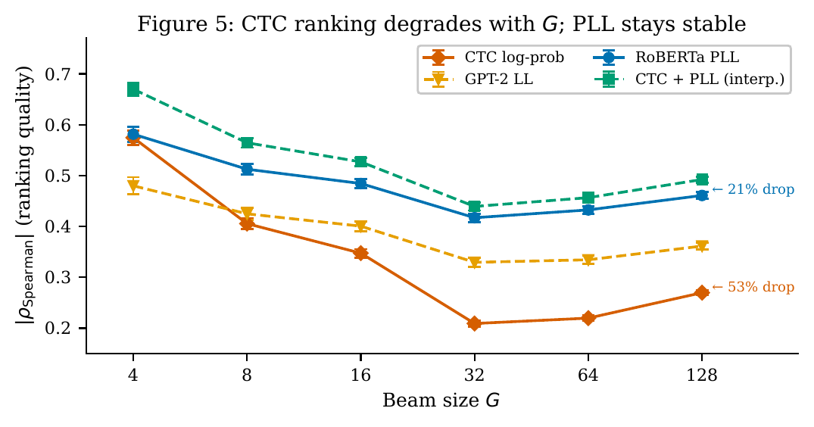
Probe B, step 1 — the acoustic signal is exhausted
Freeze the same CR-CTC model; reselect using only CTC’s own information.
11 CTC-internal scorers → none beats greedy (best −0.035 pp, all n.s.):
argmax · length-norm · MBR-CER (τ=1, 50) · MBR-WER · self-consistency · MC-dropout · contrastive decoding · 3-gram fusion · 14-feature MLP · encoder value head
Spearman ρ: −0.57 → −0.27 across G — CTC ranking collapses (53% drop, blank-path proliferation).
⇒ The bottleneck is linguistic, not acoustic.
Notes:
Second probe: freeze the model and try to pick a better candidate using only what the acoustic model knows. I tried eleven scoring methods built from CTC posteriors and encoder features. None of them beats greedy by a significant margin. And there's a clean mechanism: as the candidate list grows, CTC's ability to rank candidates collapses, its correlation with true error drops by half, because the list fills up with near-duplicate paths that differ only in blank placement, which is acoustically meaningless. So the acoustic signal is genuinely exhausted. That's the central diagnosis: the bottleneck is not acoustic. It's linguistic. Q&A: the eleven methods are eleven distinct scoring strategies beyond the greedy and argmax baseline; the appendix table lists thirteen rows.

Slide 6
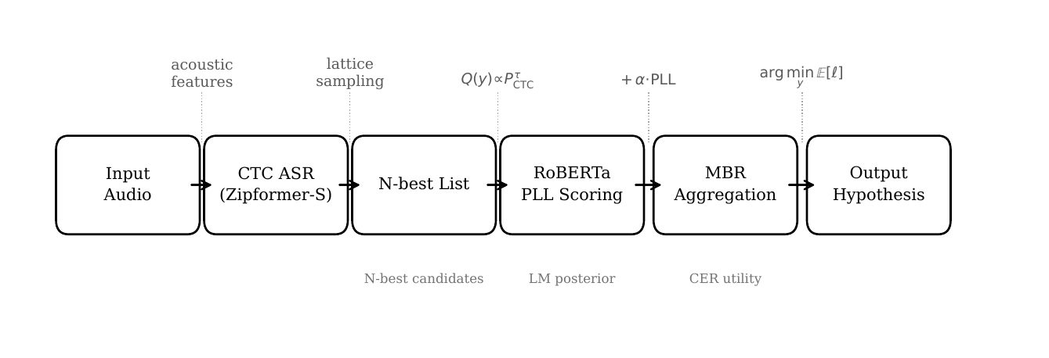
Probe B, step 2 — language information breaks through
Supply the missing linguistic signal — two ingredients:
X · RoBERTa PLL posterior
how good is each candidate as English?
Y · MBR decoding
pick the consensus candidate, not the argmax
PLL ranking drops only 21% over the same range — sharp where CTC dies.
Held-out test-other, G=128
5.96% → 5.42%
−0.535 pp · 9.0% relative · p < 0.0001
Breaking through confirms the diagnosis.
Notes:
If the missing information is linguistic, supply it. I combine two ingredients: a RoBERTa language-model score that measures how good each candidate is as English, and Minimum Bayes Risk decoding, which picks the consensus candidate rather than the single highest-scoring one. The language-model ranking barely degrades as the list grows, twenty-one percent versus CTC's fifty-three, so it stays informative exactly where the acoustic model fails. On the held-out test set, error drops from 5.96 to 5.42 percent: a nine-percent relative reduction, highly significant, with no retuning. And here's the key move: the fact that adding linguistic information breaks through a ceiling no acoustic method could touch is what proves the bottleneck was linguistic all along. Q&A on cost: MBR plus PLL over 128 candidates is expensive, PLL needs a masked forward pass per token and MBR is pairwise over the set; that cost is exactly why I frame this as diagnostic rather than deployable, and an efficient version is future work. Q&A on CER vs WER: optimizing and scoring the same metric on the same set is circular, so I optimize CER and report WER as the fair comparison; the MBR-WER optimum is 0.07 pp better and sits in backup only. Q&A if 0.5 pp sounds small: it's about 21 percent of the 2.49 pp recoverable oracle gap, gap closure 20.7 percent, and it's a diagnostic existence result, not a deployment claim. Q&A if the method looks self-contradictory (PLL-only posterior vs needing CTC): two roles — CTC generates and bounds the candidate set, that's the anchoring, while the final posterior weights are PLL-only with the CTC exponent driven to zero; pure PLL argmax without CTC-generated candidates degrades to 9.75 percent. Acoustics propose, language disposes.

Slide 7
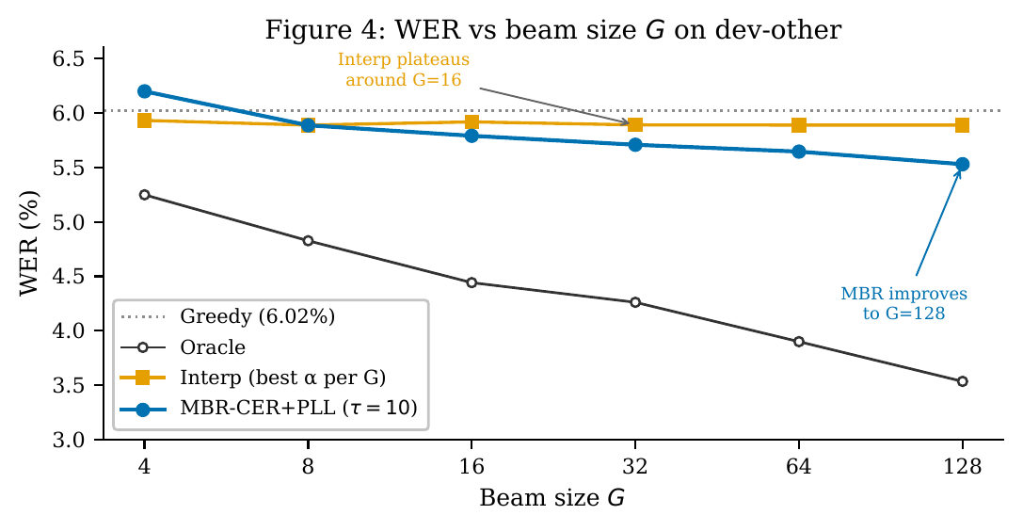
Why MBR — consensus gains where rescoring stalls
Plain rescoring (argmax) plateaus at G=8 (~5.89%).
MBR keeps improving to G=128 (5.53% on dev-other).
Near-duplicate candidates vote together; the consensus denoises the list — redundancy becomes evidence.
Notes:
Why MBR specifically. Plain rescoring picks one winner and stops gaining past eight candidates; MBR keeps improving to a hundred and twenty-eight, because near-duplicate candidates vote together and the consensus cancels the per-candidate noise. Redundancy becomes evidence.

Slide 8
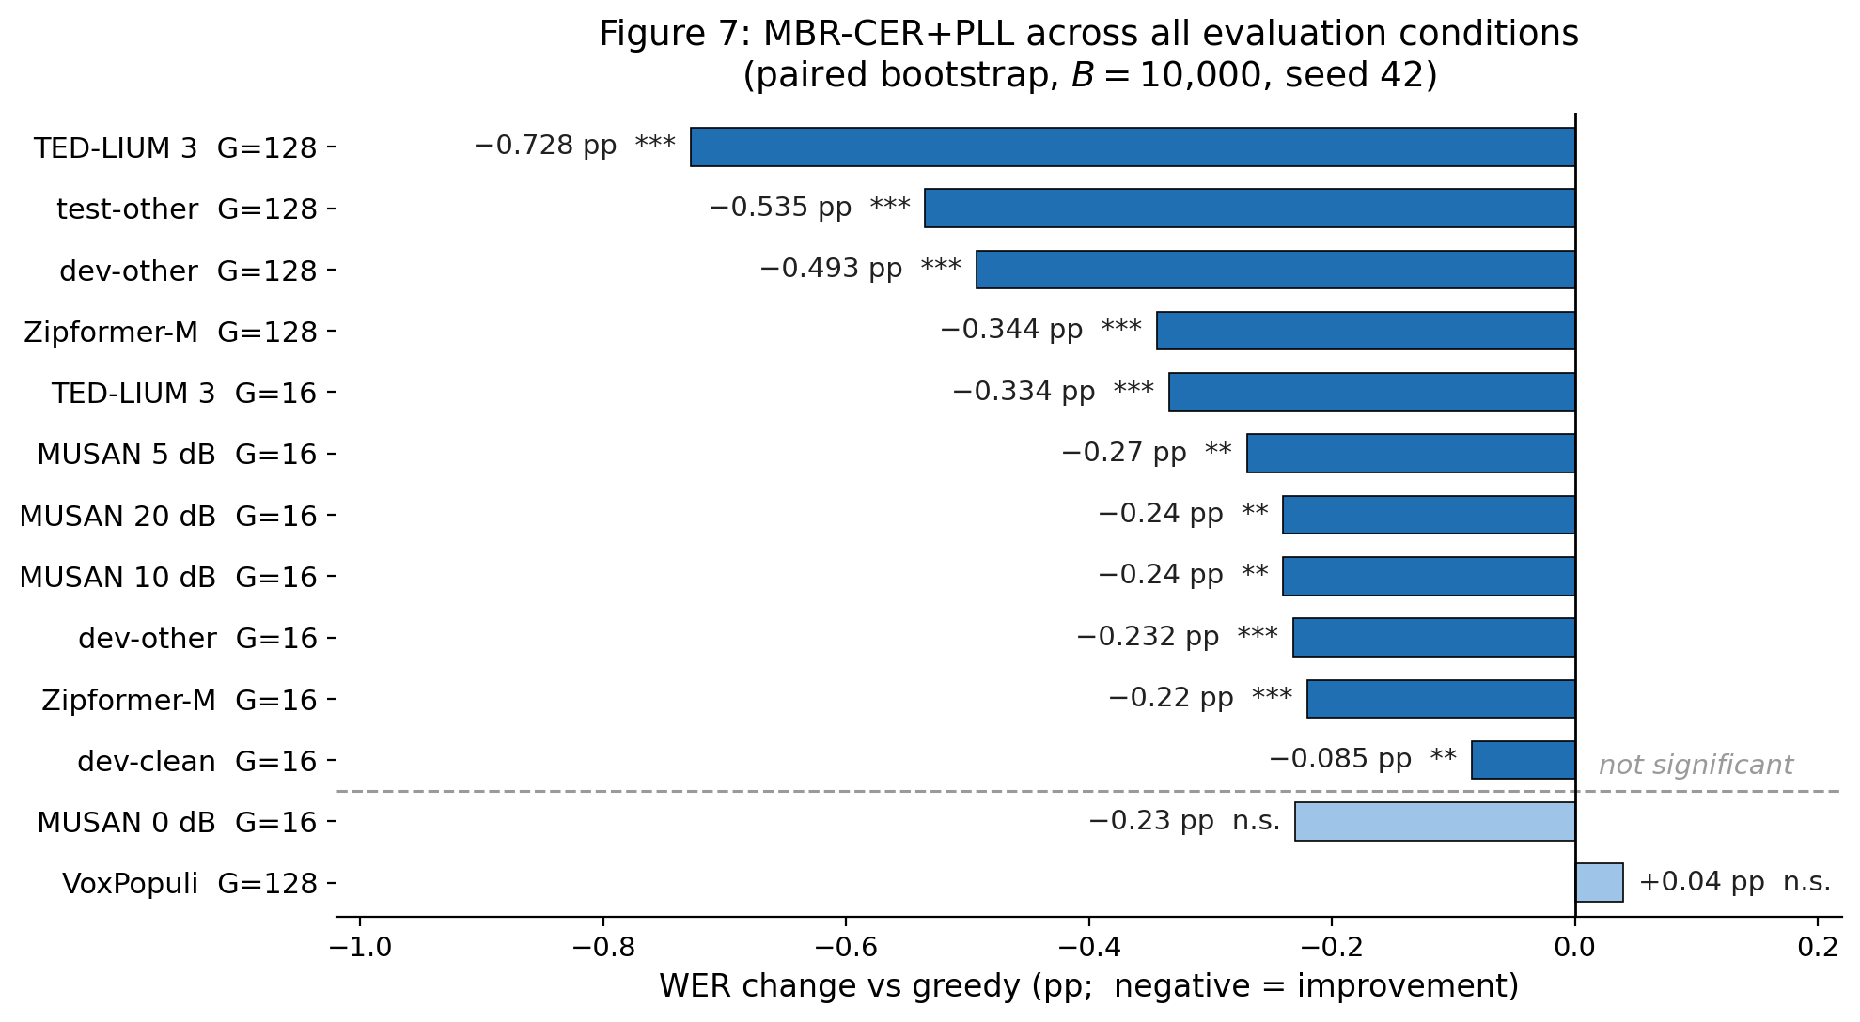
The recipe transfers — 11 of 13 conditions, zero retuning
Same recipe — τ=10, CER, G=128 — unchanged across:
2 model sizes (22M / 65M)
3 domains
4 noise levels
The 2 misses (VoxPopuli, MUSAN 0 dB) are explained by the same ranking-divergence analysis — candidate-quality limits, not method limits.
All conditions Zipformer-S (22M) unless marked Zipformer-M (65M).
Notes:
A single number on one dataset isn't a contribution, so I fixed the recipe and ran it untouched across thirteen conditions: two architectures, three domains, four noise levels. It's significant in eleven of them, with no per-condition tuning. The two that don't reach significance aren't surprises, they fall out of the same ranking-divergence analysis. On European-Parliament speech almost every utterance is already optimal, so there's nothing to recover; and under the heaviest noise the candidate list itself degrades. The method works wherever the candidates contain something worth selecting, and fails only where they don't. Q&A: the thirteen aren't independent replications, the axes are beam size, architecture, domain and noise, and the independent domain transfers are TED-LIUM 3 and VoxPopuli. MUSAN 0 dB shows a negative point estimate but p is 0.646: the corpus delta is driven by a few high-error utterances and the per-utterance interval spans zero. Q&A on multiple comparisons: I corrected — Holm-Bonferroni across all 13 leaves every one of the 11 significant (worst adjusted p=0.019, dev-clean), and Benjamini-Hochberg FDR at q=0.05 gives the identical set; the two non-significant results are non-significant before and after correction.

Slide 9
The ceiling, characterized
0.47 pp recovered
2.01 pp selection residual — 81% of the recoverable gap
2.49 pp oracle gap at G=128
Most of the residual is selection error: the right answer is in the list, but the score surface is too flat to pick it.
Robust across everything tested: 63 MBR configs · a trained DistilBERT reranker · a 2-LM ensemble — none beats RoBERTa PLL alone.
⇒ The remaining error points beyond text-only scoring, toward acoustic grounding — the next frontier.
Notes:
So is there more to squeeze? I mapped the ceiling. Most of the leftover gap isn't missing candidates, it's selection: the right answer is in the list, but the score surface is too flat to pick it. And this ceiling is robust across everything I tried: sixty-three MBR configurations, a trained neural reranker, and a two-language-model ensemble, none beat RoBERTa on its own. So within text-only scoring the signal is saturated; the remaining error points to acoustic information the text scorer doesn't have, which tells the next researcher where to look. Q&A: if acoustic features got zero weight in the value head, why is acoustic grounding next? Because the value head used frozen-checkpoint embeddings on near-perfect data with no error signal, the same sparsity problem; acoustic grounding trained with a real error signal is the natural next probe, not a guarantee.

Slide 10
Conclusion
The bottleneck in near-converged CTC decoding is linguistic, not acoustic — proven by breaking through it.
Question: close the 2.49 pp oracle gap with no new data and no extra inference cost — by training it (MWER, RAFT) or decoding it smarter (11 internal scorers)?
Answer — no: training has no better lever (CTC backward is already the Rao-Blackwellized REINFORCE estimator; at convergence there is no reward, 0.007 pp), and the 11 acoustic scorers are exhausted.
Positive control: external linguistic information (MBR + RoBERTa PLL) recovers ~9% relative — a control, not a recipe. Only linguistic information breaks through, which is what proves the bottleneck is linguistic.
0 / 11
CTC-internal scorers beat greedy — acoustic signal exhausted
9.0%
relative WER reduction with linguistic information (held-out)
11 / 13
conditions improved, zero retuning
Notes:
Let me close by retracing the whole thing as one question. We start from a clear opportunity: a converged CTC model leaves two and a half points on the table — better transcripts already sit in its own N-best. The question this work asks is whether that gap can be closed without new data and without paying at inference time, either by training the model, with MWER and distillation, or by decoding it more cleverly, with eleven internal and acoustic scorers. The analysis answers no, and says exactly why. On the training side there's no better lever to pull: CTC's own backward pass is already the Rao-Blackwellized REINFORCE estimator, the lowest-variance one, and at a converged checkpoint there is no reward signal to begin with — the training oracle gap is seven thousandths of a point. On the decoding side the acoustic signal is exhausted: all eleven scorers fail. Then, to prove the gap is genuinely recoverable and to locate what's missing, I run a positive control — Minimum Bayes Risk with an external RoBERTa posterior. It recovers nine percent relative. It's expensive, and that's the point: it isn't a deployment recipe, it's the control that shows the gap is real and that the missing ingredient is linguistic, not acoustic. Thank you; I'm happy to take questions. Q&A on what I did vs the libraries: the components are off-the-shelf; the diagnostic program is mine — eleven null scorers, the 2x2 training study, the 63-config MBR sweep, the cross-condition battery, the selection-vs-coverage decomposition, and identifying and numerically verifying CTC backward as Rao-Blackwellized REINFORCE.

Slide 11
Thank you
Ivan Novosad · HSE University
Code & raw results: github.com/Melodiz/RBPO
Notes:
Closing slide — stays up during Q&A.

Slide 12
Backup — Results across conditions
Condition | Model | G | Greedy | Oracle | MBR+PLL | Δ pp | p | Gap %
dev-clean | Zipformer-S | 16 | 2.37 | 1.54 | 2.28 | −0.09 | 0.008 | 10.3
dev-other | Zipformer-S | 16 | 6.02 | 4.44 | 5.79 | −0.23 | <1e-4 | 14.7
dev-other | Zipformer-S | 128 | 6.02 | 3.53 | 5.53 | −0.49 | <1e-4 | 19.8
test-other | Zipformer-S | 128 | 5.96 | 3.37 | 5.42 | −0.54 | <1e-4 | 20.7
dev-other | Zipformer-M | 16 | 4.78 | 3.44 | 4.56 | −0.22 | <1e-4 | 16.5
dev-other | Zipformer-M | 128 | 4.78 | 2.73 | 4.43 | −0.34 | <1e-4 | 16.8
TED-LIUM 3 | Zipformer-S | 16 | 11.30 | 9.16 | 10.97 | −0.33 | <1e-4 | 15.6
TED-LIUM 3 | Zipformer-S | 128 | 11.30 | 7.51 | 10.57 | −0.73 | <1e-4 | 19.2
VoxPopuli | Zipformer-S | 128 | 18.29 | 17.97 | 18.33 | +0.04 | n.s. | —
MUSAN 20 dB | Zipformer-S | 16 | 6.62 | 4.89 | 6.38 | −0.24 | 0.006 | 13.9
MUSAN 10 dB | Zipformer-S | 16 | 8.04 | 6.26 | 7.80 | −0.24 | 0.003 | 13.5
MUSAN 5 dB | Zipformer-S | 16 | 11.10 | 9.06 | 10.84 | −0.27 | 0.001 | 13.0
MUSAN 0 dB | Zipformer-S | 16 | 17.88 | 15.57 | 17.64 | −0.23 | 0.646 | —
13 conditions, 11 significant (VoxPopuli and MUSAN 0 dB n.s.). test-other G=16 (−0.19 pp) is reported inline, not duplicated.
Notes:
Backup — Q&A only. The report's master results table (Appendix A): 13 conditions, 11 significant — matches Fig. 7 (Slide 8) exactly. If asked why test-other G=16 isn't a row: it's reported inline (−0.19 pp, p=3e-4) and not duplicated, per the report convention.

Slide 13
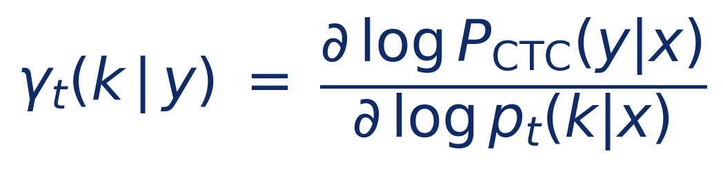
Backup — the theory in one line
CTC backward returns the alignment posterior γₜ — the gradient of the log-probability w.r.t. log-emissions. That makes standard MWER a Rao-Blackwellized REINFORCE estimator: variance 2.96× below Viterbi, 3.87× below sampled (250 utterances, 0 violations).
At decode time the model is frozen — there is no policy to improve. MBR is Bayes-optimal hypothesis selection under a posterior, not RL.
Notes:
Backup — Q&A only. The training-side theory and the RL / decision-theory boundary.

Slide 14
Backup — ranking quality by beam size (Spearman ρ)
G | CTC ρ | RoBERTa PLL ρ | Gap |Δρ|
4 | −0.574 | −0.581 | 0.007
8 | −0.406 | −0.513 | 0.107
16 | −0.347 | −0.484 | 0.137
32 | −0.209 | −0.417 | 0.208
64 | −0.220 | −0.433 | 0.213
128 | −0.270 | −0.461 | 0.191
More negative = better ranker. Over G=4→128: CTC degrades 53%, RoBERTa PLL only 21%.
Notes:
Backup — Q&A only. The numbers behind the G-scaling divergence.

Slide 15
Backup — training-time detail
CR-CTC — training oracle gap 0.007 pp → no reward; all 4 MWER configs collapse +6.18 to +8.90 pp.
Standard CTC — gap 0.74 pp (106× larger) → mild drift +3.4% / 3000 steps; the signal does not transfer to dev.
RAFT (clean gradient) — collapses at lr 1e−6 (4.86% → 65.5% by step 800); frozen at 1e−7 / 1e−8. Collapse boundary < 1 order of magnitude.
⇒ Two separable failures: missing reward (CR-CTC) vs sharp basin (standard CTC). Neither model meets both necessary conditions.
Side-finding: CR-CTC also improves calibration — anti-correlated ρ fraction 15.7% → 6.9%.
Caveat: the standard-CTC checkpoint is AED-shaped (90% attention-decoder loss), so the matrix separates CR-CTC vs AED-shaped CTC, not vs pure CTC.
Notes:
Backup — Q&A only. The 2x2 outcome matrix in numbers.

Slide 16
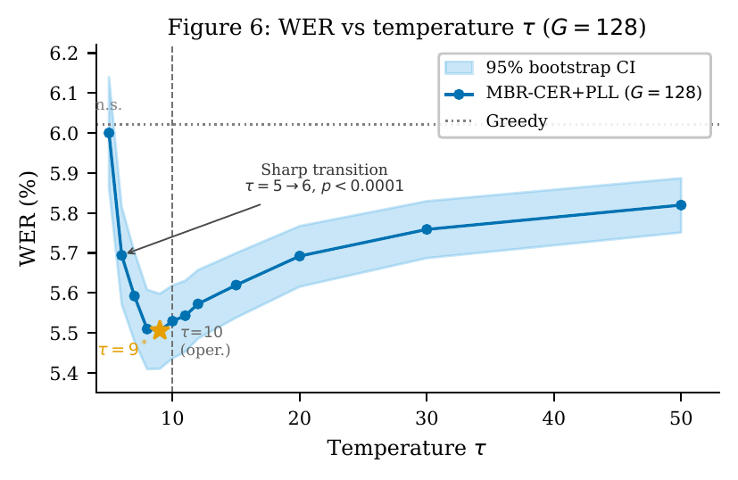
Backup — temperature calibration (τ)
Sharp transition at τ = 5→6 (n.s. → p < 0.0001).
Flat optimum τ ∈ [8, 11]; operational τ = 10 is 0.024 pp off the τ = 9 optimum.
The flat region means no held-out tuning is needed.
Notes:
Backup — Q&A only. Why τ=10 needs no held-out tuning.

Slide 17
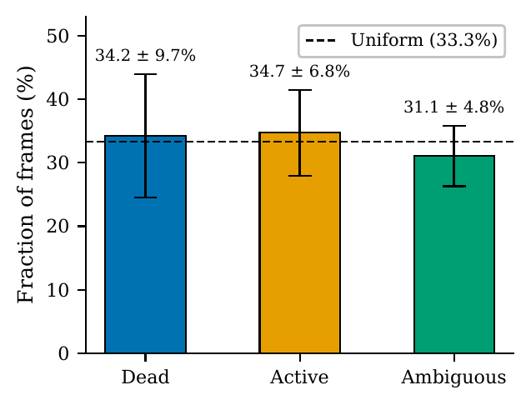
Backup — CR-CTC alignment posterior γₜ
Prior prediction: blank dominates 70–90% of frames.
Measured (n=100): a near-equal three-way split — dead 34.2%, active 34.7%, ambiguous 31.1%.
CR-CTC’s consistency regularization spreads alignment mass, so ~2× more frames carry gradient signal.
Notes:
Backup — Q&A only. Empirical γ_t distribution behind the Rao-Blackwell variance reduction.

Slide 18
Backup — related work & novelty
Novel = a combination: a masked-LM PLL used as the MBR posterior over a CTC N-best (not a score in an argmax rescore), plus the identification of CTC backward as Rao-Blackwellized REINFORCE.
Masked-LM / PLL rescoring (Salazar 2020; Shin 2019): PLL as a drop-in score in argmax rescoring → here PLL defines the MBR posterior.
MBR in MT (Kumar 2004; Eikema 2020; Freitag 2022; Finkelstein 2024): MBR over MT samples with model / neural-metric utility → here CTC-ASR N-best, masked-LM posterior, CER utility.
MBR in ASR (Goel 2000): posterior from the acoustic lattice only, no external linguistic signal → here the posterior carries external LM evidence.
MWER / sequence training (Prabhavalkar 2018; Shannon 2017): gains from CE-pretrained checkpoints with headroom → here analyzed at a near-converged checkpoint, where it fails — and we identify why.
Variance reduction & RL (Williams 1992; Casella 1996; Shao 2024 / GRPO): → we identify CTC backward as Rao-Blackwellized REINFORCE, and show clipping cannot fix a zero-reward problem.
Notes:
Backup — Q&A only. Most contestable claim: is MBR+PLL over a CTC N-best really new vs rescoring? Defence: rescoring scores each candidate and takes the argmax; we use PLL to build a distribution and pick the min-expected-CER consensus, and the two diverge by 0.36 pp at G=128 (Slide 7), so empirically it is not the same operation.

Slide 19
Backup — the training failure is real, not a bug
Two unrelated methods, same outcome: MWER (REINFORCE) and RAFT (supervised distillation) both fail — disjoint gradient paths, so no single bug explains both.
The gradient is verified, not assumed: k2 get_tot_scores vs explicit γₜ loss agree to 2.4e−7; variance 2.96× (Viterbi), 3.87× (sampled), 0 ordering violations / 250 utts — matches Rao-Blackwell theory.
The cause is in the data, not the code: training oracle gap = 0.007 pp (greedy 1.09% vs oracle 1.08%, 5k utts) → no reward. Computed before any training ran.
Failure tracks the checkpoint: CR-CTC (gap 0.007) collapses; standard CTC (gap 0.74, 106×) only drifts +3.4%. RAFT boundary < 1 order of magnitude; loss ↓ while dev WER ↑ = generalization failure, not non-learning.
Notes:
Backup — Q&A only. The defence that the all-negative training result is real, not an implementation bug. Strongest single point: two methods with almost no shared code both fail.

Slide 20
Backup — the 11 CTC-internal scorers (all n.s.)
Method | WER % | Δ pp | p | 95% CI (pp)
Greedy (baseline) | 6.022 | 0.000 | — | —
Argmax P_CTC | 6.022 | 0.000 | 1.000 | [0.00, 0.00]
Length-norm (tokens) | 6.022 | 0.000 | 0.652 | [−0.01, +0.01]
Length-norm (chars) | 6.022 | 0.000 | 1.000 | [0.00, 0.00]
MBR-WER (τ=1) * | 6.022 | 0.000 | 1.000 | [0.00, 0.00]
MBR-CER (τ=1) | 6.028 | +0.006 | 1.000 | [0.00, +0.02]
Self-consistency | 6.040 | +0.018 | 0.721 | [−0.05, +0.08]
MBR-CER (τ=50, best) | 5.987 | −0.035 | 0.163 | [−0.10, +0.03]
Contrastive decoding | 6.071 | +0.049 | — | —
MC-dropout (T=4) | 6.030 | +0.008 | 0/5 sig. | —
14-feature MLP | 6.050 | +0.028 | — | —
3-gram shallow fusion | 6.018 | −0.004 | 0.368 | —
Encoder value head | 6.020 | −0.002 | — | —
LibriSpeech dev-other, G=16, greedy WER 6.022%. Paired bootstrap B=10,000, seed 42. *MBR-WER uses WER as both utility and metric (circular).
Notes:
Backup — Q&A only. The full CTC-internal scoring table (Appendix A.2). Every method whose CI is shown covers zero; the strongest, MBR-CER at τ=50, is −0.035 pp and still not significant (p=0.163).

Slide 21
Backup — what is CTC, and why use it?
How it works
The encoder splits audio into short frames and emits one token — or a blank — per frame; consecutive repeats and blanks are then collapsed into the transcript.
Collapse example: C C _ A _ T T → CAT
Training marginalizes over all valid frame alignments (forward–backward); no alignment labels needed.
Why CTC (vs attention seq2seq)
Frames are conditionally independent → fully parallel, non-autoregressive decoding.
Fast, low-latency, streaming-friendly; simpler to deploy — no autoregressive decoder.
Trade-off: that same independence means CTC carries almost no language model of its own.
→ That missing language model is exactly the linguistic information this work supplies at selection time.
Notes:
Backup — Q&A only, a CTC primer for any committee member who wants it. CTC emits a token or blank per encoder frame and collapses; conditional independence across frames buys parallel, low-latency decoding versus an autoregressive seq2seq decoder. The price of that independence is that CTC has almost no built-in language model — which is precisely why external linguistic rescoring is the lever that works here.

