Slide 1
Анализ данных в тестировании ПО
17 октября 2018
Антон Ситников

Slide 2
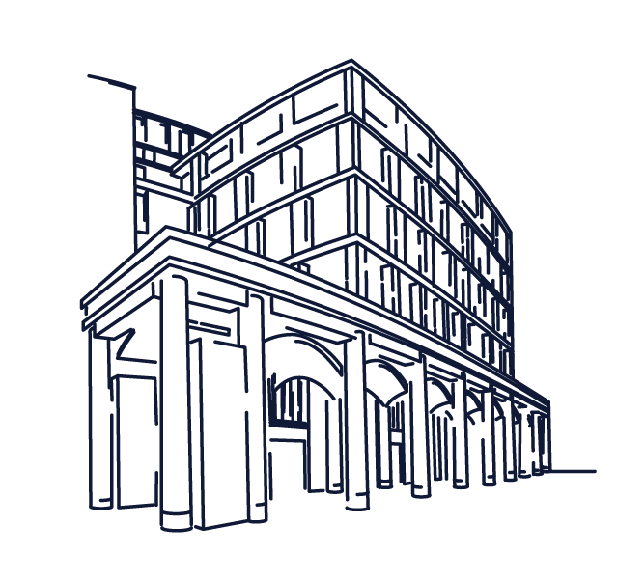
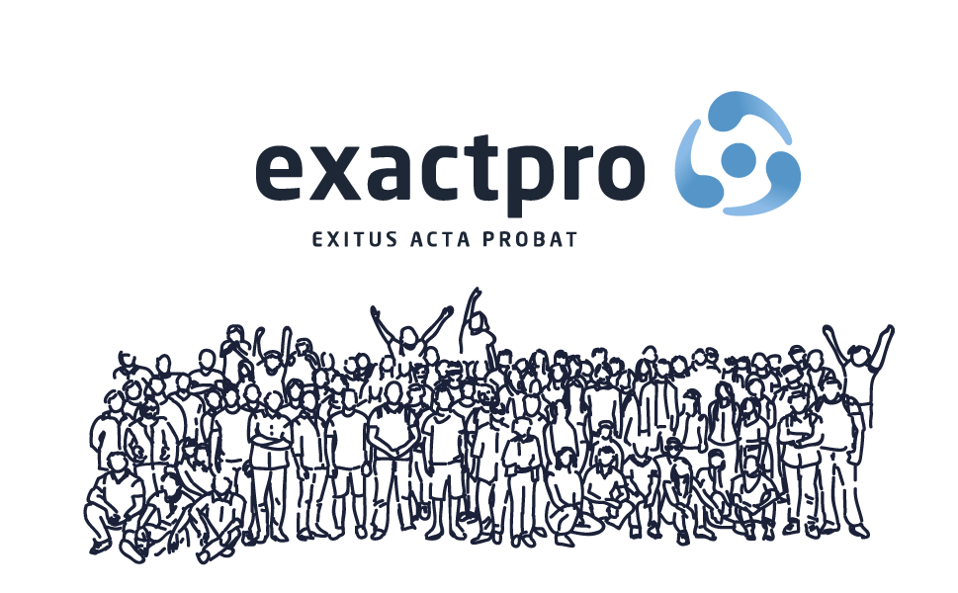
Build Software to Test Software
Exactpro была основана в день тестировщика 9.09.2009 и специализируется на разработке и тестировании программного обеспечения для ведущих финансовых организаций, к числу которых относятся биржи, инвестиционные банки, брокеры и поставщики технологических решений.
Exactpro была частью группы компаний Лондонская фондовая биржа с 2015, снова став независимой в январе 2018 года в результате выкупа компании менеджментом.
Наши проекты - это анализ и верификация распределенных и высоконагруженных технологических платформ, систем клиринга и взаиморасчетов и систем риск-менеджмента, основанных на ультрасовременных технологиях, с целью достижения их бесперебойной работы в условиях промышленной эксплуатации.
Основанная в 2009 небольшой командой из 10 человек, exactpro спустя годы выросла до компании с штатом более 550 человек и офисами в Европе, Азии и США

Slide 3
Качество ПО и тестирование

Slide 4
Обшибка. Дефект. Сбой
Ошибка (Error, Mistake) – действие, сделанное человеком в процессе разработки или проектирования ПО и ведущее к появлению дефекта
Дефект (Bug) – ошибка в программном продукте, вследствие которой продукт ведет себя непредвиденно или некорректно
Сбой (Failure) – проявление дефекта в процессе эксплуатации программного продукта

Slide 5
Программа с дефектом
public static void main(String[] argv) {
int value = new Scanner(System.in).nextInt();
System.out.println(“5 / “ + value + “ = “ + 5 / value);
}

Slide 6
Активное тестирование
Система автоматического тестирования
Программный продукт
QA engineer
Логи

Slide 7
Пассивное тестирование
Программный продукт
Система автоматического тестирования
Логи

Slide 8
Проблемы использования логов в тестировании
Большие
Неструктурированные
Формат может меняться
Неполные

Slide 9
Анализ логов
Программный продукт
Система автоматического тестирования
Логи

Slide 10
Логи
Содержание лога
Уровни вывода
ошибки
запросы пользователя
результаты промежуточных вычислений
ERROR
WARNING
INFO
DEBUG
TRACE

Slide 11
Программа с дефектом
public static void main(String[] argv) {
int value = new Scanner(System.in).nextInt();
if (value == 0) {
logger.error(“Can not divide to ” + value);
return;
}
System.out.println(“5 / “ + value + “ = “ + 5 / value);
}

Slide 12
Программа с дефектом
public static void main(String[] argv) {
int value = new Scanner(System.in).nextInt();
try {
System.out.println(“5 / “ + value + “ = “ + 5 / value);
}
catch (Exception ex) {
logger.error(“Can not divide to ” + value, ex);
}
}

Slide 13
public static void main(String[] argv) {
int value = new Scanner(System.in).nextInt();
try {
System.out.println(“5 / “ + value + “ = “ + 5 / value);
}
catch (Exception ex) {
logger.error(“Can not divide to ” + value, ex);
}
}
Can not divide to 0
Exception in thread "main“
java.lang.ArithmeticException at
com.exactpro.example.Test.Main(Test.java:4)

Slide 14
Log entry with exception
WARN 03:52:41.358 [main] [, ] NetworkClient - [Consumer clientId=consumer-1, groupId=] Error connecting to node kafka-svc:9093 (id: -1 rack: null)
java.io.IOException: Can't resolve address: kafka-svc:9093
at org.apache.kafka.common.network.Selector.doConnect(Selector.java:235)
at org.apache.kafka.common.network.Selector.connect(Selector.java:214)
at org.apache.kafka.clients.NetworkClient.initiateConnect(NetworkClient.java:864)
at org.apache.kafka.clients.NetworkClient.ready(NetworkClient.java:265)
at org.apache.kafka.clients.consumer.internals.ConsumerNetworkClient.trySend(ConsumerNetworkClient.java:485)
at org.apache.kafka.clients.consumer.internals.ConsumerNetworkClient.poll(ConsumerNetworkClient.java:261)
at org.apache.kafka.clients.consumer.internals.ConsumerNetworkClient.poll(ConsumerNetworkClient.java:242)
at org.apache.kafka.clients.consumer.internals.ConsumerNetworkClient.poll(ConsumerNetworkClient.java:218)
at org.apache.kafka.clients.consumer.internals.Fetcher.getTopicMetadata(Fetcher.java:274)
at org.apache.kafka.clients.consumer.KafkaConsumer.partitionsFor(KafkaConsumer.java:1774)
...
at com.google.inject.Guice.createInjector(Guice.java:87)
at com.google.inject.Guice.createInjector(Guice.java:69)
at net.minium.simcoe.infrastructure.process.ProcessManager.<init>(ProcessManager.java:25)
at net.minium.simcoe.backend.auth.authservice.rpc.server.AuthRPCServer.main(AuthRPCServer.java:29)
Caused by: java.nio.channels.UnresolvedAddressException: null
at sun.nio.ch.Net.checkAddress(Net.java:101)
at sun.nio.ch.SocketChannelImpl.connect(SocketChannelImpl.java:622)
at org.apache.kafka.common.network.Selector.doConnect(Selector.java:233)

Slide 15
Текст сообщения
WARN 03:52:41.358 [main] [, ] NetworkClient - [Consumer clientId=consumer-1, groupId=] Error connecting to node kafka-svc:9093 (id: -1 rack: null)
java.io.IOException: Can't resolve address: kafka-svc:9093
at org.apache.kafka.common.network.Selector.doConnect(Selector.java:235)
at org.apache.kafka.common.network.Selector.connect(Selector.java:214)
at org.apache.kafka.clients.NetworkClient.initiateConnect(NetworkClient.java:864)
at org.apache.kafka.clients.NetworkClient.ready(NetworkClient.java:265)
at org.apache.kafka.clients.consumer.internals.ConsumerNetworkClient.trySend(ConsumerNetworkClient.java:485)
at org.apache.kafka.clients.consumer.internals.ConsumerNetworkClient.poll(ConsumerNetworkClient.java:261)
at org.apache.kafka.clients.consumer.internals.ConsumerNetworkClient.poll(ConsumerNetworkClient.java:242)
at org.apache.kafka.clients.consumer.internals.ConsumerNetworkClient.poll(ConsumerNetworkClient.java:218)
at org.apache.kafka.clients.consumer.internals.Fetcher.getTopicMetadata(Fetcher.java:274)
at org.apache.kafka.clients.consumer.KafkaConsumer.partitionsFor(KafkaConsumer.java:1774)
...
at com.google.inject.Guice.createInjector(Guice.java:87)
at com.google.inject.Guice.createInjector(Guice.java:69)
at net.minium.simcoe.infrastructure.process.ProcessManager.<init>(ProcessManager.java:25)
at net.minium.simcoe.backend.auth.authservice.rpc.server.AuthRPCServer.main(AuthRPCServer.java:29)
Caused by: java.nio.channels.UnresolvedAddressException: null
at sun.nio.ch.Net.checkAddress(Net.java:101)
at sun.nio.ch.SocketChannelImpl.connect(SocketChannelImpl.java:622)
at org.apache.kafka.common.network.Selector.doConnect(Selector.java:233)

Slide 16
Шаблон текста сообщения
WARN 03:52:41.358 [main] [, ] NetworkClient - [Consumer clientId=consumer-1, groupId=] Error connecting to node kafka-svc:9093 (id: -1 rack: null)
java.io.IOException: Can't resolve address: kafka-svc:9093
at org.apache.kafka.common.network.Selector.doConnect(Selector.java:235)
at org.apache.kafka.common.network.Selector.connect(Selector.java:214)
at org.apache.kafka.clients.NetworkClient.initiateConnect(NetworkClient.java:864)
at org.apache.kafka.clients.NetworkClient.ready(NetworkClient.java:265)
at org.apache.kafka.clients.consumer.internals.ConsumerNetworkClient.trySend(ConsumerNetworkClient.java:485)
at org.apache.kafka.clients.consumer.internals.ConsumerNetworkClient.poll(ConsumerNetworkClient.java:261)
at org.apache.kafka.clients.consumer.internals.ConsumerNetworkClient.poll(ConsumerNetworkClient.java:242)
at org.apache.kafka.clients.consumer.internals.ConsumerNetworkClient.poll(ConsumerNetworkClient.java:218)
at org.apache.kafka.clients.consumer.internals.Fetcher.getTopicMetadata(Fetcher.java:274)
at org.apache.kafka.clients.consumer.KafkaConsumer.partitionsFor(KafkaConsumer.java:1774)
...
at com.google.inject.Guice.createInjector(Guice.java:87)
at com.google.inject.Guice.createInjector(Guice.java:69)
at net.minium.simcoe.infrastructure.process.ProcessManager.<init>(ProcessManager.java:25)
at net.minium.simcoe.backend.auth.authservice.rpc.server.AuthRPCServer.main(AuthRPCServer.java:29)
Caused by: java.nio.channels.UnresolvedAddressException: null
at sun.nio.ch.Net.checkAddress(Net.java:101)
at sun.nio.ch.SocketChannelImpl.connect(SocketChannelImpl.java:622)
at org.apache.kafka.common.network.Selector.doConnect(Selector.java:233)

Slide 17
Exception part
WARN 03:52:41.358 [main] [, ] NetworkClient - [Consumer clientId=consumer-1, groupId=] Error connecting to node kafka-svc:9093 (id: -1 rack: null)
java.io.IOException: Can't resolve address: kafka-svc:9093
at org.apache.kafka.common.network.Selector.doConnect(Selector.java:235)
at org.apache.kafka.common.network.Selector.connect(Selector.java:214)
at org.apache.kafka.clients.NetworkClient.initiateConnect(NetworkClient.java:864)
at org.apache.kafka.clients.NetworkClient.ready(NetworkClient.java:265)
at org.apache.kafka.clients.consumer.internals.ConsumerNetworkClient.trySend(ConsumerNetworkClient.java:485)
at org.apache.kafka.clients.consumer.internals.ConsumerNetworkClient.poll(ConsumerNetworkClient.java:261)
at org.apache.kafka.clients.consumer.internals.ConsumerNetworkClient.poll(ConsumerNetworkClient.java:242)
at org.apache.kafka.clients.consumer.internals.ConsumerNetworkClient.poll(ConsumerNetworkClient.java:218)
at org.apache.kafka.clients.consumer.internals.Fetcher.getTopicMetadata(Fetcher.java:274)
at org.apache.kafka.clients.consumer.KafkaConsumer.partitionsFor(KafkaConsumer.java:1774)
...
at com.google.inject.Guice.createInjector(Guice.java:87)
at com.google.inject.Guice.createInjector(Guice.java:69)
at net.minium.simcoe.infrastructure.process.ProcessManager.<init>(ProcessManager.java:25)
at net.minium.simcoe.backend.auth.authservice.rpc.server.AuthRPCServer.main(AuthRPCServer.java:29)
Caused by: java.nio.channels.UnresolvedAddressException: null
at sun.nio.ch.Net.checkAddress(Net.java:101)
at sun.nio.ch.SocketChannelImpl.connect(SocketChannelImpl.java:622)
at org.apache.kafka.common.network.Selector.doConnect(Selector.java:233)

Slide 18
Exception
WARN 03:52:41.358 [main] [, ] NetworkClient - [Consumer clientId=consumer-1, groupId=] Error connecting to node kafka-svc:9093 (id: -1 rack: null)
java.io.IOException: Can't resolve address: kafka-svc:9093
at org.apache.kafka.common.network.Selector.doConnect(Selector.java:235)
at org.apache.kafka.common.network.Selector.connect(Selector.java:214)
at org.apache.kafka.clients.NetworkClient.initiateConnect(NetworkClient.java:864)
at org.apache.kafka.clients.NetworkClient.ready(NetworkClient.java:265)
at org.apache.kafka.clients.consumer.internals.ConsumerNetworkClient.trySend(ConsumerNetworkClient.java:485)
at org.apache.kafka.clients.consumer.internals.ConsumerNetworkClient.poll(ConsumerNetworkClient.java:261)
at org.apache.kafka.clients.consumer.internals.ConsumerNetworkClient.poll(ConsumerNetworkClient.java:242)
at org.apache.kafka.clients.consumer.internals.ConsumerNetworkClient.poll(ConsumerNetworkClient.java:218)
at org.apache.kafka.clients.consumer.internals.Fetcher.getTopicMetadata(Fetcher.java:274)
at org.apache.kafka.clients.consumer.KafkaConsumer.partitionsFor(KafkaConsumer.java:1774)
...
at com.google.inject.Guice.createInjector(Guice.java:87)
at com.google.inject.Guice.createInjector(Guice.java:69)
at net.minium.simcoe.infrastructure.process.ProcessManager.<init>(ProcessManager.java:25)
at net.minium.simcoe.backend.auth.authservice.rpc.server.AuthRPCServer.main(AuthRPCServer.java:29)
Caused by: java.nio.channels.UnresolvedAddressException: null
at sun.nio.ch.Net.checkAddress(Net.java:101)
at sun.nio.ch.SocketChannelImpl.connect(SocketChannelImpl.java:622)
at org.apache.kafka.common.network.Selector.doConnect(Selector.java:233)

Slide 19
Exception text
WARN 03:52:41.358 [main] [, ] NetworkClient - [Consumer clientId=consumer-1, groupId=] Error connecting to node kafka-svc:9093 (id: -1 rack: null)
java.io.IOException: Can't resolve address: kafka-svc:9093
at org.apache.kafka.common.network.Selector.doConnect(Selector.java:235)
at org.apache.kafka.common.network.Selector.connect(Selector.java:214)
at org.apache.kafka.clients.NetworkClient.initiateConnect(NetworkClient.java:864)
at org.apache.kafka.clients.NetworkClient.ready(NetworkClient.java:265)
at org.apache.kafka.clients.consumer.internals.ConsumerNetworkClient.trySend(ConsumerNetworkClient.java:485)
at org.apache.kafka.clients.consumer.internals.ConsumerNetworkClient.poll(ConsumerNetworkClient.java:261)
at org.apache.kafka.clients.consumer.internals.ConsumerNetworkClient.poll(ConsumerNetworkClient.java:242)
at org.apache.kafka.clients.consumer.internals.ConsumerNetworkClient.poll(ConsumerNetworkClient.java:218)
at org.apache.kafka.clients.consumer.internals.Fetcher.getTopicMetadata(Fetcher.java:274)
at org.apache.kafka.clients.consumer.KafkaConsumer.partitionsFor(KafkaConsumer.java:1774)
...
at com.google.inject.Guice.createInjector(Guice.java:87)
at com.google.inject.Guice.createInjector(Guice.java:69)
at net.minium.simcoe.infrastructure.process.ProcessManager.<init>(ProcessManager.java:25)
at net.minium.simcoe.backend.auth.authservice.rpc.server.AuthRPCServer.main(AuthRPCServer.java:29)
Caused by: java.nio.channels.UnresolvedAddressException: null
at sun.nio.ch.Net.checkAddress(Net.java:101)
at sun.nio.ch.SocketChannelImpl.connect(SocketChannelImpl.java:622)
at org.apache.kafka.common.network.Selector.doConnect(Selector.java:233)

Slide 20
Exception text
WARN 03:52:41.358 [main] [, ] NetworkClient - [Consumer clientId=consumer-1, groupId=] Error connecting to node kafka-svc:9093 (id: -1 rack: null)
java.io.IOException: Can't resolve address: kafka-svc:9093
at org.apache.kafka.common.network.Selector.doConnect(Selector.java:235)
at org.apache.kafka.common.network.Selector.connect(Selector.java:214)
at org.apache.kafka.clients.NetworkClient.initiateConnect(NetworkClient.java:864)
at org.apache.kafka.clients.NetworkClient.ready(NetworkClient.java:265)
at org.apache.kafka.clients.consumer.internals.ConsumerNetworkClient.trySend(ConsumerNetworkClient.java:485)
at org.apache.kafka.clients.consumer.internals.ConsumerNetworkClient.poll(ConsumerNetworkClient.java:261)
at org.apache.kafka.clients.consumer.internals.ConsumerNetworkClient.poll(ConsumerNetworkClient.java:242)
at org.apache.kafka.clients.consumer.internals.ConsumerNetworkClient.poll(ConsumerNetworkClient.java:218)
at org.apache.kafka.clients.consumer.internals.Fetcher.getTopicMetadata(Fetcher.java:274)
at org.apache.kafka.clients.consumer.KafkaConsumer.partitionsFor(KafkaConsumer.java:1774)
...
at com.google.inject.Guice.createInjector(Guice.java:87)
at com.google.inject.Guice.createInjector(Guice.java:69)
at net.minium.simcoe.infrastructure.process.ProcessManager.<init>(ProcessManager.java:25)
at net.minium.simcoe.backend.auth.authservice.rpc.server.AuthRPCServer.main(AuthRPCServer.java:29)
Caused by: java.nio.channels.UnresolvedAddressException: null
at sun.nio.ch.Net.checkAddress(Net.java:101)
at sun.nio.ch.SocketChannelImpl.connect(SocketChannelImpl.java:622)
at org.apache.kafka.common.network.Selector.doConnect(Selector.java:233)

Slide 21
Stacktrace
WARN 03:52:41.358 [main] [, ] NetworkClient - [Consumer clientId=consumer-1, groupId=] Error connecting to node kafka-svc:9093 (id: -1 rack: null)
java.io.IOException: Can't resolve address: kafka-svc:9093
at org.apache.kafka.common.network.Selector.doConnect(Selector.java:235)
at org.apache.kafka.common.network.Selector.connect(Selector.java:214)
at org.apache.kafka.clients.NetworkClient.initiateConnect(NetworkClient.java:864)
at org.apache.kafka.clients.NetworkClient.ready(NetworkClient.java:265)
at org.apache.kafka.clients.consumer.internals.ConsumerNetworkClient.trySend(ConsumerNetworkClient.java:485)
at org.apache.kafka.clients.consumer.internals.ConsumerNetworkClient.poll(ConsumerNetworkClient.java:261)
at org.apache.kafka.clients.consumer.internals.ConsumerNetworkClient.poll(ConsumerNetworkClient.java:242)
at org.apache.kafka.clients.consumer.internals.ConsumerNetworkClient.poll(ConsumerNetworkClient.java:218)
at org.apache.kafka.clients.consumer.internals.Fetcher.getTopicMetadata(Fetcher.java:274)
at org.apache.kafka.clients.consumer.KafkaConsumer.partitionsFor(KafkaConsumer.java:1774)
...
at com.google.inject.Guice.createInjector(Guice.java:87)
at com.google.inject.Guice.createInjector(Guice.java:69)
at net.minium.simcoe.infrastructure.process.ProcessManager.<init>(ProcessManager.java:25)
at net.minium.simcoe.backend.auth.authservice.rpc.server.AuthRPCServer.main(AuthRPCServer.java:29)
Caused by: java.nio.channels.UnresolvedAddressException: null
at sun.nio.ch.Net.checkAddress(Net.java:101)
at sun.nio.ch.SocketChannelImpl.connect(SocketChannelImpl.java:622)
at org.apache.kafka.common.network.Selector.doConnect(Selector.java:233)

Slide 22
Stacktrace
WARN 03:52:41.358 [main] [, ] NetworkClient - [Consumer clientId=consumer-1, groupId=] Error connecting to node kafka-svc:9093 (id: -1 rack: null)
java.io.IOException: Can't resolve address: kafka-svc:9093
at org.apache.kafka.common.network.Selector.doConnect(Selector.java:235)
at org.apache.kafka.common.network.Selector.connect(Selector.java:214)
at org.apache.kafka.clients.NetworkClient.initiateConnect(NetworkClient.java:864)
at org.apache.kafka.clients.NetworkClient.ready(NetworkClient.java:265)
at org.apache.kafka.clients.consumer.internals.ConsumerNetworkClient.trySend(ConsumerNetworkClient.java:485)
at org.apache.kafka.clients.consumer.internals.ConsumerNetworkClient.poll(ConsumerNetworkClient.java:261)
at org.apache.kafka.clients.consumer.internals.ConsumerNetworkClient.poll(ConsumerNetworkClient.java:242)
at org.apache.kafka.clients.consumer.internals.ConsumerNetworkClient.poll(ConsumerNetworkClient.java:218)
at org.apache.kafka.clients.consumer.internals.Fetcher.getTopicMetadata(Fetcher.java:274)
at org.apache.kafka.clients.consumer.KafkaConsumer.partitionsFor(KafkaConsumer.java:1774)
...
at com.google.inject.Guice.createInjector(Guice.java:87)
at com.google.inject.Guice.createInjector(Guice.java:69)
at net.minium.simcoe.infrastructure.process.ProcessManager.<init>(ProcessManager.java:25)
at net.minium.simcoe.backend.auth.authservice.rpc.server.AuthRPCServer.main(AuthRPCServer.java:29)
Caused by: java.nio.channels.UnresolvedAddressException: null
at sun.nio.ch.Net.checkAddress(Net.java:101)
at sun.nio.ch.SocketChannelImpl.connect(SocketChannelImpl.java:622)
at org.apache.kafka.common.network.Selector.doConnect(Selector.java:233)

Slide 23
Примеры ошибок
An exception was caught and reported. Message: Unknown internal error!
INFO: 2018/10/04 03:52:35.538394 ->[10.0.21.4:6783] error during connection attempt: dial tcp4 :0->10.0.21.4:6783: connect: connection refused
ERROR 05:05:08.563 [http-nio-8080-exec-3] [a74743517b3d1957, 618a120c7254696] [dispatcherServlet] - Servlet.service() for servlet [dispatcherServlet] in context with path [] threw exception [Request processing failed; nested exception is SimcoeException{errorCode=100, message=The system has not been properly initialized, details='null'}] with root cause net.minium.framework.error.SimcoeException: The system has not been properly initialized
at net.minium.simcoe.systemapi.rest.routes.SystemRoutes.lambda$fetchCurrentBusinessDate$0(SystemRoutes.java:45)
at java.util.Optional.orElseThrow(Optional.java:290)
at net.minium.simcoe.systemapi.api.system.rest.routes.SystemRoutes.fetchCurrentBusinessDate(SystemRoutes.java:45)
at sun.reflect.GeneratedMethodAccessor85.invoke(Unknown Source)
at sun.reflect.DelegatingMethodAccessorImpl.invoke(DelegatingMethodAccessorImpl.java:43)
at java.lang.reflect.Method.invoke(Method.java:498)
at org.springframework.web.method.support.InvocableHandlerMethod.doInvoke(InvocableHandlerMethod.java:209)
...

Slide 24
Примеры ошибок
W1004 03:52:47.359180 7 controller.go:700] error obtaining service endpoints: error getting service kube-system/kibana-logging from the cache: service kube-system/kibana-logging was not found
INFO 03:52:47.407 ClientCnxn - Opening socket connection to server zk-svc/10.39.129.19:2181. Will not attempt to authenticate using SASL (unknown error)
s.c.CassandraSpanConsumer$StoreSpansCall : error from InsertSpan{ts_uuid=061d3180-c7d8-11e8-bd1e-8663b29a6902
Field type conflict [pool-6-thread-1] [54aabff4573dc389]

Slide 25
Распределенное приложение
Computer 3
Computer 1
Application C
Computer 2
Application A1
Application A2
Application B
Application D
Logs

Slide 26
Дополнительная информация
Идентификатор компьютера
Идентификатор приложения
Важность сообщения (severity)
Время создания

Slide 27
Задачи
Кластеризация с дообучением
Классификация
Ручная подстройка кластеров
Поиск новых сообщений

Slide 28
Биржа
Продать IBM
Купить IBM
Биржа
Купить MSFT
Продать MSFT

Slide 29
Книжка
50
21.0
1000
1000
50
100
20.0
200
10
19.0
100
50
100
18.0
15.0
1000
1000
50
100
14.0
10
2000
13.0
40
60

Slide 30
Отправка запросов
Биржа
{ instrument: MSFT, price: 13.0, quantity: 100, side: buy }

Slide 31
Видимость информации на бирже
Клиент видит всю информацию о своих заявках
Клиент видит часть информации о чужих заявках
Биржа знает все
Возможность получить представление биржи есть не всегда

Slide 32
Состояния заявки
New
Placed
Partially filled
Filled
Canelled
Rejected

Slide 33
Состояния книжки?
Кластеризация состояний?
Процессы в книжке?
Все ли процессы воспроизводятся во время тестов?

Slide 34
Вопросы

Slide 35
Спасибо

