Slide 1


Slide 2
Laboratory
on Algebraic Transformation Groups
Moscow, 2021

Slide 3

Laboratory on Algebraic Transformation Groups
Laboratory on Algebraic Transformation Groups was created at the Faculty of Mathematics of HSE in June 2020.
Research areas
Algebraic Geometry
Commutative Algebra
Invariant Theory
Representation Theory
Lie Groups and Lie Algebras

Slide 4
Laboratory on Algebraic Transformation Groups
Main research topics
Automorphism groups of algebraic varieties
Varieties with torus actions and graded algebras
Additive actions on complete varieties
Locally nilpotent derivations
Cox rings and their applications

Slide 5
Laboratory on Algebraic Transformation Groups
Goals of the laboratory
Study of algebraic transformation groups
Involvement of students and postgraduates in research activities and current projects of the laboratory
Organization of conferences, schools, and seminars in affine algebraic geometry and transformation groups

Slide 6
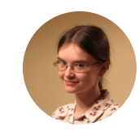
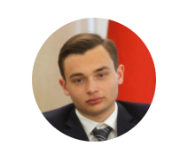
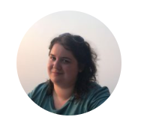
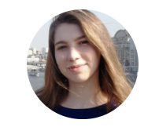
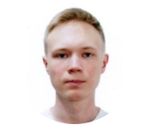
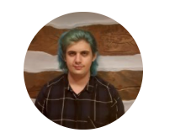
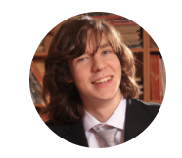
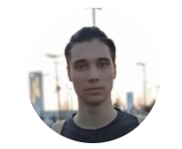
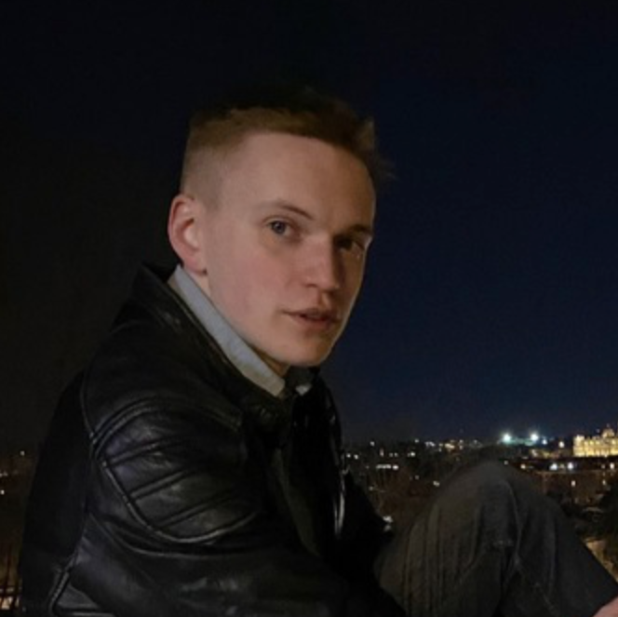
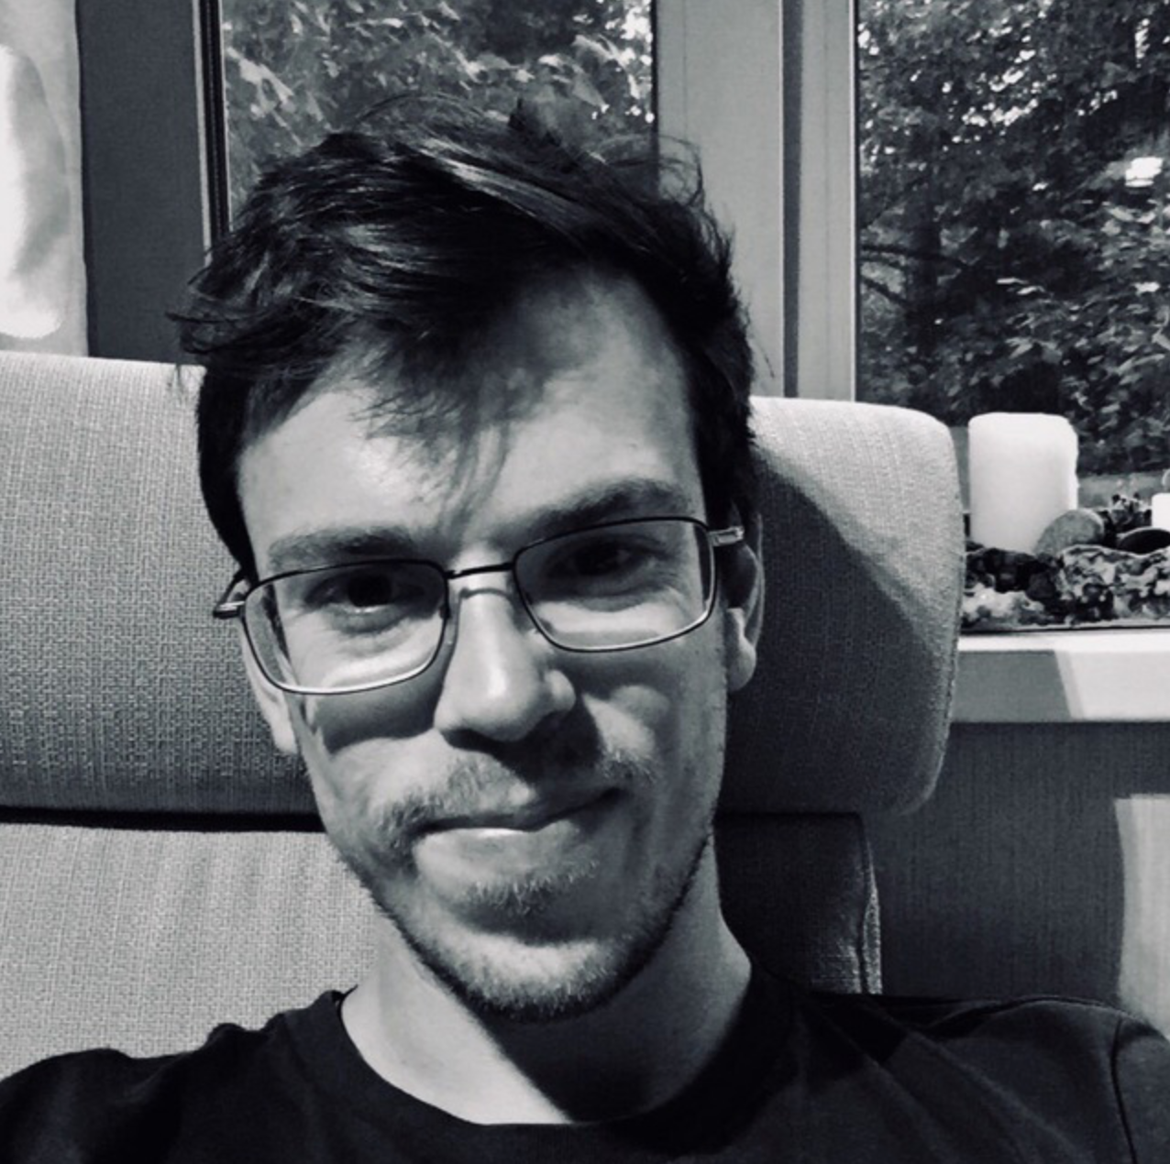
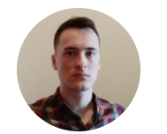
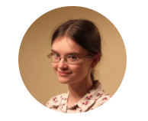
Laboratory on Algebraic Transformation Groups
Researchers
We have 1 Professor, 3 Research Fellows and 11 Research Assistants working in our Laboratory.
Research Assistants
Yulia Zaitseva
HSE
Doctoral School in Mathematics,
postgraduate
Lecturer at HSE
Boris Bilich
HSE
Faculty of Mathematics,
4th year student
Alisa Chistopolskaya
HSE
Faculty of Mathematics,
4th year student
Viktoriia Borovik
MSU
Faculty of Mechanics and Mathematics,
5th year student
Alexander Popkovich
HSE
Faculty of Mathematics,
master student
Grigory Taroyan
HSE
Faculty of Mathematics,
4th year student
Sergey Dzhunusov
MSU
Faculty of Mechanics and Mathematics,
graduate
Evgeny Zhukov
HSE
Faculty of Mathematics,
4th year student
Denis Kremko
HSE
Faculty of Mathematics,
3rd year student
Nikolai Slinkin
HSE
Faculty of Mathematics,
master student
Kirill Shakhmatov
MSU
Faculty of Mechanics and Mathematics,
5th year student

Slide 7
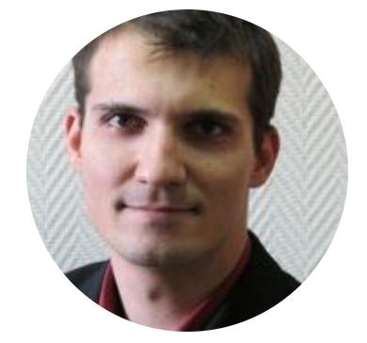
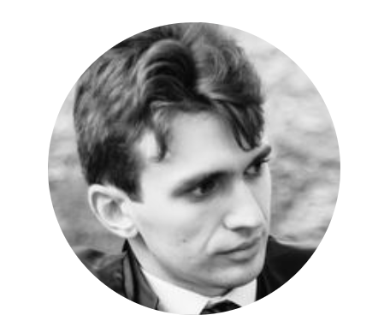
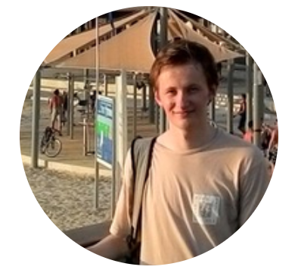
Laboratory on Algebraic Transformation Groups
Research Fellows
Sergey Gaifullin
2012 Candidate of Sciences (PhD) in Mathematics
Lomonosov Moscow State University
Associate Professor at MSU
Associate Professor at HSE
Alexander Perepechko
2014 Candidate of Sciences (PhD) in Mathematics
Lomonosov Moscow State University and University of Grenoble
Associate Professor at MIPT
Researcher at Kharkevich Institute
Anton Shafarevich
2019 Candidate of Sciences (PhD) in Mathematics
Lomonosov Moscow State University
Teaching assistant at MSU
Teaching assistant at HSE

Slide 8
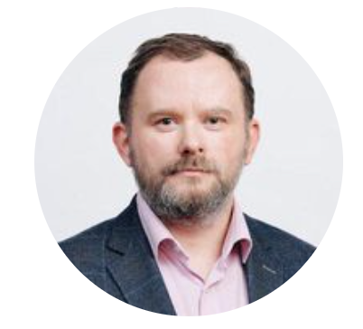
Laboratory on Algebraic Transformation Groups
Ivan Arzhantsev
Laboratory Head, Senior Research Fellow
Author of over 50 scientific papers and 4 manuals. Co-author of a 2015 monograph in the Cambridge Studies in Advanced Mathematics series. He has trained 10 candidates of sciences.
Dean of the Faculty of Computer Science
Professor of the Faculty of Computer Science/Big Data and Information Retrieval School
Member of the HSE Academic Council
Senior Research Fellow of the Faculty of Mathematics
Degrees
and Academic Titles
2020 Professor
2011 Doctor of Sciences in Mathematical Logic, Algebra and Number Theory
Lomonosov Moscow State University
Thesis Title: Embeddings of Homogeneous Space and Geometric Invariant Theory
2009 Associate Professor
1998 Candidate of Sciences (PhD) in Mathematical Logic, Algebra and Number Theory
Lomonosov Moscow State University
Thesis Title: Reductive group actions with spherical orbits
1995 Degree in Mathematics. Applied Mathematics
Lomonosov Moscow State University

Slide 9
Laboratory on Algebraic Transformation Groups
Seminars organized by the laboratory
Seminar on Additive Actions (2019-2020)
over 30 reports on theory of additive actions, local algebras, toric geometry, algebraic number theory.
Seminar on Algebraic Transformation Groups
(2020-present)
main topics discussed in the seminar: toric geometry, theory of locally nilpotent derivations, infinite transitivity, infinite-dimensional algebraic geometry, theory of spherical varieties, infinite dimensional Lie algebras.

Slide 10
Laboratory on Algebraic Transformation Groups
Schools and conferences supported by the laboratory
Past Events
Topology and Geometry of Group Actions
  18–22 November 2020, HSE University, Moscow, Russia
Lie algebras, Algebraic Groups and Invariant Theory
  27 January – 1 February 2020, Moscow State University, Steklov Mathematical Institute, Moscow, Russia

Slide 11
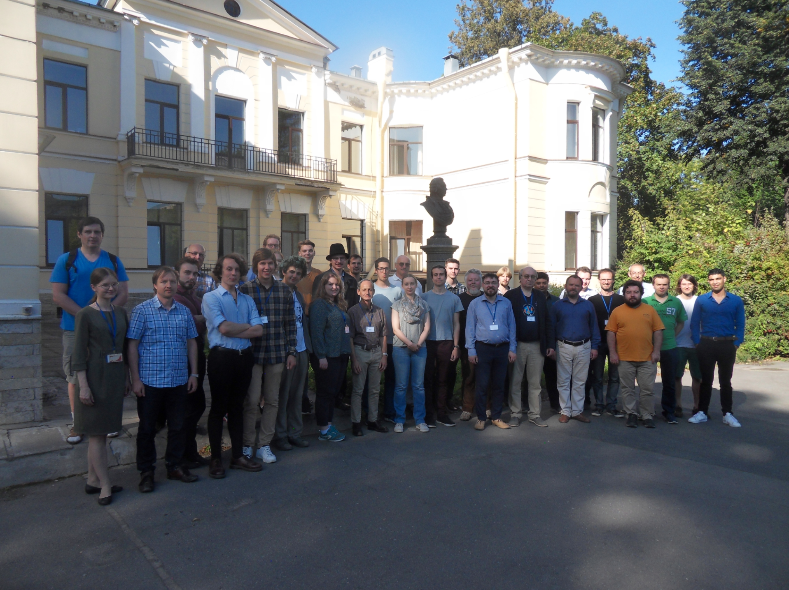
Laboratory on Algebraic Transformation Groups
Schools and conferences organized
by the laboratory
Forthcoming Events
Affine Varieties: Embeddings, Automorphisms, Structure and Topology
(AV-EAST-2021)
Dedicated to 70th anniversary
of Shulim Kaliman
  26–30 July 2021, Euler Institute,
Saint Petersburg, Russia
At Summer School "Visions of Algebraic Groups",
Euler Institute, Saint Petersburg, August 2019

Slide 12
Laboratory on Algebraic Transformation Groups
Our partners
Moscow State University, Moscow, Russia
Steklov Mathematical Institute of Russian Academy of Science, Moscow, Russia
The Euler International Mathematical Institute,
St. Petersburg, Russia
Samara University, Samara, Russia
Fourier Institute, Grenoble, France
Eberhard Karls University of Tübingen, Germany

Slide 13


Laboratory on Algebraic Transformation Groups
Grants
Russian Foundation for Basic Research, grant "Expansion", project 20-11-50106 "Automorphisms of algebraic varieties and infinite transitivity", 2020-2021, Head — Ivan Arzhantsev.
Basis Foundation, grant “Leader”, project “Automorphisms of affine varieties, graded algebras and locally nilpotent derivations”, 2018-2021, Head — Ivan Arzhantsev.
Russian Science Foundation, grant 20-71-00109, project “Orbits of regular automorphisms groups of G-varieties”, 2020-2022, Head — Sergey Gaifullin.
Russian Science Foundation, grant 19-11-00172, project “Additive actions on complete algebraic varieties and their generalizations”, 2019-2021, Head — Ivan Arzhantsev.

Slide 14
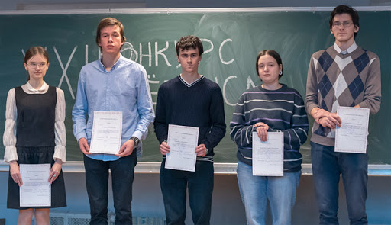
Laboratory on Algebraic Transformation Groups
Awards
Sergey Dzhunusov was awarded a finalist diploma in the "Undergraduates" category of the 24nd August Möbius Competition 2020 for his work «Additive actions on complete toric surfaces and On uniqueness of additive actions on complete toric varieties».
Yulia Zaitseva was awarded a second degree diploma in the "Undergraduates" category of the 22nd August Möbius Competition 2018 for her work "Homogeneous locally nilpotent derivations of non-factorial trinomial algebras".
Dmitry Matveev was awarded a finalist diploma in the "Undergraduates and graduates" category of the 22nd August Möbius Competition 2018 for his work "Commuting homogeneous locally nilpotent derivations".
Yulia Zaitseva was awarded a finalist diploma in the "Undergraduates" category of the 23nd August Möbius Competition 2019 for her work "Commutative algebraic monoid structures on affine spaces".

Slide 15
Laboratory on Algebraic Transformation Groups
Talks
Topology and Geometry of Group Actions, November 2020, Moscow.
  Talk Automorphisms of affine surfaces, the Markov numbers, and the Thompson group T. Alexander Perepechko.
Zoom Algebraic Geometry Marathon, September 2020.
  Talk Generic flexibility of cubic cones. Alexander Perepechko.
Workshop on Torus Actions in Topology, May 2020, Toronto.
  Talk Infinite transitivity, finite generation, and Demazure roots. Ivan Arzhantsev.
Iskovskikh Seminar, March 2020, Moscow.
  Talk Commutative algebraic monoid structures on affine spaces. Yulia Zaitseva.
The eighth school-conference on Lie Algebras, Algebraic groups and Invariant Theory, January 2020, Moscow.
  Talk Additive actions on complete algebraic varieties. Ivan Arzhantsev.
  Talk Additive actions on toric projective hypersurfaces. Anton Shafarevich.
  Poster Commutative actions on smooth quadrics. Viktoriia Borovik, Sergey Gaifullin, Anton Trushin.
  Poster Additive actions on complete toric surfaces. Sergey Dzhunusov.
  Poster Nilpotent generators of the symplectic Lie algebra. Alisa Chistopolskaya.
  Poster Commutative algebraic monoid structures on affine spaces. Yulia Zaitseva.

Slide 16
Laboratory on Algebraic Transformation Groups
Publications
More than 20 articles have been prepared in 2020-2021. Eight of them have already been published in Q1 and Q2 journals.
Recent publications
Ivan Arzhantsev and Mikhail Zaidenberg. Tits alternative and highly transitive actions on toric varieties. International Mathematics Research Notices Published online (2021). Q1 SJR.
Ivan Arzhantsev, Alvaro Liendo, and Taras Stasyuk. Lie algebras of vertical derivations on semiaffine varieties with torus actions. Journal of Pure and Applied Algebra 225 (2021), no. 2, 106499: 1-18. Q1 SJR.
Sergey Gaifullin. Automorphisms of Danielewski varieties. Journal of Algebra 573 (2021), 364-392. Q1 SJR.
Sergey Dzhunusov and Yulia Zaitseva. Commutative algebraic monoid structures on affine surfaces. Forum Mathematicum 33 (2021), no. 1, 177-191. Q1 SJR.
Alexander Perepechko. Affine cones over cubic surfaces are flexible in codimension one. Forum Mathematicum, Published online (2020). Q1 SJR.
Ivan Arzhantsev, Sergey Bragin, and Yulia Zaitseva. Commutative algebraic monoid structures on affine spaces. Communications in Contemporary Mathematics 22 (2020), no. 8, 1950064: 1-23. Q1 SJR.
Alisa Chistopolskaya. On nilpotent generators of the symplectic Lie algebra. Published online in Linear and Multilinear Algebra (2020). Q2 SJR.
Sergey Dzhunusov Additive actions on complete toric surfaces. International Journal of Algebra and Computation. Published online (2020). Q2 SJR.

Slide 17
Laboratory on Algebraic Transformation Groups
Some results
Moscow, 2021
Notes:
черновик

Slide 18





Laboratory on Algebraic Transformation Groups
Commutative algebraic monoids
an algebraic variety with a commutative associative multiplication
which is a morphism and has a unit.
The case of affine space X = A^{n}
Ivan Arzhantsev, Sergey Bragin, and Yulia Zaitseva.
Commutative algebraic monoid structures on affine spaces.
Communications in Contemporary Mathematics (2020), Q1 SJR
A¹:
A²:
A³:
The case of affine surface X
Sergey Dzhunusov and Yulia Zaitseva. Commutative algebraic monoid structures on affine surfaces. Forum Mathematicum (2021), Q1 SJR

Slide 19
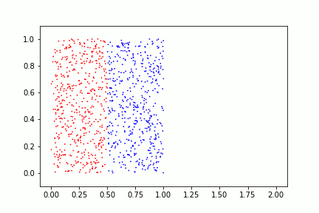
Laboratory on Algebraic Transformation Groups
Infinite transitivity
Physical picture: a configuration of particles in a state-space. Suppose that some forces are acting on these particles. When all configurations with a given number of particles are equivalent under the action of these forces?
Assume that the state-space is an algebraic variety and the forces are acting algebraically. Then the problem can be approached using the theory of algebraic transformation groups.
Infinitely transitive action of a group is a purely algebraic substitute for the concept of a mixing dynamical system. The action is infinitely transitive precisely when a configuration of non-coinciding points is equivalent to any other such configuration.
Currently the researchers Alisa Chistopolskaya and Grigory Taroyan are preparing a paper on the partial solution of this problem in 2-dimensional case.
Ivan Arzhantsev. Infinite transitivity and special automorphisms.
Arkiv for Matematik (2018), Q2 SJR
Ivan Arzhantsev, Karine Kuyumzhiyan, and Mikhail Zaidenberg.
Infinite transitivity, finite generation, and Demazure roots
Advances in Mathematics (2019), Q1 SJR

Slide 20
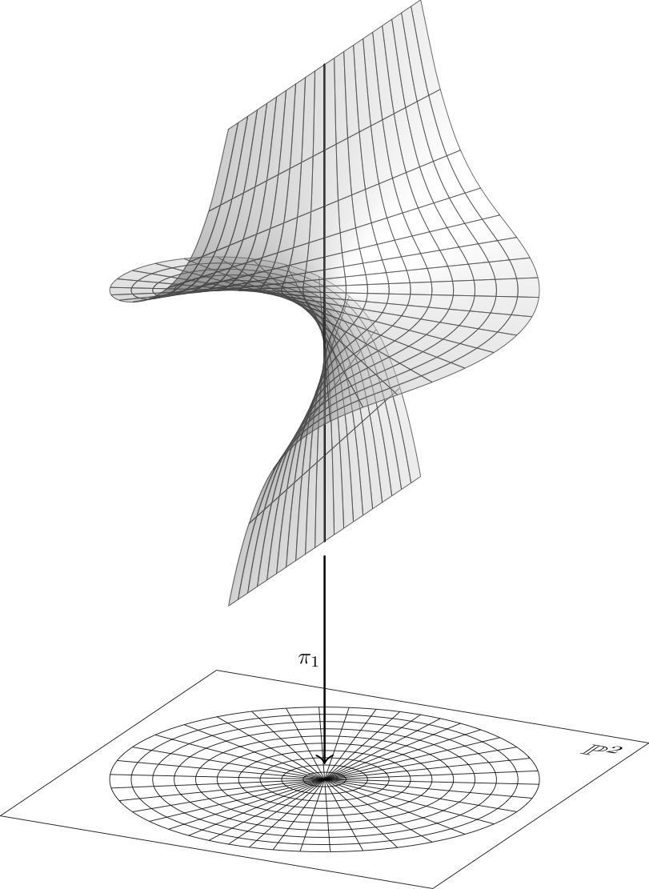
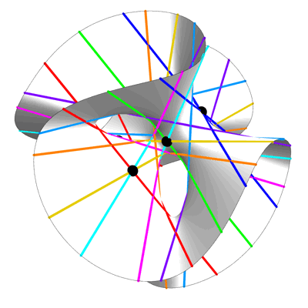
Laboratory on Algebraic Transformation Groups
Affine cones over cubic surfaces
Cubic surfaces are blowups of the projective plane in 6 points. They contain 27 lines.
The affine cones over them are described by points in the 7-dimensional polyhedral cone.
The transformations of affine cones fix
some of lines and exist in polyhedral subcones, which we studied using SageMath.
We proved that all the affine cones admit infinite transitivity almost everywhere.
Clebsch cubic surface
x₁³+x₂³+x₃³+x₄³=(x₁+x₂+x₃+x₄)³
Image by Greg Egan
Blowup at a point
Image by
Charles Staats
Alexander Perepechko. Affine cones over cubic surfaces are
flexible in codimension one. Forum Mathematicum (2021), Q1 SJR

Slide 21



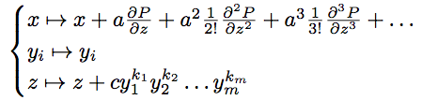

Laboratory on Algebraic Transformation Groups
Automorphisms of Danielewski varieties
Danielewski variety where
These varieties provide a counter-example to generalized Zariski problem.
THEOREM.
Let be the subgroup of automorphisms that permute with coinciding
and multiply variables and by constants (the image of can be computed).
And let be the subgroup of automorphisms of the form
Then the group of regular automorphisms of the variety is isomorphic to the semi-direct product .
Sergey Gaifullin. Automorphisms of Danielewski varieties.
Journal of Algebra (2021), Q1 SJR

Slide 22




Laboratory on Algebraic Transformation Groups
Computer algebra skills
In some areas of the laboratory research, computer algebra systems yield deep results. Our researchers incorporate occasionally such tools into their work.
Sagemath, Python (numpy)
Alexander Perepechko (+ sympy)
Boris Bilich
Wolfram Mathematica
Boris Bilich
Grigory Taroyan
Singular
Grigory Taroyan

Slide 23
www.math.hse.ru/latg
11 Pokrovsky Bulvar, Pokrovka Complex, room S826

