Slide 1

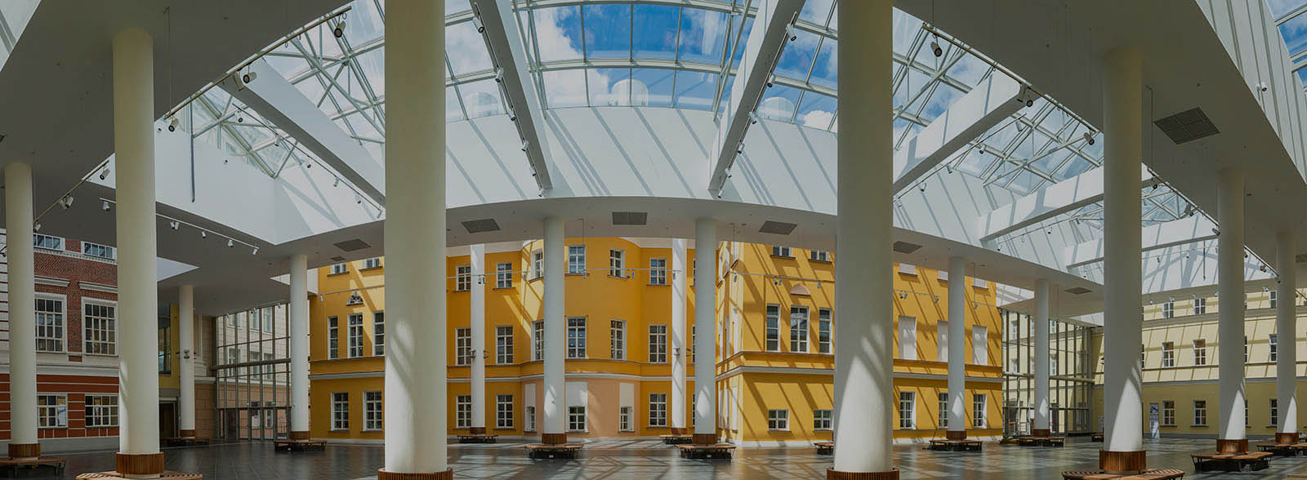
Faculty of Computer Science

Slide 2

Faculty of Computer Science
Established in March 2014
4
Bachelor’s
Programmes
1
Research centre
8
Master’s
Programmes
12
Laboratories
1
Doctoral
School
6
Russian Science Foundation
grants
Faculty Members
2751
Students
396
177
Foreign
Students
19
Vocational education
programmes

Slide 3



Bachelor’s Programmes
Data Science and Business Analytics
249
4
years
English
students
Applied Mathematics and Information Science
1022
4
Russian
English
students
years
Software Engineering
843
4
Russian
English
students
years
Computer Science and Data Analysis
80
4
Russian
Online programme
spots
years

Slide 4



Master’s Programmes
Math of Machine Learning
43
2
years
English
students
System and Software Engineering
65
2
years
English
students
Data Science
180
2
Russian
English
students
years
Financial Technologies and Data Analysis
93
2
Russian
English
students
years

Slide 5


Master’s Programmes
Data Analysis in Biology and Medicine
49
2
Russian
English
students
years
System Programming
31
2
Russian
English
students
years
Master of Data Science
199
2
Online programme
years
English
students
Machine Learning and Data-Intensive Systems
30
2
years
English
Online programme
spots

Slide 6
Doctoral School
PhD in Computer Science
62
3-4
Russian
English
students
years
Theoretical Computer Science
System Programming
Artificial Intelligence
Data Analysis

Slide 7


Coursera Specializations
7
Advanced Machine Learning
4
Mathematics for Data Science
In Russian and English
courses
courses
6
Data Structures and Algorithms
Industrial Machine Learning
3
courses
courses
Introduction to Discrete Mathematics for Computer Science
5
courses
5
Machine Learning: From Statistics to Neural Networks
courses

Slide 8
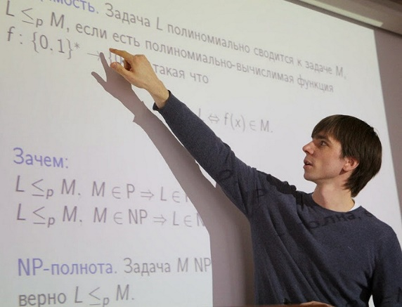

Research
Centre of Deep Learning and
Bayesian Methods
Laboratory of Financial
Data Analysis
International Laboratory of Bioinformatics
Yandex Laboratory
International Laboratory for Intelligent Systems and Structural Analysis
Laboratory of Methods for Big
Data Analysis
Laboratory of Process-Aware Information Systems
International Laboratory
of Stochastic Algorithms and High-Dimensional Inference
Laboratory of Complex Systems Modelling and Control
International Laboratory of Theoretical Computer Science
Laboratory of Models and Methods of Computational Pragmatics
International Laboratory of
Algebraic Topology and Its Applications
Laboratory on AI for Computational Biology

Slide 9





Joint Departments
Yandex Department
1C Department
Department of Technologies for Complex System Modelling of the Kharkevich Institute for Information Transmission Problems
Department of Intelligent Technologies in System Analysis Control of the Federal Research Centre for Computer Science and Control
SAS Department
Otkritie Bank Department
Department of the Ivannikov Institute
for System Programming
JetBrains Department

Slide 10







Partners

Slide 11
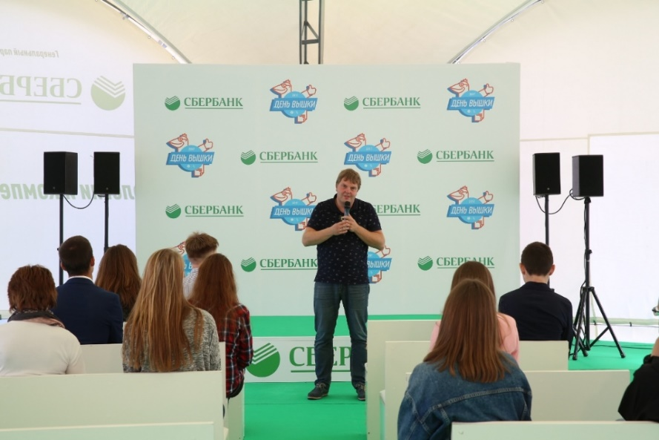
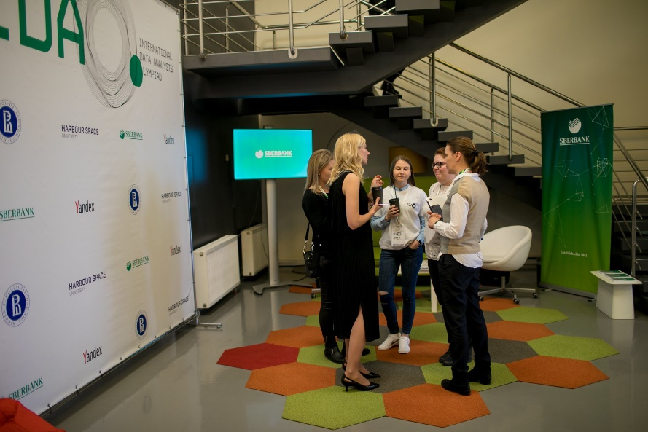
SBER
Financial Technologies and Data Analysis Joint Master’s Programme
Hand-on work experience with data science experts
Sberbank covers 100% of tuition fee for students
Projects
IDAO 2018, 2019, 2020
Laboratory of Financial Data Analysis

Slide 12
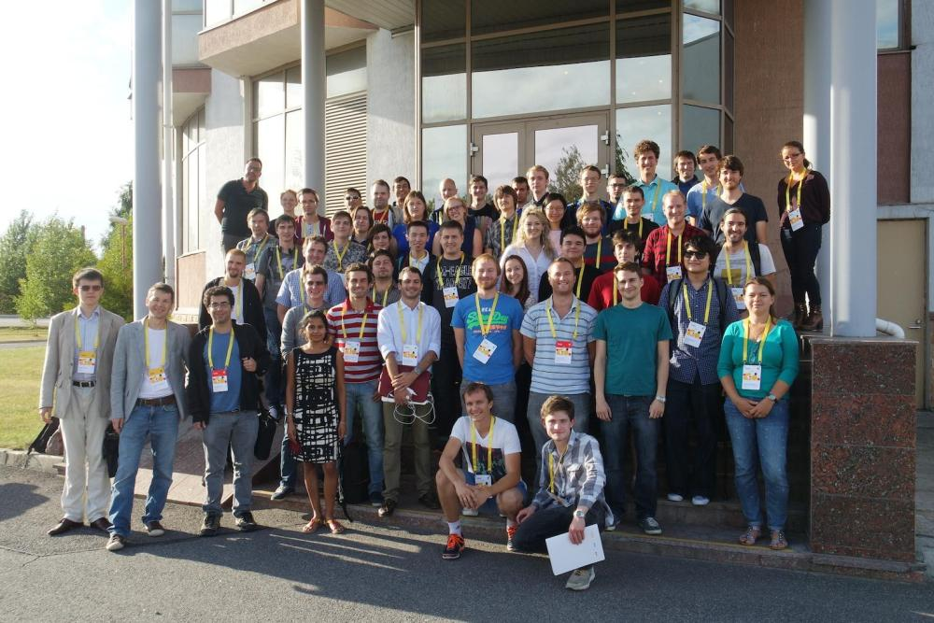
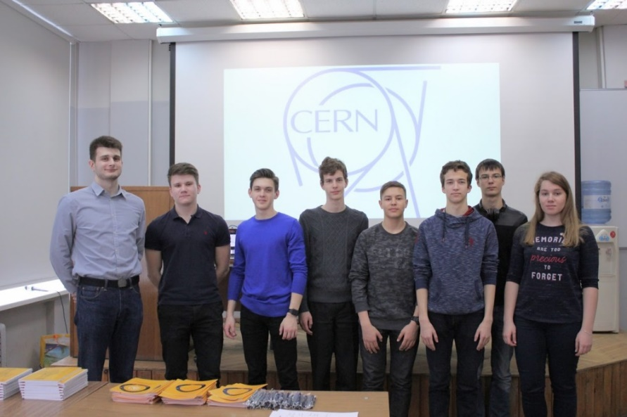
CERN
HSE University is LHCb Associate Member at CERN
Laboratory of Methods for Big Data Analysis (LAMBDA)
Projects
Annual CERN workshops in particle physics
Summer School on Machine Learning
in High Energy Physics

Slide 13
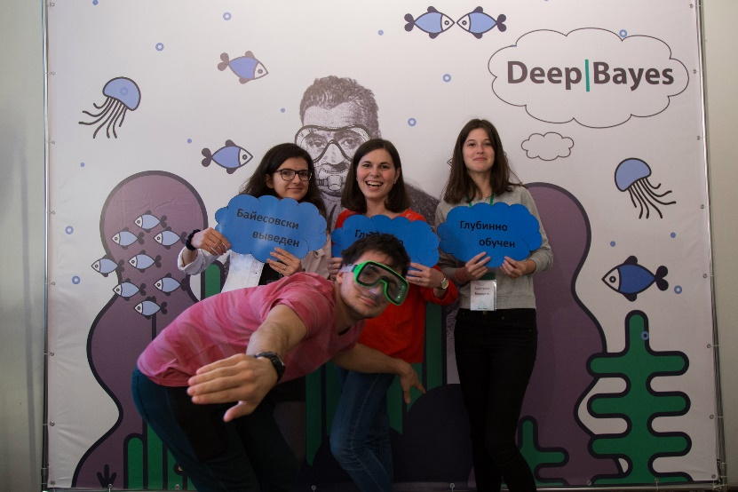




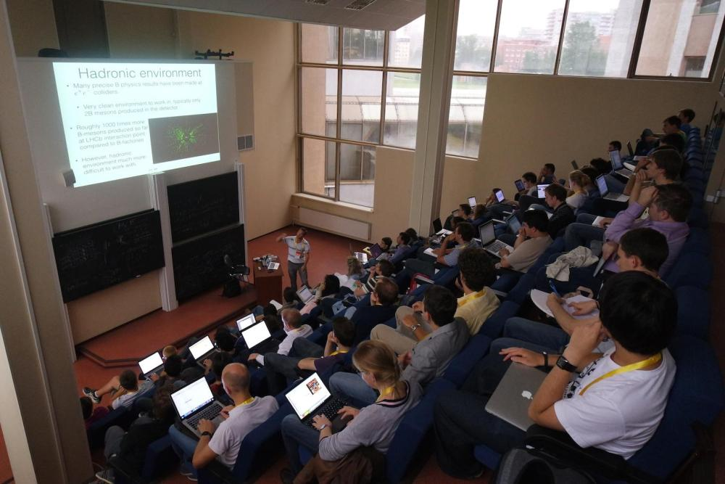

Schools
Winter School on Math of Machine Learning
Summer School on Machine Learning in High Energy Physics
Summer School on Deep Learning and Bayesian Methods
Summer School on Machine Learning in Bioinformatics
Autumn School on Applications of Topology and Geometry

Slide 14
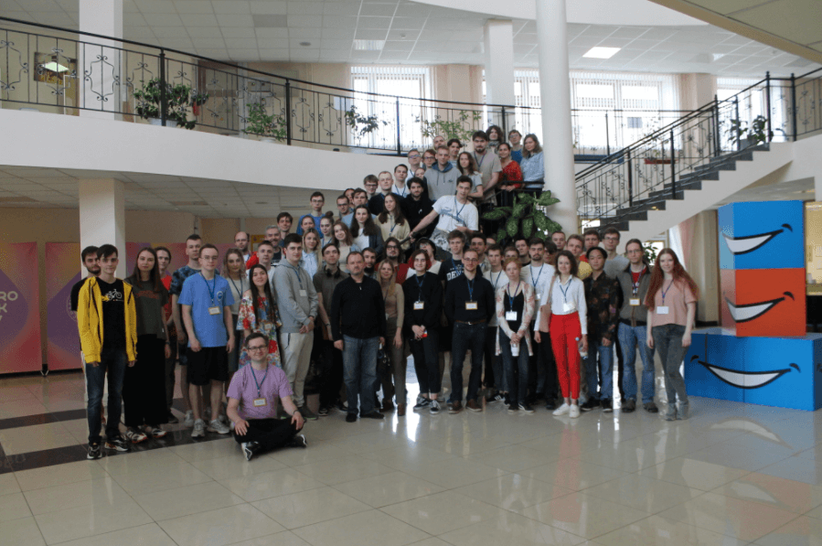
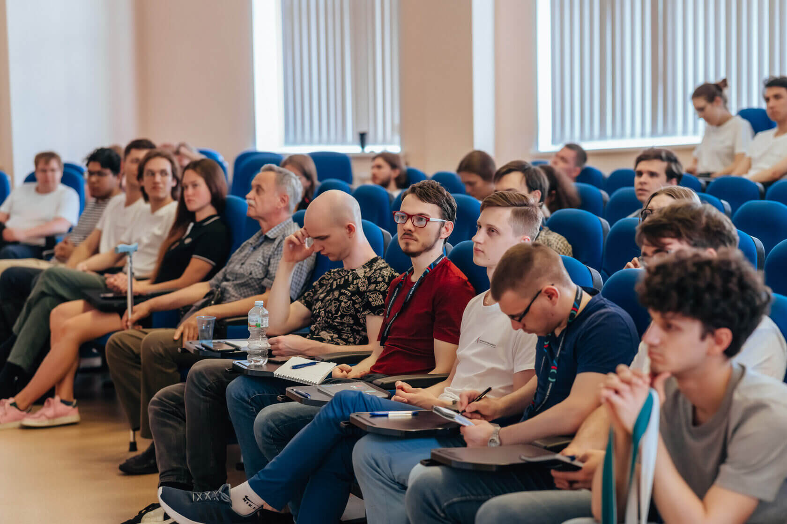
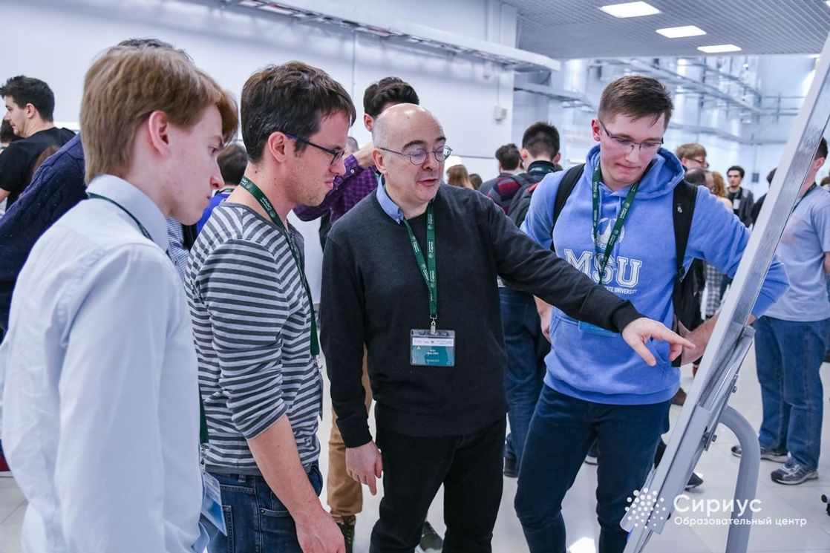
Conferences
A, B and Z: The Structure, Function and Genetics of Z-DNA and Z-RNA conference
Spring/Summer Young Researchers' Colloquium on Software Engineering (SYRCoSE )
International Conference on Analysis of Images, Social Networks and Texts (AIST)
Modeling and Analysis of Complex Systems and Processes (MACSPro)
International Conference on Computer Simulation in Physics and beyond (CSP)
International Conference on Topology and Geometry of Group Actions
Logic Matters research seminar

Slide 15

Rankings
2018
2019
2020
2021
QS Overall
382
343
322
298
QS Under 50
48
38
38
31
QS Mathematics
101-150
101-150
101-150
95
QS Computer
Science
251-300
201-250
151-200
151-200

Slide 16


Rankings
2018
2019
2020
2021
THE Overall
351-400
301-350
251-300
251-300
THE Under 50
84
60
41
57
THE Computer
Science
301-400
301-400
401-500
2018
2019
2020
2021
ARWU Mathematics
76-100
76-100
101-105
76-100

Slide 17






















Foreign Partner Universities

Slide 18



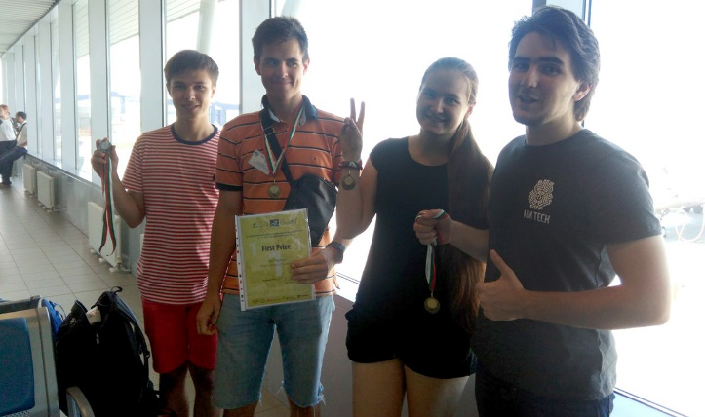
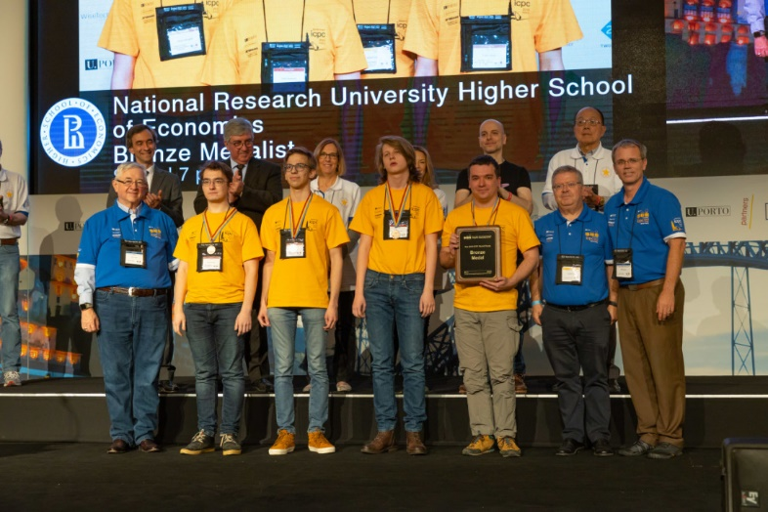
Competitions and Olympiads
Centre of Student Competitions helps students prepare for various competitive programming contests including ICPC, Yandex.Algorithm, Google Code Jam, Russian Code Cup, etc.
2016
2017
2018
2019
2020
IMC
IMC
ICPC Final China
ICPC Final Portugal
NERC
(ICPC semi-final)
VJIMC
Czech Republic
IMC
IMC

Slide 19
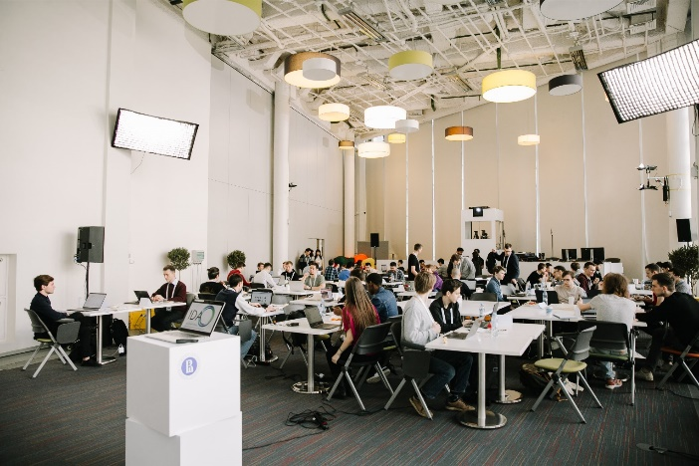
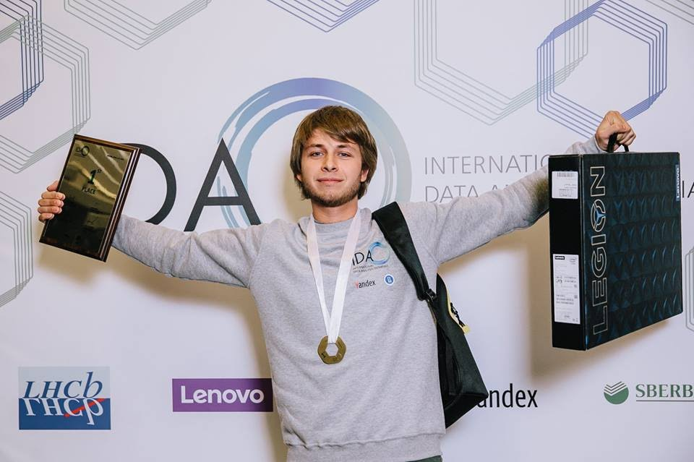

International Data Analysis
Olympiad
Key numbers of IDAO 2021
648
Online Round teams
66
Countries
32
Final Round teams

Slide 20
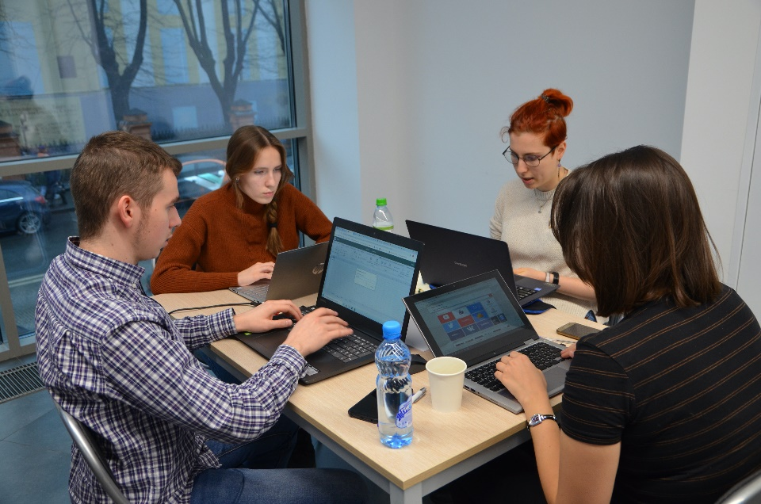
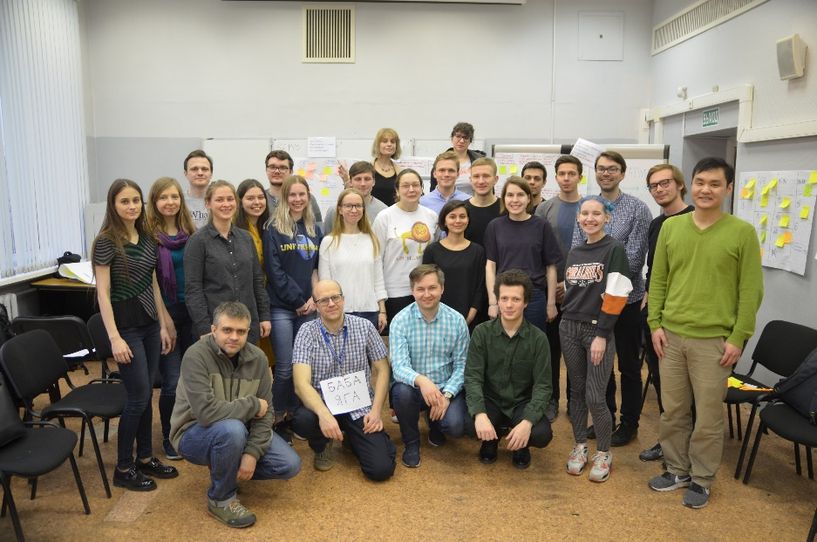
Data Culture
Data Culture project aims at teaching all undergraduate students of HSE University to apply latest data science technologies in their respective fields
Project’s aim is to help HSE students develop skills in
Digital literacy
Programming
Data analysis

Slide 21

computerscience@hse.ru
cs.hse.ru/en
facebook.com/hsecs

