Slide 1
Person-based recommendation system for making new relationships
Faculty of
Computer Science
School of Data Analysis
and Artificial Intelligence
Moscow,
2022

Slide 2
Core Idea
School of Data Analysis
and Artificial Intelligence
Person-based recommendation system for making new relationships
Core Idea.
Problem. Relevance.
Our person-based recommendation system, which is based on a user's preliminary information, activity, and created and visited events, introduces you to a new method for meeting people or developing new relationships.
The fundamental idea is to give users the ability to create and attend events in order to identify their unique habits, close friends, communication, and group distinction. A recommender system can be used to extend groups based on the collected data, and events in the user feed can be customized to best meet the needs of specific users.

Slide 3
Problem. Relevance
School of Data Analysis
and Artificial Intelligence
Person-based recommendation
system for making new relationships
Core idea.
Problem. Relevance
49%
77%
67%
Of people describe themselves as introverts following the result of Myers, McCaulley, Quenk, & Hammer (1998) survey.
Of people stated that they fall somewhere between the two extremes of personalities by a study conducted by the American Trends Panel (2014).
Of the world’s territory is best suited for existence of introverts, according to a Merchant Machine study.

Slide 4
Problem. Relevance
School of Data Analysis
and Artificial Intelligence
Person-based recommendation system for making new relationships
Core idea.
Problem. Relevance
Stress
Cycle
Stress may lead to:
Depression (Jon Cooper “Stress and Depression”);
Isolation and health disorders (Julia Cruces, Cesar Venero “The effect of psychological stress and social isolation on neuroimmunoendocrine communication”);
Less communication (Depressive symptoms are associated with social isolation in face-to-face interaction networks);
It can easily lead to:
Lesser parties and events attendance (just logic);
Less new experiences (just logic);
More stress from acetylcholine disorder (Group of researchers “Hippocampal acetylcholine modulates stress-related behaviors)

Slide 5
More than half of teens make new friends online
School of Data Analysis
and Artificial Intelligence
Person-based recommendation system for making new relationships
Core idea.
Problem. Relevance
57%
29%
78%
Of teens have made new friends online without any specific recommendation systems.
Say that they have made more than five friends just in digital space.
Of surveyed girls finds friends on the Internet.

Slide 6
Main competitors
School of Data Analysis
and Artificial Intelligence
Person-based recommendation system for making new relationships
Competitors.
Business analysis
All competing products are in high demand, which may be shown in the amount of downloads, subscriptions, or user profiles. However, they fail to retain the audience based on user behavior and surveys.
Social networks communities;
Apps for dating or making new friends;
Apps for events.
Hypothesis 1: failure to retain audience due to bad recommended content.
Hypothesis 2: the complete absence of recommendations leads to a decrease in the audience

Slide 7
School of Data Analysis
and Artificial Intelligence
Person-based recommendation system for making new relationships
Competitors.
Business analysis
Social network
communities
User profiles from the feed of social network dating pages tend to receive few likes and comments even if the page has a sizable subscription base. There is a demand from the public, which is not being met, it might be argued. In our opinion, this is because such pages don't have any means to individually recommend people who the user might be interested in.

Slide 8
Apps for dating or making friends
School of Data Analysis
and Artificial Intelligence
Person-based recommendation system for making new relationships
Competitors.
Business analysis
All of these apps feature some sort of recommendation system, that has a number of flaws. Let's examine the most well-known Tinder system as an example. Others mimic it in numerous ways while adding their own qualities to it.
Tinder;
Badoo;
Wink;
Bumble.

Slide 9
Tinder cons and pros
School of Data Analysis
and Artificial Intelligence
Person-based recommendation system for making new relationships
Competitors.
Business analysis
CONS
Music synchronization
Matches mean nothing
Recommender system based on music preferences
Solution: implement events which you can plan with any you liked.
Swipes
Bad differentiation
Cards system made a revolution in dating apps and not only there
In case of recommendation system based on photos (like in tinder)
Geopositioned
Data for recommendation
This is even more relevant for our idea of events and recommendations
Solution: preliminary information, using the Plutchik’s wheel of emotions, events analysis
Native ads
Empty profiles
Inconspicuous advertising to avoid losing customers.
This is not a problem for our solution because pertinent information will be obtained by people’s activity
PROS

Slide 10
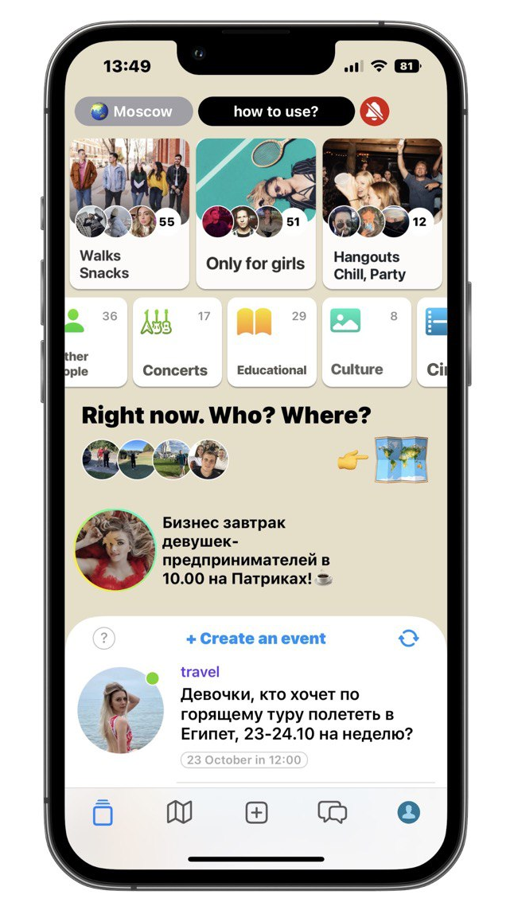
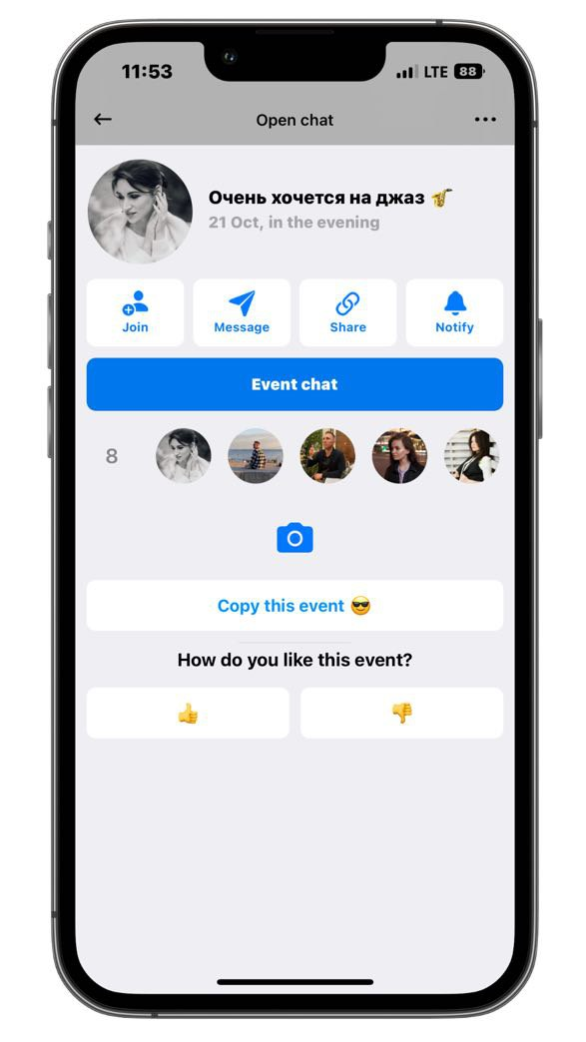
Invitor as a main competitor
School of Data Analysis
and Artificial Intelligence
Person-based recommendation system for making new relationships
Competitors.
Business analysis
Pros | Cons
Geopositioned | No event filters
Participants filter | No recommendations
Events tags | Overcrowded main page
Events groups | Insufficient event description

Slide 11
Ways to earn money
School of Data Analysis
and Artificial Intelligence
Person-based recommendation system for making new relationships
Ways to earn money
$1-20/click
ADS in cards Similar to tinder system of advertisement
ADS
$0.5-infty
Events may be with a fee Suits for some club events; Filtering
Events fee
$2.99
Subscription based revenue model Needs improvement
Secretary problem

Slide 12
First year plan
School of Data Analysis
and Artificial Intelligence
Person-based recommendation system for making new relationships
First year plan
Existing data
Telegram bot
Complex analysis of real data taken from Kaggle and scrapped from competitors services
Testing the recommendation system with a telegram bot on real students
Improve system
Design the mobile app
Improving recommender system following the real data obtained by usage of telegram bot
Creating UI/UX design for our mobile app observing nativeness and minimalism axioms.

Slide 13
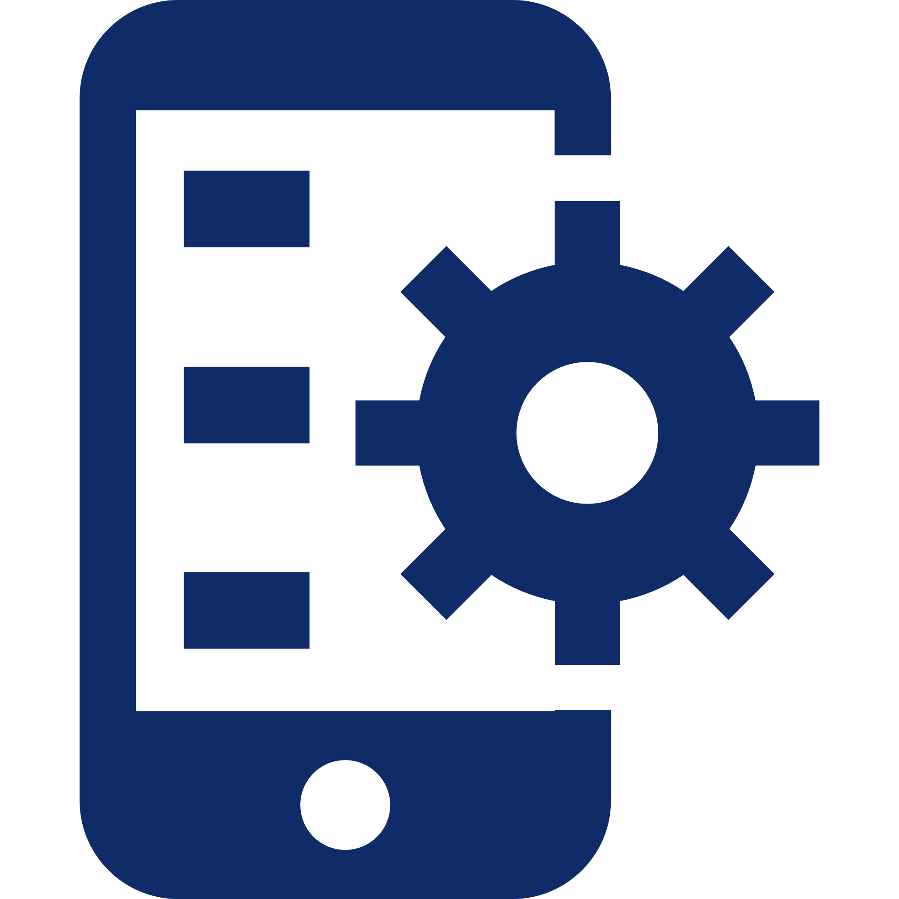
Global plans
School of Data Analysis
and Artificial Intelligence
Person-based recommendation system for making new relationships
Global plans.
Recommendation system API
Mobile app
Payment system
Advertising

