Slide 1
Feynman checkers: number-theoretic properties
Fedor Kuyanov
HSE University
Satellite mini-workshop, Israel, 10-12 Feb 2023

Slide 2
Young diagrams
A Young diagram (YD) is a finite set of cells aligned by the left side such that row lengths are monotonous
Height $h$ = number of rows, width $w$ = max row length
Number of steps = number of distinct row lengths
A YD is even (odd) if the number of steps is even (odd)
h
w
Which diagrams of size $w × h$ occur more often – with odd or even number of steps?

Slide 3
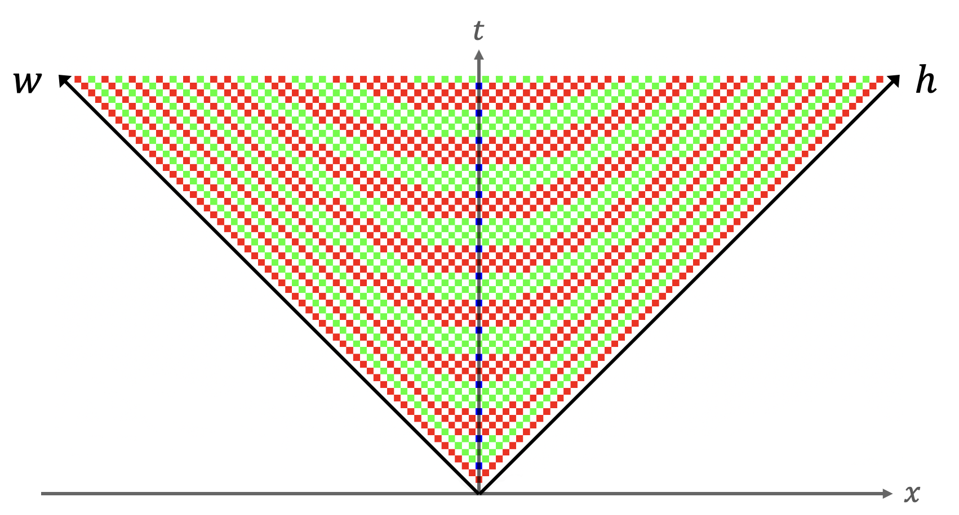
Main result
Theorem. If $\frac{h}{w}>3+2\sqrt{2}$, then the number of even YDs is greater than the number of odd YDs iff $w$ is even.
Remark. $3+2\sqrt{2}$ is the sharp estimate.
This result is related to Feynman checkers, a mathematical model of electron motion, aka a quantum walk.
Sign of the difference between the numbers of odd and even YDs for various sizes. Red = +1, green = -1, blue = 0.

Slide 4
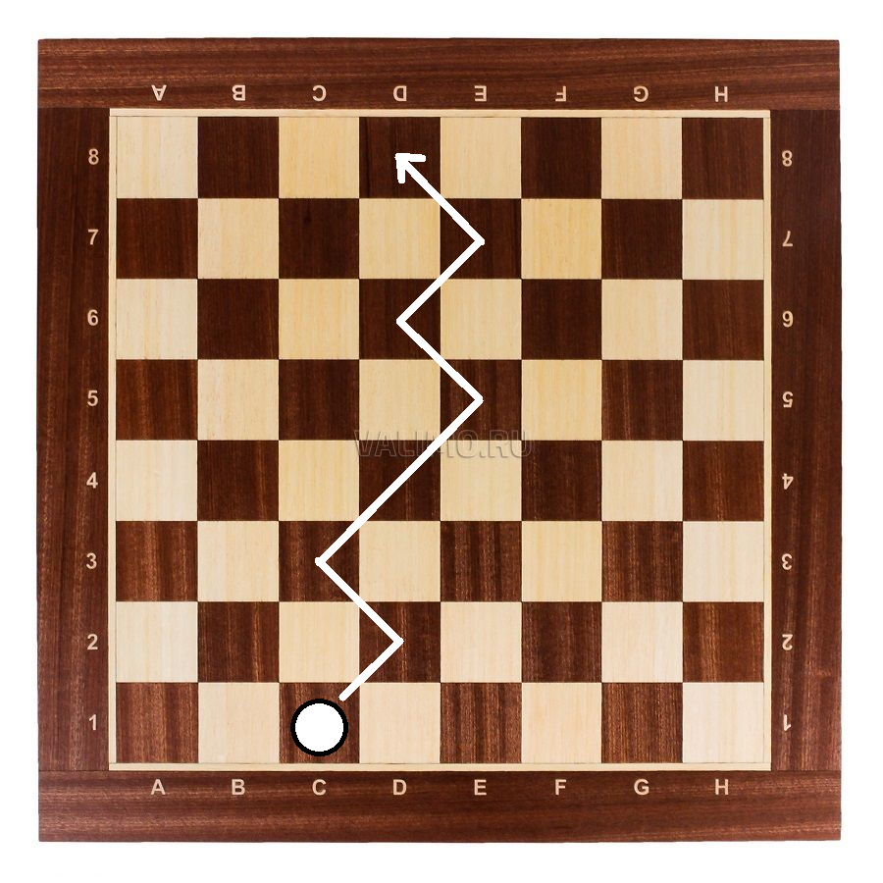
Feynman checkers: informal definition
Initially, a checker is located at$(0, 0)$ and wants to get to$(x, t)$.
Consider all paths consisting of upwards-right and upwards-left moves, with the first one upwards-right.
To each path assign an arrow: initially, it points upwards; and after each turn, it rotates $90°$ clockwise.
Wave function $a(x, t)$ is the sum of the arrows multiplied by $2^{(1−t)/2}$.
${\left|a\left(x, t\right)\right|}^{2}$ is the probability to find an electron emitted from $(0, 0)$, at the point $\left(x, t\right)$.
A path from (0, 0) to (1, 7) with 5 turns => the arrow points to the right

Slide 5
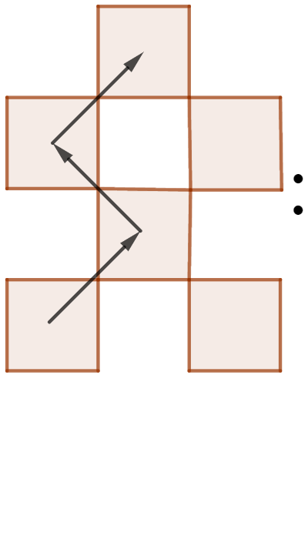
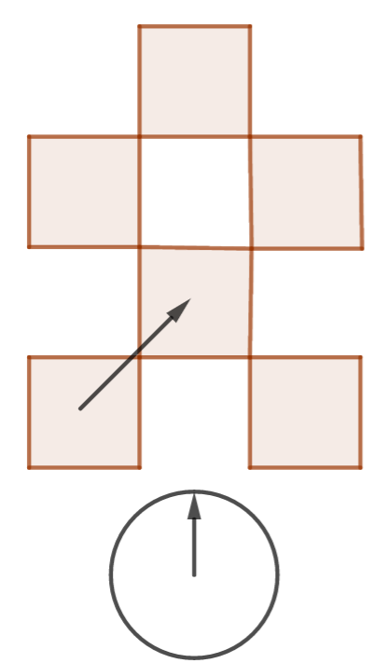
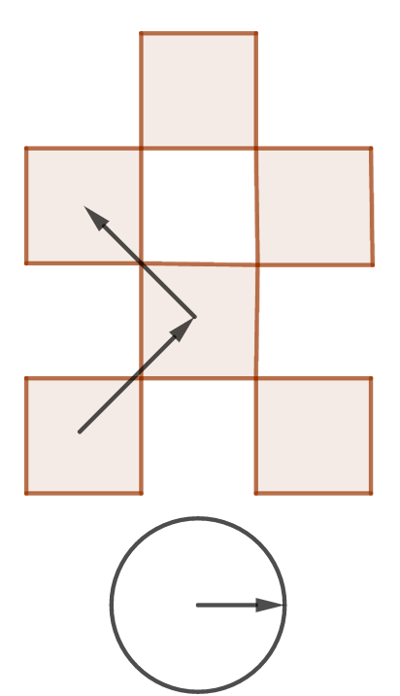
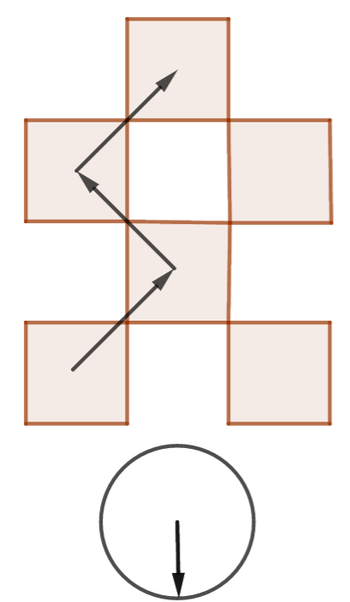
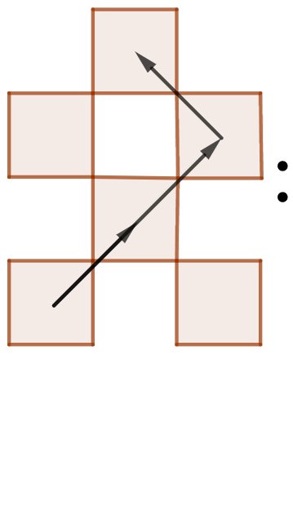
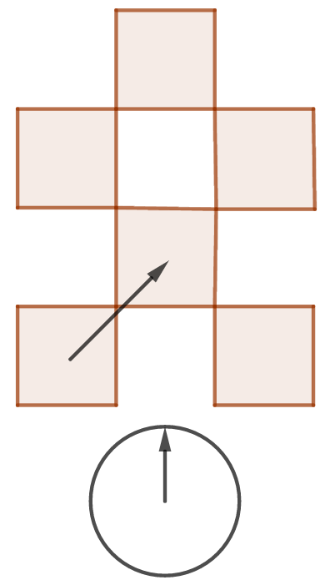
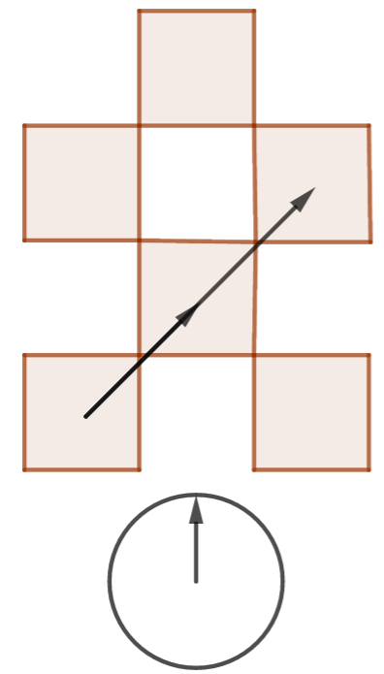
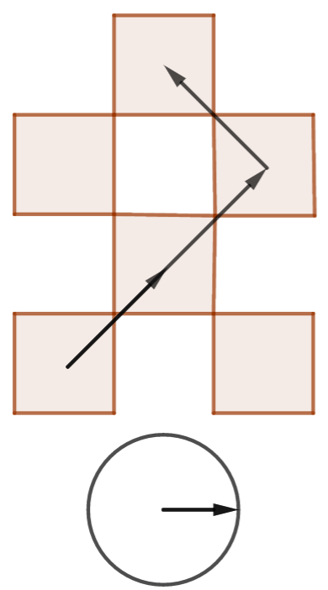
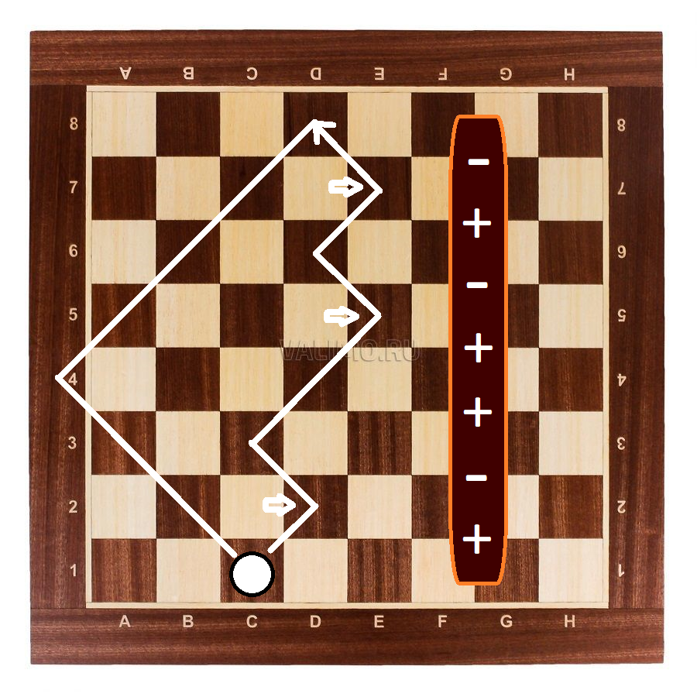
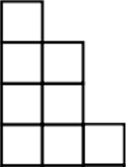
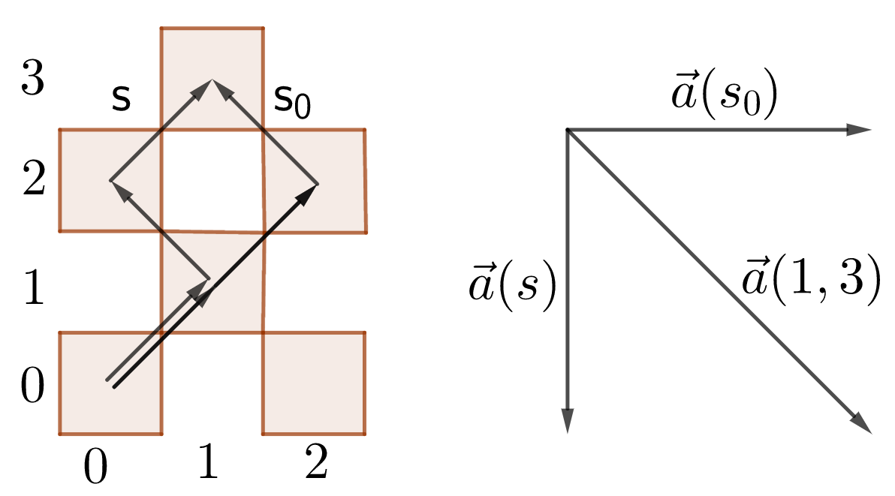
Example
$a\left(1, 3\right)=(0.5,−0.5)$
$Re a\left(h−w, h+w\right) \sim$ number of odd $w×h$ YDs minus number of even $w×h$ YDs
→

Slide 6
Precise & more general definition
Fix $m≥0$ and $ε>0$ – particle mass and lattice step.
Consider lattice$εℤ^{2}=\{\left(x, t\right) :\frac{x}{ε},\frac{t}{ε}∈ℤ\}$.
A checker path$s$ is a finite sequence of points of $εℤ^{2}$, such that every vector connecting two consecutive points is either $\left(−ε, ε\right)$ or $\left(ε, ε\right)$.
$turns(s)$ = the number of points in $s$ such that the vectors from it to the previous and to the next one are orthogonal.
For each $\left(x, t\right)∈εℤ^{2}$, $t>0$, define
$$a\left(x, t, m, ε\right)≔{\left(1+m^{2}ε^{2}\right)}^{\frac{1−t/ε}{2}}i\sum_{s}{{\left(−imε\right)}^{turns\left(s\right)}},$$
where the sum is over all paths from$(0, 0)$ to $(x, t)$ passing through $(ε, ε)$.
For $m=ε=1$ we get the previous definition.

Slide 7
Wave function behavior
Now we restate the main result in terms of Feynman checkers.
Theorem (F. K., A. Slizkov, 2022)
Denote ${\tilde{a}}_{1}\left(x, t\right)≔Re a\left(x, t+ε\right)$, ${\tilde{a}}_{2}\left(x, t\right)≔Im a(x+ε, t+ε)$.
Then for each $x, t∈εℤ$ such that $\frac{1}{\sqrt{1+m^{2}ε^{2}}}<\frac{x}{t}≤1$ we have
$$\operatorname{sgn}\left({\tilde{a}}_{1}\left(x, t\right)\right)={\left(−1\right)}^{\frac{t−x−ε}{2ε}}, \left|{\tilde{a}}_{1}\left(x−ε, t\right)\right|>\left|{\tilde{a}}_{1}\left(x+ε, t\right)\right|,$$
$$\operatorname{sgn}\left({\tilde{a}}_{2}\left(x, t\right)\right)={\left(−1\right)}^{\frac{t−x}{2ε}}, \left|{\tilde{a}}_{2}\left(x−ε, t\right)\right|>\left|{\tilde{a}}_{2}\left(x+ε, t\right)\right|.$$
Remark. The value $\frac{1}{\sqrt{1+m^{2}ε^{2}}}$ is the sharp estimate.

Slide 8
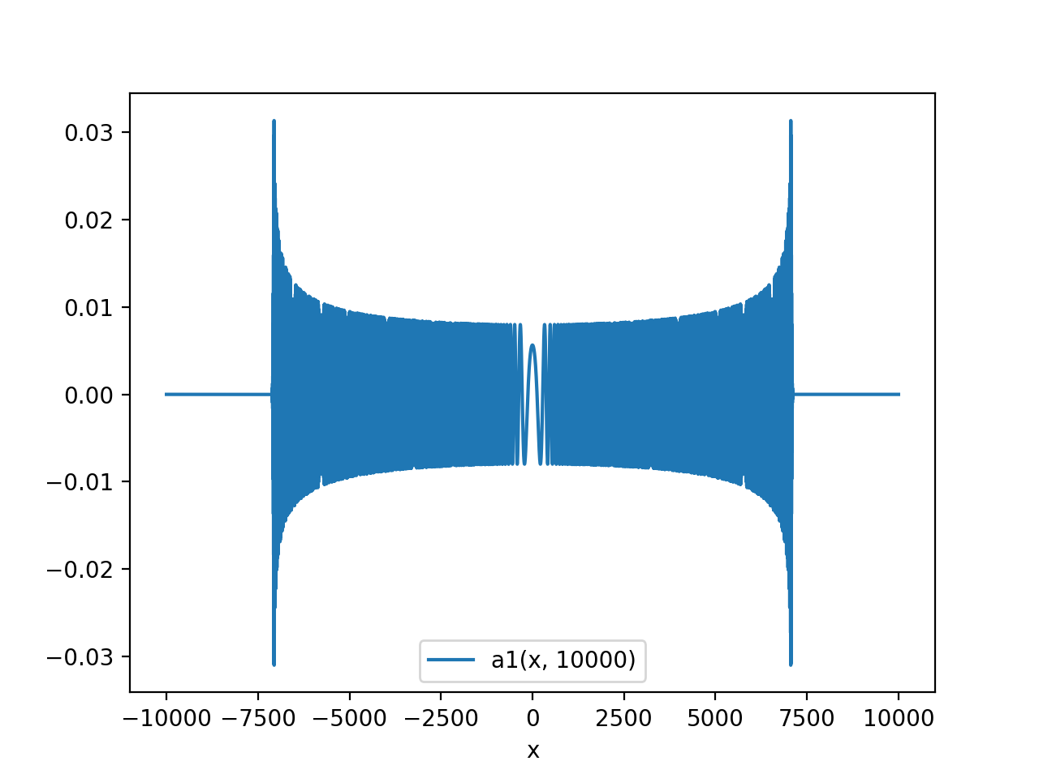
Visualization of ${\tilde{a}}_{1}(x, t=10000)$

Slide 9
Main idea of the proof
Denote $b_{1}\left(x\right)≔{\left(−1\right)}^{\frac{t−x−ε}{2ε}}{\tilde{a}}_{1}\left(x, t, m, ε\right)$
We prove that $b_{1}(x)$ is monotonous by induction on $x$ using the recurrence relation found in 2022 [3]:
$$\left(x+ε\right)\left({\left(x−ε\right)}^{2}−{\left(t−ε\right)}^{2}\right) a_{1}\left(x−2ε, t, m,ε\right)+\left(x−ε\right)\left({\left(x+ε\right)}^{2}−{\left(t−ε\right)}^{2}\right) a_{1}\left(x+2ε, t, m,ε\right)=2x\left(\left(1+2m^{2}ε^{2}\right)\left(x^{2}−ε^{2}\right)−{\left(t−ε\right)}^{2}\right) a_{1}(x, t, m,ε)$$
To prove the sharpness of the lower bound, we investigate the positions of “dips” – the problem posed by S. Nechaev.

Slide 10
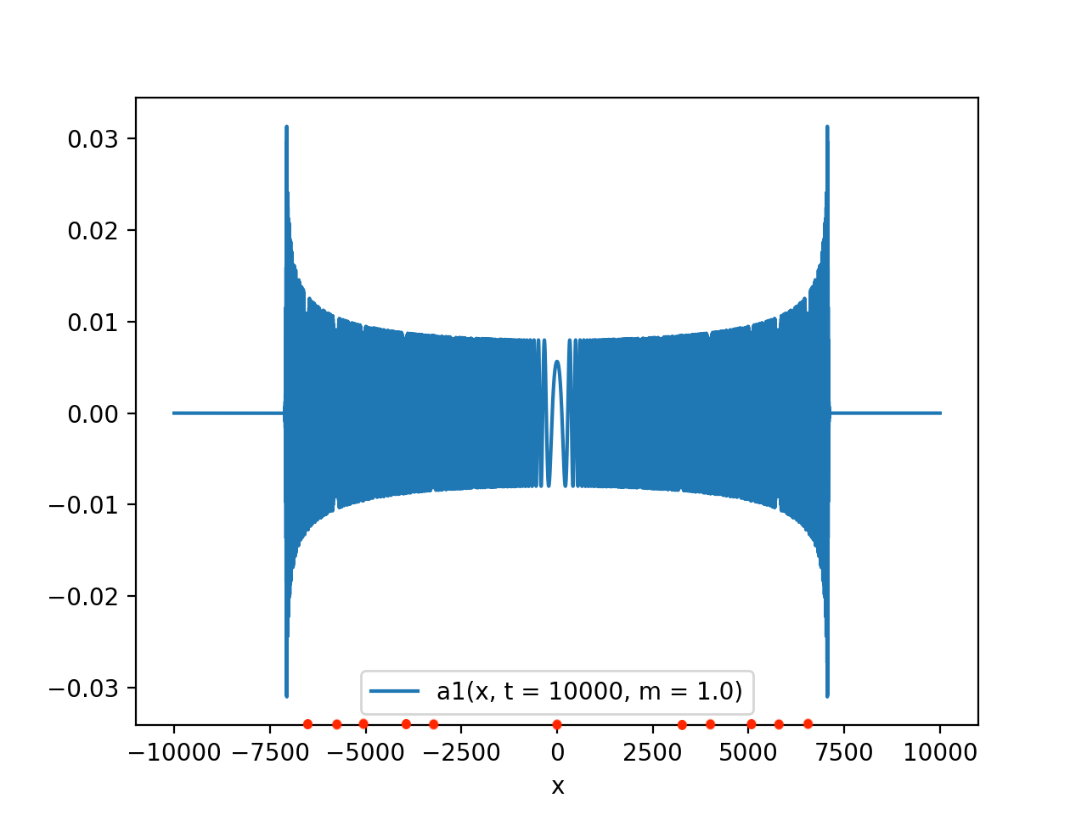
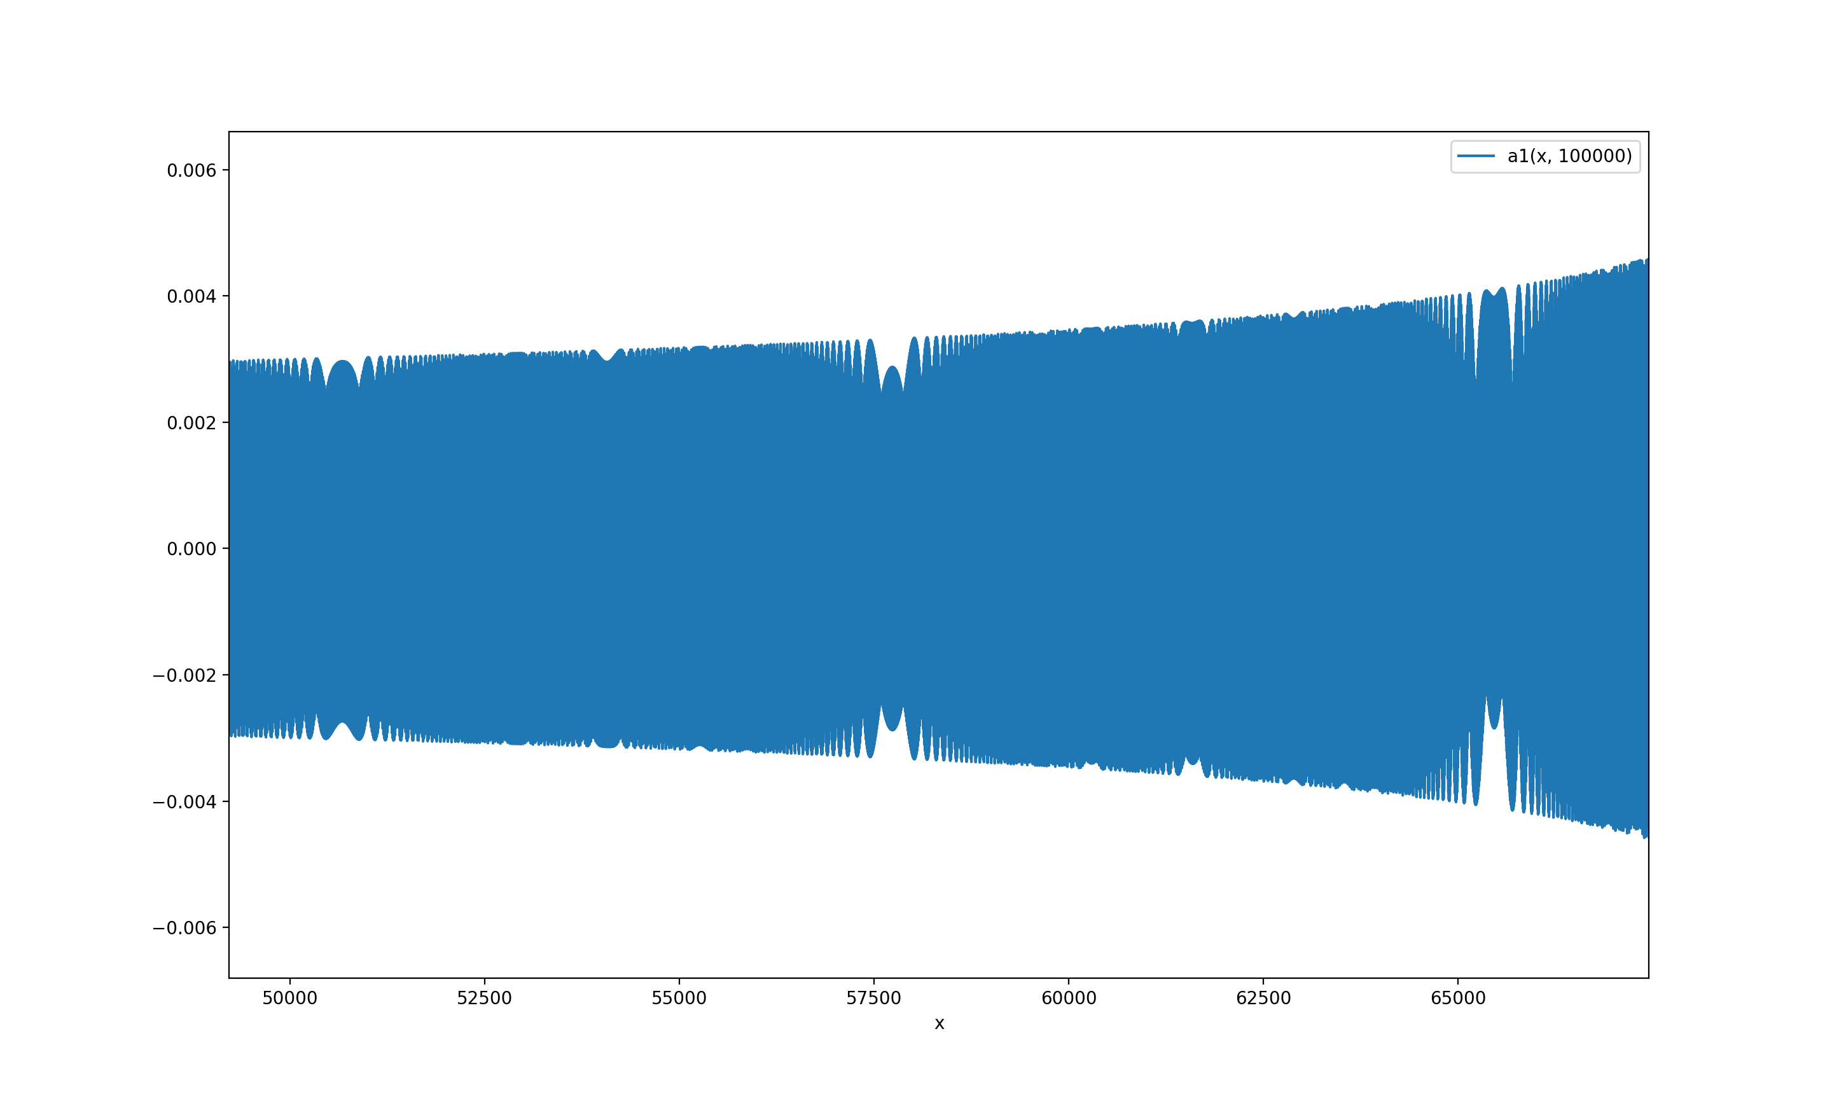
Dips
Definition. $v∈\left(\frac{1}{\sqrt{1+m^{2}}};\frac{1}{\sqrt{1+m^{2}}}\right)$ is called a dip of order $T$ iff for each $\left(x_{t}\right)=vt+o\left(t^{1/2}\right)$ we have ${\tilde{a}}_{1}\left(x_{t}, t, m\right)−{\tilde{a}}_{1}\left(x_{t}−2T, t, m\right)=o(t^{−1/2})$.
Theorem (F. K., 2022)
Dips of order $T$ are described by the formula
$$v=\frac{sin⁡(πk/T)}{\sqrt{m^{2}ε^{2}+\sin^{2}{(πk/T)}}},$$
where $k∈\left(−\frac{T}{2};\frac{T}{2}\right)∩ℤ$.

Slide 11
Open problems
Investigate the signs of ${\tilde{a}}_{1}$ and ${\tilde{a}}_{2}$ for $(x, t)$ in the central area.
Zeros of ${\tilde{a}}_{1}$ are conjectured to be on the line $x=0$, and zeros of ${\tilde{a}}_{2}$ are conjectured to be only for $\left(x,t\right)∈\left\{\left(−4, 10\right),\left(4, 10\right)\right\}$.
Sign of ${\tilde{a}}_{1}(x, t)$
Thank you for your attention!

Slide 12
Bibliography
[1] R.P. Feynman, A.R. Hibbs, Quantum mechanics and path integrals, New York, McGraw- Hill, 1965. Russian transl.: Mir, Moscow, 1968.
[2] F. Kuyanov, A. Slizkov, Feynman checkers: number-theoretic properties, arxiv:2210.07306.
[3] M. Skopenkov, A. Ustinov, Feynman checkers: towards algorithmic quantum theory, preprint (2020), arxiv:2007.12879v1.
[4] T. Sunada, T. Tate, Asymptotic behavior of quantum walks on the line, J. Funct. Anal. 262 (2012) 2608–2645.

